Slide 1
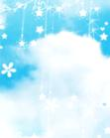
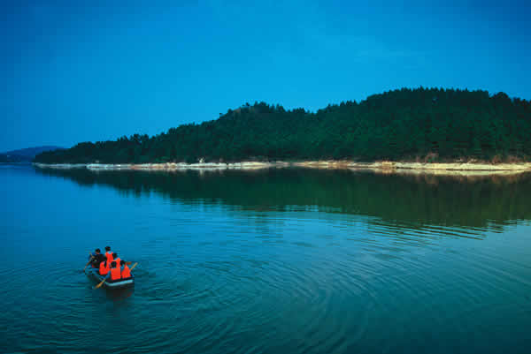
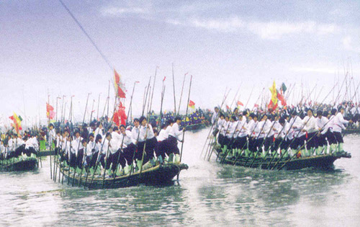
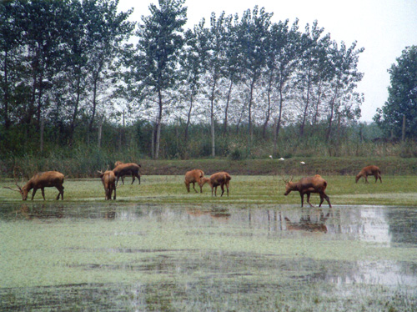
Unit 8
Natural Disasters

Slide 2
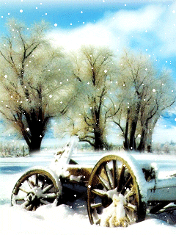
snowy

Slide 3
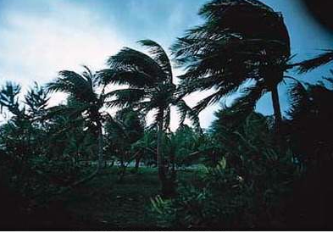
windy

Slide 4
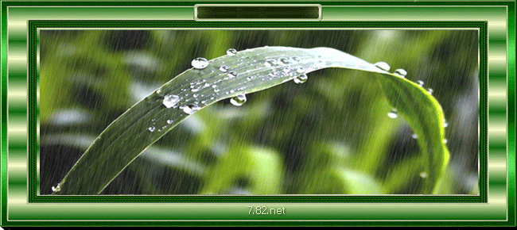
rainy

Slide 5
foggy

Slide 6
cloudy

Slide 7
sunny

Slide 8
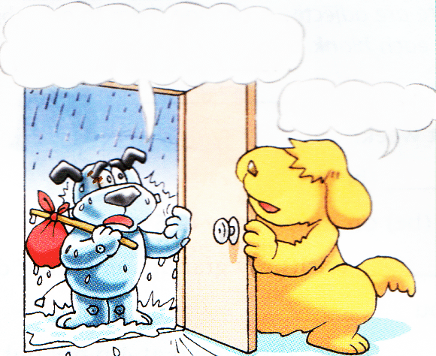
It is raining.

Slide 9
Read and answer more questions:
1.What happened to Hobo’s house?
2.What was he doing when it began to rain?
3. Did he hear the rain?

Slide 10
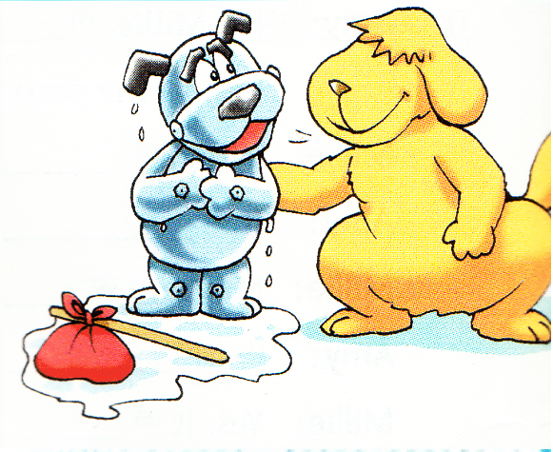
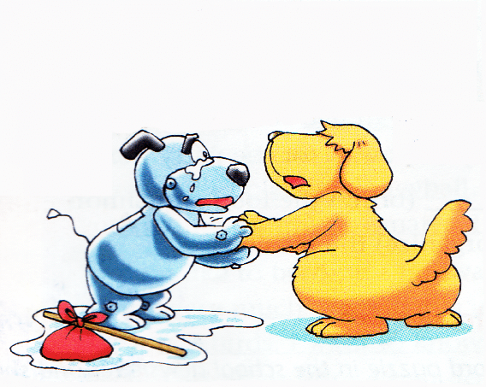
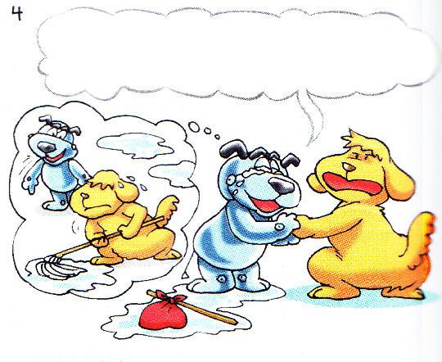
Practice in pairs and act out the dialogue

Slide 11
Complete the blanks
One day, Hobo went to Eddie’s home, because his own home was all________. He was _________ when it started to _______. When he _________, there was water ______. He asked Eddie to ______home with him because he wanted Eddie to _________ all the water _________.
wet
sleeping
rain
woke up
everywhere
go
mop
up
was sleeping------过去进行时
（表示过去某个时间正在发生的事情）
结构： was/were (not) + doing

Slide 12
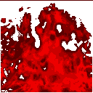
I
am
going
to
school.
He was going to school when the fire started.

Slide 13
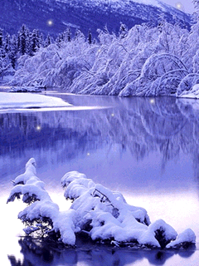
He was walking when it began to snow.

Slide 14
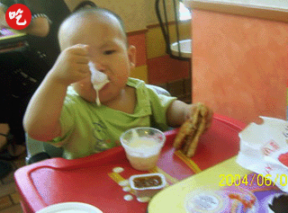
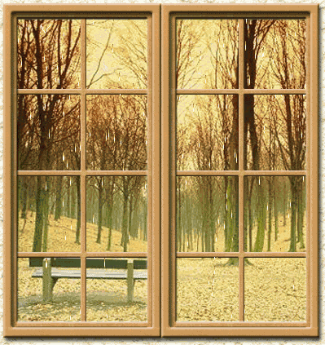
He was eating when it started to rain.

Slide 15
rainstorm
r

Slide 16
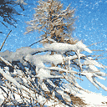
snowstorm

Slide 17
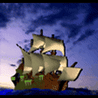
typhoon

Slide 18
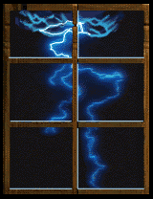
thunder and lightning
Bad weather always causes natural disasters

Slide 19
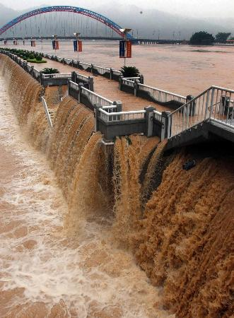
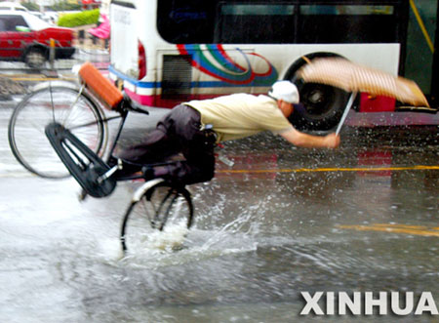
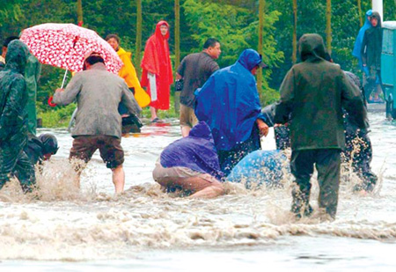
Natural disasters are often caused by natural forces like the bad weather.
cause
It washes away
everything.
rain
flood

Slide 20
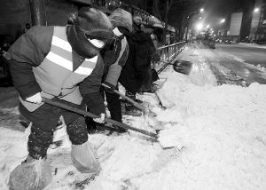
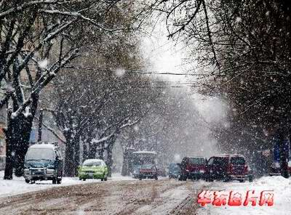
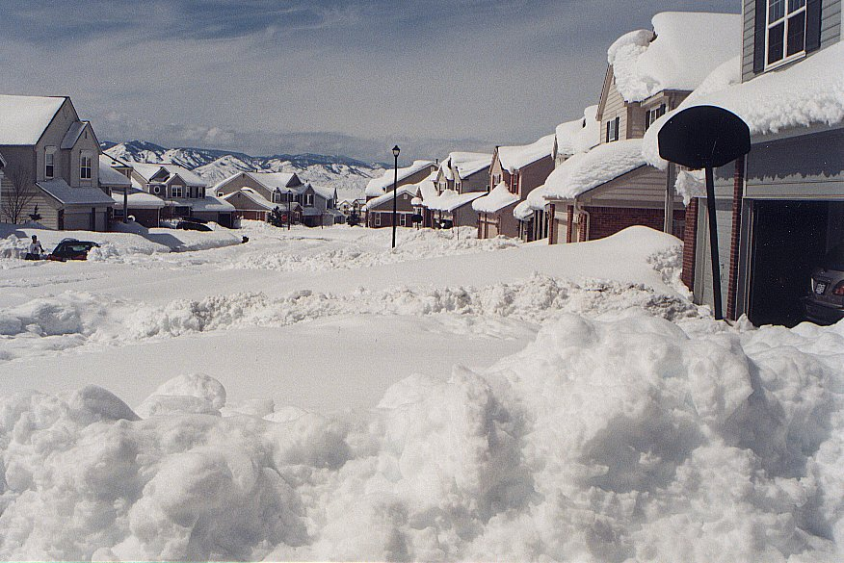
cause
snow
snowstorm

Slide 21
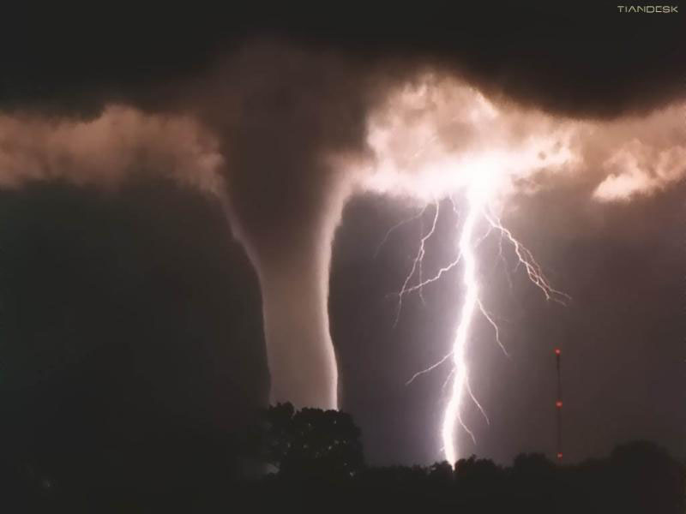
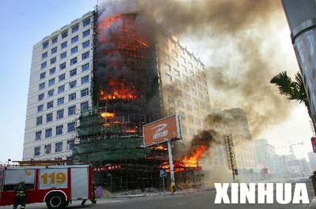
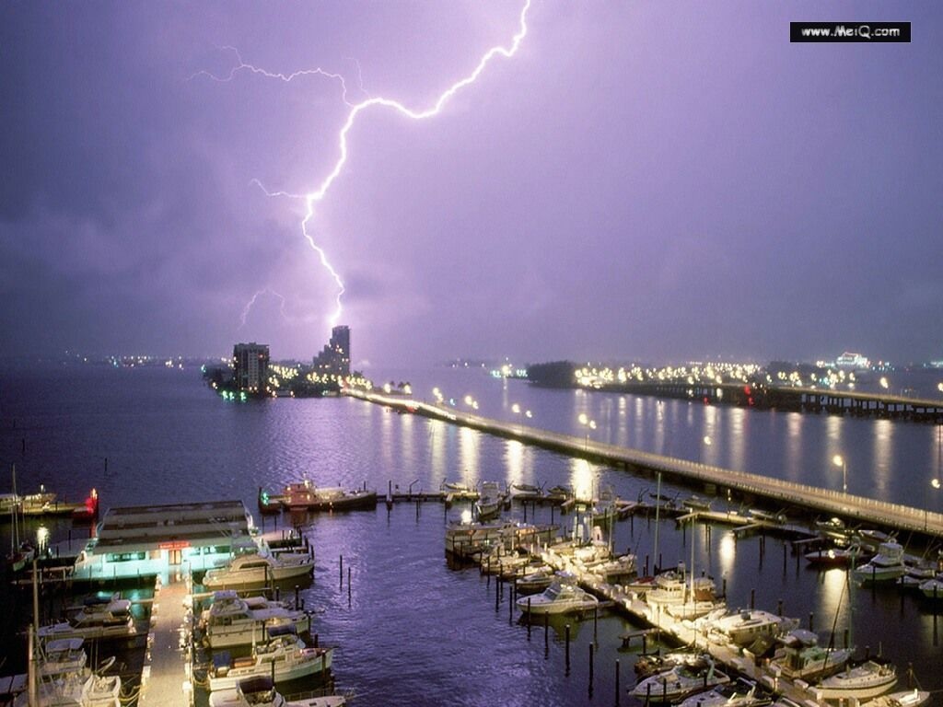
thunder and lightning雷电
cause
a big fire

Slide 22
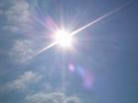
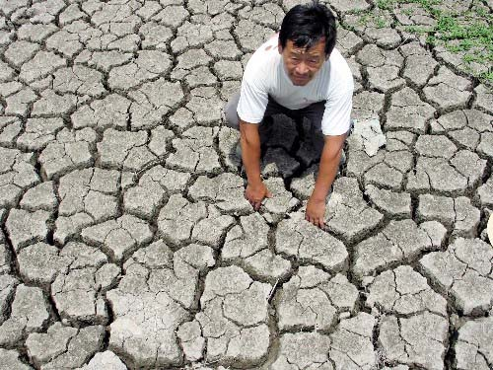
The earth is short of water.
cause
drought 干旱
[draut]
缺水

Slide 23
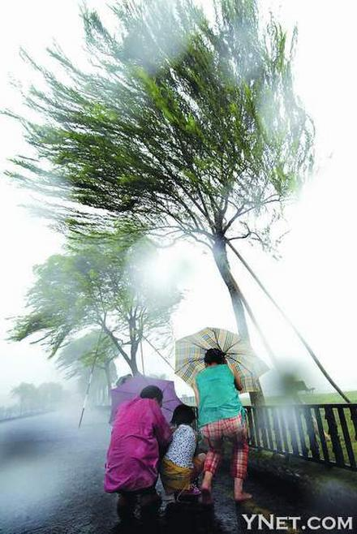
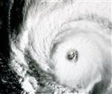
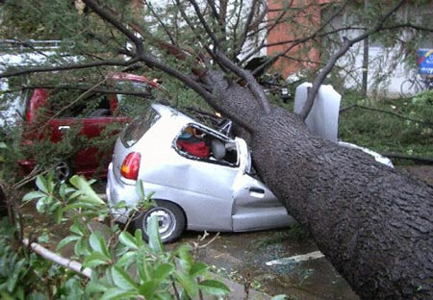
typhoon台风
flood
cause
accident事故

Slide 24
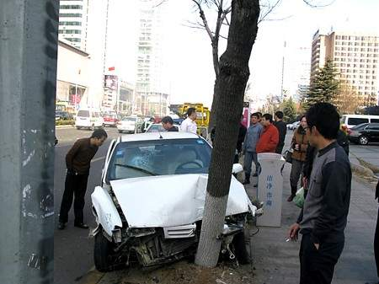
Accidents are caused by people.
Natural disasters are caused by natural forces.
A car crashed into a tree.
撞上

Slide 25
Natural disasters and accidents
Which headlines are about natural disasters?
School football team loses final
2. Earthquake kills thousands of people
3. Car accident kills three men
4. coach crashes into tree

Slide 26
5. Flood washes away village
6. Lightning starts big fire in classroom building
7. Young boy falls from tree and hurts legs
8. Big storm kills 20 people

Slide 27
Listening
Listen to the conversation and answer the questions.
1. What happened to Vivien’s school?
2. When did it happen?
Lightening hit a classroom building and it caught fire.
It happened at night.

Slide 28
Life is beautiful because of
the strong will.
生命因坚强而美丽
Life is wonderful because of
the true love.
生活因关爱而精彩.
Thank you !

