Slide 1
8A Unit3 comic strip and welcome
Where are they?

Slide 2
Learning aims
To recognize the places of interest and their cities.
01
To talk about the facts of these places of interest.
02

Slide 3
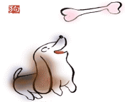
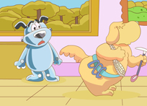


What is Eddie going to do?
play…
climb…
eat…
Notes:
Eddie also want to have some outdoor fun. Look and guess, what is he going to do? Ss... Why do you guess so?

Slide 4
Notes:
Eddie also want to have some outdoor fun. Look and guess, what is he going to do? Ss... Why do you guess so?

Slide 5
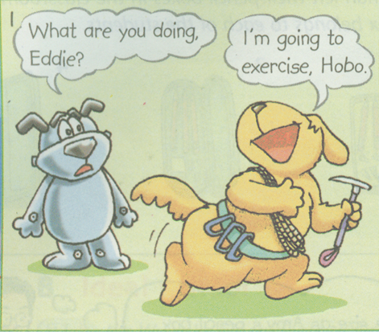
Is he going to climb a real hill?
No, he isn't.
What is the hill he is going to climb made of?
It's made of food.

Slide 6
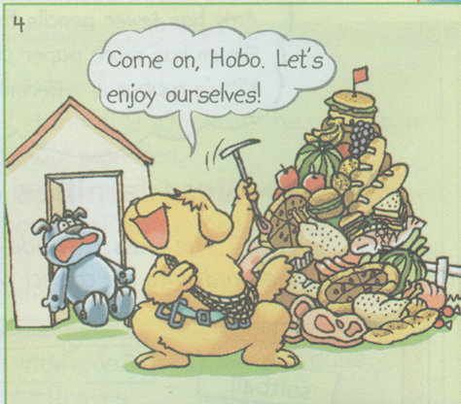
Eddie is going to eat
a big pile of food !
a hill of food !
Notes:
a hill of food

Slide 7
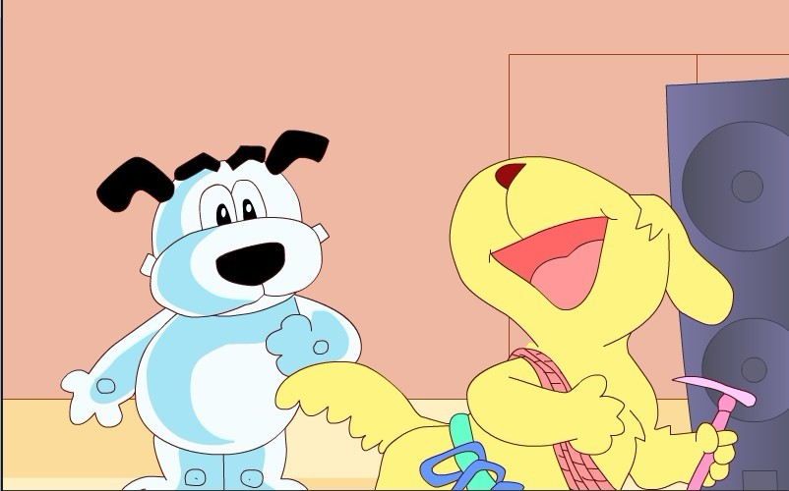
Read after the tape and mark the intonations.
Notes:
Please mark the intonation.

Slide 8
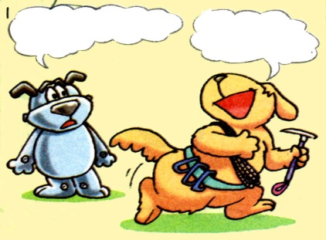
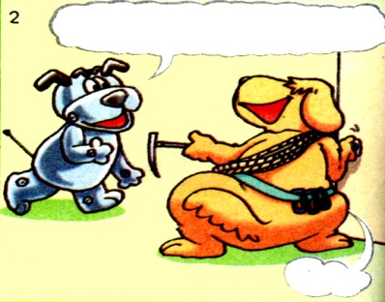
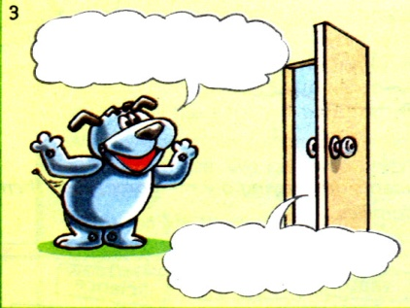
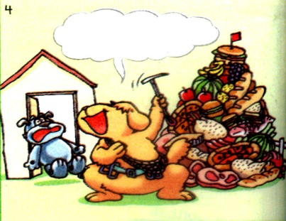
Answer questions.
1. Why is it good for Eddie to exercise ?
Because he needs to keep fit.
2. Does Eddie really want to exercise?
No, he doesn’t.
He wants to enjoy himself.

Slide 9
Language points:
1. You need to exercise and keep fit.
need是实义动词，意为“需要”，后接动词不定式，随人称
和时态的变化而变化。
eg: 她需要向我道歉。
She needs to say sorry to me.
2) need也可用作情态动词，后须接动词原形，没有人称和数的变化。
eg:她不必向我道歉。
She needn’t say sorry to me.

Slide 10
keep fit意为“保持健康”。其中，keep意为“保持（某种状态）”，后通常可接形容词，fit在此处用作形容词，意为“健康的”。
eg:请保持安静！
Please keep quiet!
2. This hill isn’t as high as a real one.
as…as意为“和……一样”。
eg: 她画得和我一样好。
She draws as well as I.
3. Let’s enjoy ourselves.
4.enjoy oneself 过得很高兴/ have a good time
eg: 昨晚他们玩得很高兴。
They enjoyed themselves last night.

Slide 11

Today you have a great chance to travel free in the US.
Pass the tests
The best group will get free tickets!
Try your best ！
Notes:
一个还是两个获胜者。积分如何计分？

Slide 12
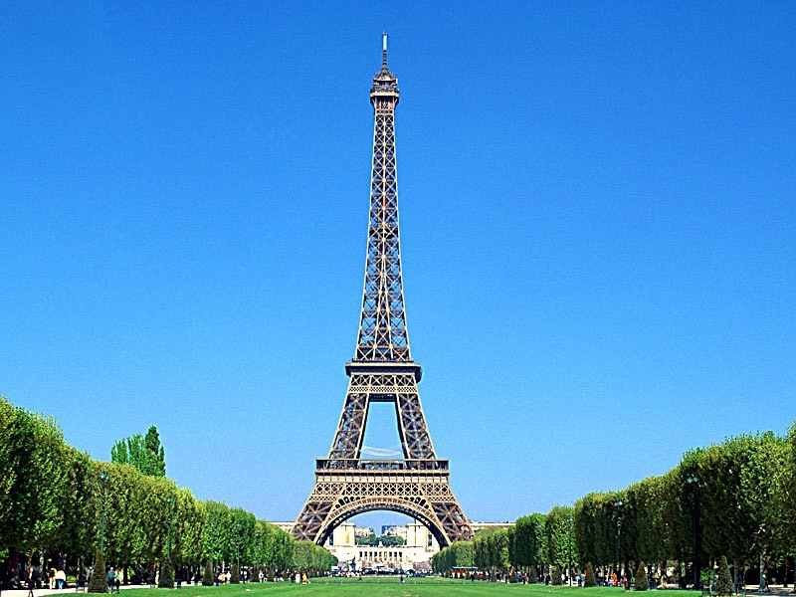
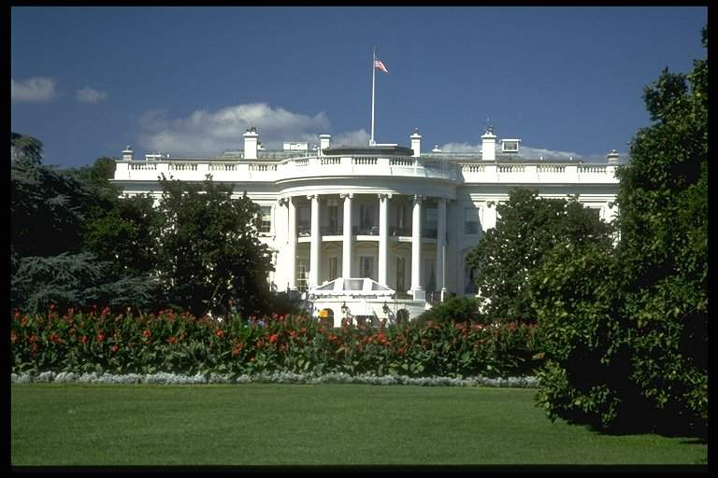
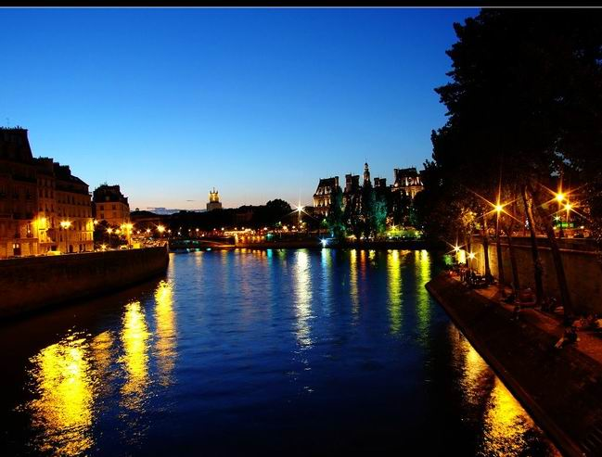
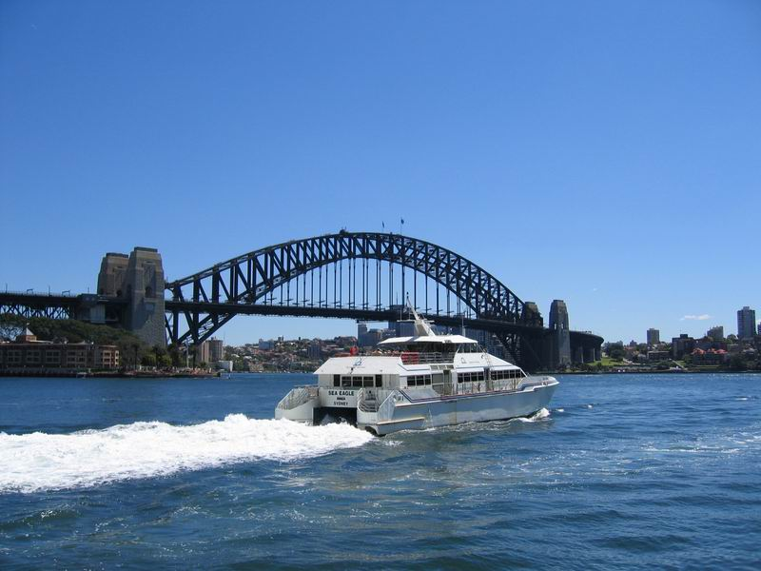
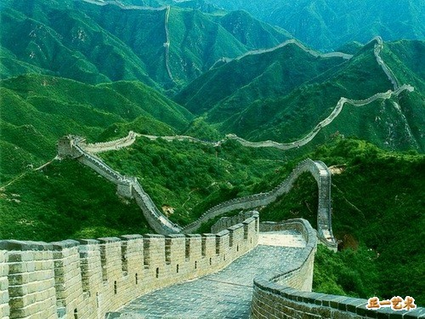
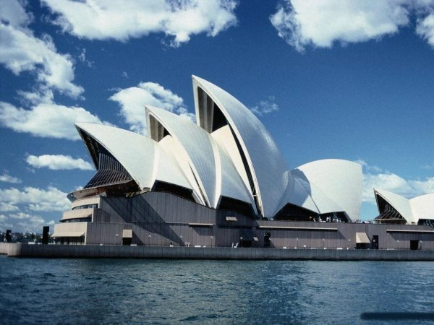
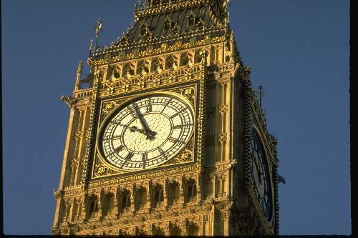
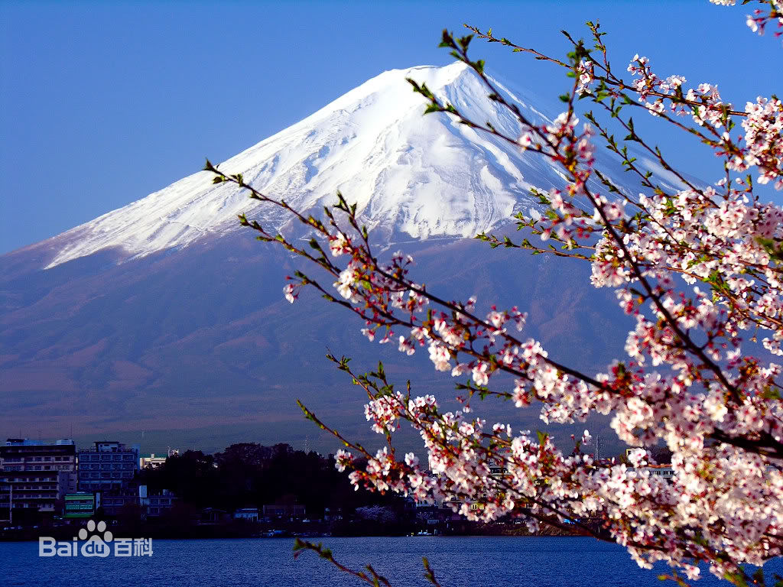
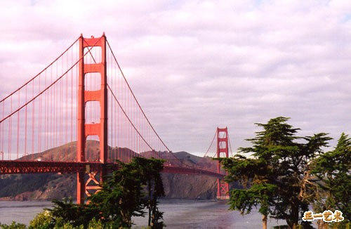
What are they called ?
places of interest
the Eiffel Tower
the White House
the River Seine
/sein /
the Harbour Bridge
the Great Wall
the Opera House
/'hɑːbə/
Big Ben
Mount Fuji
the Golden Gate Bridge
Notes:
Suzhou has many places of interest , like ...

Slide 13
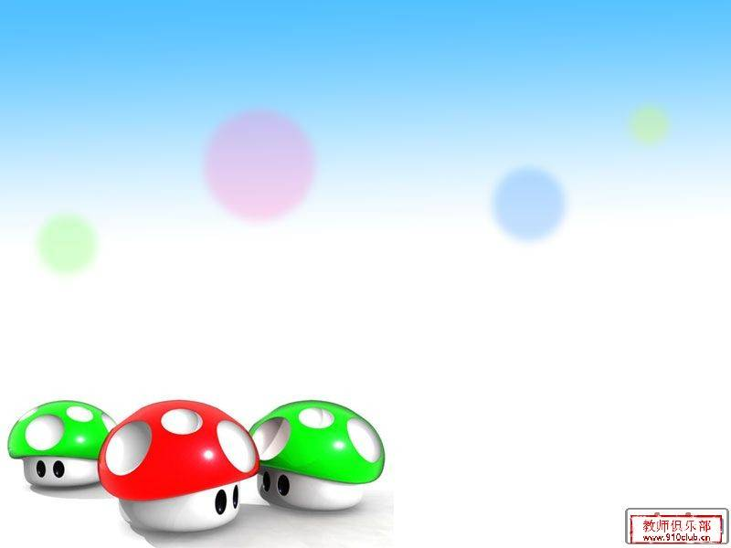

Test 1:Good eyesight(眼力).

Slide 14

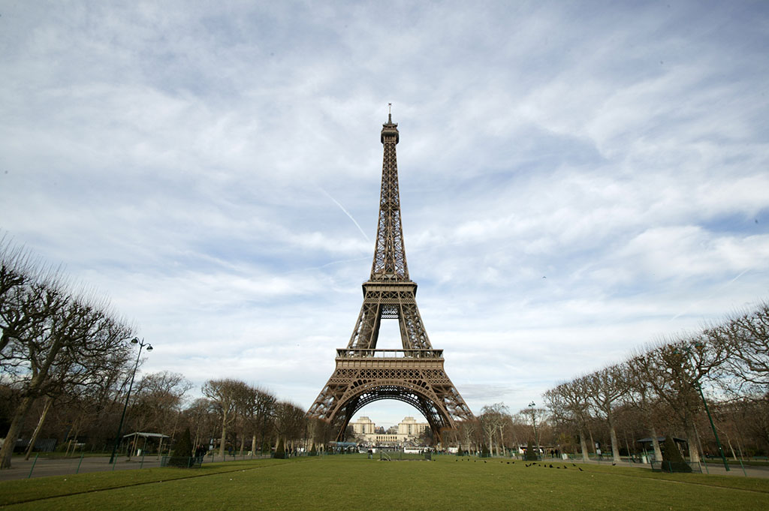
Watch the video carefully.
Notes:
链接有问题

Slide 15
Which places of interest can you find from the video ?
Do you have good knowledge
about them?

Slide 16
the Great Wall
city:
Beijing
country:
China
21196.1 km
How long is it?
What is it made of?
It's made out of stones and bricks.
Why did people build it?
To protect our country.

Slide 17
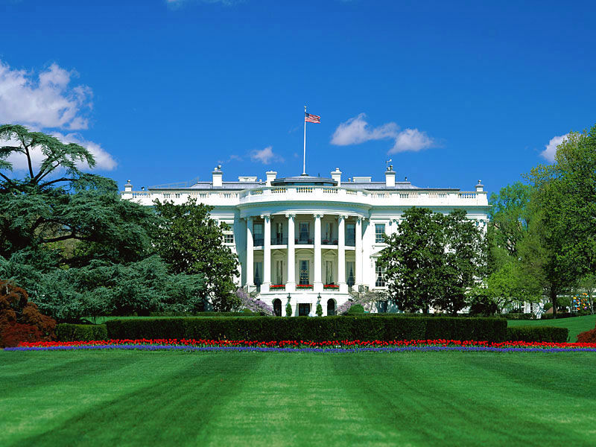

the White House
city:
Washington DC
['wɔʃiŋtən]
country:
the USA
Who works and lives there?
the President of ...
/'prezIdənt/
How does the building look?
It looks beautiful with a big garden and many trees.
Trump
Notes:
提前板书重点词汇、短语

Slide 18
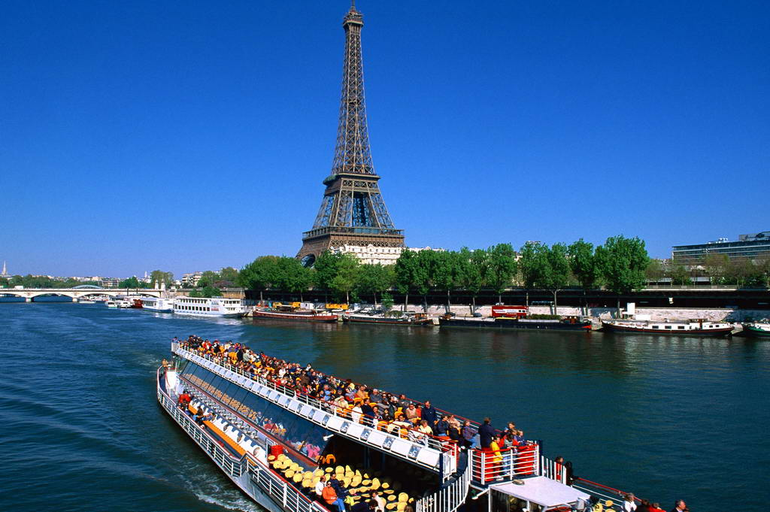
the Eiffel Tower
city:
Paris
country:
France
What is it made of?
It's made of steel.
What can you do there?
You can take a lift to the top of the Tower.
From there you can have a bird's eye view of the whole city.
Notes:
加一个问题：How much does it weigh? It weighs ...tons.

Slide 19
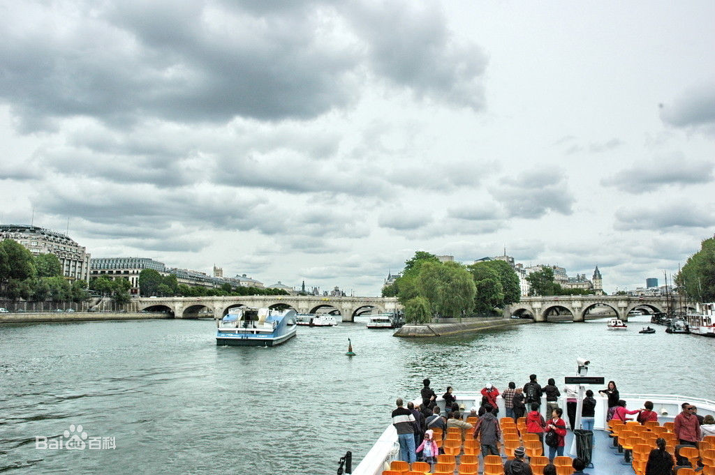
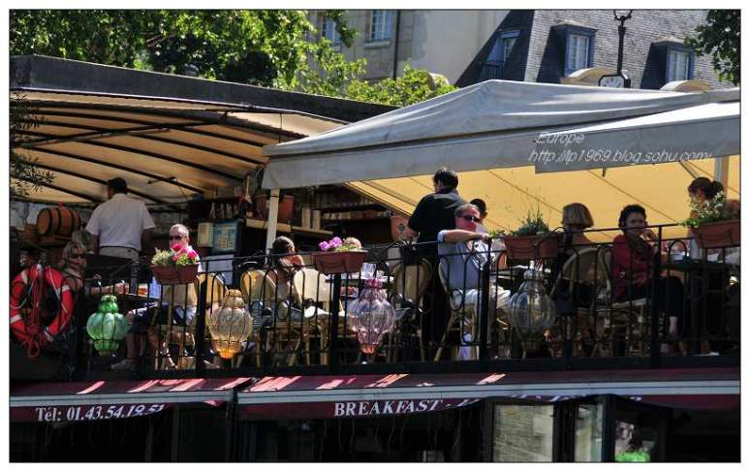
the River Seine
city:
Paris
country:
France
How long is it?
780 km
What can you do there?
You can take a boat trip.
coffee shops by it
=go on a trip by boat

Slide 20
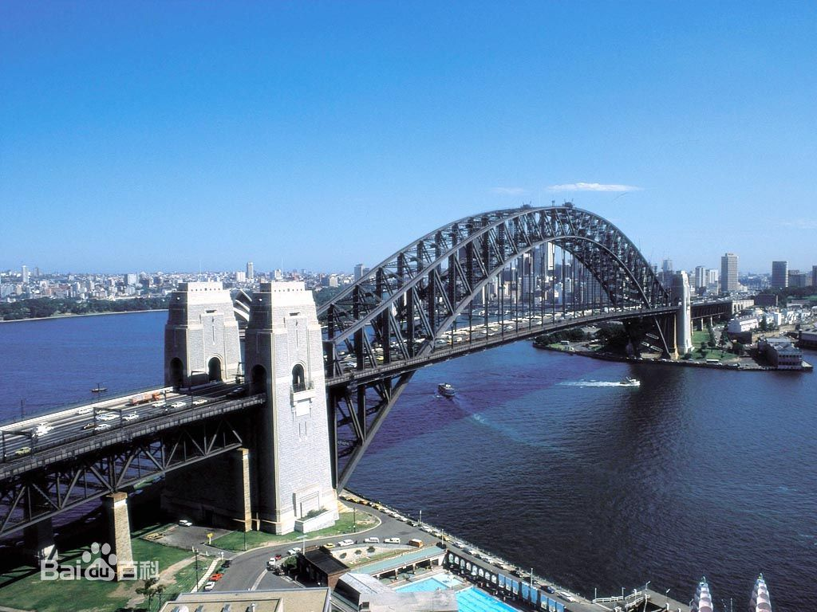
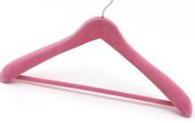
the Harbour Bridge
city:
Sydney
country:
Australia
Ask me questions.
How long ...?
How wide ...?
3,770 feet (1149m) long
1 foot (ft)=0.3048 m
161 feet (49m) wide
the “Coat Hanger”
Notes:
整个悉尼大桥桥身长度（包括引桥）1149米,桥面宽49米,从海面到桥面高58.5米,从海面到桥顶高达134米,1924年悉尼海港大桥破土建造桥基,1932年3月19日竣工通车,历时8年多。 Dr J.J.C. Bradfield

Slide 21
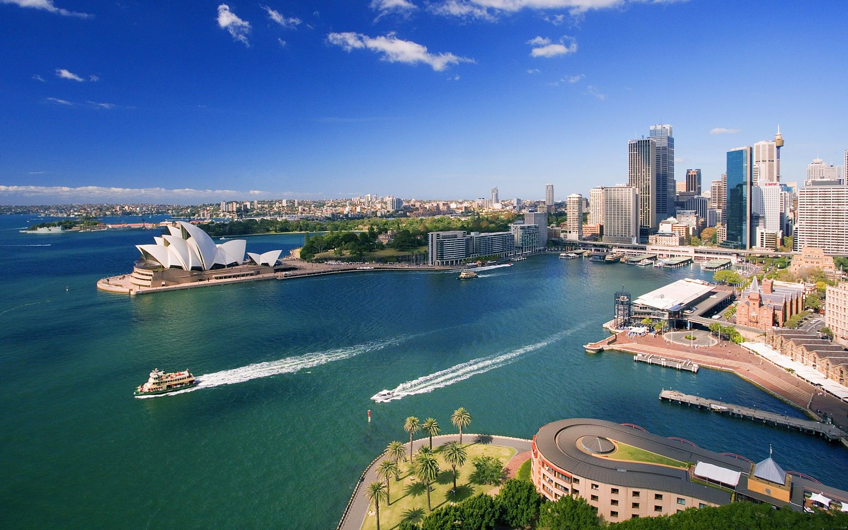
the Opera House
city:
Sydney
country:
Australia
What is it used for?
It's an art centre.
What does it look like?
It looks like a boat with sails(帆).
What can we do there?
We can enjoy the opera shows .
Notes:
It looks like a boat with ...(sails). What else does it look like? Do you think it looks like white shells?

Slide 22
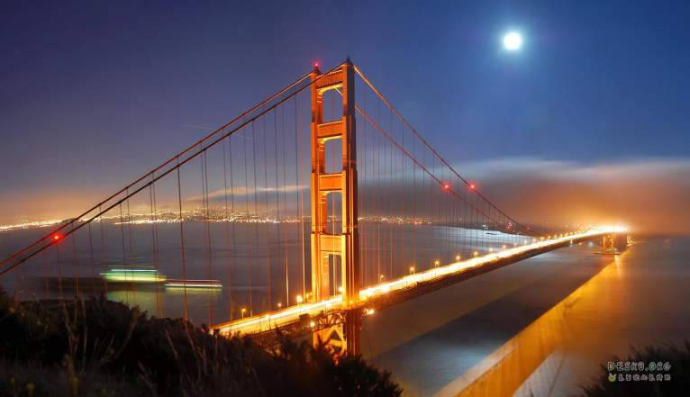
the Golden Gate Bridge
city:
San Fransisco
[sæn frən'sɪskəu]
country:
the USA
What do you know about the Golden Gate Bridge?
Ask me questions.
How long ...?
How wide ...?
How much ... weigh?
1.7 miles(2735m) long
1 mile =1,609m
90 feet (27.4m) wide
over 100,000 tons

Slide 23
Match each building with its city and country
    the White House
    the Great Wall
    the Opera House
    the Harbour Bridge
    the Golden Gate
    Bridge
    the Eiffel Tower
San Francisco
Paris
Beijing
Sydney
Washington D.C.
China
France
America
Australia

Slide 24
Test 2: Good abilities to
communicate with others.

Slide 25
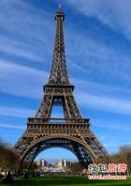
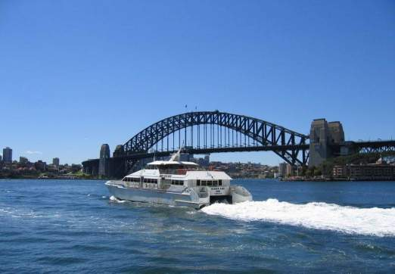
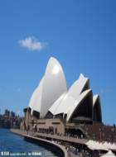
◆ 324 metres tall
◆132 metres wide
◆ 7,000 tons
◆ made of steel
◆ steps: 1,711
Model
A: Which place of interest do you want to visit?
B: I want to …
A: Where is it?
B: It’s in …
A: How tall is …?
B: It’s about …
A: How … is …?
B: It’s …
A: … is made of …, isn’t it?
B: Yes, and it weighs …
A: What can you do there …?
B: …
◆1,149 metres long
◆134 metres tall
◆ 49 metres wide
◆ 52,800 tons
◆ made of steel
◆97 metres tall
◆7 metres wide
◆ made of steel
◆13.5 tons
◆ 3 floors
◆183 metres long
◆118 metres wide
◆ 67 metres tall
◆ weigh 15,000 tons
◆ 1000 rooms in it
Notes:
Group 1: The Eiffle Tower ... 2 min for you to prepare

Slide 26
◆ 324 metres tall
◆132 metres wide
◆ 7,000 tons
◆ made of steel
◆ steps: 1,711
Model
A: Which ... do you want to visit?
B: I …
A: Where is it?
B: It’s …
A: How tall is …?
B: It’s …
A: How … is …?
B: It’s …
A: … is made of …, isn’t it?
B: Yes, ... it weighs …
A: What can you do there …?
B: …
◆1,149 metres long
◆134 metres tall
◆ 49 metres wide
◆ 52,800 tons
◆ made of steel
◆97 metres tall
◆7 metres wide
◆ made of steel
◆13.5 tons
◆ 3 floors
◆183 metres long
◆118 metres wide
◆ 67 metres tall
◆ weigh 15,000 tons
◆ 1000 rooms in it
Notes:
有没有必要做学案？ 要不要拆支架？ Big Ben 铁造的。重量。。。

Slide 27
◆ 324 metres tall
◆132 metres wide
◆ 7,000 tons
◆ made of steel
◆ steps: 1,711
Model
A: Which ... ?
B: …
A: Where ... ?
B: …
A: How ... is …?
B: …
A: How … is …?
B: …
A: … is made of …, isn’t it?
B: Yes, ... weighs …
A: What can ... do …?
B: …
◆1,149 metres long
◆134 metres tall
◆ 49 metres wide
◆ 52,800 tons
◆ made of steel
◆97 metres tall
◆7 metres wide
◆ made of steel
◆13.5 tons
◆ 3 floors
◆183 metres long
◆118 metres wide
◆ 67 metres tall
◆ weigh 15,000 tons
◆ 1000 rooms in it
Notes:
有没有必要做学案？ 要不要拆支架？ Big Ben 铁造的。重量。。。

Slide 28
Test 3:
Good reading

Slide 29


Read the postcards.Match their postcards with the correct pictures.

Slide 30

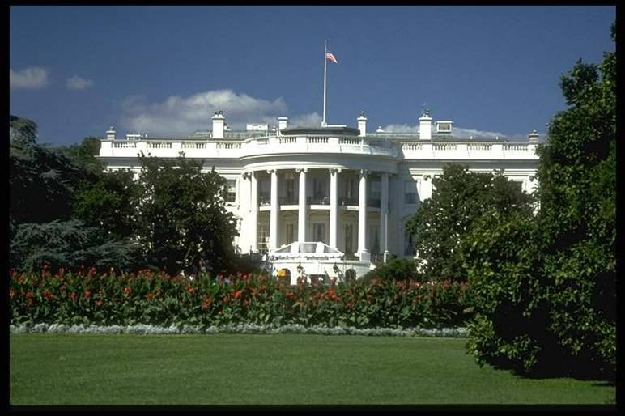
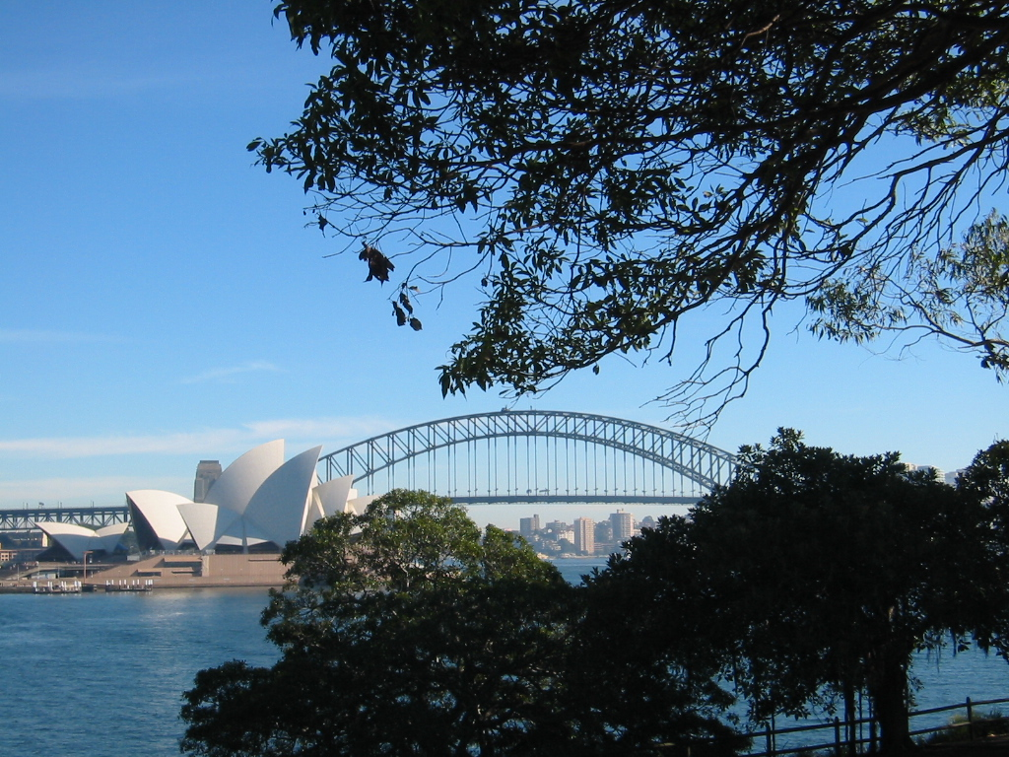
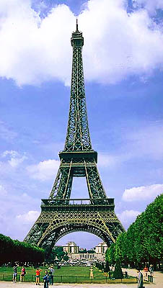
Hi Amy Yesterday, I took a boat trip under the famous Harbour Bridge and went past the Opera House. I’m having a great time here! Take care! Nick | Amy Room 401 38Hill Building Sunshine Town Beijing China
A
B
C

Slide 31
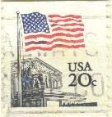
Hi Amy We are sitting in a little coffee shop by the River Seine. We are going to the top of the Eiffel Tower this afternoon! All the best! Leo | Amy Room 401 38Hill Building Sunshine Town Beijing China
A
B
C

Slide 32
Hi Simon I saw the White House. The President of the USA lives there. It is a beautiful building with a big garden and many trees. See you soon. Jane | Simon Flat A, 6/F, Block3 North Street Sunshine Town Beijing 100000 China
C
A
B

Slide 33
Why do people travel a lot?
Traveling can open our mind!
Traveling can enrich our life!
Traveling will bring us a whole new world !

Slide 34
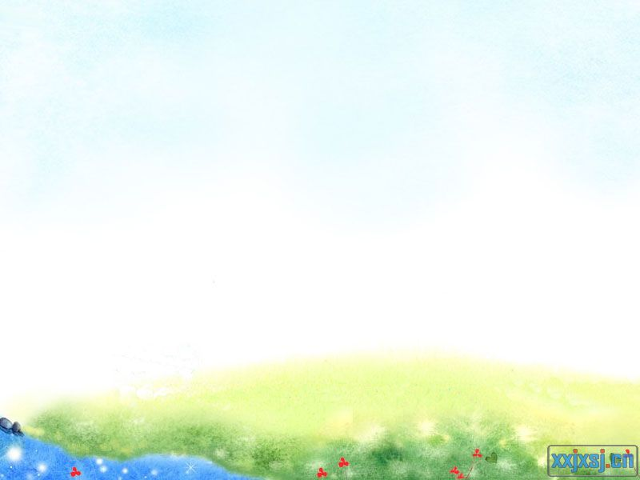
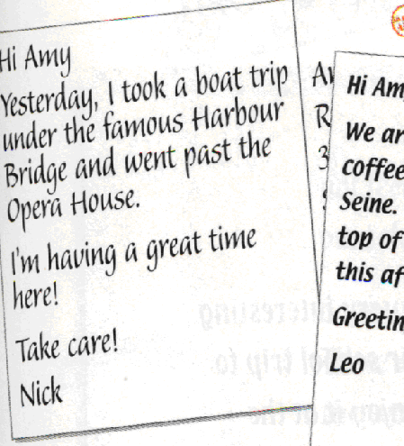
=have a trip by boat
乘游船
go past
Prep.介词
=have fun
=enjoy oneself
=play happily 玩的开心
Past/pass
Past：介词 经过 e.g. She walked past my window just now.
Pass：动词 过，传递 e.g. Please pass me the salt.
照顾，照看
take (good) care of sb.
=look after sb. (well)
保重

Slide 35
Language points
5.take a boat trip/take a trip by boat
6.go past the Sydney Opera House
7. sit in a little coffee shop by the River Seine.
8. the top of the Eiffel Tower
9. a beautiful building with a big garden and many trees.
10. the president of the USA
11.take care
12.I’m having a great time in Australia
I’m enjoying myself in Australia

Slide 36
Language points
13. How long is …?/what’s the length of…?
How tall/high is…?/ What’s the height of…?
How heavy is …?/What’s the weight of..?
14.How wide is the bridge ?
15. 90 feet wide 90英尺宽
16. be made of steel 由钢材制成
17.It weighs over 100,000 tons.重十万多吨
Its weight is more than 100,000 tons

Slide 37
Discussion
Situation: You want to discuss with your friend about something. The following ideas may help you.
1) where/what 2) how wide
3) how high 4) how long
5) what’s it made of
6) …

Slide 38
How questions
多长
多高
多宽
多少
多大年纪
多重
多远
隔多久
多久之后
多大
how long
how tall/high
how wide
how many/much
how old
how heavy
how far
how often
how soon
how big

Slide 39
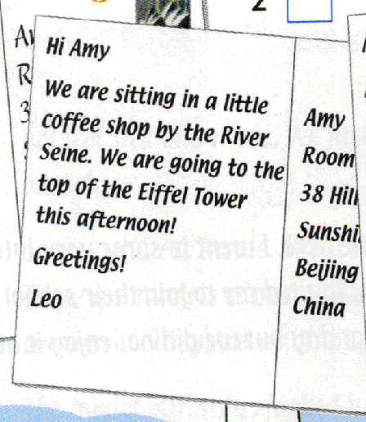
by：在..旁，靠近
by的用法（1）乘（车，船等）（by+交通工具）
e.g. She often goes to school by bike.
=she often rides a bike to school.
（2）固定搭配：
by the way
by oneself
顺便说一下
独自，单独=alone

Slide 40
Fill in the following sentences.
Exercise
1. 你需要锻炼来保持体形。
You ____ ___exercise to _____ ____.
2. 让我们玩得开心点吧！
Let’s ______ _________!
need
to
keep fit
enjoy
ourselves

Slide 41
3. 我乘船旅行经过港湾大桥。
We take __ ____ ____ under the
Harbour Bridge.
4. 美国总统住在白宫里。
The ________ of the USA _____ in
the White House.
a
boat
trip
President
lives

Slide 42
5. 这是一间带有漂亮花园的大房子。
This is a big house _____ a
beautiful _______.
6. 我坐在塞纳河边的咖啡店里。
I sit in a coffee shop _____ _____
______ ______.
with
garden
by
the
River
Seine

Slide 43
6.你可以通过多练习来提高你的英语
You can improve your English _____
_______ _______.
7.昨天你和Mike玩的开心吗？
____ you and Mike ____ _____ yesterday?
8.当他们到达山顶时我们还在山脚下
When they _______ the ____ ____ the hill,
we were still ___ the ____ ____ the hill.
9.这是顶皮制的帽子 The hat ___ ____ ___
leather/ It’s a hat _____ ____ leather.
by
practicing
more
yourselves
Did
enjoy
reached
top
of
at
foot
of
is
made
of
made
of

Slide 44
10. 这个婴儿出生时只有2公斤
The baby ______ only 2 kilograms when she _____ _____.
The ______ ____ the baby was only 2 kilograms ___ ____.
11.这条河有多宽？
____ _____ is this river?
12.那株古树将近30 米高
That old tree is _____ 30 metres _____
That old tree is _____ 30 metres __ ______
weighed
was
born
weight
of
at
birth
How
wide
nearly
high
nearly
in
height

Slide 45
Homework
Work in a group and write a postcard to me.

Slide 46
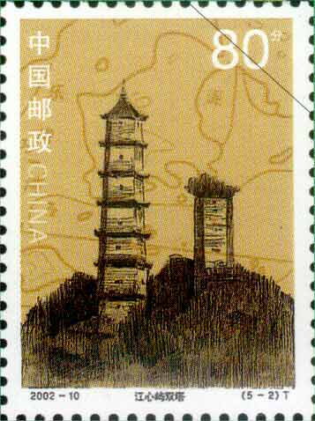

Maybe you want to travel to one of the places of interest. Suppose you are in one of them. Write a postcard to Miss Liu. You can say something about what you see, what you do and how you feel.
Design a postcard
Dear Miss Bu
I (went to/saw/visited)…
……
I am going to……
……
Take care.
_______
Selene
Suzhou International Foreign Language School
222100 Jiangsu
China

