Slide 1
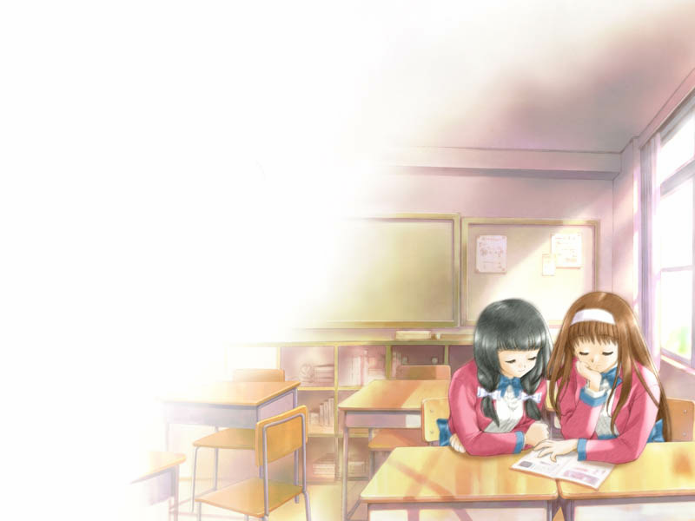
Unit 2
School Life !
Unit 2
School life
Task

Slide 2
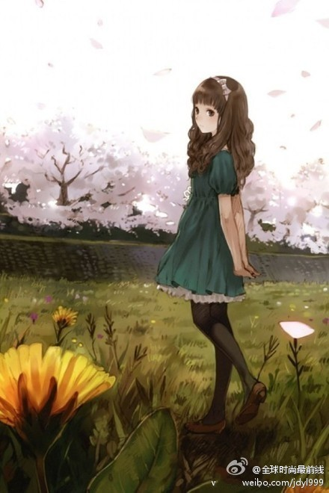
Step1:Revision Life in a British school
Name: Nancy
Grade:
8
School: 1.name
2. a mixed school
at Woodland School near London
have lessons together
Favourite subject:
French
Why? Learning ……is fun.
Activity:
a Reading Week
Bor more books from ….
in books and magazines from….
Read more books than…..
discussthe books with…..

Slide 3
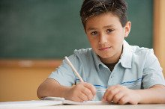
Name: John
Age:
Grade:
School:
14
8th
Rocky Mountain High School near Denver
Activity:
1. go to the Buddy Club
In the club, older students help…
My friend Tony is in the 12th grade. He often…
2.We have different classes every day. On Friday afternoon,….
Twice a week, I play……. I love …..
Our team…

Slide 4
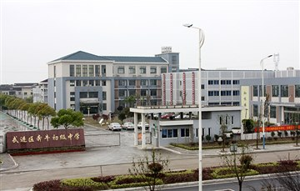
Lead-in
Their school life is different from yours.

Slide 5
Free Talk
Ask and answer:
What time does your school start?
Do you think this is too early or too late?
What time does your school end?
Do you think this is too late?
What time does your ideal school start and end?

Slide 6
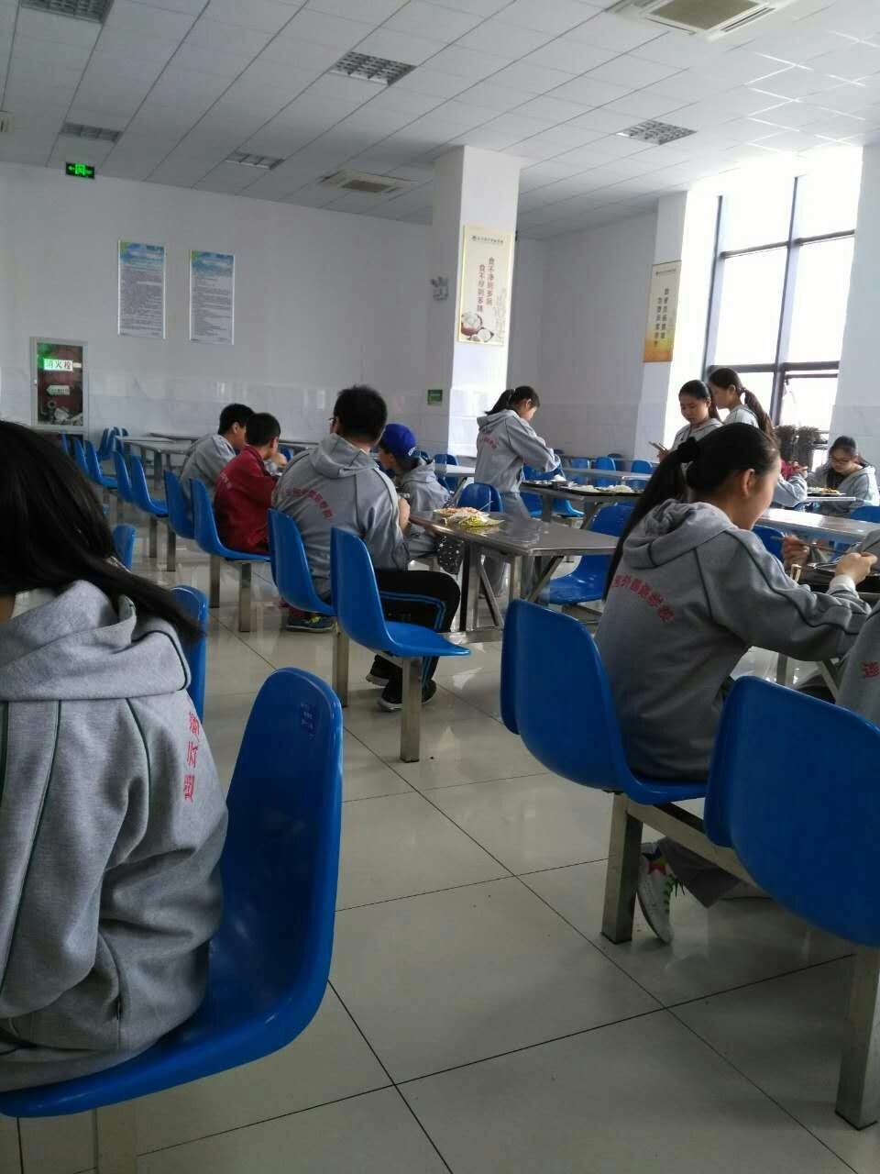
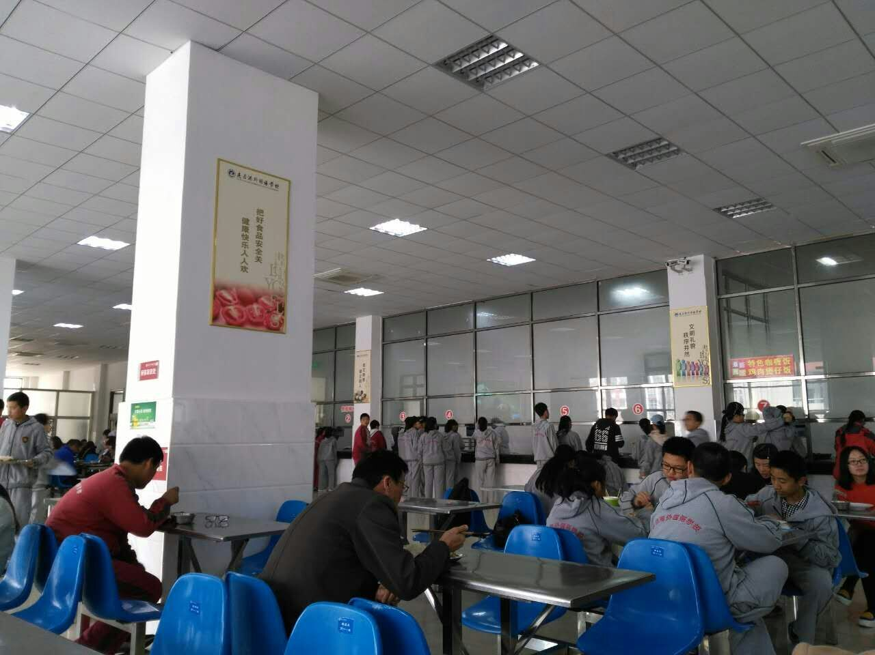
Lunchtime
How long is lunchtime at your school?

Slide 7
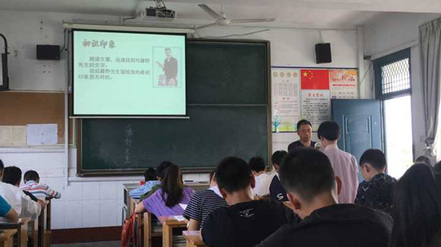
Do you wear uniforms at school?
Do you like wearing school uniforms? Why or why not?

Slide 8
Turn to Page 28
Which is your favourite subject/sport/club?
Choose the one you like best.
Subjects Sports Clubs
□ Chinese □ Badminton □ Art Club
□ English □ Baseball □ Chess Club
□ Geography □ Football □ Dance Club
□ History □ Table tennis □ English Club
□ Maths □ Tennis □ Reading Club
□ Physics □ Volleyball □ Singing Club
□ □ □ .

Slide 9
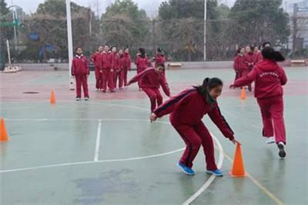
How much time do you spend on your homework every day?
How much time do you have for your hobbies every day?

Slide 10
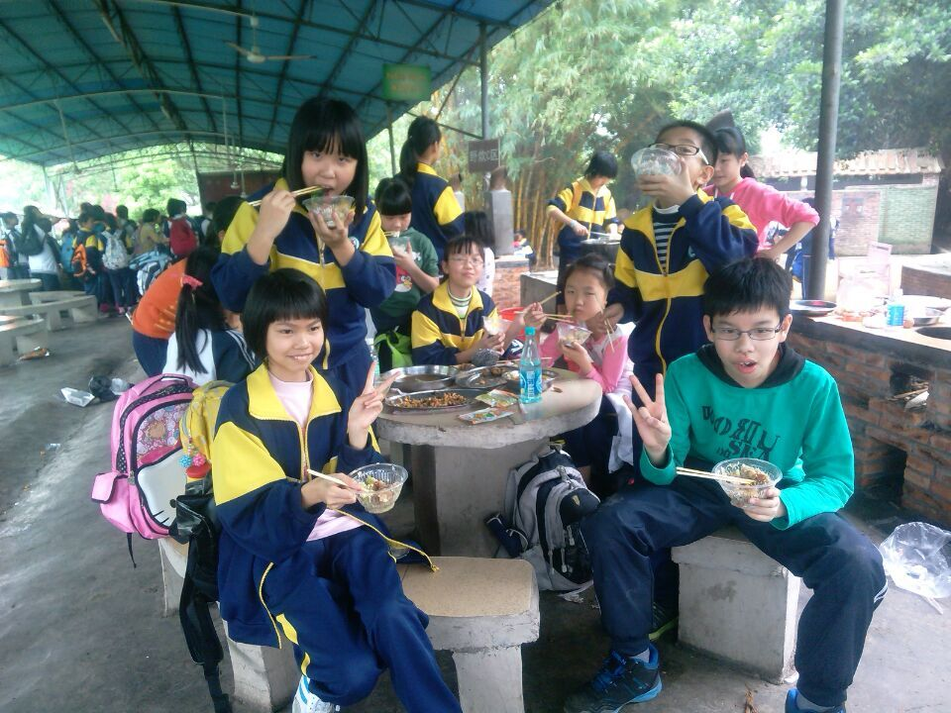
How often do you go on a school trip?

Slide 11
Do you think your school is a good one? Why or why not?
My ideal school should ……

Slide 12
My ideal school

Slide 13
Listen and answer
How many students in each class at Daniel's ideal school?
There are about 20 students in each class.

Slide 14
Who has the best memory?
school day starting time | 9 a.m
school day finishing time | 3 p.m
homework | an hour
lunchtime | an hour
subjects | maths and computer
facilities(设施) | a big library, a football field, a swimming pool
after-school activities | school trip, monthly

Slide 15
Read and find
Difficulties
My ideal school ends at 3 p.m.
We do not have to get up early.
We have much time to do after-school activities.
We do homework for only an hour every day.
We listen to music when we have lunch.
We have different subjects to study.
Every month, we have a school trip.
My ideal school finishes at 3 p.m.
We do not need to get up early.
We have lots of time for after-school activities.
We only have an hour of homework every day.
We listen to music at lunchtime.
We can choose subjects to study.
Every month, we go on a school trip.

Slide 16
Step7: Writing clues
How does Daniel write the article about his ideal school?

Slide 17
Can you tell me the main
idea of each paragraph?
Paragraphs | Key words
Paragraph 1
Paragraph 2
Paragraph 3
Paragraph 4
time
school _______
lunchtime
_______ and _______________
school uniforms
classes
_______ and _________
subjects
facilities (设施)、 ________
clubs
and _________________
after-school activities

Slide 18
A flow chart
time for homework / after-school activities
lunch
starting/finishing time
uniform
School time
School life
Ideal school
Study
Activities
classes
after-school
activities
subjects
facilities(设备)

Slide 19
Make a presentation in groups
Four students in a group to make a presentation about your ideal School. Make sure everyone must talk about one point. (四人一组陈述你们的理想学校，每人阐述一点)
Useful expressions
My ideal school starts at ... and finishes at ...
time
We have .... of homework.
homework
lunch
We have an hour for .../ It takes us an hour to have lunch.
subject
I have ...every day/ I love..../...is my favourite because I think... is interesting/...
facility(设施)
There is ...
activity
We have lots of.../ I'm a member of.../I join... Every...,we go on a schcool trip.

Slide 20
Step8: Writing practise
Write an article about your ideal school
上学放学时间 | 早9:30上学 下午4:00放学
作业 | 每天半小时
午饭 | 2小时，可聊天，听音乐，散步
班级及课程 | 10人一班，上物理，音乐，电脑课
学校设施 | 阅览室，足球场，游泳池
活动 | 有各种俱乐部，每月一次外出旅行

Slide 21
Homework
Write your own article and
make the poster.

Slide 22
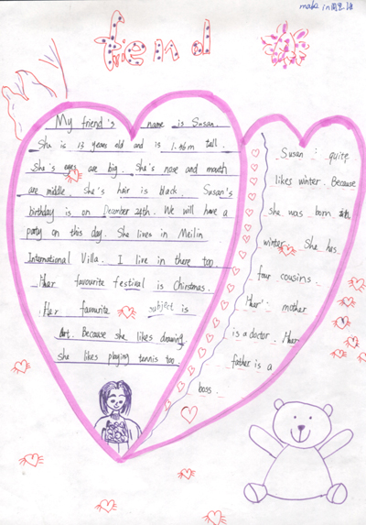
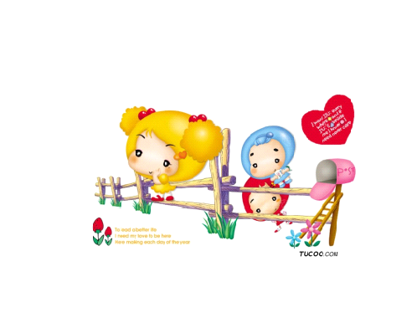
Make the poster

