Slide 1


8A Unit 2
School life
Reading （II）
LIFE

Slide 2


School lives
Life in a British school
Life in an American school
点击添加文本
Nancy
Who
John
French
点击添加文本
What activities
baseball
Reading Week
Buddy Club
Learning foreign languages is fun.
Older students help new students learn more about the school.
点击添加文本
What to do
They can borrow more books from the school library, or bring in books and magazines from home.
点击添加文本
loves this game and practices
hard，won two games

Slide 3

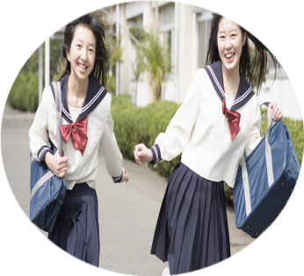
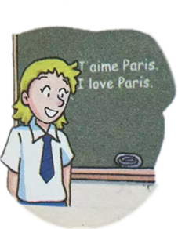
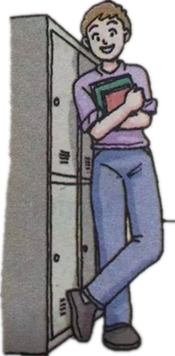
Check your memory
a mixed school
play baseball
have lessons together
like French best
practice baseball
learn a foreign language
go to a Buddy Club
Reading Week
learn more about school
offer new students help
bring in books and magazines
do sports

Slide 4
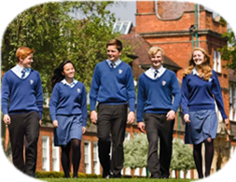
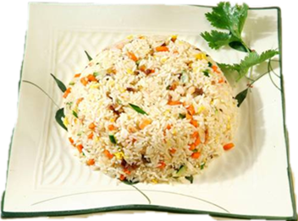
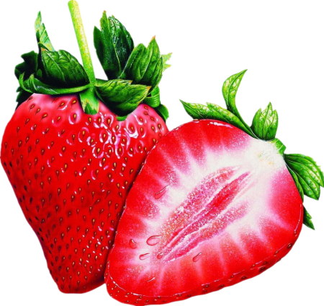
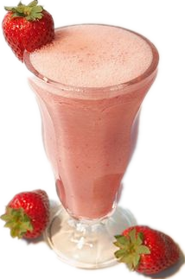
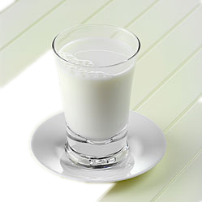
Think over
Boys and girls have lessons together.
a mixed school
Yangzhou fried rice is
a kind of ______ food.
mixed
Mix
and
= ?
V.
a ______ drink
mixed
adj.

Slide 5

My favourite subject is French.
Among all my subjects, I like French.
Learning foreign languages is fun.
It is fun to learn foreign languages.
Doing sth. is +adj.=It is +adj+to do sth.
What subject do you like best? Why?
Think over

Slide 6
Think over
Does Nancy likes reading?
How do you know ?
books
I often read more books than my classmates.
6
Times seems to go faster
when we are reading books.
4
3
more …than …
2
during the Reading Week
Nancy
Simon
Sandy
Daniel
more
than
Nancy reads ____ books _____ Daniel.
Daniel reads ____ books _____ Sandy.
Sandy reads____ books ____Simon.
Nancy reads_____books _____ the other students.
more
than
more
than
more
than

Slide 7
Which is better?
Expression A
Expression B
During the Reading Week, I read 6 books Daniel reads 4 books. Sandy reads 3 books. Simon reads 2 books.
During the Reading Week, I read more books than my classmates.
Making a comparison(作比较) is a better way to express(表达)the amount of things.
Notes:
对比的写法输入 WHICH attracts you more -- contrast

Slide 8
Think over
Try to find out more sentences that make comparisons in John’s article.
In the club, older students help new students
learn more about the school.
On Friday afternoon, our school ends earlier than usual.
Can you make a sentence that make a comparison
like this?

Slide 9
Times seems to go faster
when we are reading books.
Does time really go faster (than usual)?
Time seems to go faster
if you like doing something.
Think over
Times seems faster …
It seems that time goes faster …
seem:
seem to do sth /seem +adj./It seems that …
When does time go faster in your daily life?

Slide 10
Think over
What do they do near the end of the week
at Nancy’s school?
They discuss the books with their classmates.
Is it good for learning? Do you often discuss with your classmates in learning?
Doing sth. is +adj.=It is +adj+to do sth.
Discussing with
______________our classmates in learning __good.
is
It is good to discuss with our classmates in learning.

Slide 11
Why is Tony John’s hero?
Think over
Tony often listens carefully to John’s problems
and offers John help.
______ often listens carefully to
others’ problems and offers them help in our class.
offer sb. sth./ offer sth. to sb.
give sb. sth./ give sth. to sb.
______ often offer(s)_____ to _____...
______ often offer(s) ______ _______ …

Slide 12
Think over
What do you know about John
on Friday afternoon?
Their school ends earlier than usual.
He and his friends often do sports together.
What kind of ball game does John love?
John loves playing baseball after school.
What kind of sport do you like best?
play+ ball games
baseball/play football/ volleyball/ basketball/ tennis/table tennis/ badminton/ chess
Why could John’s team win two games last month?

Slide 13
Think over
How often does John play baseball?
Twice a week, he plays baseball after school.
How does John play baseball?
practice doing
work hard
study hard
He practices hard every time.
Do you practice hard every time
When you love/doing something?
What should you/… do in the future?
_____ should practice _____ hard(er) every time/day.
every time
every day
Then as a result, what happened last month?
John’s team won two games last month.
win – won win the game/ match/ competition

Slide 14
My dream school life
Ｇｒｏｕｐ ｗｏｒｋ
Choose one topic to talk about.
Using at least 6 phrases is better.
…club
fixed
do sports
together
点击添加文本
like…best
doing… is…
My
school
life
play…
listen to… carefully
点击添加文本
different
classes
every day
learn more about…
discuss
…with…
点击添加文本
offer
…to…
practice hard
more…
than…
点击添加文本
in class
seem to …

Slide 15

Conclusion
American school life
British school life
Chinese school life
Dream school life
LIFE

Slide 16
Advice to all of you!
Enjoy the school life,
grow up in the school life!
享受校园生活，
成长于校园生活。

Slide 17
Homework
Write a letter to your e-friend.
Dear …
How are you ? In our dream school, we want… because… .
…
…
…
…
Can you tell me about your school life? I hope to hear from you soon.
Yours faithfully
…

Slide 18

Ｔｈａｎｋ ｙｏｕ！
LIFE

