Slide 1

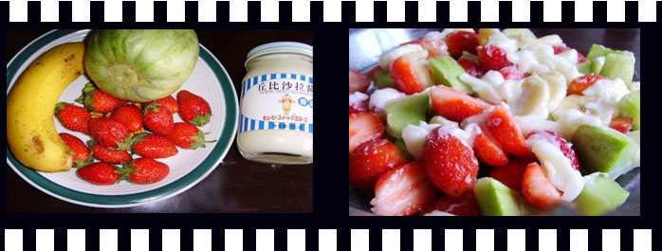

Slide 2
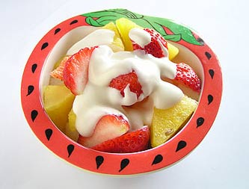
fruit salad 水果色拉
['sæləd]

Slide 3

the things

Slide 4

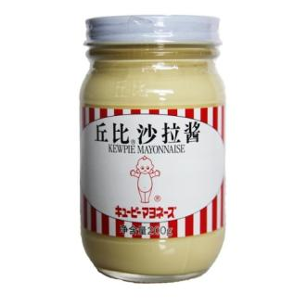
strawberry
['strɔ:bəri]
strawberries
grape [ɡreip]
salad cream [kri:m]

Slide 5

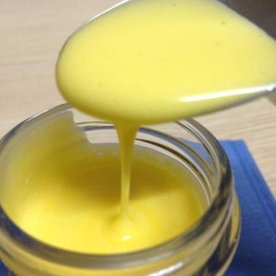
spoon [spu:n]
mix [miks]
add [æd]
增加，补充
混合，搅拌

Slide 6





Amy and Suzy are making a fruit salad. Listen to their conversation and tick the things they need.
a watermelon
grapes
strawberries
a bowl
a spoon
apples
salad cream
plates
bananas

Slide 7
the things
the steps

Slide 8
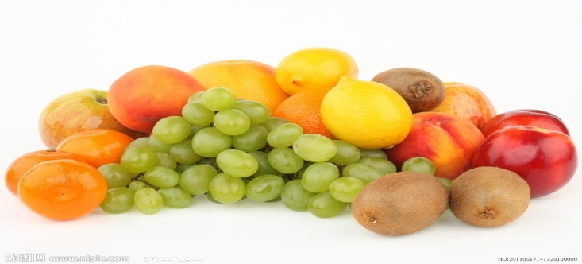
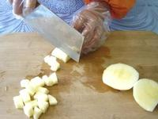
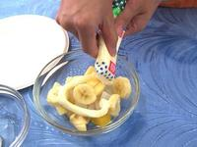
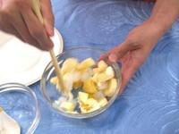

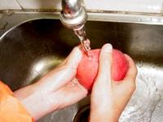
How do we make a fruit salad?
Wash the fruit.
Choose your favourite fruit.
Cut larger fruit into small pieces.
Mix them together. Add some salad cream if you like.

Slide 9
Put them in the right order
2
Wash the fruit
Mix them together. Add some salad cream if you like.
Cut some of the larger fruit into small pieces.
Choose your favourite fruit.
4
3
1

Slide 10
Retell the orders
First, ______ your favourite fruit.
Then, _____ the fruit.
Next, ____ some of the larger fruit ____ small pieces.
At last, ____ them together. _____ some salad cream if you like.
Choose
Wash
Cut
into
Mix
Add

Slide 11
the things
the steps
tips
[tips] 小建议，小窍门

Slide 12
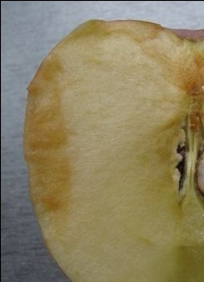
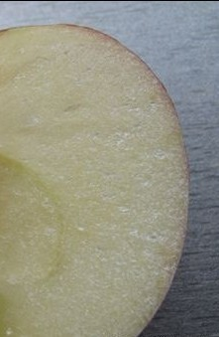
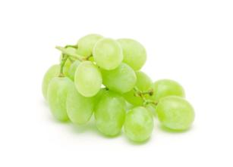
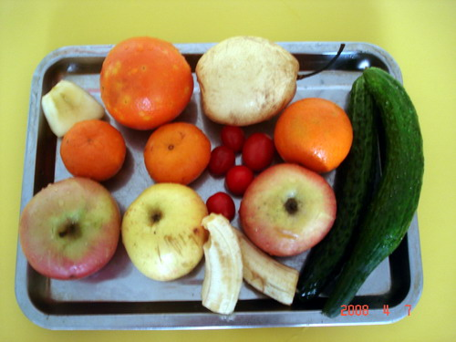
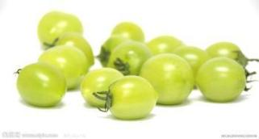
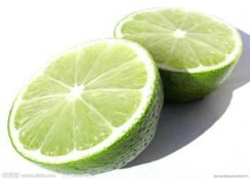
Tips for me
B
A

Slide 13
Tips:
Tips for making a fruit salad
Use fruit __________. Make sure it is ______.
Use fruit of _________ colours and try to make your fruit salad look __________ it tastes. For example, red apples, green ______, purple grapes and ________ together will make the salad look very colourful.
Prepare the fruit salad ___________ you are going to eat it. some of the fruit will quickly ____________ when you leave it __________ for some time.
(1)
(2)
(3)
(4)
(5)
(6)
(7)
(8)
(9)

Slide 14

Tips:
Tips for making a fruit salad
Use fruit __________. Make sure it is ______.
Use fruit of _________ colours and try to make your fruit salad look __________ it tastes. For example, red apples, green ______, purple grapes and ________ together will make the salad look very colourful.
Prepare the fruit salad ___________ you are going to eat it. some of the fruit will quickly ____________ when you leave it __________ for some time.
in season
fresh
(1)
(2)
different
(3)
as good as
(4)
pears
(5)
oranges
(6)
just before
(7)
turn brown
(8)
in the air
(9)

Slide 15

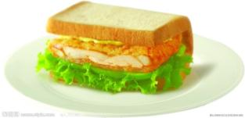
Let’s make some sandwiches
What do we need to make sandwiches?
ham [hæm] 火腿
sauce [sɔ:s] 酱

Slide 16
Listen and answer
1. What are they going to make for lunch?
Some sandwiches.
2. Are they quick and easy to make?
Yes, they are.

Slide 17
Read and answer (P50 B)
How do they make a sandwich?
First, pick _________________.
a piece of bread
Then, put some ______________ on it.
tomato sauce
Next, put some __________________ on it.
ham and vegetables
Finally, just put another piece of bread _____________ it.
on the top of

Slide 18
Let’s read
Read the dialogue.
Sandy: It’s time for lunch, Mum. Can we stop
cleaning the house and make some food? I’m
hungry.
Mum: OK. Let’s make some sandwiches.
Sandy: Are they quick and easy to make?
Mum: Sure. Look at me. First, pick a piece of bread.
Then put some tomato sauce on it.
Sandy: Next, we can put some ham and vegetables
on it.
Mum: That’s correct.
Sandy: Is that all right?
Mum: Well. Just put another piece of bread on the top
of it. Finished!

Slide 19

Share my advice
As Grade 8 students, you must be very busy with your lessons. As you see, we can still make our life more colourful with our hands and mind.

Slide 20
1. 一勺色拉酱
2. 搅拌他们
3. 把A添加到B中去
4. 如果你喜欢
5. 切成小快
6. 制作色拉的要点
7. 当季水果
8. 确信
9. 不同颜色的水果
10. 打个比方
11. 看起来色彩缤纷
12. 很快（颜色）变深
13. 把某物放在空气中
14. 一些时间zx，xk
a spoon of salad cream
mix them together
add A to B
if you like
cut sth. into small pieces
tips for making a fruit salad
the fruit in season
make sure
fruit of different colours
for example
look colourful
quickly turn brown
leave sth in the air
some time

Slide 21

That’s all for this class!
Notes:
Eddie goes back home. I have to arrange my homework here.

