Slide 1
语法@形容词/副词的比较级和最高级
一、形容词或副词有“级”的划分
英语中，大多数形容词或副词都有“级”的分——原级（即：原形）、比较级、最高级三个等级。
比较级意为：“较… ，更…” 最高级意为：“最…”
如：tall--taller--tallest （高--更高--最高）
good--better--best （好--较好--最好）
二、形容词或副词的比较级和最高级的构成规则：
1.一般情况，大多数在词尾加-er ,构成比较级；词尾加-est ,构成最高级。
如：long--longer--longest short--shorter--shortest

Slide 2
2.词尾是字母e的，只加-r ,构成比较级；只加-st，构成最高级。 【不能重复字母e】
如：late--later--latest nice--nicer--nicest
large--larger--largest close--closer--closest
3.词尾是字母y的，变y为i，再加-er ，构成比较级；再加-est，构成最高级。
如： early--earlier--earliest easy--easier--easiest
funny--funnier--funniest
friendly--friendlier--friendliest
busy-busier--busiest curly-curlier-curliest
4.但由“形容词+ly”演变成的副词，其比较级和最高级并非是按第（3）条进行的，而是在原级前面加上more 或most构成比较级或最高级。

Slide 3
如：carefully--more carefully-- most carefully
【carefully是一个副词，它是由形容词careful词尾加上后缀ly变来】
loudly--more loudly--most loudly
quickly--more quickly--most quickly
slowly--more slowly--most slowly
quietly--more quietly--most quietly
5.由“辅音字母+元音字母+辅音字母”构成的单音节形容词或副词，其比较级和最高级，不是直接加-er/-est变成，而是先双写末尾的辅音字母，然后再加-er / -est . 【当然只是少数几个】
如：big--bigger--biggest hot--hotter--hottest
thin--thinner--thinnest sad--sadder--saddest
6.所有多音节或部分双音节形容词或副词的比较级和最高级，并非在词尾加-er/-est,而是在原级前放more或most . 【简单说：就是很长的词】

Slide 4
如：outgoing--more outgoing --most outgoing
beautiful--more beautiful --most beautiful
serious--more serious--most serious
interesting--more interesting --most interesting
difficult--more difficult --most difficult
boring--more boring--most boring
creative--more creative-- most creative
important-- more important -- most important
三、有八个形容词或副词的比较级和最高级是不规则变化的，须熟记。
(1) good--better--best (2) well--better--best
(3) bad--worse--worst (4) badly--worse--worst

Slide 5
(5) many--more--most (6)much--more--most
(7) far--farther--farthest 【指实际距离的远】
(7) far--further--furthest 【指抽象意义上的远】
【注：后者用的较少，father（父亲）与 farther（更远）的读音相同，书写时不要出错】
old--older--oldest 【规则变化：指实际年龄大小】
old--elder--eldest 【不规则变化；指辈分、排行，elder不能与than连用】
如：She is my elder sister. 她是我的姐姐。
He is my elder brother .他是我的哥哥。
He is my eldest son .他是我的大儿子。
I'm 15 years old , he is ten years old . I am older than him.
我15岁，他10岁。 我（年龄上）比他大。

Slide 6
(8) little--less--least
所以，记住：many/much 、 little、 good/well 、bad/badly 、far 八个的比较级与最高级。
强化训练
写出下列形容词或副词的比较级和最高级形式：
young long friendly qiute ugly small big warm
cold beautifully quick quickly blue white short
large thin funny interesting good little many
clever smart fast slow slowly high tired outgoing
happy happily successful little bad well
close far young loud loudly wide deep hungry
clear clearly

Slide 7
关于比较级词尾-er和最高级词尾-est的读音问题
-er 读作：/倒e恶/ ; -est读作：/ist衣思特/
注意：-ng结尾的形容词，其比较级和最高级，要把
/g 格/ 音读出来 。
如：long--longer--longest
young--younger-youngest
-r结尾的形容词，其比较级和最高级，要把
/r润/ 音读出来。
clever--cleverer--cleverest poor--poorer--poorest
clear--clearer--clearest
你能正确读出这些比较级和最高级的发音吗？
longer longest cleverer smarter taller tallest bigger
biggest faster fastest smaller smallest higher highest
louder loudest older oldest ……

Slide 8
形容词或副词的比较级的用法
用法：表示两者（两个人或两个物）之间的比较，则用比较级。
表示“其中一个比另一个更…”或“较…”。后面通常用连词than连接另一个比较对象。
基本句型是：
主语+谓语动词（系动词be）+比较级+than+比较对象
eg: Jim is taller than Mike. Mike is shorter than Jim.
I am more outgoing than him. He is quieter than me .
Lily studies harder than Lucy. Tom is lazier than Bob.
Pandars are smarter than pigs . I run faster than her .
The Changjiang River is longer than The Yellow River.
注：than（比）后若是人称代词，书面语用主格，口语多用宾格形式。

Slide 9
你能用以上比较级的基本句型汉译英吗？
1.我比他高 2. 他比我矮 3. Lily比lucy更小心些。
4.他工作比你较努力一些。5.这本书比那一本更有趣
6.Tom比Jim大。 7.我比你小得多。
8.我的苹果比你的大 9. 你的书包比我的小
10.这幢楼房比那一幢更旧
11.我比你更用功些。
12.这支钢笔比那一支更贵。
13.他跑得比你快。
14.你比他矮一点点。
15.这山比那山高。

Slide 10
比较级还实用于下列句型：
Which /Who ……+比较级，A or B ?
【or表示选择关系，作“还是，或者”讲】
如：Which do you like better , coffee or tea?
咖啡和茶，你更喜欢哪一种？
Which is more delicious , apples or pears?
哪一种水果更美味，是苹果还是梨？
Which is higher , Mountain Tai or Fu Ji Mountain ?
哪座山更高些，是泰山还是富士山？
Who is more famous , Lu Xun or Li Bai?
Who is more popular , Zhao Benshan or Beckham?
谁更受欢迎些，是赵本山还是贝克汉姆？

Slide 11
英语中，表示“越来越……”，常用“比较级+and+比较级”结构表达。 【即：同一个比较级用and连接叠加在一起】
如果是多音节的形容词或副词，则用“more and more +多音节形容词或副词原级”。
bigger and bigger 越来越大 smaller and smaller
younger and younger 越来越年轻
stronger and stranger 越来越强（大/壮）
faster and faster 越来越快
more and more beautiful 越来越漂亮/美丽
more and more important越来越重要
more and more outgoing越来越开朗
常用句型：Sb./Sth. becomes/gets……某人/物变得越来越…… 如：You are getting younger and younger.
你正变得越来越年轻了。
It is getting colder and colder . 天越来越冷。

Slide 12
句型：主语+…the+比较级+of+the two….
如：Tom is the taller of the two boys.
Tom是这两个男孩中最高的。
英语中，表示“越…，越…”，则用句型：
“The +比较级……，The +比较级……”
如：The more, the better.越多越好！
The harder you study , the better grades you will get .
你学习越努力，你取得的成绩就越好。
The more you eat , The heavier you will get.
你吃得越多，你将会变得越胖（重）
你能否会翻译：“站得高看得远”
( )( )you stand , ( ) ( ) you see.

Slide 13
你能否会翻译：“他越忙就越高兴”
( ) ( ) he is , ( ) ( ) he feels .
形容词的比较级前可加数词，表示“大（小）……多少” 或“长（短）……多少”
如：He is five years younger than me.他比我小（年轻）5岁。
I am two years older than my brother.
我比我的弟弟大（老）两岁。
This ruler is three meters longer than that one.
这把尺子比那一把长3米。
This hole is ten meters deeper than that one .
这个洞比那一个深十米。
Yao Ming is 0.5 meter taller than Pan Changjiang.
姚明比潘长江高半公分。
I am one meter shorter than You.我比你矮一米。

Slide 14
表示倍数时用“……times +比较级+than+……”
如：My room is three times bigger than yours.
我的房间比你的大3倍。
China is many times larger than Janpan.
中国（面积）比日本（的面积）大许多倍。
注意：1. 在使用比较级时，必须是同类比较，不能异类比较。
eg: My school is more expensive than ( C ).
A. you B. your C. yours
The population of China is larger than ( C )
A.India B. Indian C. India's

Slide 15
2.为了加强比较的程度，可以在比较级前面加上一些词或短语，如：much/a lot/far+比较级 “……得多”
a little+比较级 “……一点点” ，当然还可以在比较级前加上even , a bit 等等。
如：I am much taller than you .我比你高得多。
She is a lot shorter than me.她比我矮得多。
Tom is far more outgoing than Jim.
汤姆比吉姆外向得多。
His homework is a little better than yours.
他的家庭作业比你的要好一点儿。
选择：This movie is ( ) than that one.
A. more much interesting B. much more interesting

Slide 16
表示两个人或物在某一方面相同（一样），用同级比较句型：
……as+形容词/副词原级+as+比较对象。
“……和……一样……”
eg: I am as tall as him. Are you as friendly as him?
She is as hard-working as me.
You run as fast as him.
This movie is as boring as that one.
He works as hard as me.
My father gets up as early as my mother.
【注：第一个as是副词，修饰形容词或副词原级，第二个as是连词，后接另一个比较对象】

Slide 17
选择：Tom is as ( )as Jim.
A.thiner B.thinner C. thin D.the thinnest
He plays the piano as ( ) as you do .
A. good B. better C. well D. best.
翻译填空：
我和他一样搞笑。
I am ( ) ( ) as him.
篮球和足球一样受人欢迎。
Basketball is ( ) popular ( ) soccer.
我和你一样严肃。
I am ( ) ( ) ( ) you.

Slide 18
表示“甲不如（不及）乙”，则用上一句型的否定式：
…not…as/so+形容词/副词原级+as+比较对象。
“…不如/不及…” “…和…不一样…”
【注：第一个as是副词，修饰形容词或副词原级，可以用so替换,第二个as是连词，后接另一个比较对象，则不能用so替换】
eg: I'm not as/so tall as him. 我不如他高。
She isn't as/so hard-working as me. 她不及我用功刻苦。
You don't run as/so fast as him. 你不及他跑得快。
This movie is not as/so boring as that one.
这部电影不如那一部烦人。
He doesn't work as/so hard as me. 他工作不如我努力。
My father doesn't get up as/so early as my mother.
我爸爸不如妈妈起得早。

Slide 19
句型：
…not…as/so+形容词/副词原级+as+比较对象。
“…不如/不及…” “…和…不一样…”
可以与比较级句型相互转化为同义句。
你能把以下句子转化成同义句吗？
I'm not as tall as him. （ ）
She isn't as hard-working as me. （ ）
You don't run as fast as him. （ ）
This movie is not as boring as that one.（ ）
He doesn't work as hard as me. （ ）
My father doesn't get up as early as my mother.
（ ）
Made by He Peng 2015 .10. 28

Slide 20
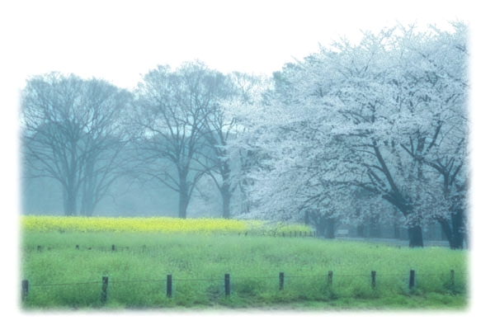
The bike goes fast.
Which goes faster, the bike or the car?
The car goes faster than the bike.

Slide 21
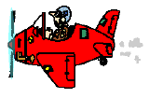
The bird flies high.
Which flies higher,the plane or the bird?
The plane flies higher than the bird .

Slide 22
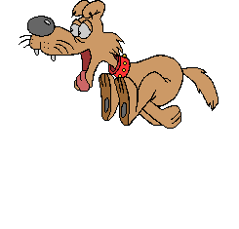
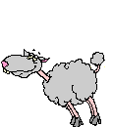
The sheep runs fast.
Which runs faster, the dog or the sheep?
The dog runs faster than the sheep.

Slide 23
￥100 ￥200
The brown coat is expensive.
Which is more expensive , the brown coat
or the the yellow coat?
The yellow coat is more expensive than
the brown one.

Slide 24
Donald duck
Harry Potter
Donald duck is interesting.
Which is more interesting?
Harry potter is more interesting than Donald duck.

Slide 25
Guess!

Slide 26
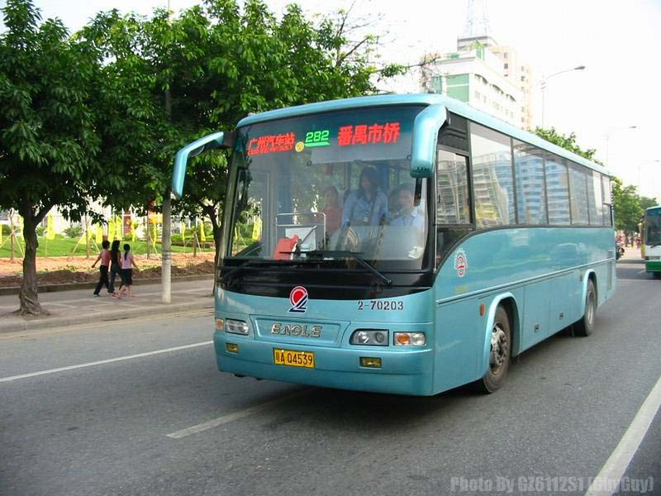
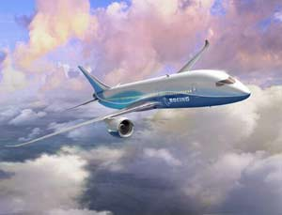
Which means of transportation is safer?
bus
plane

Slide 27
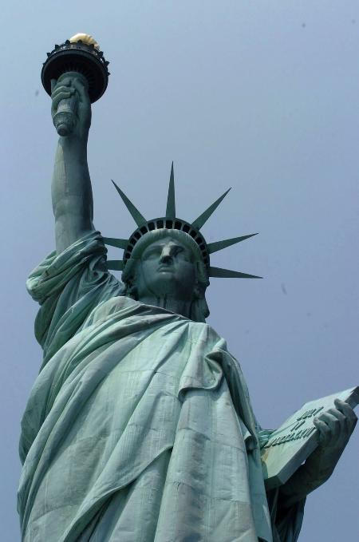
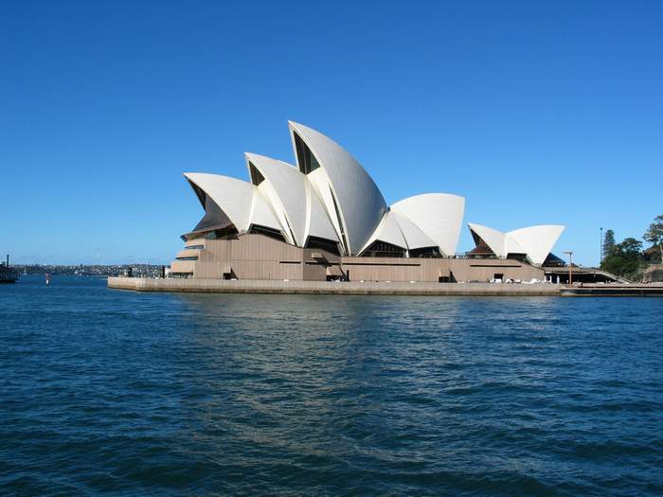
Which country is larger?
U.S.A
Australia

Slide 28
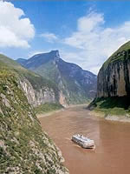
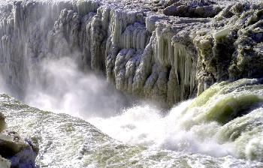
The Changjian River
The yellow River
Which river is longer?

Slide 29
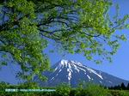
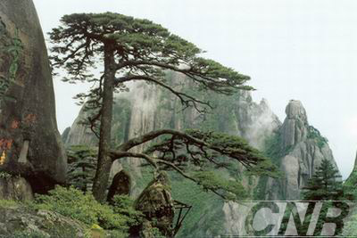
Which mountain is higher?
Fu Ji mountain
Huangshan

Slide 30
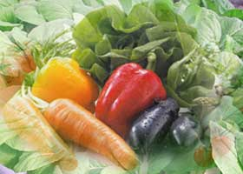
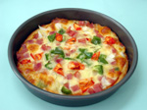
vegetables
pizza
Which is more delicious?

Slide 31
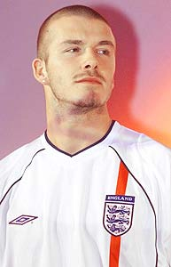
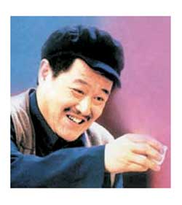
Who is more popular?
Beckham
Zhao Benshan

Slide 32
“比较”出来的英语
1. A friend is easier lost than found. 朋友易失不易得。
2. Enough is as good as a feast. 知足常乐。
3. Better to do well than to say well. 说得好不如干得好。
4. Better the last smile than the first laughter.
宁可最后微笑，不可首先狂喜。
5. Doing is better than saying. 会说不如会做。
6. Two heads are better than one. 两人智慧胜一人。
7. Good to begin well, better to end well. 善始好，善终更佳。
8. An eye finds more truth than two ears. 百闻不如一见

Slide 33
Let’s think.
If you have a chance to travel, where do you like to choose? And why?
2. When you want to shop , where would you like to go? And why?
3. If your parents aren’t at home and they give you some money to buy food by yourself, where would you like to buy? And why?
4. If this Sunday your classmates and you want to have a picnic , where would you like to go? And why?

Slide 34
My answer
1.I want to travel to Hai nan, because it has the
most beautiful scenery .
2. I want to go shopping in a supermarket, because
I think it has the most comfortable environment.
3. I would like to go to KFC, because it has the
friendliest service.
4. I want to go to the Forest Park, because it has the
freshest air and it can make us relaxed.

Slide 35
选择精题：
1. Lucy is very short, but she is __________ than her sister.
A. shorter B. longer C. taller D. older
2. Frank is __________ friendly than his brother.
A. a little more B. a few more C. much D. a little
3. Sam is __________ at Chinese than Jim. A. good B. well
C. better D. gooder

Slide 36
4. This one is too large. Can you show me a __________one?
A. larger B. large C. small D. smaller
5. —Do you think March is __________ than January?
—Yes, it’s __________ warmer.
better, a little B. well, much
C. worse, very D. nicer, quite

Slide 37
7. I’m __________ quieter than Susan.
A. little B. few
C. a little D. a few
8. The watch is not __________ beautiful as that one.
A. very B. too
C. so D. more

Slide 38
9. His French isn’t so good as __________.
A: he B: him C:his D: hers
10. It’s much better than __________ classes.
A. have B. has
C. to have D. having
11. Her bag is newer than __________.
A. mine B. my
C. me D. I

Slide 39
13. Which one is __________, this one or that one?
A. good B. bad C. best D. worse
14. He is __________ than me.
A. older B. elder
C. young D. more younger
15. I think your room is __________ bigger.
A. a lot B. a lot of
C. lots of D. more

Slide 40
16. The __________, the better.
A. much B. many
C. more D. most
17. Do you know who is __________ of the twins?
A. shorter B. heavier
C. the older D. the funny
18. The weather in North China is colder than __________ in South China.
A. \ B. this C. the one D. that

Slide 41
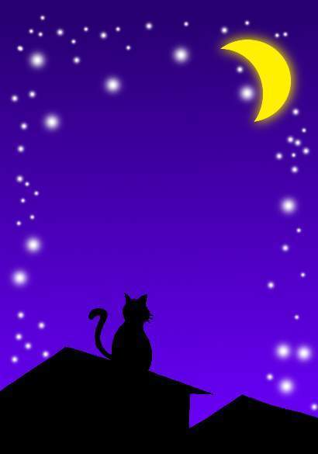
Thank you for listening!

