Slide 1

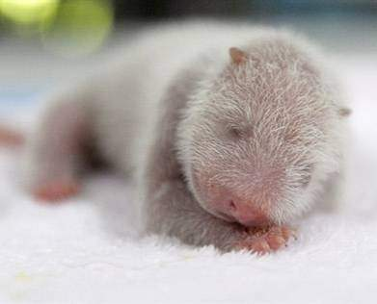
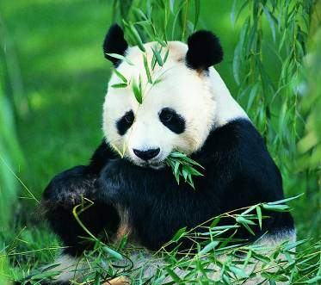
Unit 5 Wild animals
Reading

Slide 2

Play a guessing
game

Slide 3
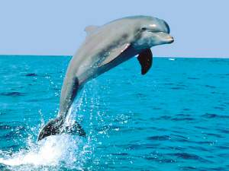
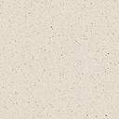
It is a sea animal and looks like a large fish. It is very clever and often plays some games for us in the zoo.
dolphin

Slide 4

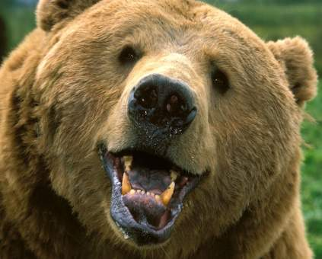
It’s a heavy wild animal
with thick fur and sharp
(锋利的) paws. It can
walk upright(竖直地).
bear

Slide 5
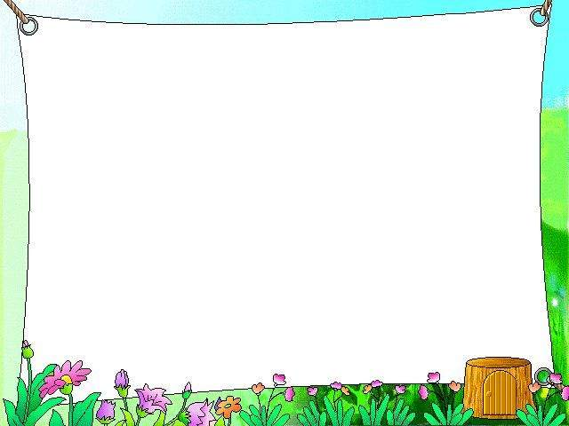
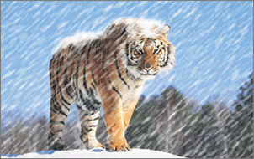
It’s the king of the animal world. It has yellow fur and black stripes(条纹) on its body.
tiger

Slide 6

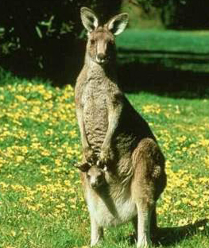
It jumps with its baby in its pocket. You can see it in Australia.
kangaroo

Slide 7

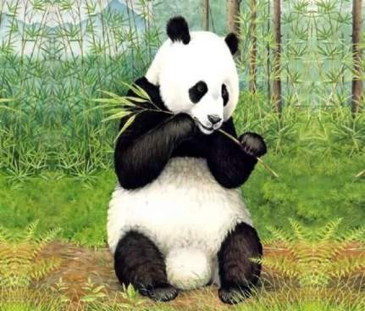
It lives in China. It is black and white. Its favorite food is bamboo .
giant panda

Slide 8
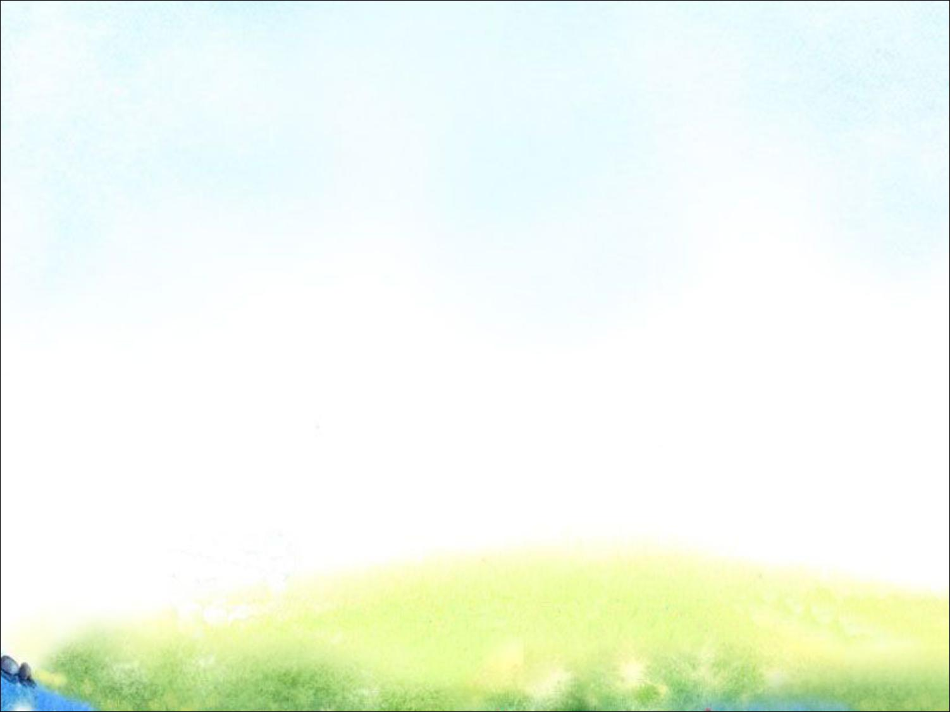
Listen & Answer
1.What’s the name of the giant panda?
2.What does it mean?
3.What will happen if we do nothing?
Xi Wang.
It means hope.
There will be none left in the world.

Slide 9
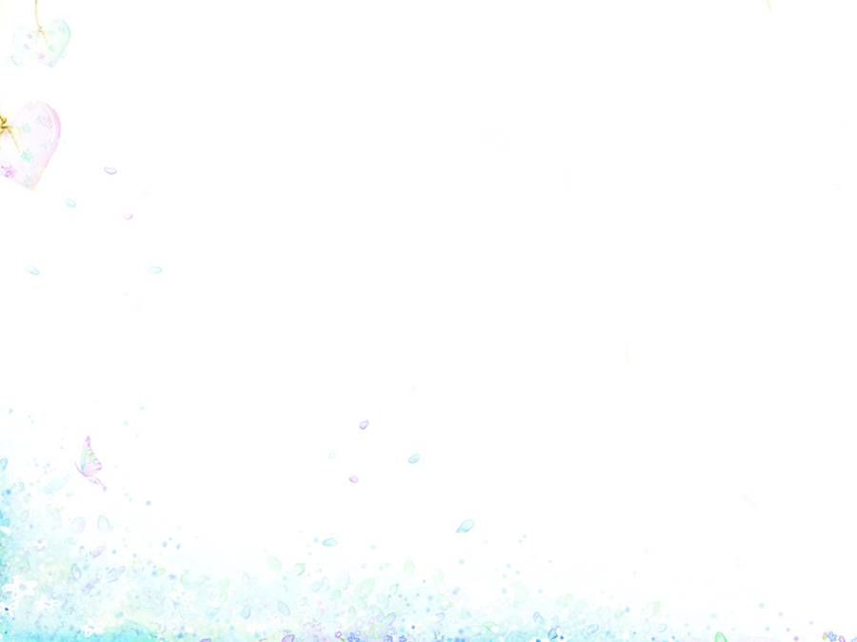
Match the words on the left with the meanings on the right.
be born
in the beginning
serious
mainly
take action
none
a do something
b not any
c bad or dangerous
d at first
e more than anything
else
f come into the world
as a baby

Slide 10
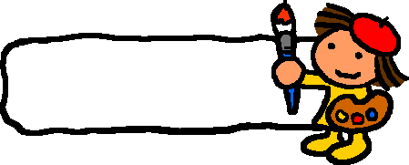
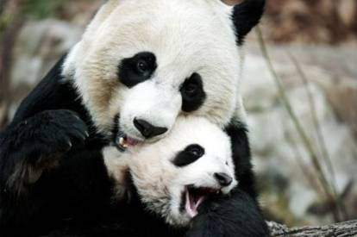
Lead-in
Which animal do you like best?
Do you like giant pandas?
Why?

Slide 11


Giant pandas
Here is the story of Xi Wang, a lovely giant panda. Listen carefully and finish the following “true or false”.

Slide 12


1. When the writer first saw Xi Wang,
she weighed less than 100 grams.
2. When she went outside for the first
time, she started to eat bamboo.
3. At Eight months old, she weighed over
35 kilograms.
4. When she was 8 months old, she
learnt to look after herself.
5. It’s very easy for pandas to have babies.
6. Building more reserves for giant
pandas will help to protect them.

Slide 13

Reading
Find the main ideas
Paragraph 1:
something about Xi Wang
Paragraphs 2-3:
the growth of Xi Wang
Paragraph 4:
the problems of pandas
Paragraphs 5-6:
take action to protect pandas

Slide 14
Note-making
The growth of Xi Wang
Age | Weight | Food
1 day
10 days | /
4 months
6 months | /
12 months
20 months | /
100 g
her mother’s milk
8 kg
bamboo
35 kg

Slide 15

The growth of Xi Wang
Match the sentences with the pictures and write the correct letters in the boxes.
B2 on Page59

Slide 16
a. She learnt to look after herself.
b. She was about eight kilograms and
started to go outside.
c. She looked like a white mouse.
d. She began to eat bamboo.
e. She weighed 100 grams.
f. She weighed over 35 kilograms.

Slide 17
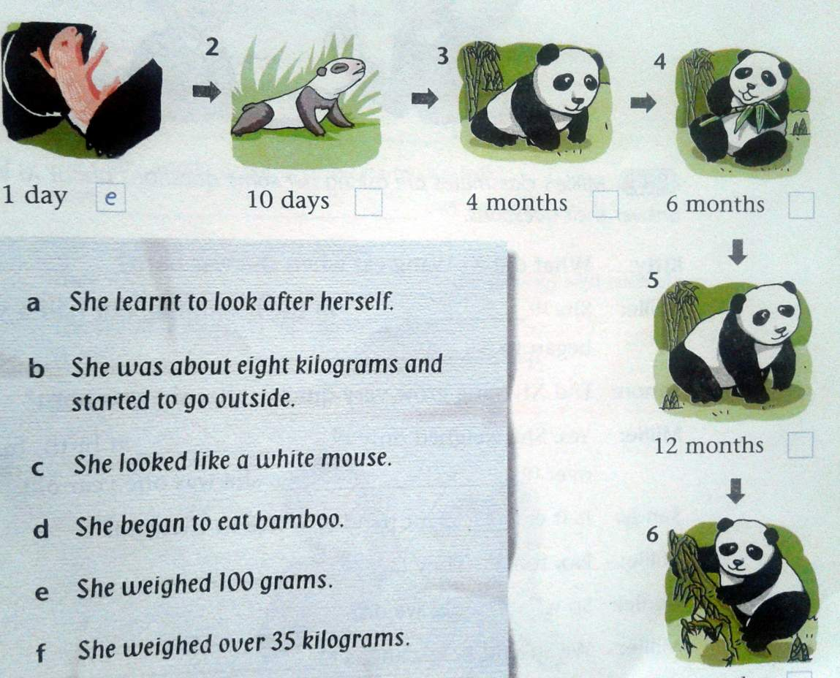
c
1 day 10 days 4 months
e
b
20 months
a
12 months
f
6 months
d

Slide 18
Note-making
Problems | Ideas
· It is very difficult for pandas to have babies, and many baby pandas die when they are very young.
· Giant pandas live mainly on a special kind of bamboo. However, the bamboo forests are becoming smaller and smaller.
· help pandas have more babies
· build more panda reserves
· make laws to protect pandas

Slide 19

Discuss
How can we protect giant pandas?

Slide 20
Ways to protect giant pandas
1.Make giant panda reserves bigger.
2.Build more reserves(保护区).
3.Encourage（鼓励） famers to leave
the giant panda reserves.
4.Don’t kill animals for their fur.
5.Don’t cut down trees and forests.
6.Don’t buy the clothes made of
animal fur.

Slide 21
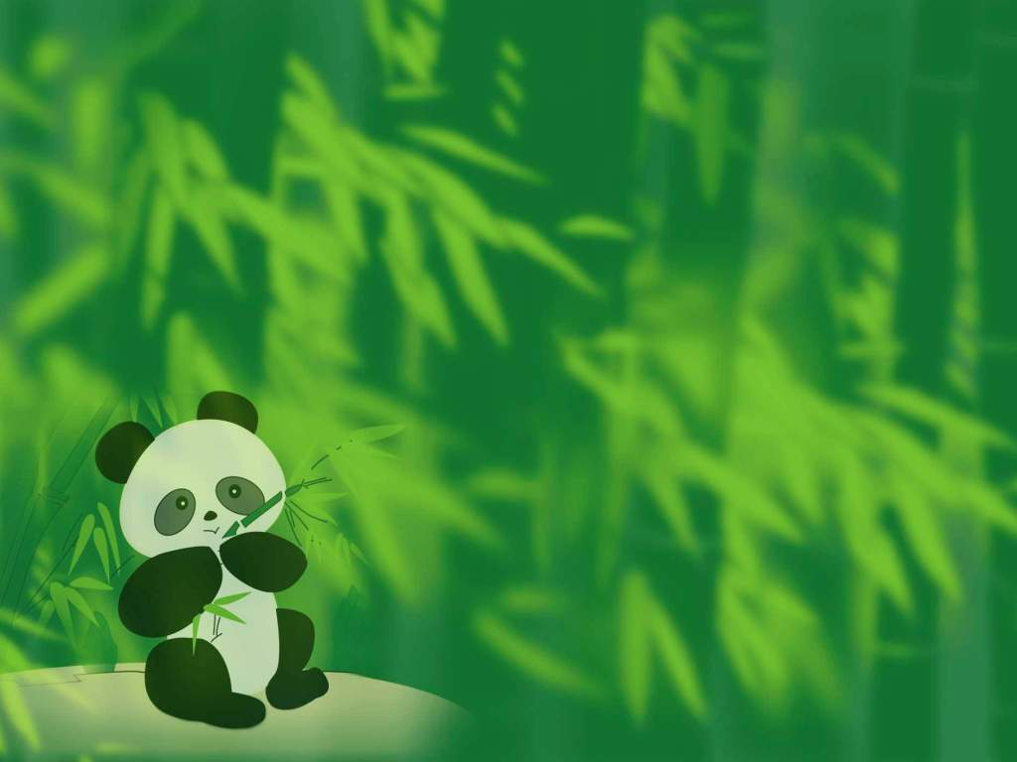
Giant pandas are crying!
Please show your hands,
show your love!
Do everything to help them!

Slide 22
Reflection
1. be born 出生，出世
2. look like 看起来像……
3. start / begin to do sth. 开始做某事
4. for the first time 第一次
5. not … any more 不再
6. in the beginning 一开始
7. look after 照顾
8. sadly / sad 伤心地/的
face 面临

Slide 23
9. It is difficult/hard/easy for sb. to do sth.
对某人来说，做某事很难/容易
10. live on 以食……为生
11. as a result 因此
12. in danger 处境危险
13. take action 采取行动
14. right away 立刻，马上
15. However, we do believe that where
there is Xi Wang, there is hope.
然而，我们坚信熊猫在，希望就在。

Slide 24
Additional exercises
用所给词的适当形式填空。
1 When Tom was born, he ________
(weigh) 3 kilograms.
2 We should take action _____
(help) his good friend.
3 If you ____ (be) thirsty, you can use tea ______ (leaf) to make tea.
weighed
to help
are
leaves

Slide 25
4 All people should do something.
We should take _______ (act)
before it’s too late.
5 It’s __________ (danger) for the
children _______ (play) games
in the street.
6 The baby panda _______ (look)
like a white mouse when she
was born.
actions
dangerous
to play
looked

Slide 26
