Slide 1

Unit 4 Do it yourself
Comic strip and Welcome to the unit

Slide 2


A man is going to build a house by himself.

Slide 3
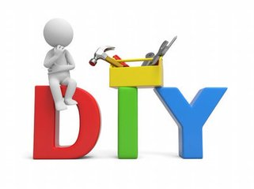
Do
It
Yourself

Slide 4
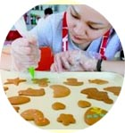
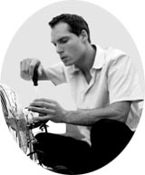
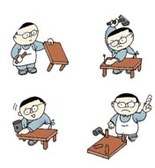


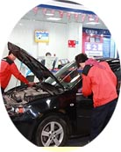
make biscuits
repair an electric fan
make a table
decorate the house
repair a car

Slide 5





Slide 6
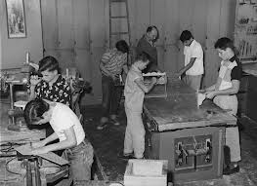
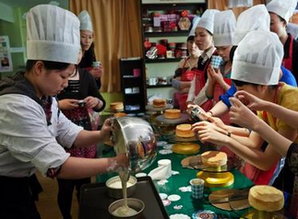
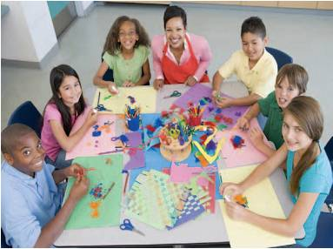
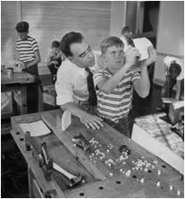
DIY is popular all over the world now.

Slide 7
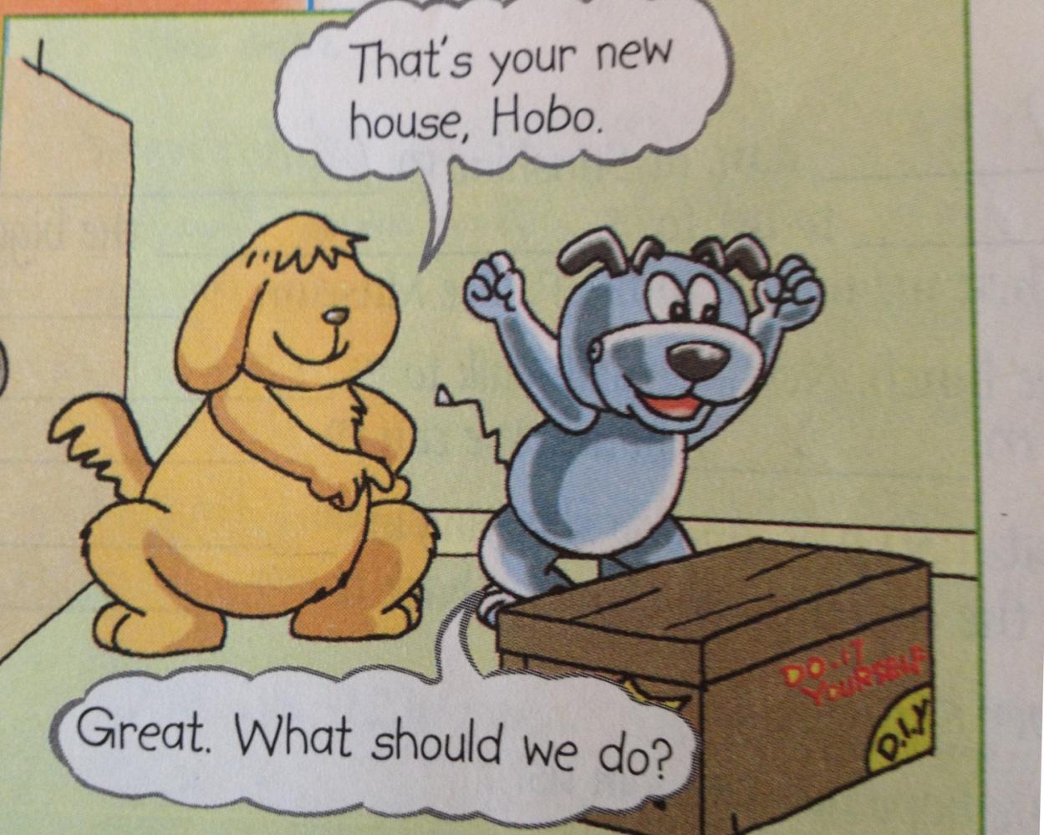
Hobo is excited.

Slide 8
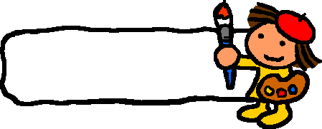
Listen and answer
1. What’s Hobo going to do?
2. Will Eddie help Hobo?
3. What should Hobo read first?
4. What does Hobo probably need?
5. What should Hobo do at last?

Slide 9
Listen and answer
1. What’s Hobo going to do?
He’s going to build/make his new house.
2. Will Eddie help Hobo?
No, he won’t.
3. What should Hobo read first?
He should read the instructions first.
(He’d better read the instructions first.)

Slide 10
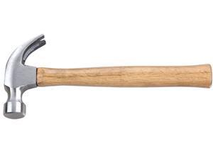
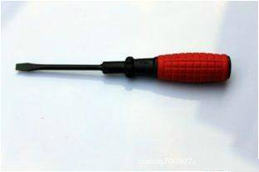
Listen and answer
4. What does Hobo probably need?
He should get some tools.
hammer
screwdriver
5. What should Hobo do at last?
He should build the house by himself.

Slide 11
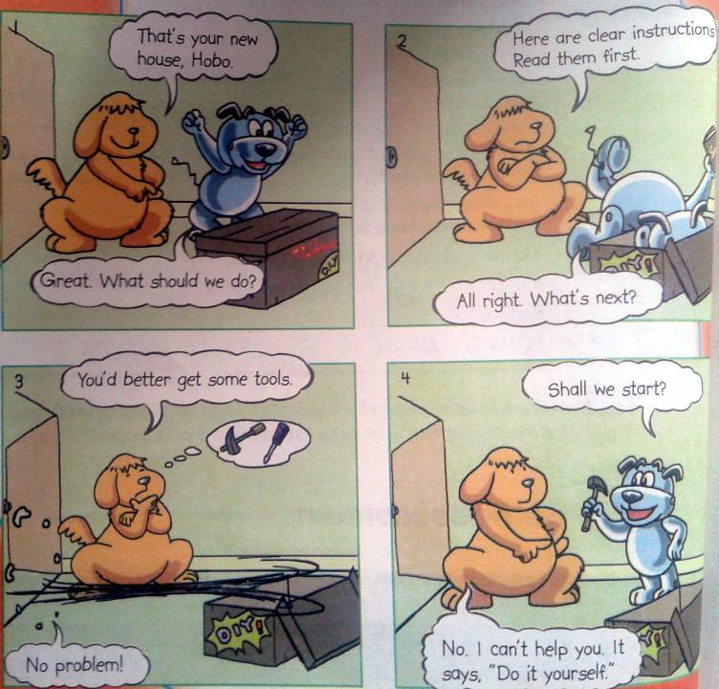
Act it out

Slide 12
A DIY story
house
One day Eddie brings Hobo a new ______. Hobo is very ______ , but he _______ know what to do. Eddie tells him to read the ____________ first and says to him, “You'd better _____ some ______.” When Hobo _____ everything OK, Eddie doesn’t want to help him any more. Do you know why?
excited
doesn’t
instructions
get
tools
gets

Slide 13
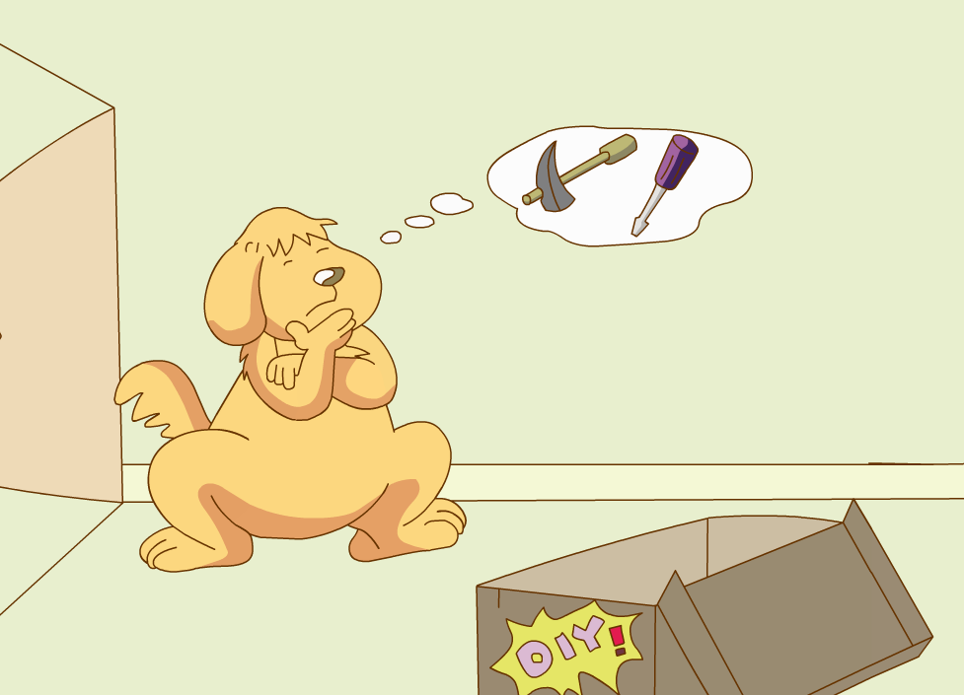


Slide 14

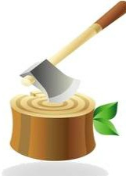
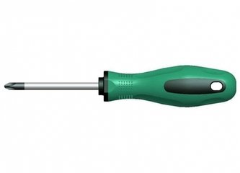

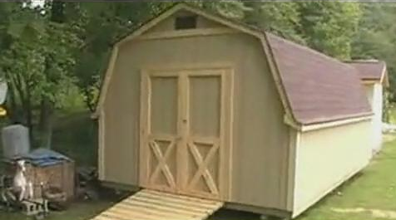
hammer
screwdriver
axe

Slide 15
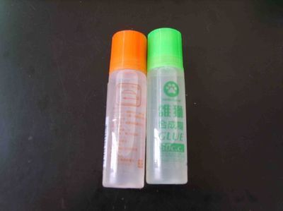



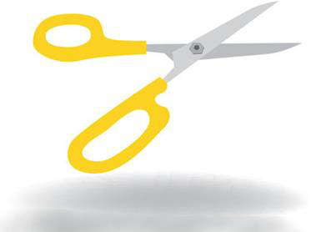
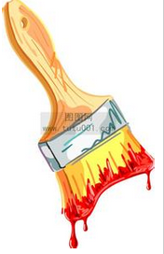

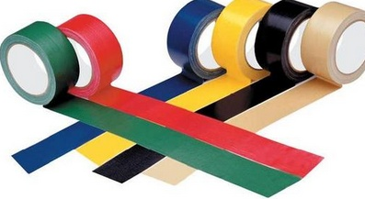



scissors
glue
rope
tools
brush
tape

Slide 16
About DIY
tools
brush
glue
rope
scissors
tape
Andrew

Slide 17
Match
What is it used for?
We always use it to stick paper on the wall.
brush
We can use it to join things together.
scissors
glue
We use it to paint the walls.
tape
We can't cut paper or cloth easily without them.

Slide 18




Do it yourself
exactly
确切地，精确地
make , repair or decorate things yourself
修补
装饰

Slide 19

Listen and answer
1. What’s DIY?
2. What is Suzy going to do?
3. What does Suzy need for her DIY?

Slide 20
Read the dialogue
Millie: What’s DIY exactly, Suzy?
Suzy: It stands for “do-it-yourself”. When you do DIY, you
make, repair or decorate things yourself instead of
paying someone to do it.
Millie: What are you going to do then?
Suzy: I’m going to make some paper roses.
Millie: It sounds lovely. What do you need for that?
Suzy: I need some paper, glue and a pair of scissors.
Millie: Do you like DIY?
Suzy: Yes, I do. I enjoy making something new. That’s fun.

Slide 21
1. What’s DIY?
It stands for “do-it-yourself”. When you do DIY, you make, repair or decorate things yourself instead of paying someone to do it.
2. What is Suzy going to do?
She’s going to make some paper roses.
3. What does Suzy need for her DIY?
She needs some paper, glue and a pair of scissors.

Slide 22
Word phrases
1.清楚的说明
2.最好
3.最好不
4.没问题
5.自己做
6.代替，替代（而不是）
7.自己制作，修理，装饰东西
8.代表
9.一些纸玫瑰
10.喜欢做一些新的东西
11.准确地说DIY是什么？

Slide 23
Make up a similar dialogue
A: What’s DIY exactly, xxx?
B: It stands for _____________. When you
do DIY, ___________________.
A: What are you going to do then?
B: I’m going to _____________________.
A: It sounds _______. What do you need for that?
B: I need ___________________________.
A: Do you like DIY?
B: Yes, I do. I _______________________.
That’s fun.
tips：(things) kites, paper planes, paper ships, lucky stars …
(tools) bamboo, wood, rulers, scissors, glue …

Slide 24

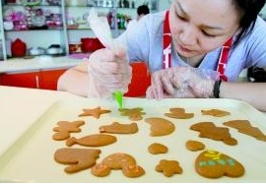
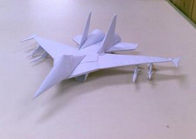
Discussion
Do you like DIY?
What do you like to make?
What tools do you need?

Slide 25
Activate your brain, and use your hands to create something. As long as you set your heart on it, you will make it.
This is the spirit of DIY.
From nature, back to nature. Make yourself feel relaxed and feel every beautiful thing around in DIY.
This is the idea of DIY.
Give some sugar to our life.
This is the purpose of DIY.

Slide 26
Remember its slogan:
Just to be yourself!

Slide 27
Enjoy your life!
Just to be yourself!

Slide 28
Thank you!

