Slide 1
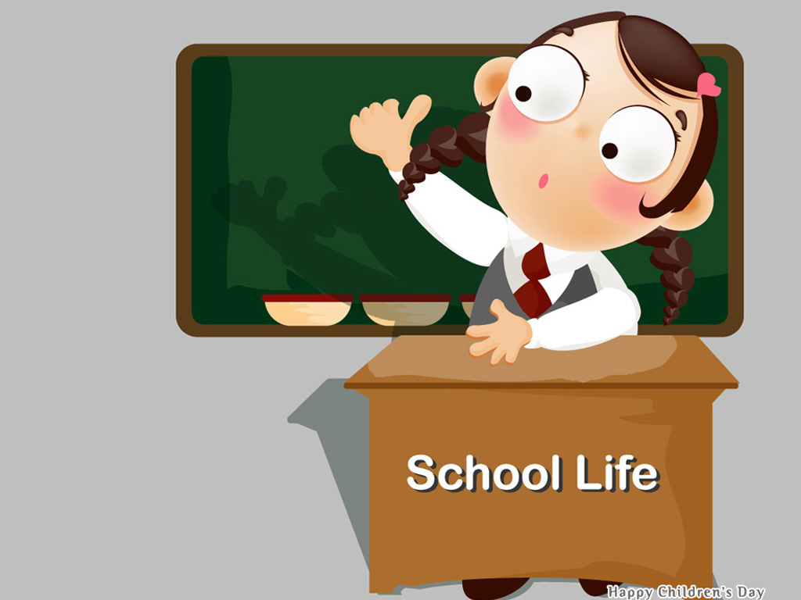
8A Unit 2
Integrated skills

Slide 2
Free talk
a Chinese school
Benniu Middle School
an American school
a British school
Rocky Mountain High School
Woodland School

Slide 3
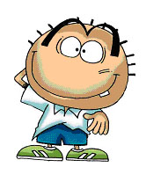
How much do you know about our school?
Benniu Middle School

Slide 4
Lead-in
About our school
1.How many students/ teachers/classrooms
are there in our school?
There are more than 1000/ 100/ 30.
(What’s the number of the students/ teachers/ classrooms?)
The number is 1000/ 100/ 30.
2.How long do you have our summer holiday?
About 8 weeks.
Have 8 weeks off.
3.How long do you spend on your homework every day?
…hours.
4.Do students wear uniforms?
Yes.
5.Do students do morning exercises?
Yes.

Slide 5
Lead-in
Benniu Middle School
Number of students
1000
Number of teachers
100
Number of classrooms
30
How long is the summer holiday?
8 weeks
How much time do students spend on homework every day?
… hours
Do students wear uniforms?
yes
Do students do morning exercises?
yes

Slide 6
our friends
Daniel
Sunshine Middle School (China)
Nancy
Woodland School (the UK)
John
Rocky Mountain High School (the USA)

Slide 7
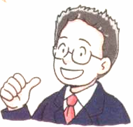
Task 1
Listen and complete the table.
Sunshine Middle School
Number of students
1,309
Number of teachers
90
How long is the summer holiday?
8 weeks
Listening tip （听力训练小提示）:Prediction 预测
How much time do students spend on homework every day?
3 hours
在做听力之前，我们可以尝试根据已有的信息和上下文语境来推测所缺内容。
Do students wear uniforms?
yes
Do students do morning exercises?
yes
Part A1

Slide 8
Schools Information | Sunshine Middle School | Woodland School | Rocky Mountain High School
 | 1,309
 | 90 | 66
 | 8 weeks
 | 3 hours
 | yes | /
 | yes | / | no
Number of students
308
1,215
Number of teachers
85
How long is the summer holiday?
6 weeks
12 weeks
How much time do students spend on homework every day?
2 hours
1 hour
no
Do students wear unifoms?
Do students do morning exercises?
A: What’s the number of students/teachers at _____School?
B: The number of ___________ is _________.
A: How long is the summer holiday at __________School? B: _________.
A: How much time do the students spend on homework every day at__ school?
B: __________.
A: Do students wear unifoms at __________ school ? B: _________.
Part A2

Slide 9
Task 2 Compare the three schools.
Schools Information | Sunshine Middle School | Woodland School | Rocky Mountain High School
Number of students | 1,309 | 308 | 1,215
Number of teachers | 90 | 66 | 85
Woodland School is smaller than Rocky Mountain High School. There are ________ teachers and _______ students at Woodland School than at Rocky Mountain High School. Sunshine Middle School has _____________ teachers and students of the three.
fewer
fewer
the most
Part A3

Slide 10
Schools Information | Sunshine Middle School | Woodland School | Rocky Mountain High school
How long is the summer holiday? | 8 weeks | 6 weeks | 12 weeks
How much time do students spend on homework every day? | 3 hours | 2 hours | 1 hour
Do students wear uniforms? | yes | / | no
Do students do morning exercises? | yes | / | no
Chinese students have__________ weeks off for the summer holiday than British students. British students spend________ time doing homework than Chinese students. Among the three schools, American students spend _________ time on homework, and they have _____________ summer holiday. Chinese students spend ___________ time on homework. They work ______________.
more
less
the least
the longest
the most
the hardest
Part A3

Slide 11
Compare schools
Schools Information | Sunshine Middle School | Woodland School | Rocky Mountain High School
Number of students | 1,309 | 308 | 1,215
Number of teachers | 90 | 66 | 85
How long is the summer holiday | 8 weeks | 6 weeks | 12 weeks
How much time do students spend on homework every day? | 3 hours | 2 hours | 1 hour
Do students wear uniforms? | yes | / | no
Do students do morning exercises? | yes | / | no

Slide 12
Task 3
A memory test
A
B
C
D
E

Slide 13
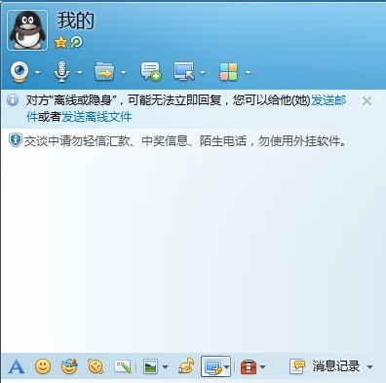
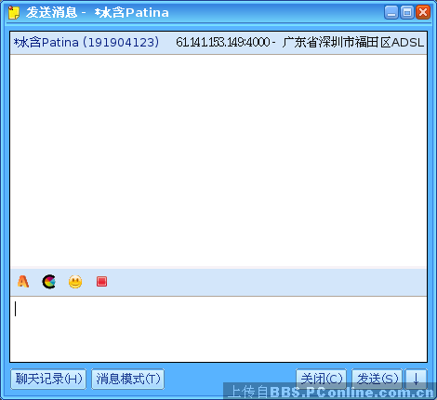
Find out who he/she is.
Nancy
_______ My school has fewer weeks off for the
summer holiday than Daniel’s .
Part A4

Slide 14
Find out who he/she is.
John
_______ Students at my school do not wear
uniforms.
Part A4

Slide 15
Find out who he/she is.
John
_______ I spend less time doing homework than
Nancy.
Part A4

Slide 16
Find out who he/she is.
Daniel
_______ My school has the most students .
Part A4

Slide 17
Find out who he/she is.
_______ My school has the fewest students .
Nancy
Part A4

Slide 18
Speak up
listen to the conversation
and answer the question
Who spends the most time on his hobbies?

Slide 19
Task 4 Listen and complete the table
Names | Hobbies | Time
Daniel |  | 1 hour
Millie | do some reading
Simon
Amy
play computer games and play chess
half an hour
sports
2 hours
half an hour
swimming

Slide 20
Task 5 Group work
Make a survey (every week)
Name | Hobbies | Time

Slide 21
Task 6 Report
Report
_____________________________________________________________________________________________________________________________________________________________________________________________

Slide 22
词组翻译
1学生的数量
2穿校服
3花...时间做...
4做早操
5休息几天
6至多
7读书，阅读
8有一个小时做...
1the number of students
2wear school uniforms
3spend...on/doing sth
4.do morning exercises
5have a few days off
6at most
7do some reading
8have an hour for sth
have an hour to do sth

Slide 23
Keep a balance between hobbies and school work! Have a happy school life.

