Slide 1
8A Unit 2
School life
Reading （I）
LIFE

Slide 2
Free talk
1
What is the name of your school?
点击添加文本
What is your favourite subject, why?
2
Do you like sports? What is it? How often do you do it?
3
点击添加文本
4
Are there any clubs in your school?What are they?
点击添加文本
5
What activities are there in your school?
点击添加文本
6
What do you think of your school life?

Slide 3
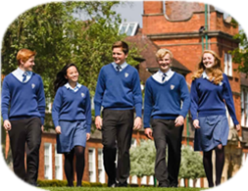
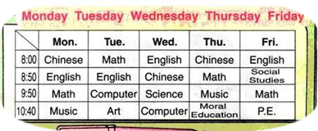
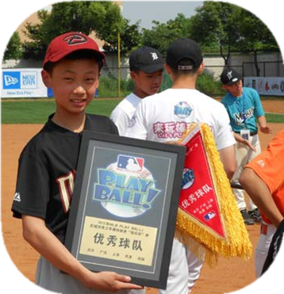
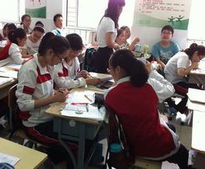
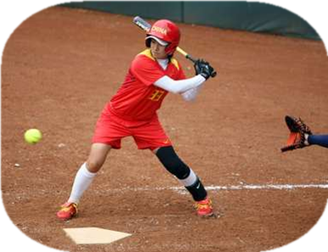
Pre-reading
foreign
language
mixed
['fɔrin]
['fɔrən ]
点击添加文本
['læŋɡwɪdʒ]
Colourful
school life!
French
点击添加文本
offer
点击添加文本
[wɪn]
discuss in class
win
点击添加文本
[dɪ'skʌs]
won
baseball
buddy

Slide 4
Pre-reading
discuss
offer
win
foreign
language
a. talk about something
b. give something to someone
c. be best or first in a competition
d. not in or from your own country
e. words used in speaking and writing

Slide 5
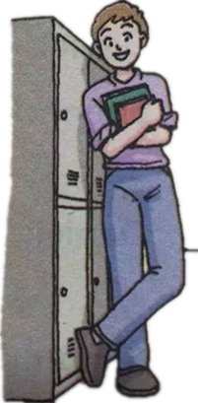
Guess before skimming
Nancy
John
点击添加文本
grade ?
grade ?
点击添加文本
点击添加文本
school ?
school ?
Where do they come from?
2. What subject may Nancy like best?
点击添加文本

Slide 6
Skim the 1st paras. of each passage.
Nancy
John
点击添加文本
in the 8th
grade
grade ?
grade ?
in Year 8
点击添加文本
['rɔki]
['wud,lænd]
点击添加文本
Rocky Mountain
High School
Woodland School
school ?
school ?
点击添加文本

Slide 7
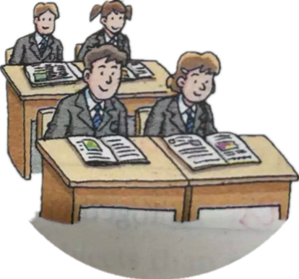
Guess before Scanning
Life in a British school
What may the second Para. be about ?

Slide 8
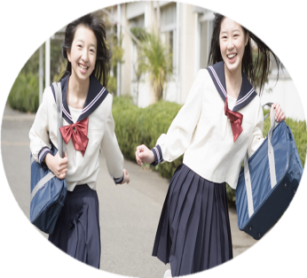
the Reading Week
When:
What:
every year
borrow more books from the school library
bring in books and magazines from home
discuss the books with the classmates in class

Slide 9
Do you know?
(Choose ‘T’ or ‘F’)
In a mixed school, boys and girls have lessons together.
Nancy’s favourite subject is English.
Students at Nancy’s school can read magazines during the Reading Week.
Students must not discuss in class near the end of the Reading Week.
T
French
F
T
can
F

Slide 10
British school life
N’s favourite subject
the Reading Week
borrow… from..
French
Nancy’s
school life
bring in…and… from
Learning foreign
lanuages is fun.
near the end of..
discuss… with…

Slide 11
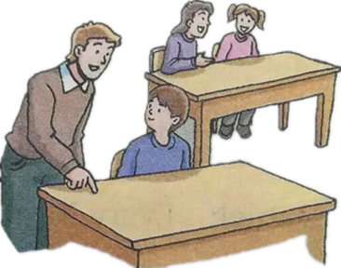
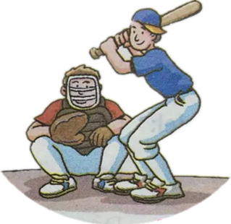
American school life
Guess before listening
John
help…do…
play baseball

Slide 12
the Buddy Club
(Listen & then finish)
What to do in the club
Who is John’s buddy
How to help
Old students help new students learn more about the school.
Tony
listen to the problems carefully and offer help
others
1. How often does John play baseball ?
√
A. Once a week.
B. Twice a week.
C. Once a month.
2. When does the school end earlier than usual ?
√
A. Monday.
B. Wednesday.
C. Friday afternoon.

Slide 13
John's school life
John has different classes every day.
Friday
Monday
点击添加文本
Tuesday
Thursday
Wednesday
school ends earlier
点击添加文本
the Buddy Club
do sports
点击添加文本
play baseball after school
点击添加文本
Tony is in grade 12.
Tony is John’s hero.

Slide 14
Post-reading
Compare their school lives.
Who | Nancy | John
Where
What
when
Why
Woodland School,
near London
Rocky Mountain High School,near Denver
the buddy Club/do sports/baseball
French/ the Reading Week
every Monday/Friday
afternoon/twice a week
every year
Learning foreign languages is fun./They can borrow more books from the school library,or bring in books and magazines from home.
Older students help new students learn more about the school./ Their school ends earlier than usual./He loves the game.

Slide 15
Who is the winner?
( Have an interview with John/Nancy) .
(One student in each team acts as John / Nancy. Other members ask him / her any question about the school life.)
Teams 6-9
Teams 1-5

Slide 16
Chinese school life

Slide 17
Talk about your school life
Life in a Chinese school
Name: __________________________
Grades:__________________________
Subjects:_________________________
Clubs/activities:____________________
Other information:______________
_________

Slide 18
Conclusion
American school life
British school life
Chinese school life
LIFE

Slide 19
Advice to all of you!
Enjoy the school life,
grow up in the school life!
享受校园生活，
成长于校园生活。
LIFE

Slide 20
Homework
To all:
1. Try to read the text fluently.
2. Finish some of the exercises about “Reading”.
Choose:
3. Try to recite the text.

Slide 21
Ｔｈａｎｋ ｙｏｕ！
LIFE

