Slide 1
Unit 3 A day out
Grammar

Slide 2
Revision:
为什么不邀请那对双胞胎一起看篮球比赛呢？
Why not invite the twins to watch
____________________________________ the basketball match?
她每天花两小时时间读书。
She spends 2 hours reading books every day.=
It takes her 2 hours to read books every day.
昨天我们到达了上海。
We got to Shanghai yesterday
We arrived in Shanghai yesterday.
We reached Shanghai yesterday.

Slide 3
做完作业，丹尼尔迫不及待打开电脑。
这条街道有多宽？ 20多米。
couldn’t wait to turn on the computer.
After finishing homework, Daniel_____________________
How wide is the street? It’s more than 20 metres wide.
我们学了/解了很多关于不同的文化。
We learned a lot about different cultures.
南京有很多景点。
There are many places of interest in Nanjing.

Slide 4
Read it more carefully and fill in blanks
I was very happy that day because my teacher Mr Wu ______ my cousin Linda to _____ in our school trip. At first we felt _____ because there was heavy _____ on the way. Finally we______ at the World Park. When we saw the Eiffel Tower, we became________. In the World Park, there were models of over a hundred places of ______ from all over the world. We also saw the song and dance_____. We really enjoyed _________ on that _________day.
After our trip, Daniel _____ a home page on the Internet. He put his photos on it.
invited
join
boring
traffic
arrived
excited
interest
shows
ourselves
amazing
put

Slide 5
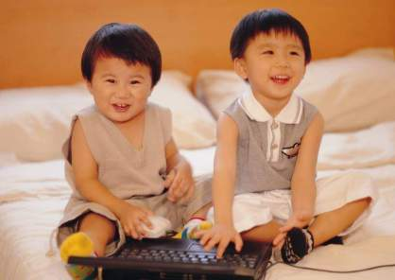
May
Lili
Lili is five years old.
May is five years old, too.
Lili is as old as May.

Slide 6
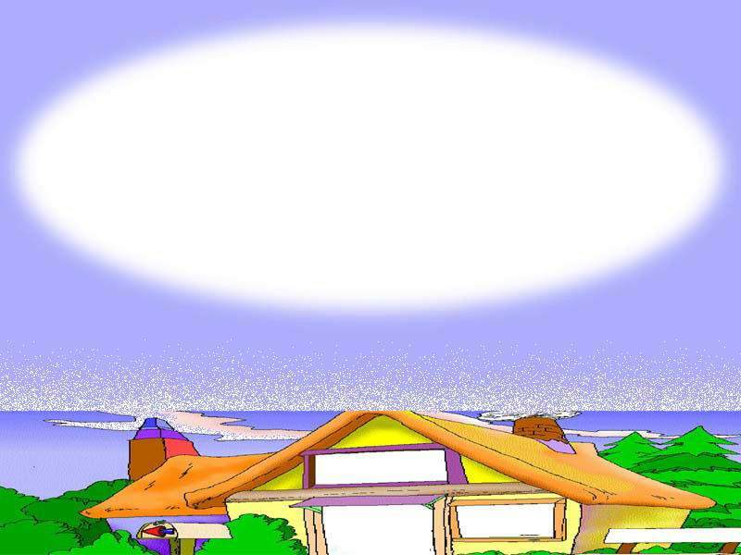
“(not) as” + adjective + “as”

Slide 7
A profile of Daniel’s classmates
 | Millie | Sandy | Amy | Peter | Kitty | Simon
Height (cm) | 150 | 160 | 160 | 161 | 150 | 161
Weight (kg) | 44 | 45 | 44 | 45 | 40 | 40
English test | 8/10 | 10/10 | 8/10 | 7/10 | 10/10 | 7/10
Millie is as tall as Kitty.
Amy is as heavy as Kitty.
Sandy’s English is as good as Kitty’s.
Notes:
Grammar C
Part One Lead-in （拍摄用时1.5分钟）
T: Just now, we compared Daniel’s classmates with each other in many ways using comparatives and superlatives.
（刚才我们运用形容词的比较级和最高级对Daniel的同学在许多方面进行了比较。）
T: But actually, some of them are the same in some ways. Now look at the profile again, what can you find?
（但是，实际上他们中的一些人在一些方面是相同。现在请再看这张档案表，你能发现什么呢？）
S: Millie和Kitty一样……。
T: Millie is 1.50 meters tall. Kitty is also 1.50 meters tall. So, we can say ‘Millie is as tall as Kitty’.
In the same way, we can find ‘Amy is as heavy as Kitty.’ Sandy’s English is as good as Kitty’s. (分别给出汉语)

Slide 8
1. 李雷和我年龄一样大。
Li Lei is as old as I.
2. 这本书和那本书一样有趣。
This book is as interesting as that one.
3. 你和你弟弟一样高。
You are as tall as your brother.
4. 游泳和滑雪一样危险。
Swimming is as dangerous as skiing.

Slide 9
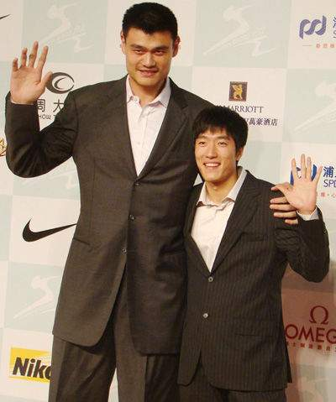
Liu Xiang is shorter than Yao Ming.
Yao Ming is taller than Liu Xiang.
Liu Xiang is not as tall as Yao Ming.

Slide 10
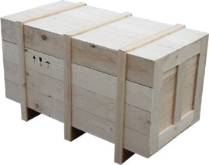
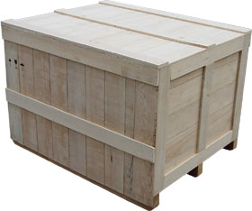
100kg
500kg
This box is not as heavy as that one.

Slide 11
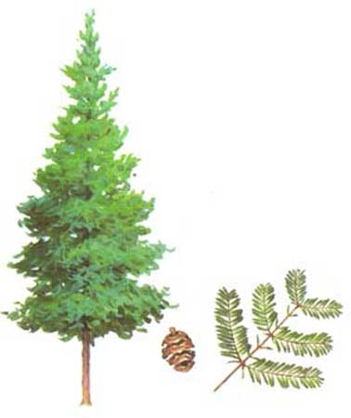
not as big as
This tree is ______________ that one.

Slide 12
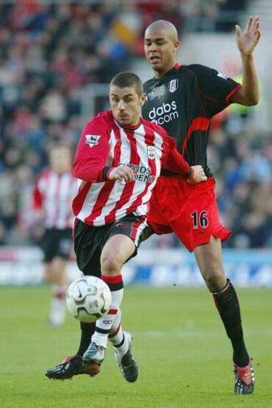
David
Daniel is shorter than David.
Daniel is not as tall as David.
Daniel

Slide 13
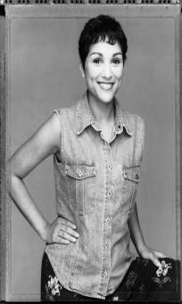
Jack
Jim is thinner than Jack.
Jack is fatter than Jim.
Jim
Jim isn’t as fat as Jack.

Slide 14
1. 我不如他强壮。
I am not as strong as he.
2. 凯特不如她妹妹漂亮。
Kate is not as beautiful as her sister.
3. 游泳不如爬山有趣。
Swimming is not as interesting as climbing.

Slide 15
Linda is sending some pictures to her parents via email. Complete her sentence under each picture with as … as or not as … as.

Slide 16
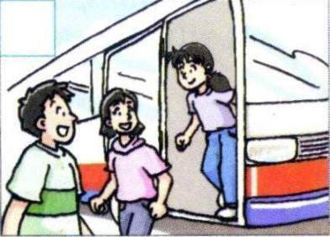
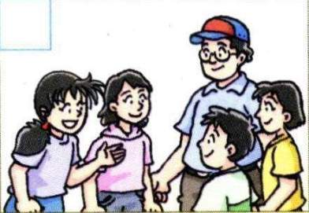
The bus is ________________ (comfortable) those in the USA.
Mr Wu is _________ (kind) a friend.
as comfortable as
as kind as

Slide 17
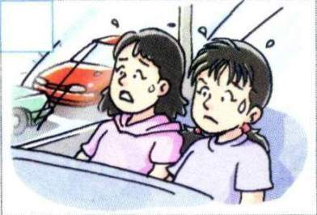
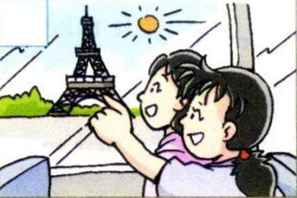
The journey is _________________ (not interesting) the visit .
The Eiffel Tower is ___________ (not tall) the real one in France .
not as interesting
as
not as tall as

Slide 18
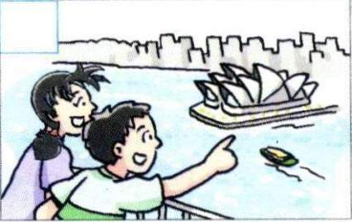
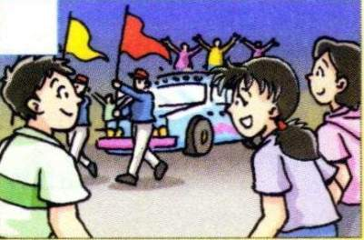
The model Sydney Opera House looks ___
___________ (wonderful) that in Australia .
The song and dance shows are _________ (good) the models in the park .
as
wonderful as
as good as

Slide 19
拓展 :
V(实义动词)+ as +adv. +as
1. He drives as __________ (care) as Sandy.
2. He draws as __________ (good) as I.
3 昨天，Lucy和你跑得一样快吗？
4 在班上，谁做作业和你一样细心？
as ......as someone can
as much +不可数名词+ as you can , as many +可数名词+ as he can ,
尽可能多 尽可能多
as possible as you can 尽可能地
as .....as possible 尽可能地......
as often as possible , as much as possible , as carefully as possible,
as soon as possible
carefully
well
Did Lucy run as fast as you?
Who does homework as carefully as you?

Slide 20
B:Reflexive pronouns
反身代词

Slide 21
We make sentences using reflexive pronouns like this.
Personal pronouns | Verb | Reflexive pronouns
I | enjoy | myself.
You |  | yourself.
You |  | yourselves.
We |  | ourselves.
They |  | themselves.
He | enjoys | himself.
She |  | herself.
It |  | itself.

Slide 22
Personal pronoun （人称代词） | Reflexive pronoun （反身代词）
I
You
He
She
It
We
You
They
myself
yourself
himself
herself
itself
ourselves
yourselves
themselves

Slide 23
. 反身代词也可用来加强语气，作主语或宾语的同位语，译作“亲自，本人”等。
主语的同位语，则反身代词可
移至句末。
你见过王先生本人吗？
Did you see Mr Wang himself?
我们自己煮了晚饭。
We ourselves cooked the dinner.
= We cooked the dinner ourselves.

Slide 24
要注意与反身代词相关的一些固定搭配，像enjoy oneself (=have a good time)，by oneself (=alone)等。
他独自一人住在乡下。
He lives by himself in the country.
我希望你能在晚会上玩的愉快。
I hope you can enjoy yourself at the party.

Slide 25
look after oneself
take care of oneself
hurt oneself dress oneself
make … by oneself
help oneself to…
look at oneself in a mirror
teach oneself = learn … by oneself
buy … for oneself

Slide 26
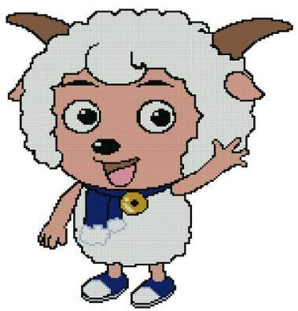
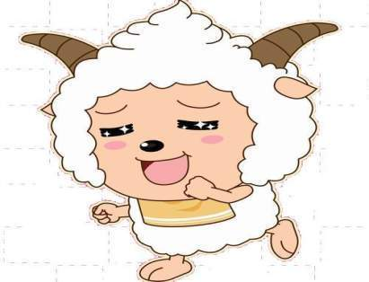
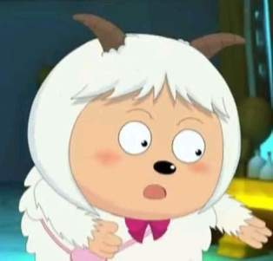
Help us!
Xiyangyang
Lanyangyang
Meiyangyang
Feiyangyang
Nuanyangyang

Slide 27
There is less and less water and grass. All the other sheep should look after __________ (they) well, just like me.
themselves

Slide 28
I am too full, because I had 5 kilos of grass just now. Well, please keep the secret to _______ (we). Don’t tell others.
ourselves
keep the secret to oneself

Slide 29
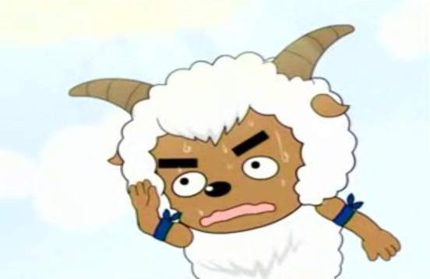
Just now a man called Mr. Wolf wanted to teach ________ (he) to ride a horse, but he fell off. It’s so funny!
himself
teach oneself to do sth.
learn to do sth. by oneself

Slide 30
Welcome to my home, and please help __________ (you) to some milk and grass, my dear friends.
yourselves
help oneself to sth.

Slide 31
A beautiful girl asked me to carry a heavy box for her. Why can't she do it by _______ (she)? Do I look so strong?
herself

Slide 32
What happened at South Hill?
The students are at South Hill. Read about Linda and Simon’s secret. Complete the sentences with the correct reflexive pronouns.

Slide 33
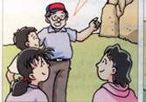
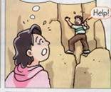
Guide: You can go and enjoy _________
now.
Linda: Oh no! Simon is trying to pull ______ up the rocks.
yourselves
himself

Slide 34
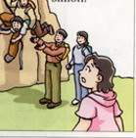
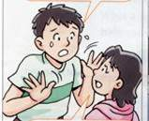
Simon: Please don’t tell anybody about this, Linda.
Linda: OK, I won’t. You’re lucky you didn’t hurt _______!
Luckily, some climbers helped Simon.
yourself

Slide 35
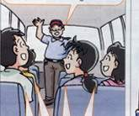
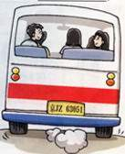
Guide: Did you all have a good time?
All: Yes, we did. We really enjoy ________!
Simon and Linda looked at each other. They kept the secret to __________.
ourselves
themselves

Slide 36
Reflexive pronouns
（反身代词）
We use reflexive pronouns when the subject and
the object are the same person.
当主语和宾语是同一个人时，我们可以使用反身代词．
eg.
1.Daniel taught himself how to learn English.
2.She enjoys herself.

Slide 37
Let's have a try!
ourselves
1) We taught ________(we) to ride a horse.
2) Some people there taught ______ (we) to ride a horse.
We
us
Some people
The guide
us
3) The guide (导游）looked after _______ (we) well.
4) We could look after ________ (we) well.
5) Mr. Li fell off the horse and hurt ________(he).
6) Mr.Li fell off and the horse hurt ________(he)
We
ourselves
Mr. Li
himself
the horse
him

Slide 38
用适当的反身代词填空。
1. The students of Class Two enjoyed _________
very much in the World Park.
2. Mary, don’t always think of ________.
3. At the weekend, I ______ often cook meals.
4. When she was in the middle school, she began
to teach ______ English.
5. He fell off the bike and hurt ______ yesterday
when he went home.
themselves
yourself
myself
herself
himself

Slide 39
6. In autumn, the leaves on the trees dropped
off __________.
7. Can she do it ______ or does she need help?
8. Please help _________ to some apples and
make _________ at home, children.
9. They wanted to keep their secrets to
__________, but they were wrong. We all
know about it.
10. The little cat can’t catch the mice by _____.
themselves
herself
yourselves
yourselves
themselves
它自己
itself

Slide 40
选择
( )1. Those girls enjoyed ____ in the party last night.
A. them B. they C. themselves D. herself
( ) 2. Help ____ to some fish, children.
A. yourself B. your C. yours D. yourselves
( ) 3. The film ____ is very fun.
A. it’s B. itself C. it D. its
( ) 4. –Who teaches ____ math? –I teach ______.
A. your, myself B. you, myself C. you, me D. you, herself
( ) 5. The father will make ____ a bike ____.
A. her, himself B. she, himself C. her, herself D. she, herself
C
D
B
B
A

Slide 41
( ) 6. The scarf is ____, she made it_____.
A. herself, her B. herself, hers C. hers, herself D. her, herself
( ) 7. Liu Hulan’s death was great. She thought more of others than ______.
A. her B. she C. hers D. herself
( ) 8. Luckily, he didn’t hurt ____ terribly yesterday.
A. him B. themselves C. himself D. they
( ) 9. I can’t mend my shoe _____. Can you mend it for ?
A. myself, me B. myself, I C. me, I D. I, me
( ) 10. I like watching in the mirror.
A. me B. I C. my D. myself
C
D
C
A
D

Slide 42
Homework
1. Review Grammar and make
some sentences with ‘(not) as …as’
and reflexive pronouns. (at least 10)
2. Finish the exercise in Learning
English.
3. Preview Integrated skills on Page 37-38.

Slide 43
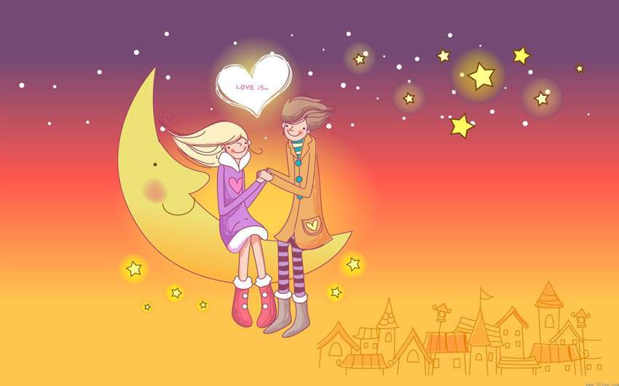
Thank you
Goodbye

