Slide 1
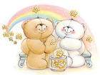
Unit 1
Friends
Integrated skills

Slide 2
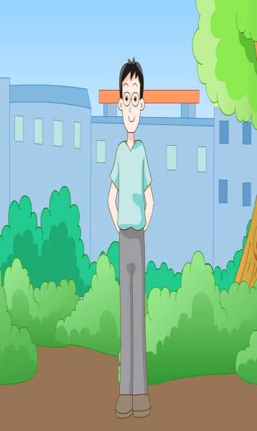

Slide 3
1.She is willing to share things with her friends .
2.I never feel bored with him.
3.She helps me with my homework.
4.She never says a bad world about anyone.
5.He wears small round glasses,they make him look smart.
6. He has a good sense of humour.
7. They do not fit well under his desk.

Slide 4
1.Max is one of my _______(good) friends.
2.Who is ____________(short),Betty,May or Max?
3.Betty is _______________(beautiful) than Max.
4.Max is ______________(heavy) of the three.
5.Max is ___________(tall) boy in his class.
6.Among the three friends,Betty sings ____(well)?
best
the shortest
more beautiful
the heaviest
the tallest
best

Slide 5
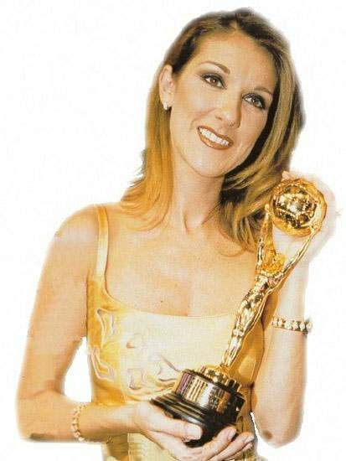
Celine Dion
a famous and popular singer
travel around the world
meet different people
make people happy

Slide 6
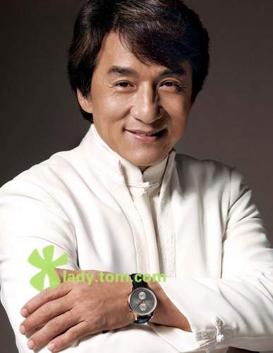
Guess who he is.
1、come from Hong Kong
2、a singer
3、an actor（演员）
4、be good at Chinese
Kung Fu
Jacky Chan

Slide 7
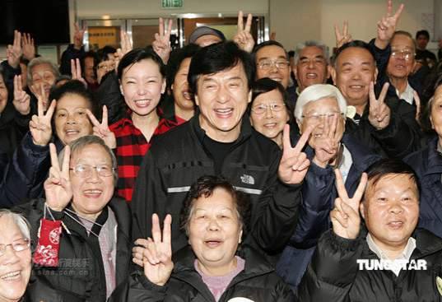
a social worker （社工）
listen to people’s
problems
help people with problems

Slide 8
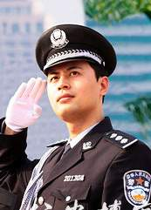
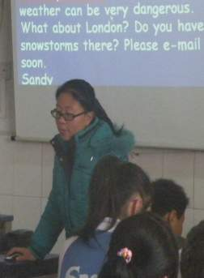
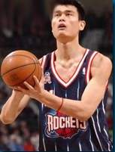
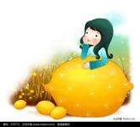
What would you like to be/do when you grow up?
why?

Slide 9
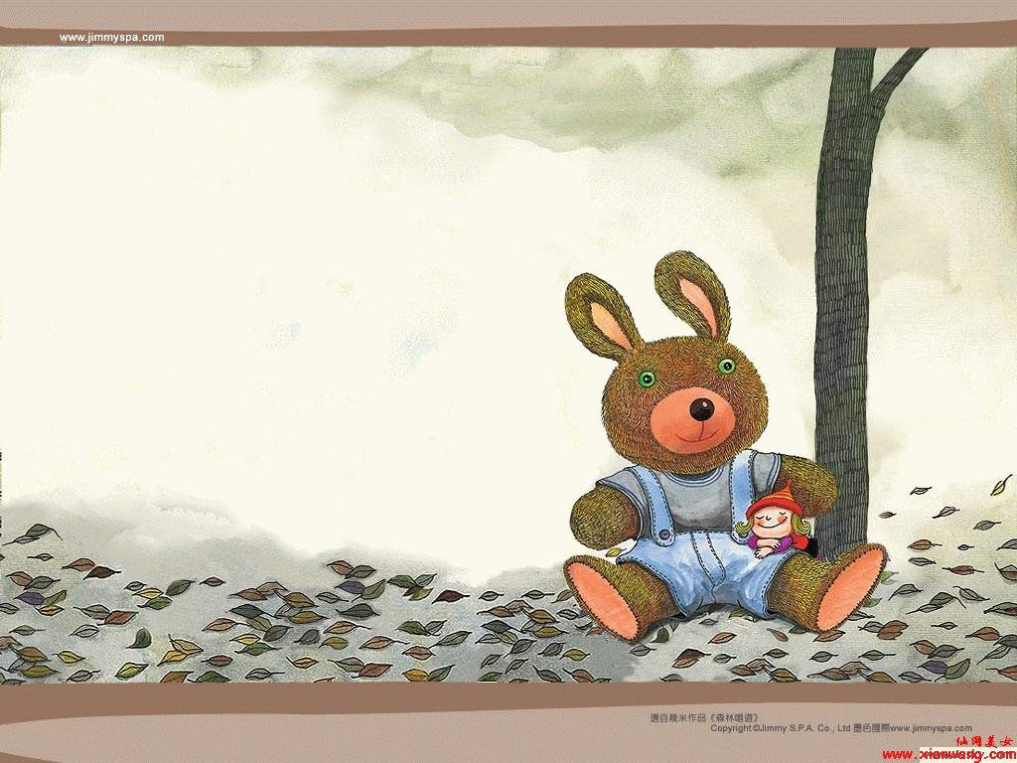
Listen to the conversation between Nora and Amy
what Nora would like to do in the future.

Slide 10
Part A1 Put a tick (√) in the correct boxes.
I would like to …
be an artist
be famous
meet different people
make friends
listen to people carefully
help people with their problems
make people happy
travel around the world
√
√
√
√
√

Slide 11
Part A2
Nora is writing about her future plans in her diary. Help Nora complete her diary entry.
Dear Diary,
Today Amy and I talked about our future plans. I would like to be a social worker when I grow up .I am always kind to people.I have many frineds at school.I like to _____a lot of people and make ________ with them.I can _______to people carefullyand help them with their_________. I will be happy if I can make other people______.
meet
friends
listen
problems
happy

Slide 12
Part A2
Dear Diary,
Today Amy and I talked about our future plans. I would like to be a social worker when I grow up .I am always kind to people.I have many frineds at school.I like to meet a lot of people and make friends with them.I can listen to people carefully and help them with their problems . I will be happy if I can make other people happy.

Slide 13
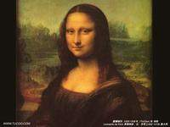
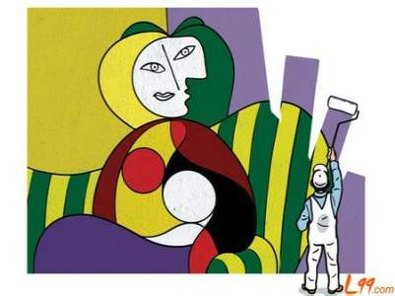
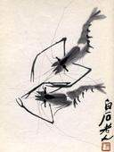
^{Works of art}
Qi Baishi
shrimp and crab
Leonardo da Vinci Italian
Picasso
Spanish painter

Slide 14
Part A3
Sandy is writing about her future plans in her diary too.Listen to her conversation with ,answer the questions.
1.What does she love doing?
2.Who does Sandy like best among all the Chinese artists ?
3.What does Sandy want to do in the future?
She loves drawing.
She likes Xu Beihong best.
He wants to travel around the world and learn more about art some day.

Slide 15
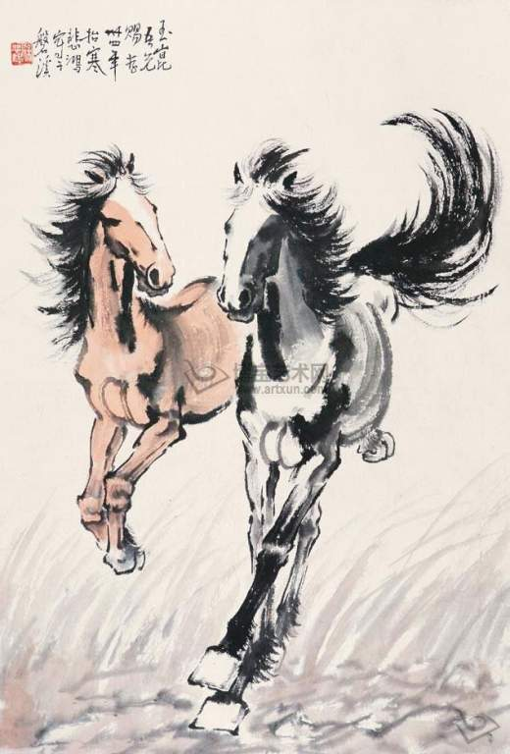
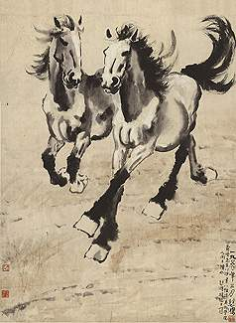

Slide 17
Part A3 Help Sandy complete her letter.
Dear Diary,
I love drawing and I would like to be _________ when I grow up.
Among all the Chinese artists, I like __________best. His pictures of ______are beautiful works of art. I want to be as _______as he is .
I want to travel around the world and learn more about ______some day.
an artist
Xu Beihong
horses
famous
art

Slide 18
Suppose(假设)you are a news reporter(记者). Interview Nora or Sandy about their
future plans.
Interview
(采访)
A: Hello, I’m a reporter from CCTV. May I ask
you some questions?
B: Sure. …
A: What would you like to do when you grow up?
B: I’d like to…/ I hope/want to…/ I’m willing
/ready to …
A: Why...?
B: Because I like/ can…
A: What would you do if you are …
B: I want / hope to…
A: It’s great to…
B: Thank you for …

Slide 19
Speak up:
What’s he like?
Sandy and Helen are talking about their friends.

Slide 20
Listen to the tape and answer the questions.
Who is the boy on the left?
2. What is he like?
3. Who’s the girl next to peter?
4. What is Lucy like?
Peter.
clever and humoroust.
Lucy,small girl with a ponytail.
Shy and quiet.

Slide 21
Talking about friends
A: Who is the boy …?
B: Oh, this is … I think he looks …
A: Yes, I agree.
B: He is … in my class.
A: What’s he like?
B: He’s …. He’d like to be … when he grows up.
A: Who is the girl …?
B: She’s…

Slide 22
Say something about your friend’s future plans
Hello, I am ...
My good friend is…
He/She would like to …when he/she grows up.
He/She wants to be ... in the future.
He/She hopes to …
He/She thinks it is great to …
2幻灯片 31
4
幻灯片 301
3

Slide 23
Our futures are not dreams, we should try hard .

Slide 24
Homework:
1.Try your best to remember the new words and phrases.
2.Write a diary about your future plains.
3.Preview next lesson.

Slide 25
Thank you !

Slide 26
She is slim and has short hair.
She is willing to share things with her friends .
She is helpful and ready to help people any time.
She helps me with my homework.

Slide 27
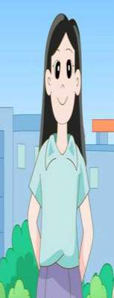
She has big bright eyes and long straight hair .
She smiles often and never says a bad world about anyone.
She is a true friend because she can keep a secret.

Slide 28
He wears small round glasses,they make him look smart.
They do not fit well under his desk.
He has a good sense of humour. I never feel bored with him.
When he walks pasts desks,he often knocks books and pens onto the floor.

