Slide 1
Unit 5 Wild animals
Task

Slide 2
Discussion
What can we do to protect wild aimals?

Slide 3
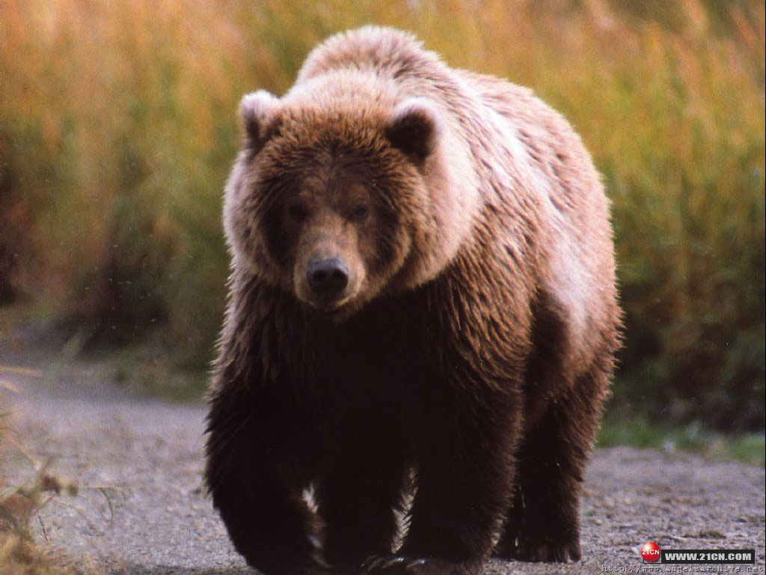

Slide 4
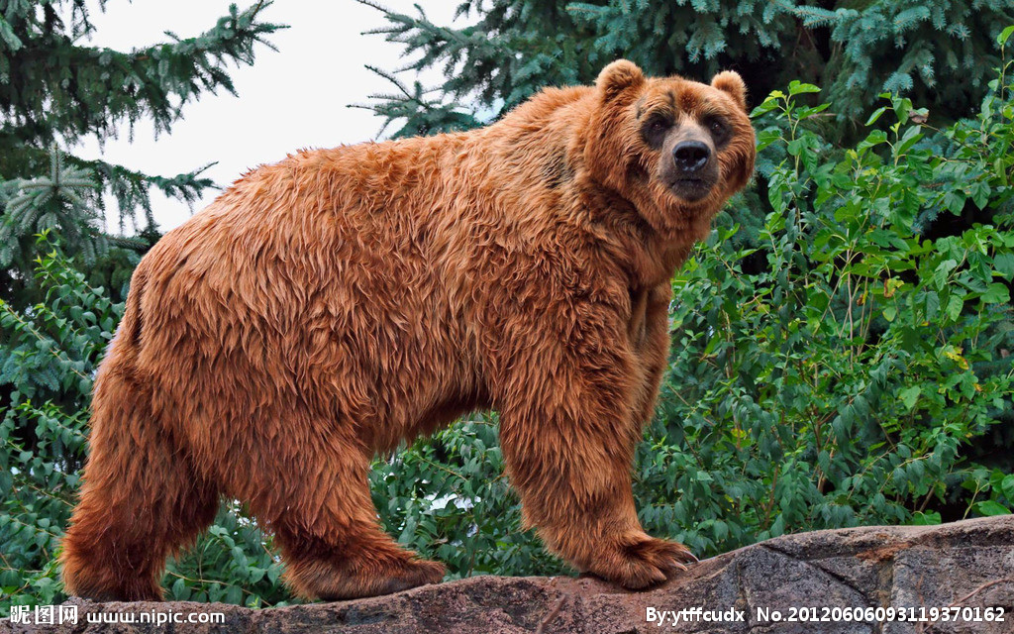
Looks
big and heavy
short tail
large body
short and strong legs
large paws

Slide 5
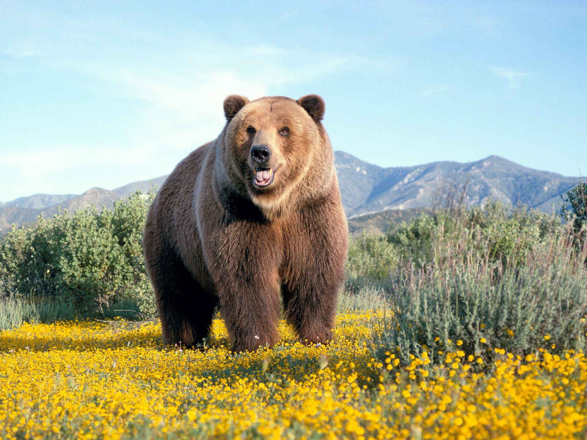
Food
meat and fish
plants and insects

Slide 6
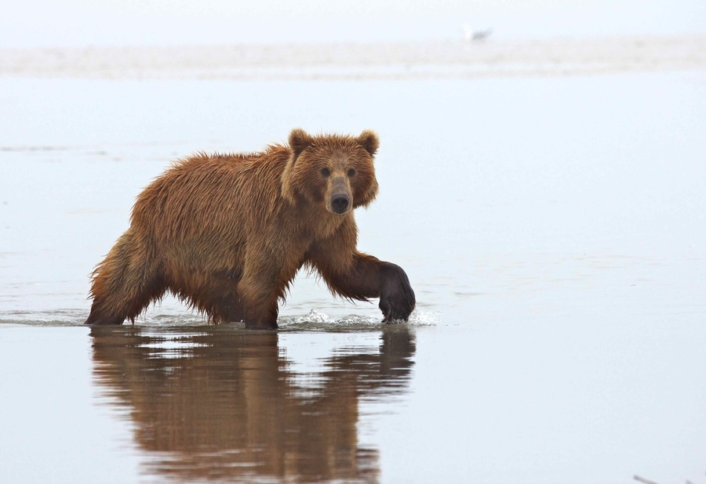
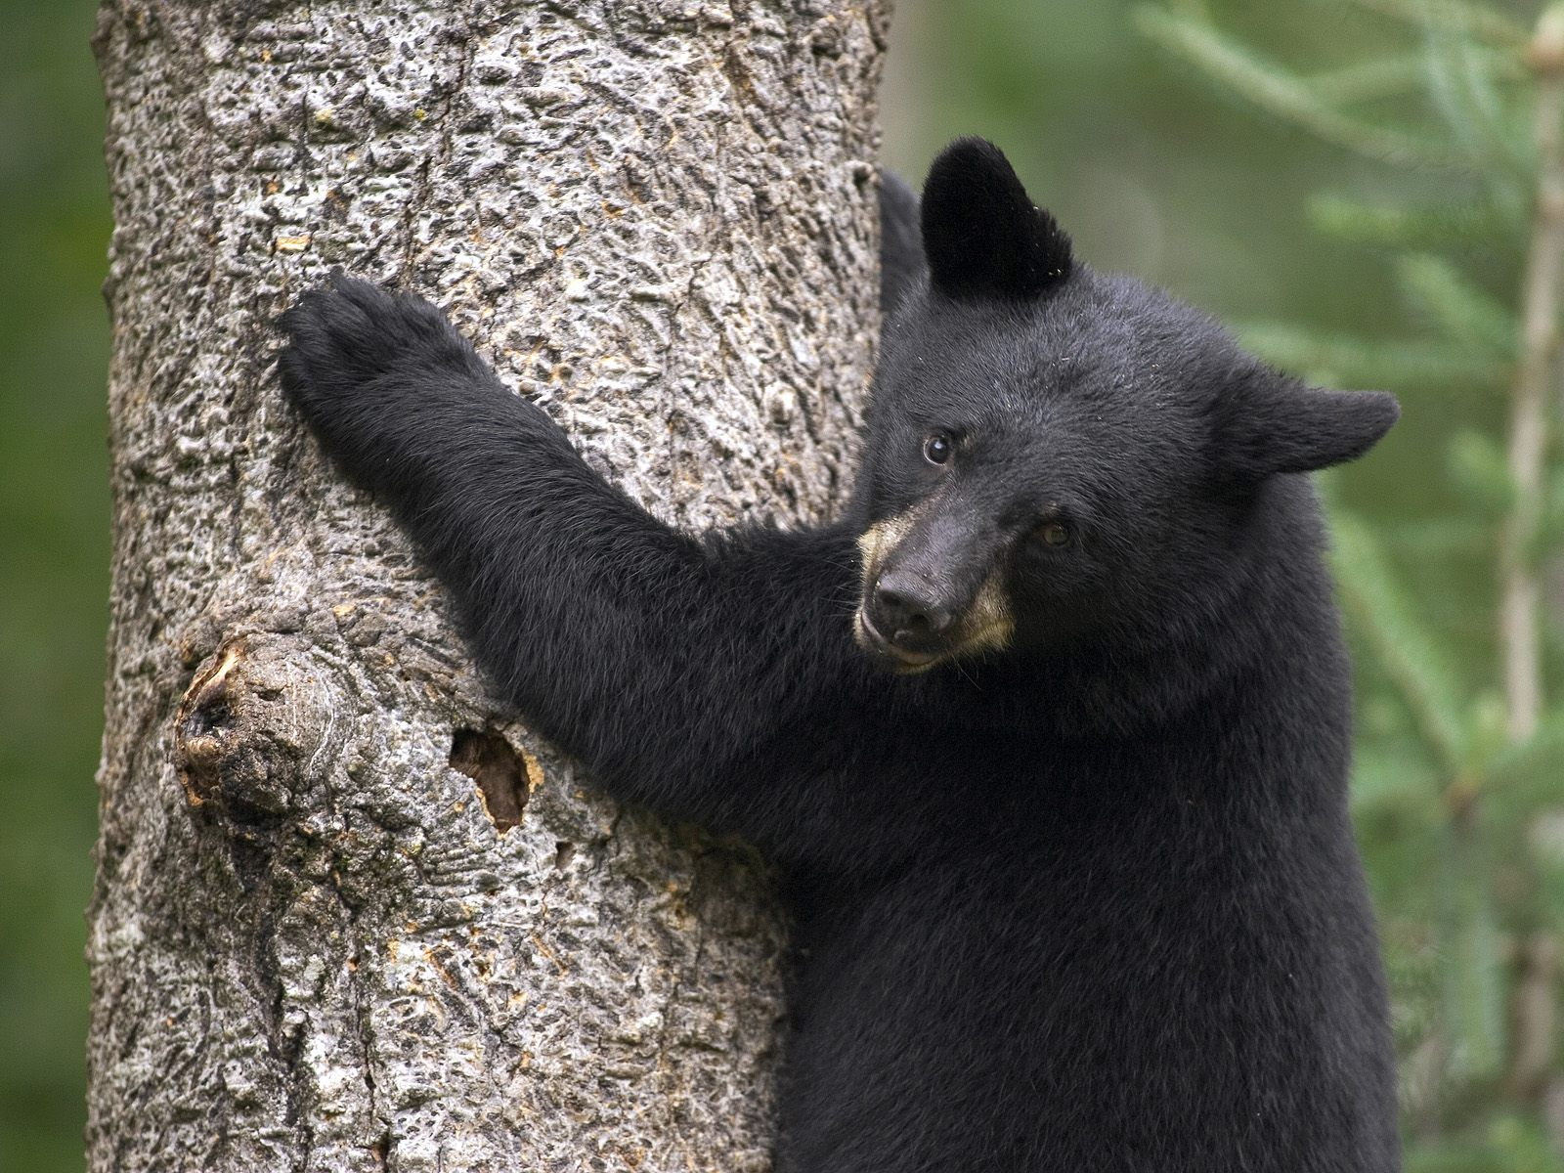
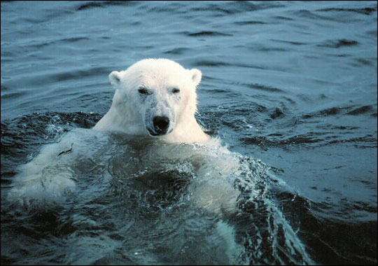
Abilities
run very fast
climbing
swimming

Slide 7
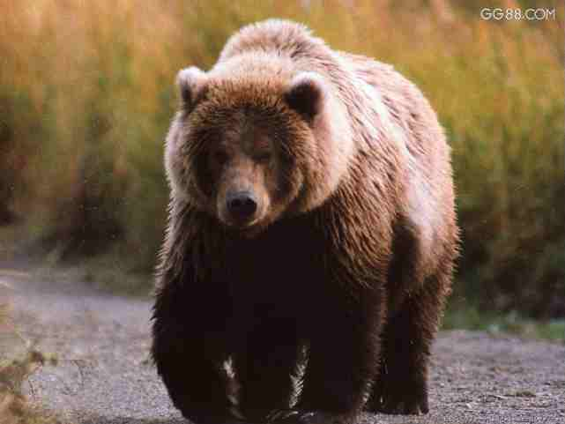
Qualities
move around slowly in the daytime
sleep through the winter
seldom hurt people

Slide 8
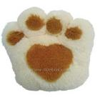
Danger
Hunters catch them for their fur and paws.

Slide 9
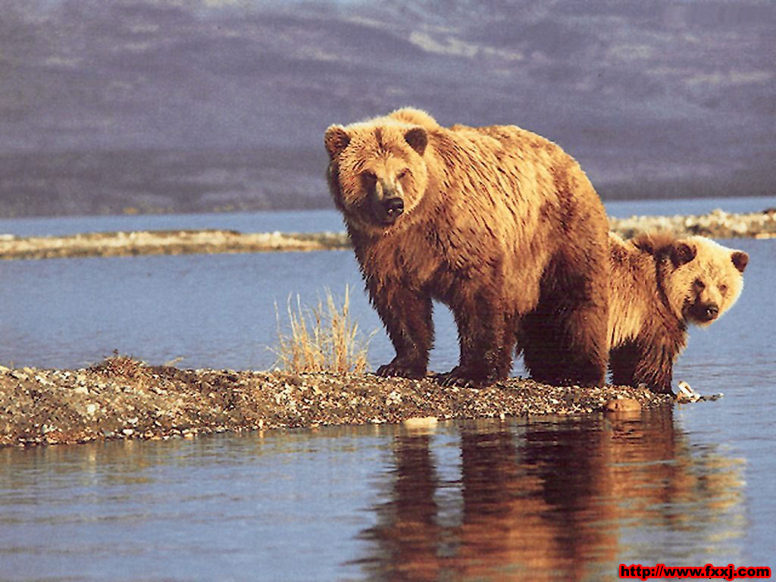
Bears are in danger!

Slide 10
help wild animals in danger

Slide 11
A report on bears
Looks
Food
Abilities
Qualities
big and heavy, large body, short and
strong legs, large paws, short tail
most eat meat and fish,
some also eat plants and insects
can run very fast;
good at climbing and swimming
move around slowly in the daytime, sleep through the winter, seldom hurt people
Danger
hunters catch them for their fur and paws

Slide 12
Help Simon complete his report.

Slide 13
Bears are in danger!
Bears are big and (1) . They have large body, short and (2) legs and large paws. Their tails are (3) .
Most bears eat meat and (4) , but some also eat plants and (5) .
Bears can (6) . They are good at
(7) and (8) .
Bears move around in the daytime. They sleep through (9) . They (10) hurt people.
Sadly, many hunters catch bears for their
(11) and (12) . We should take action to stop this. Otherwise, there may be no bears left in the world.
heavy
strong
short
fish
insects
run very fast
climbing
swimming
the winter
seldom
fur
paws

Slide 14
Bears are in danger!
Title
Bears are big and (1) . They have large body, short and (2) legs and large paws. Their tails are (3) .
Most bears eat meat and (4) , but some also eat plants and (5) .
Bears can (6) . They are good at
(7) and (8) .
Bears move around in the daytime. They sleep through (9) . They (10) hurt people.
Sadly, many hunters catch bears for their
(11) and (12) . We should take action to stop this. Otherwise, there may be no bears left in the world.
heavy
strong
short
Looks
fish
insects
Food
run very fast
climbing
swimming
Abilities
the winter
seldom
Qualities
fur
paws
Danger

Slide 15
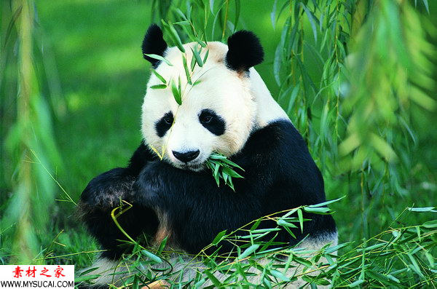
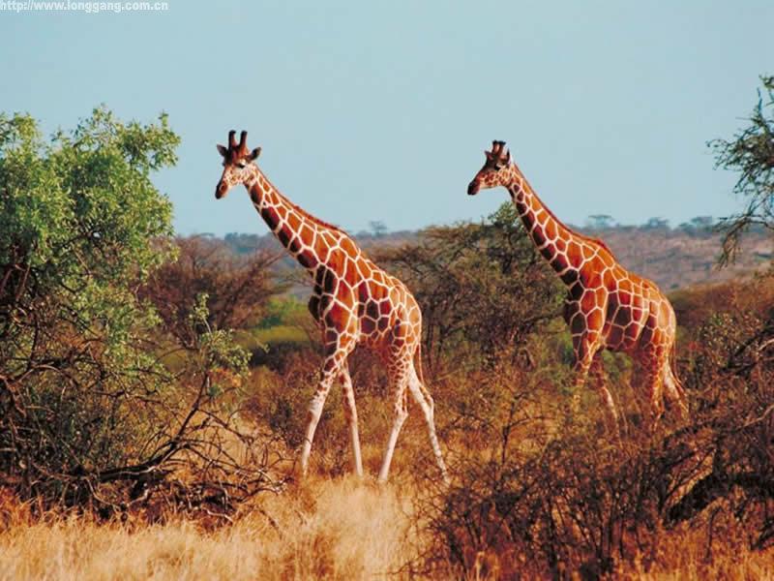
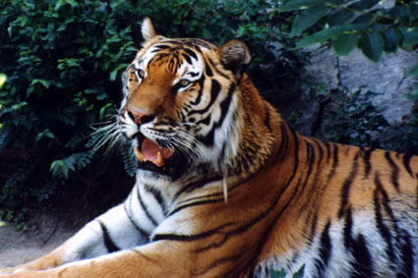
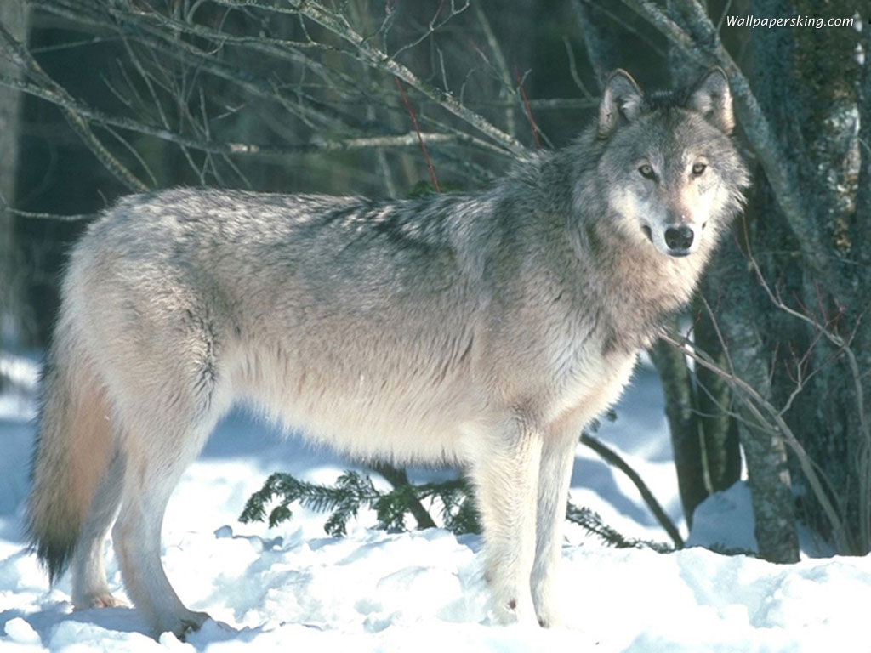
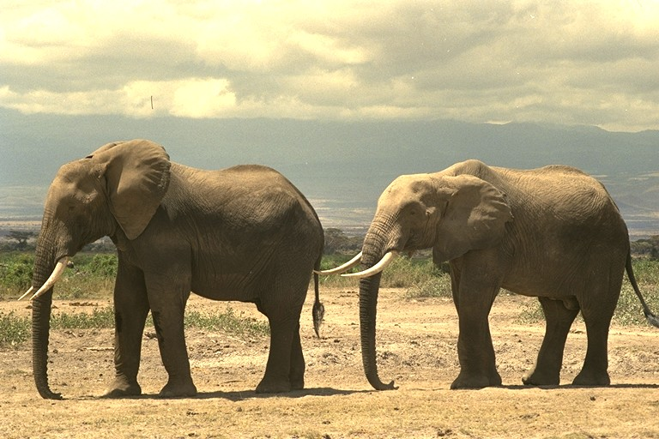
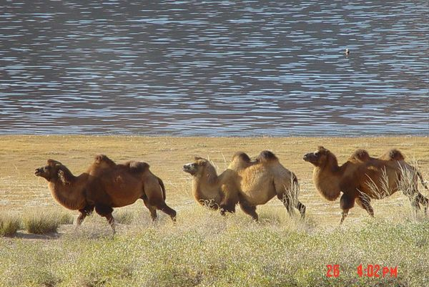
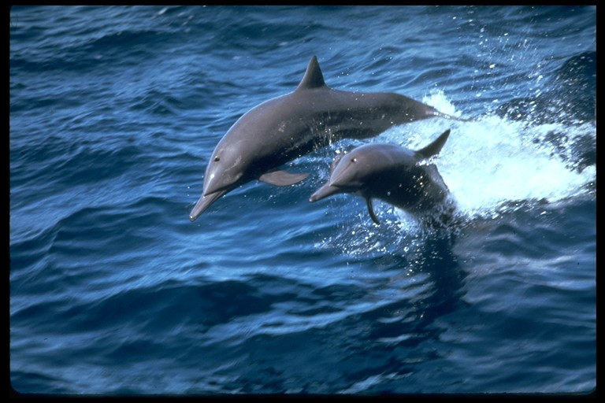
Write a report
are in danger!

Slide 16
Share your report
______ are in danger!
________________________________________
________________________________________
________________________________________
________________________________________
________________________________________
________________________________________

Slide 17
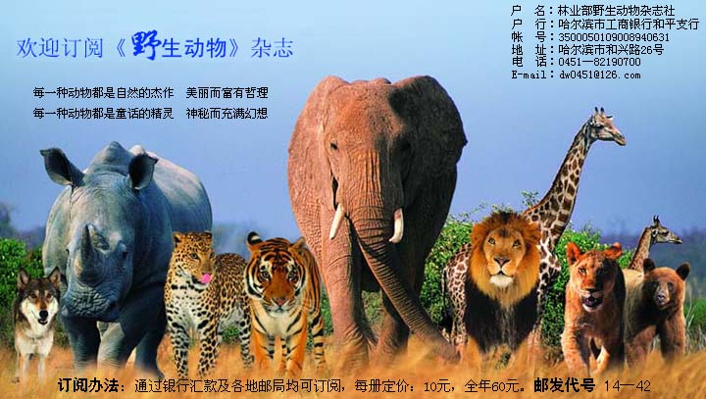
We must protect
Animals are our friends.
wild animals

Slide 18
Homework
Write a report on an animal in danger.
Finish the paper sheet.

