Slide 1
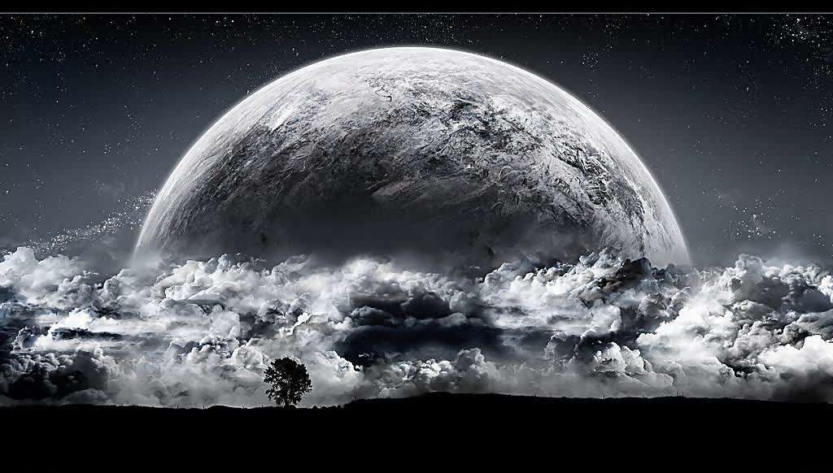
Unit 8
Natural disasters
Welcome to the unit

Slide 2
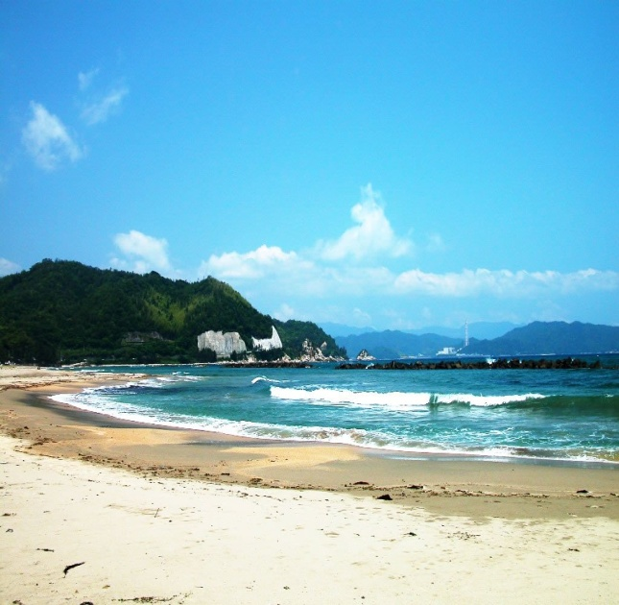
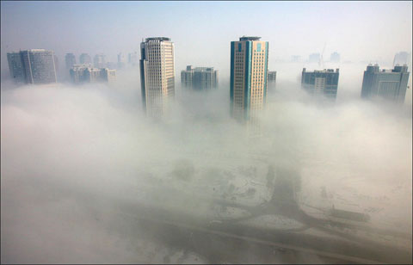
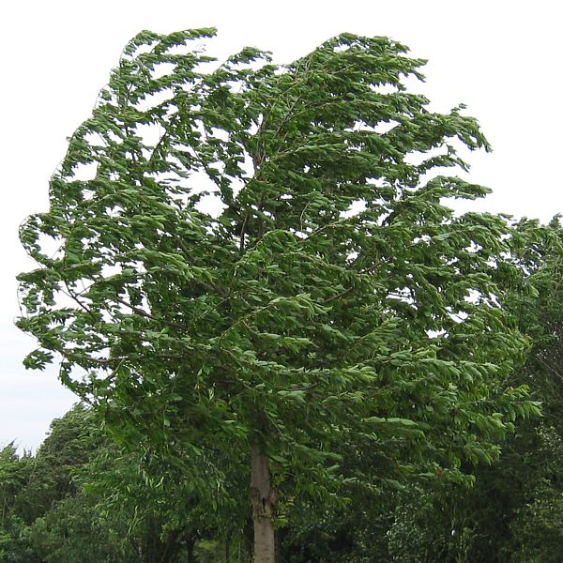
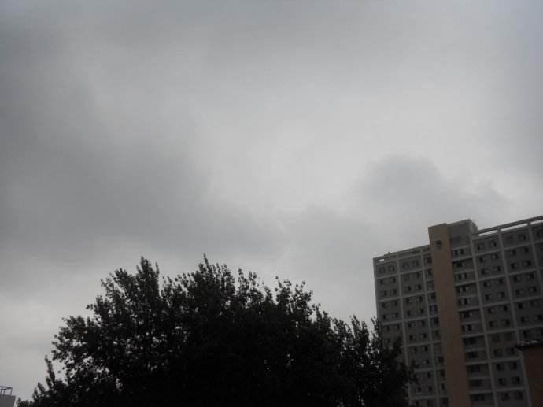
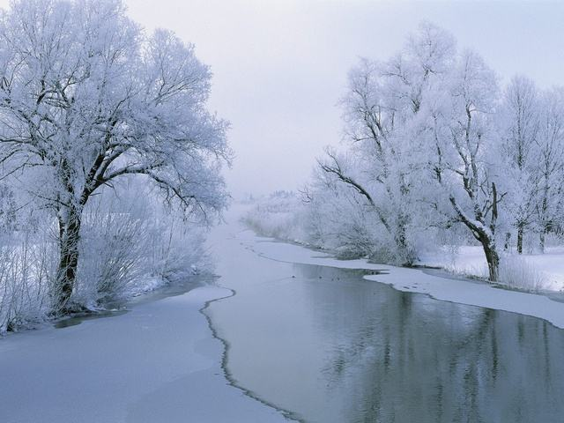
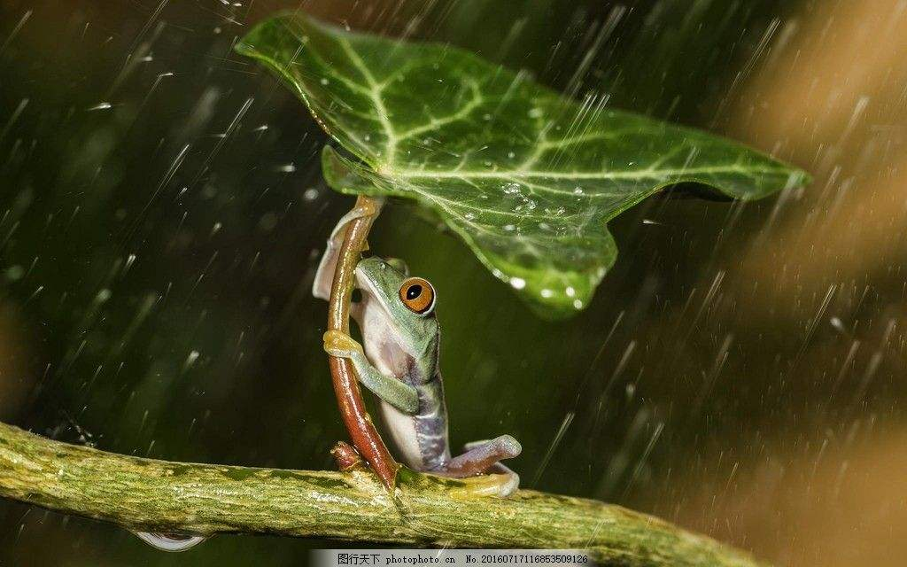
A: What’s the weather like?
B: It’s…
blow strongly / hard
a heavy fog
a strong wind
sunny
foggy
windy
snow heavily
black clouds
a heavy snow
cloudy
snowy
rain heavily
rainy
a heavy rain

Slide 3
What can it cause（引起）when there is too much rain in a short time?

Slide 4
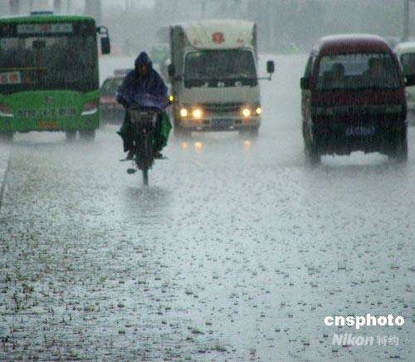
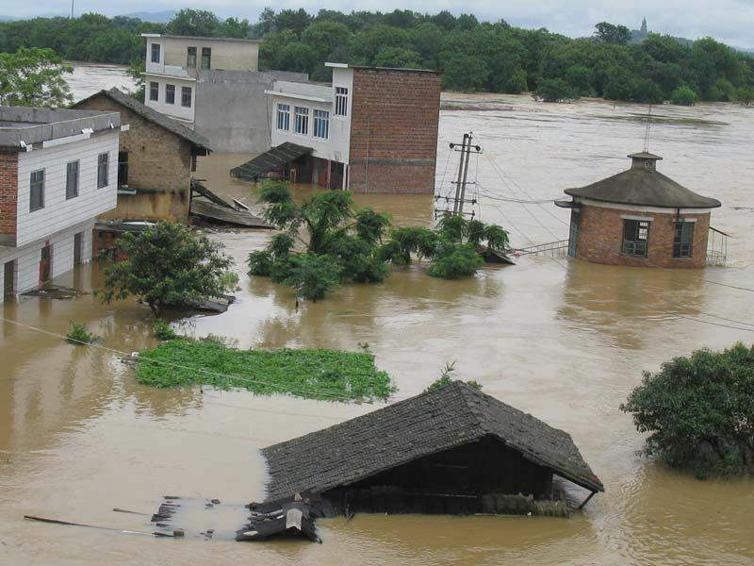
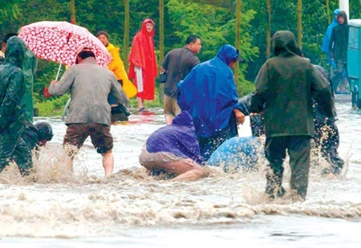
Step 1: Presentation
Sometimes bad weather may cause disasters .
cause
flood
A flood washes away the village.
rainstorm暴雨

Slide 5
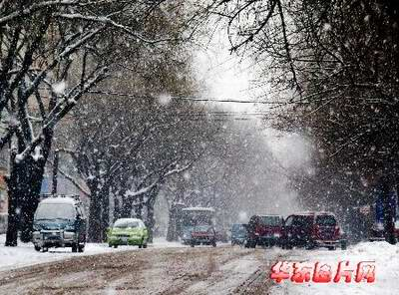
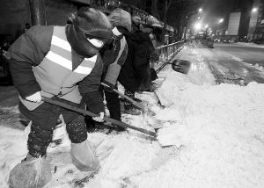
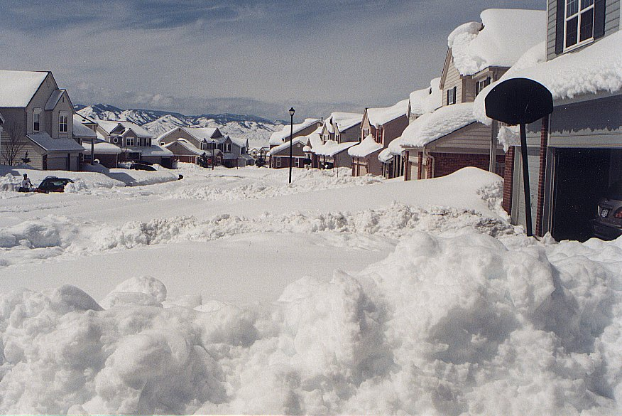
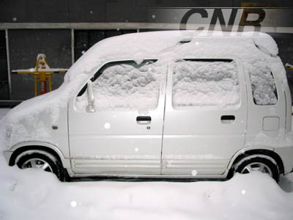
cause
snowstorm暴雪
bad traffic

Slide 6
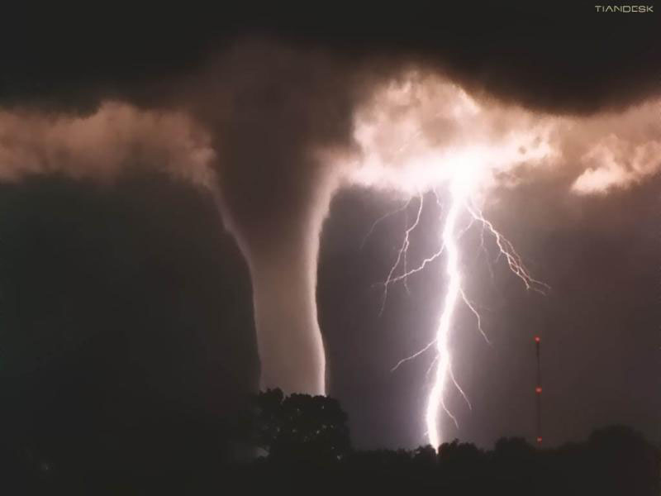
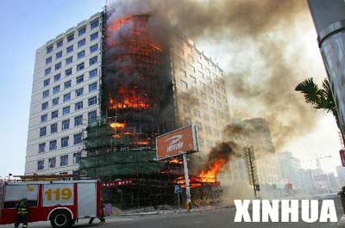
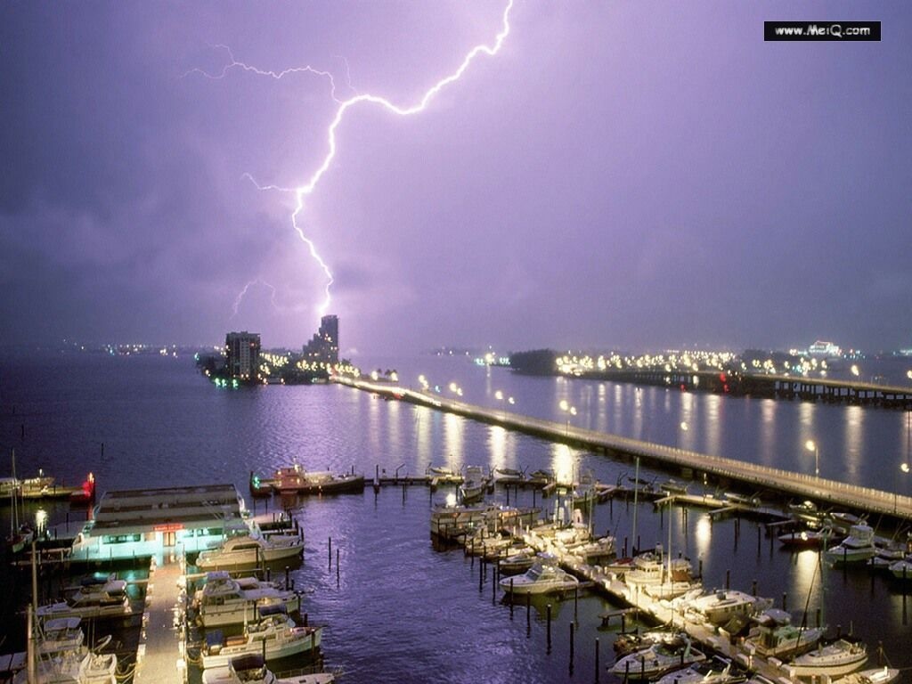
thunder and lightning雷电
cause
Lightning can start a big fire.

Slide 7
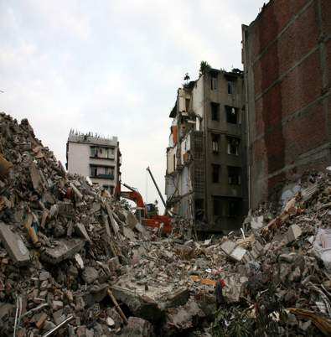
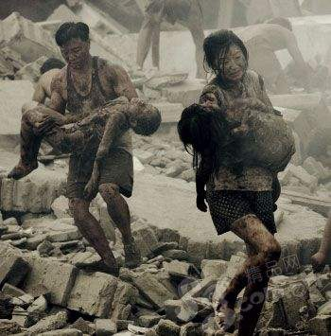
earthquake 地震
The earthquake kills thousands of people.

Slide 8
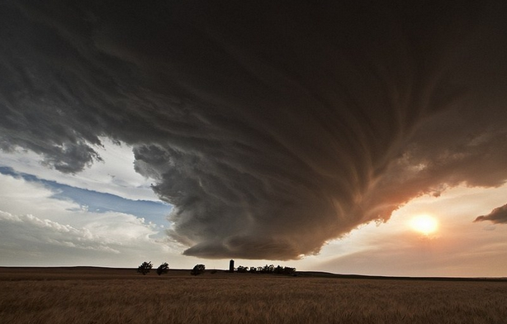
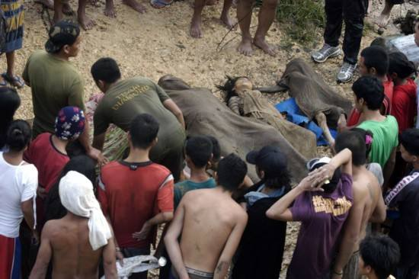
storm 风暴，暴（风）雨
Many people died in the big storm.

Slide 9
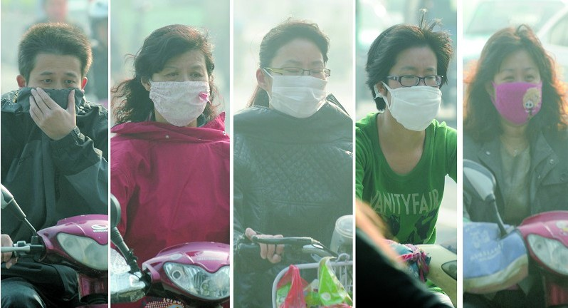
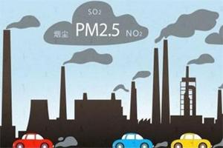
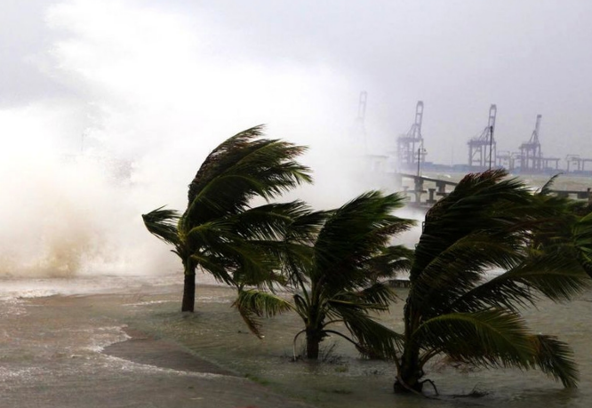
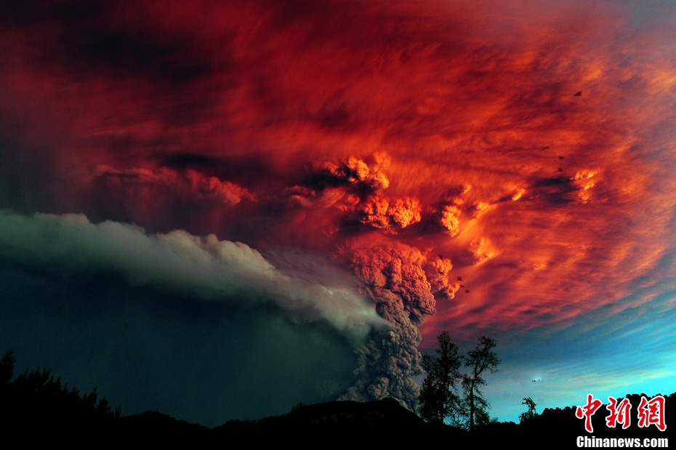
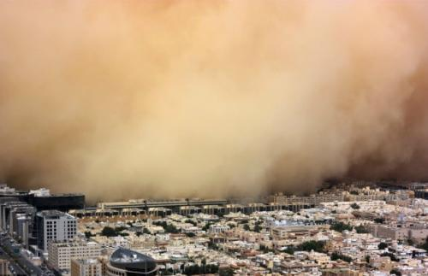
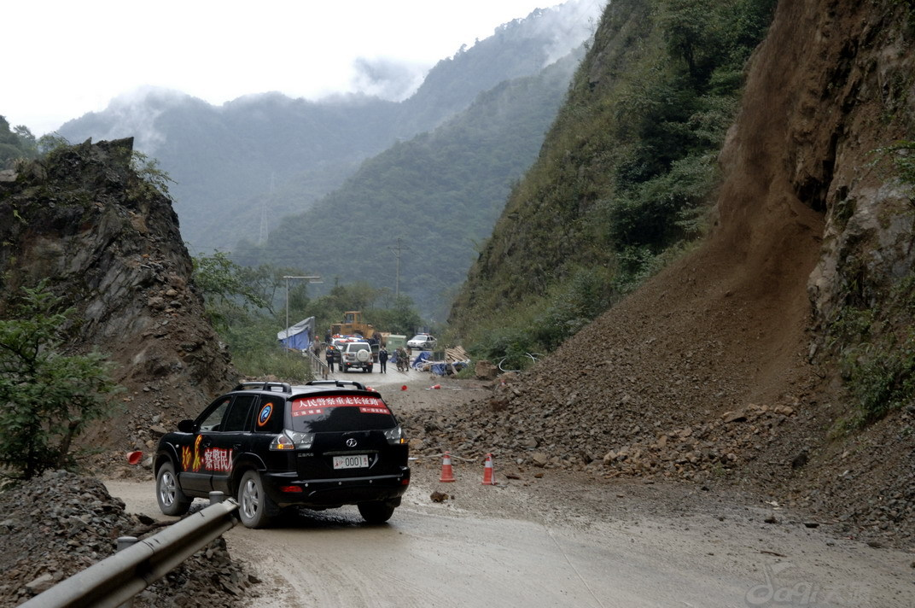
flood
typhoon 台风
volcano[vɒlˈkeɪnəʊ]
火山
fog and haze 雾霾
more natural disasters
landslide 山崩 [ˈlændslaɪd]
tsunami 海啸
sandstorm沙尘暴
forest fire

Slide 10
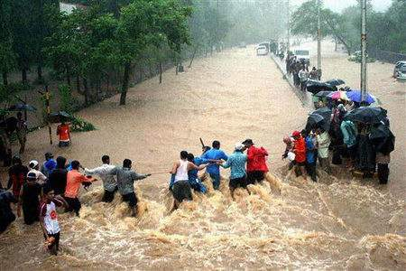
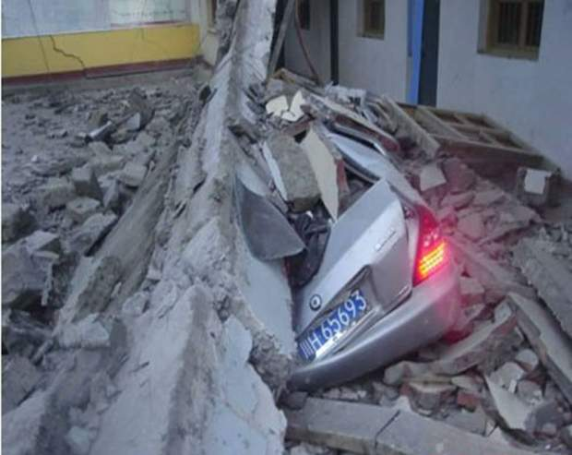
They are all
They are caused by
natural disasters.
natural forces.
自然力量

Slide 11
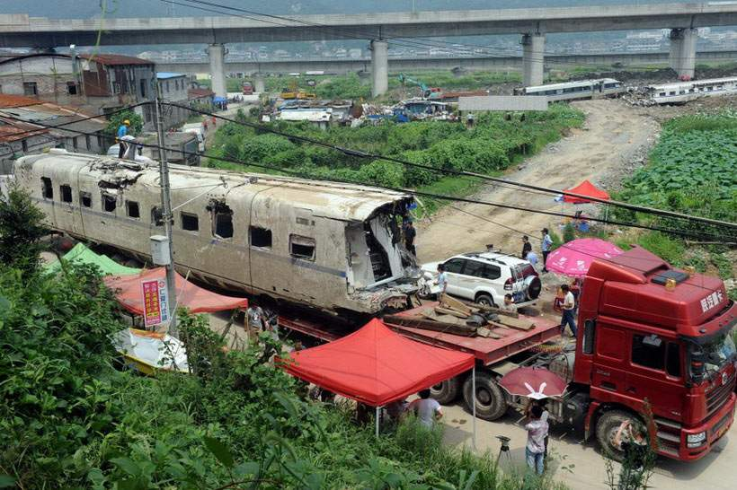
[ˈæksɪdənt]
a train accident 事故
Notes:
11

Slide 12
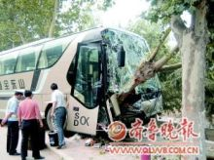
coach
长途汽车
The coach crashed into a tree.
猛撞；碰撞

Slide 13
They are both .
They are caused by .
accidents
people

Slide 14
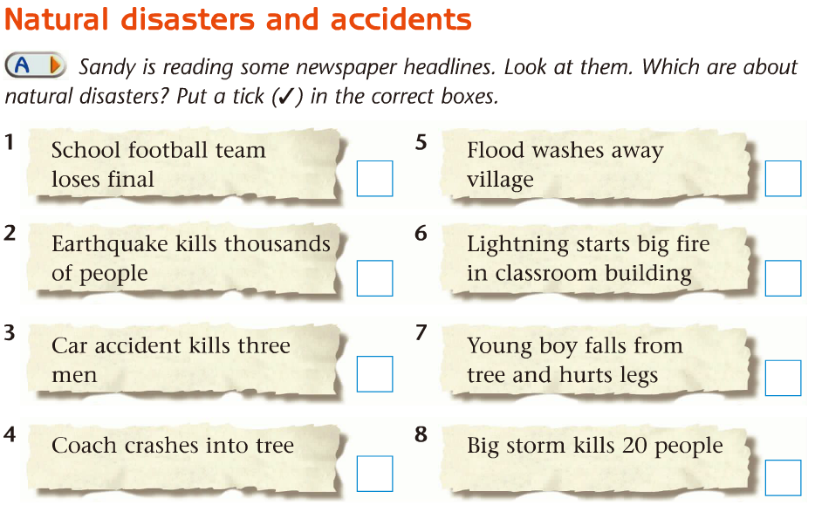
Step 2: Part A
a

Slide 15
Step 3: Part B
What are they talking about, a natural disaster or an accident?
1. Listen and answer

Slide 16
Listen and finish the form
fire
Disaster: | (1) _______
Time: | (2) __________
Place: | At a (3) ________ in the UK
Cause: | there was a heavy (4) _______ with (5) ___________ and lightning
Result: | (6) _________ hit a classroom building and it caught fire
 | Nobody was (7) _______
last week
school
Read the conversation
storm
thunder
lightning
hurt

Slide 17
what | a great earthquake
when | May 12, 2008
where | Wenchuan, Sichuan Province
consequences(后果) | Many buildings fell down, Thousands of people died
Group 1-2: talk about earthquake
Group 3-4: talk about flood
Sample conversation:
S1: Did you hear about …?
S2: No. What happened?
S1: …(describe it)
S2: Oh really?
S1: Yes, it was terrible.
S2: Was anyone hurt?
S1: Yes/No, …
what | a flood
when | last month
where | Wuhan
consequences | It washed away villages, 60 people were hurt
Pair work

Slide 18
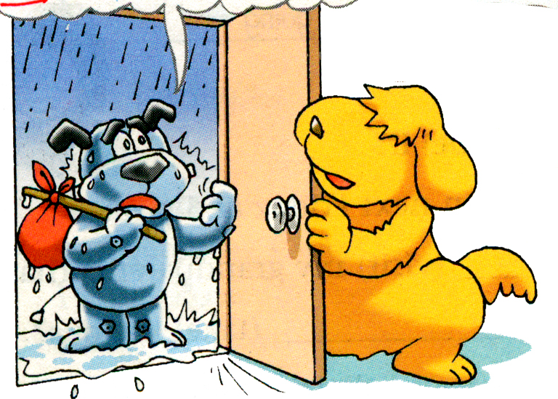
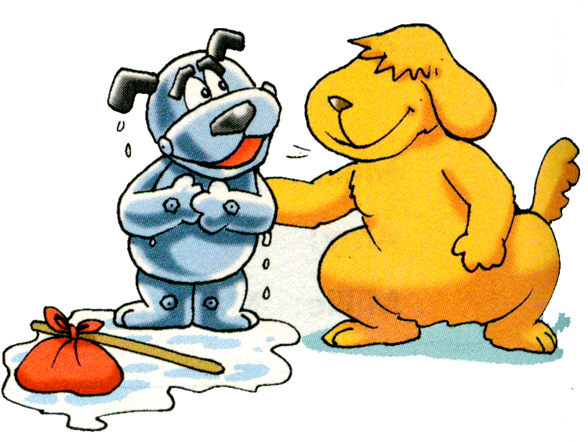
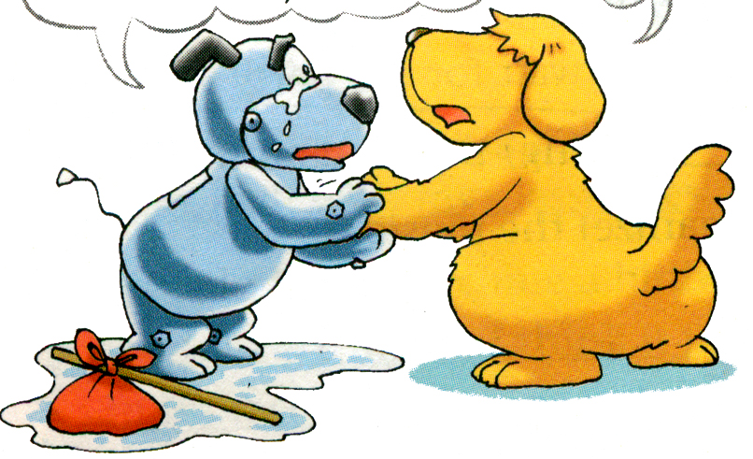
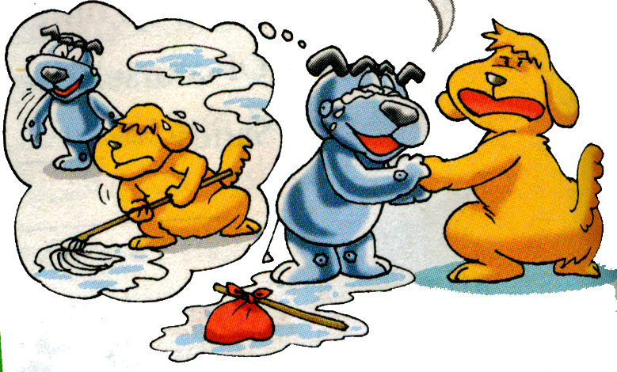
Listening Time
What’s the weather like?
It’s raining. =It’s rainy.

Slide 19
Listening Time
1.What’s wrong with Hobo’s house ?
2. Can Hobo go home alone? Why?
His house is wet.
No, because his floor is all wet and
he wants Eddie to mop it up.

Slide 20
It’s raining. My house is
all wet.Can I come in, Eddie?
I was sleeping when
it started to rain.
Sure, come in.
Why?
Didn’t you hear the rain?
No. When I woke up, there was water everywhere! Come with me, Eddie.
Who will mop up the water if I go home without you?

Slide 21
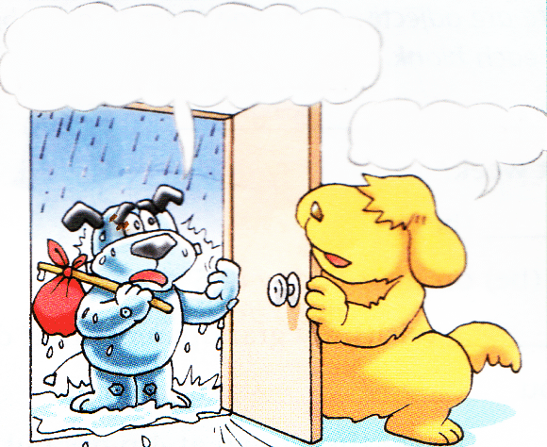
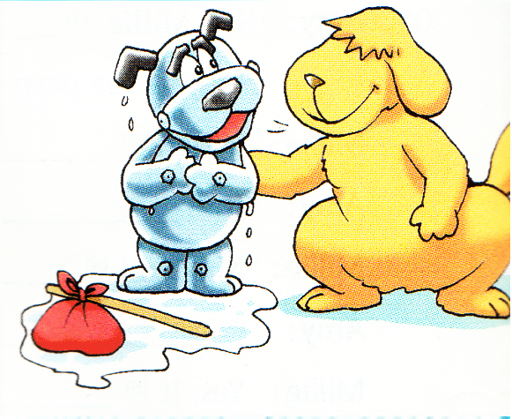
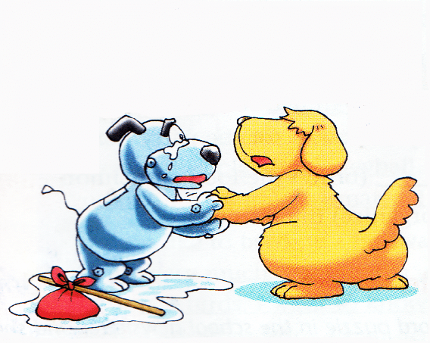
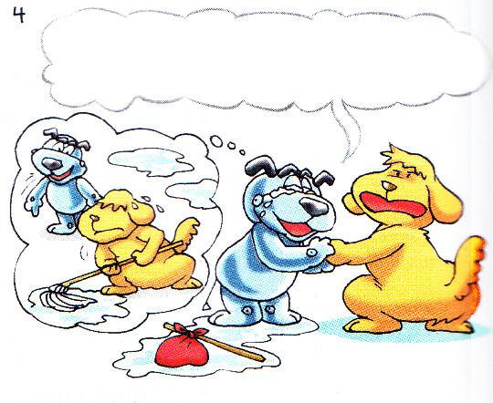
Complete the passage
One day, Hobo went to Eddie’s home, because his own home was all________. He was _________ when it started _______. When he _________, there was water ____________ . He asked Eddie ______ home with him because he wanted Eddie to _________ all the water _________.
wet
sleeping
to rain
woke up
everywhere
to go
mop
up

Slide 22
It’s raining. My house is
all wet.Can I come in, Eddie?
I was sleeping when
it started to rain.
be
Sure, come in.
Why?
Didn’t you hear the rain?
mop the water up
mop it up
wake me up
No. When I woke up, there was water everywhere! Come with me, Eddie.
Who will mop up the water
if I go home without you ?

Slide 23
Discussion
When a disaster happens ,what should we do
to protect us ?
Calm down（平静下来）;
Find cover that can protect you;
Save your strength (体力)；
Try to contact (联系) other
people and ask for help；
Never give up hope!

Slide 24
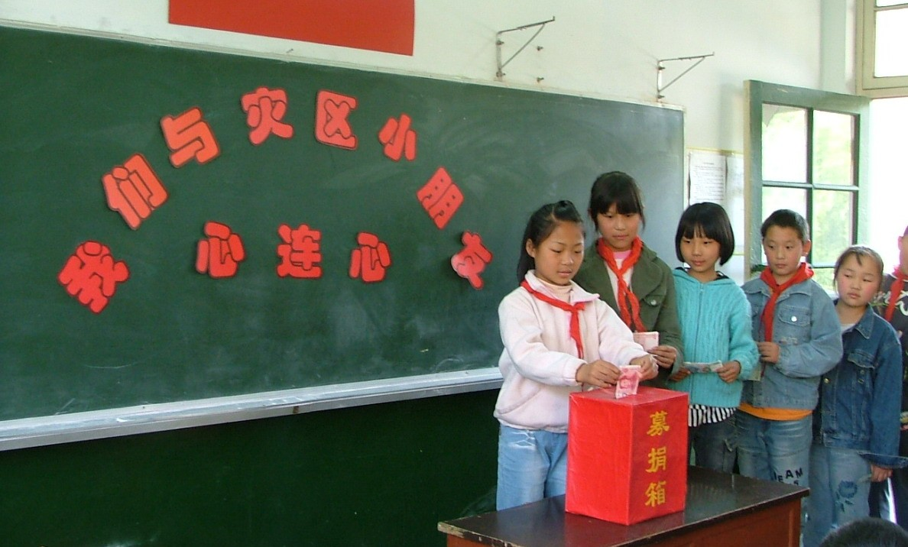
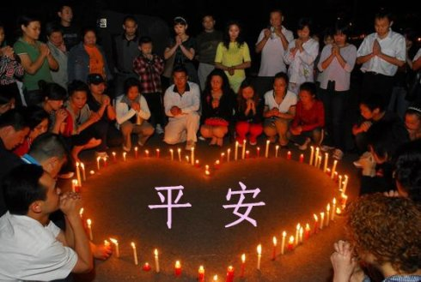
Where there are disasters, there is love!
Pray for them
Raise money and give things they need to them.

Slide 25
1.自然灾害
natural disasters
自然灾害和事故
natural disasters and accidents
2.都湿了
3. 开始下雨
start to rain
4. 当开始下雨时我正在睡觉。
I was sleeping when it started to rain
be all wet

Slide 26
5.你难道没有听到雨声吗
Didn’t you hear the rain?
6.醒过来
Wake（woke） up
把我唤醒
wake me up
7.到处有水。
There was water everywhere.
8.跟我来
come with me

Slide 27
9.把某物拖干净
mop sth up/mop up sth
把水拖干净
mop the water up/mop up the water
把它拖干净
10如果你不跟我回家，谁来拖干水呢？
Who will mop up the water if I go home without you ?
11.输了决赛
lose the final
mop it up

Slide 28
12.成千上万的人们
thousands of people
13.撞到……上
crash into…
14.把……冲走
wash sth away / wash away sth
冲毁了村庄
wash away the villages
把它冲走
15.一起车祸
a car accident
wash it away

Slide 29
16.引起大火
start a big fire
17.在教学楼
in the classroom building
18.从…摔下来
fall（down）from …..
19.一场电闪雷鸣的暴风雨
a heavy storm with thunder and lightning

Slide 30
20击中了教学楼
21.听说
22. 着火（强调动作）
catch fire
着火，失火 （强调状态）
be on fire
生火，点火;
make/light/start a fire
灭火
玩火
hit a classroom building
hear about/ of
put out a fire
play with fire

Slide 31
Homework
Try to remember new words
and phrases
2. Review Reading
Notes:
本资料来自于资源最齐全的２１世纪教育网www.21cnjy.com

