Slide 1
Seasons
Unit 7
study skills

Slide 2
Words review
1.n. 暴风雪
2.n. 风
adj.
3.adv. 大约
4.n. 阳光
5.n. 其余的部分（人）
6.n. 度数
snowstorm
wind
windy
around
sunshine (不可数）
rest
degree （可数）

Slide 3
7.n. 一点，少量
有一点
8.vi. & vt. 吹；刮
过去式
9.adv. 大声地
10.vt. & vi. 给……打电话；响起铃声
过去式
bit
a bit
blow
blew
loud
ring
rang

Slide 4
fog
11.雾（n）
adj
12. 困倦的，瞌睡的（adj）
13光亮、光泽（n）
14. 光亮的、反光的（adj）
15.突然的（adj）
adv
16.雪球（n）
17.打战（架）（n）
foggy
sleepy
shine
shiny
sudden
suddenly
snowball
fight (可数)

Slide 5
不同季节不同地方的天气
weather in different seasons and places
2. 听收音机中的天气预报
listen to the weather report on the radio
3. 傍晚来到
arrive in the late afternoon
4. 降到零度以下，达到零下10度
drop below zero, to -10℃
5. 今天主要会干旱，阳光充足。
It will be mainly dry and sunny today.
6. 但晚上会变得比较多云
But it will turn more cloudy in the evening.
7.白天在9度左右,晚上为4度左右
be around 9℃ during the day and 4℃ at night.

Slide 6
8. 今天又将是美妙、炎热的一天，气温达到30多度
It will be a beautiful, hot day again today,
with temperatures in the thirties
9. 这周剩下来的几天
10这周剩下来的几天,阳光与蓝天将陪伴着我们。
Sunshine and blue skies will stay with us
for the rest of the week
11.来自北方的暴风雪傍晚就要来了。
Snowstorms from the north will arrive
in the late afternoon.
12.风会更大。
13. 今天将会有一些阵雨。
There will be a few showers today.
for the rest of the week
The wind will be stronger.

Slide 7
14. 天气将会温暖，白天气温在18度或19度附近
It will be warm, with daytime temperatures
around 18 or 19 degrees.
15.不同的地方天气差别是如此之大。
The weather can be so different in different places.
16.明天北京将会有暴风雪。
There will be a snowstorm in Beijing tomorrow.
17.最低/最高气温
the lowest/ the highest temperature
18.保持在零度以上
19. 在9度到5度之间
20.在零度以下，为零下一度
21. 每年的这段时间
stay above zero
between 9℃ and 5℃
be below zero, at -1℃
during this time of year.

Slide 8
22. 每年的这段时间，北京总是多雪并且寒冷的。
It is always so snowy and cold in Beijing
during this time of year.
23.明天悉尼将会有阵雨。
There will be showers in Sydney.
24.南京天气如何？
How’s the weather in Nanjing?
=What’s the weather like in Nanjing?
25.这里稍微有点冷，有点干燥，但没有暴风雪。
It’s a bit cold and dry, but there are
no snowstorms here.
26. 我是简阿姨。
27. 你怎么样啊？ 我很好,但天气真的很冷。
How are you doing? I’m fine.，but it’s really cold.
This is Aunt Jane speaking.

Slide 9
28.抱歉，我听不见你说话。
Sorry, I can’t hear you.
29风刮得太猛了。
The wind is blowing hard.
30. 你能再大声一点吗？
Can you speak louder , please?
31.我会再打给你的。照顾好自己
I’ll ring you later. Take care.
32.街上的许多人不得不用围巾蒙住了脸。
Many people in the street have to cover
their faces with scarves.
33.使人们困倦
34 突然降临的大雨引起许多问题。
The sudden heavy rain causes a lot of problems.
make people sleepy

Slide 10
35.秋天是一年中最好的季节。
Autumn is the best season of the year.
36.人们幸运地享受很多晴天。
People are lucky to enjoy many sunny days.
37.他们喜欢周末在城市的周围来一个短程旅游。
They like to have a short trip around the city
at the weekend.
38.在大雪天里，大多数孩子很开心，很吵闹。
Most children are happy and noisy on snowy days.
39.喜欢打雪仗
40.浓雾对人们不健康。
Heavy fog is not healthy for people.
like snowball fights

Slide 11
What’s the temperature?
最高 a high of…
最低 a low of…
保持零上stay above zero
降到零下fall below zero
上升至…rise to…
下降到…drop to…
There’ll be a snowstorm in Beijing ,with a high of
Minus two degrees and a low of minus nine.
New York will be sunny with the temperature
between nine and five degrees.

Slide 12
Useful expressions
How is the weather today? 今天天气怎么样？ The weather is nice today. 今天天气很好。 It’s quite cold today. 今天真冷。

Slide 13
What was the weather like yesterday? 昨天天气怎么样？
Yesterday it rained all day. 昨天一天在下雨。
What will the weather be like tomorrow? 明天天气会如何？
It's going to snow tomorrow. 明天会下雪。

Slide 14
It's been cloudy all morning. 整个早上都是阴天。 Is it raining now? 现在在下雨吗？ The days are getting hotter. 天气越来越热了。 What's the temperature today? 今天几度？

Slide 15
It’s sunny.
There’s a lot of sunshine.
The sun is bright
The sun is shining brightly.
It’s windy.
There’s a strong wind.
The wind is strong.
The wind is blowing strongly/hard.
The temperature is high.
The highest temperature is ….
It’s a sunny day , with….

Slide 16
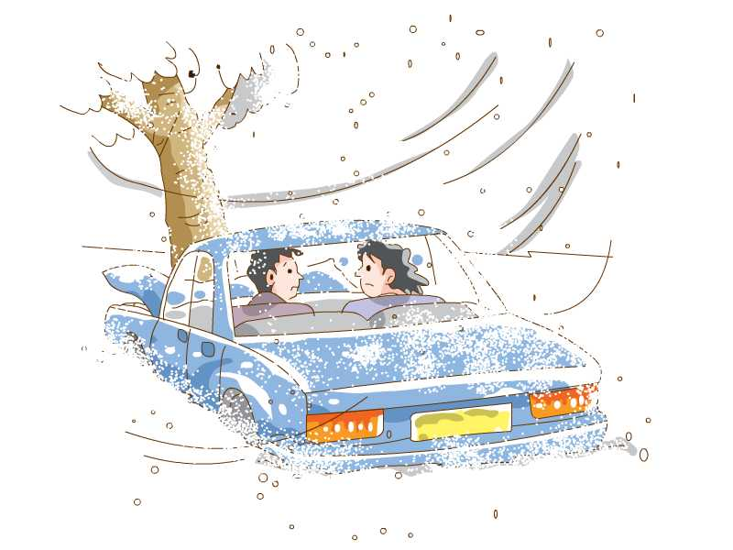
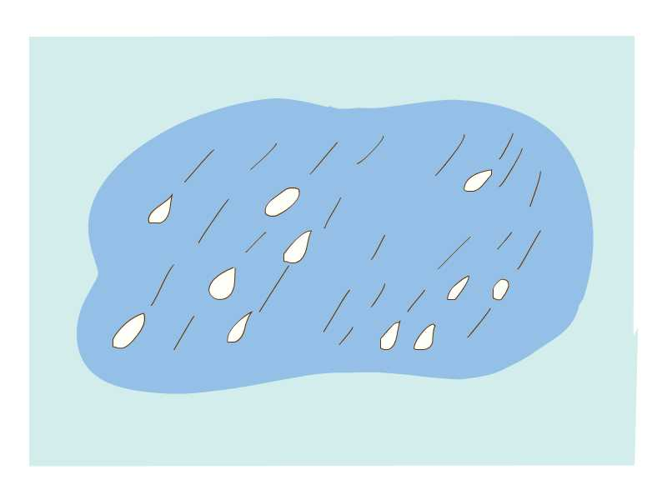
It’s snowy.
There is a heavy snow.
The snow is heavy
It is snowing heavily/hard.
It’s cloudy.
There are a lot of clouds.
It’s rainy.
There’s a heavy rain.
The rain is heavy.
It is raining heavily/hard.

Slide 17
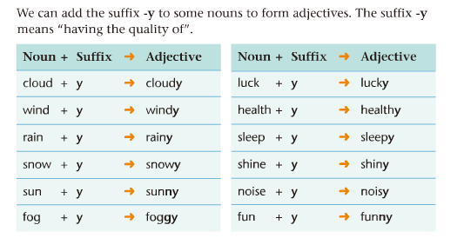

Slide 18
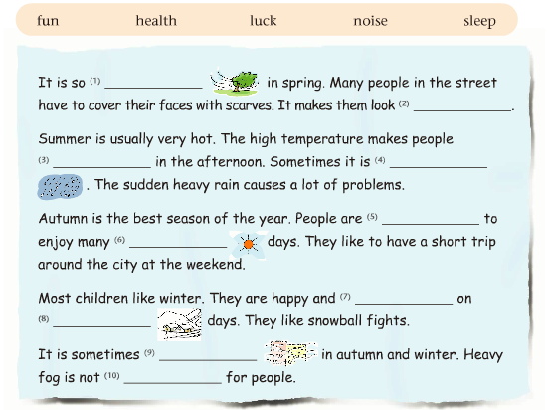
windy
funny
sleepy
rainy
lucky
sunny
noisy
snowy
foggy
healthy

Slide 19
【学海拾贝】
Sunshine and blue skies will stay with us
for the rest of the week
这周剩下来的几天,阳光与蓝天将陪伴着我们。
“其余的……,剩余的……”________________
故事的剩余部分很无聊。
_____ _____ _____ the story ____ ________.
剩下的书是给你的。
________ _____ ____ the books ______ for you.
2. 电话用语。 Who’s that (speaking)?
This is …..(speaking).
（ ）——Hello，who’s that speaking?
——_________________
A That is Jane. B This is Kangkang speaking.
C I’m Mike. D She is Maria.
the rest of…
The rest of is boring
The rest of are
B

Slide 20
What’s the weather like?
3.询问天气。______________________________
=_____________________________
回答：It’s +天气的形容词
（sunny, windy, snowy, foggy, cloudy, rainy）
明天天气怎么样？纽约是晴天，而伦敦则是多云。
______ ______the weather _____ _____tomorrow?
It ____ ___ ________ in New York and _______
in London.
How is the weather?
What will be like
will be sunny cloudy

Slide 21
4. It’s a bit cold and dry.这里稍微有点冷，有点干燥。
a bit和a little都可用作程度副词， “稍微，一点儿”，修饰动词，形容词，比较级等,二者可互换。
请你把收音机声音光小一点好吗？
Will you please ____ ______ the radio _____ _____?
多么热的天啊!我有点口渴。
_____ ____ ___ day! I am ___ _____ _______.
a little+不可数名词=a bit of +不可数名词。
Tom有一点钱。Tom has _______________ money.
not a bit =not at all “一点也不”。
not a little= very much “十分，相当，极其”
他一点儿不累。He is ______ _____ _______ tired. 他很累。 He is ______ ______ ______ tired.
/a little
turn down a bit
What a hot
a bit thirsty
a bit of/ a little
not a bit
not a little

Slide 22
5. I’ll ring you later. 我会再打给你的。
给某人打电话 ring sb=call sb=give sb a call/ring
ring sb up “打通电话，实现通话”
6.在一些名词后面加上后缀y形成形容词
（尤其是一些与天气有关的名词），后缀-y“有某种性质“
在名词后面加-y变成名词：
rain_______ cloud_______ wind______ snow_____
health_____ luck_________sleep______
以重度闭音节结尾，且词尾只有一个辅音字母的名词，
应双写词尾的辅音字母再加-y:
sun_______ fog_______ fun_______
少数以不发音的e 结尾的名词变为形容词时，
应去掉e 再加-y:
noise________ ice______ shine________
y
y
y
y
y
y
y
ny
gy
ny
noisy
icy
shiny

Slide 23
【堂清巩固】
Tom’s father’s ________(suddenly) death
made him in deep sorrow.
2. In summer the high temperature makes
people __________(sleep).
3.Today it will be warm, with the temperature
of 20 __________（度）.
4.The line is bad. I can’t hear you .
Could you speak __________(loud) , please?
5. It is raining ________ (hard) and the wind
is blowing ____________(strong).
6. I don’t like the _________ (shine) look.
7.他的突然到来使我们感到吃惊。
His ________ ________ made us surprised.
sudden
sleepy
degrees
louder
hard
strongly
shiny
sudden arrival

Slide 24
Preview
To preview Study skills on Page 89
To preview Task on Pages 90 and 91
To preview the new words in Unit 8

Slide 25
Homework
Write weather reports for different days in Nanjing.

Slide 26
Thank you!

