Slide 1
Unit 7 Seasons
Integrated skills
Weather in different seasons and places

Slide 2
1. teenagers, have, an, many, unhealthy, diet
2. makes, weak, your, body, unhealthy, diet, an
3. unhappy, they, are
4. find, difficult, homework, they, their

Slide 3
5. tired, they, are
6. cry, some, them, of
7. hobbies, teenagers, many, have
8. write, letters, many, me,
teenagers

Slide 4
Many teenagers have an unhealthy diet.
2. An unhealthy diet makes your body weak.
3. They are unhappy.
4. They find their homework difficult.
( S + V + DO )
( S + V + DO + OC )
( S + V + P )
( S + V + DO + OC )

Slide 5
5. They are tired.
6. Some of them cry.
7. Teenagers have many hobbies.
8. Many teenagers write me letters.
( S + V + P )
( S + V )
( S + V + O )
( S + V + IO + DO )

Slide 6
Study Aims:
1. To be able to make a phone call and talk about the weather .
2. To improve listening skills .

Slide 7
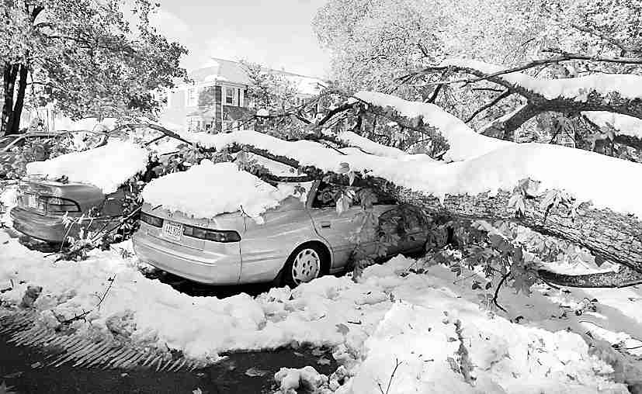
Presentation
snowstorm n. 暴风雪

Slide 8
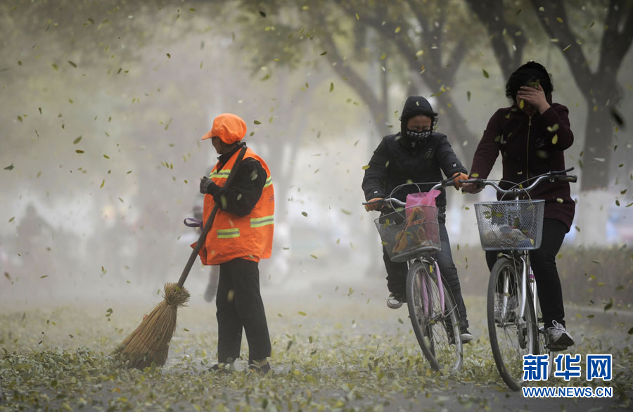
wind
n. 风

Slide 9
sunshine n. 阳光

Slide 10
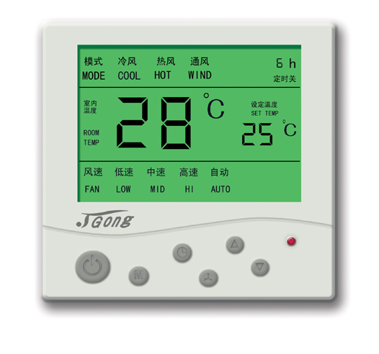
degree n. 度数

Slide 11
New words
snowstorm n. 暴风雪
wind n. 风
around adv. 大约
sunshine n. 阳光
rest n. 其余的部分（人）
degree n. 度数

Slide 12
Guide One : To be a weather reporter
Do you want to be a weather reporter ?
To be a weather reporter , you must know the following words :
temperature , drop to , above , below ,
cold , hot ,warm ,cool ,cold , wet , dry ,
foggy , cloudy ,windy , sunny , rainy ,
snowy , showers , heavy rain ,
sunshine , snowstorm , around ,
sunshine snowstorm around
（n.）阳光 n.）暴风雪 （adv.）大约
℃ (degree) , 19℃ (19 degrees )
-10℃ (10 degrees below zero)
（minus ten degrees)

Slide 13
Read and remember the new words
sunshine snowstorm around
（n.）阳光 （n.）暴风雪 （adv.）大约
℃ (degree) , 19℃ (19 degrees )
-10℃ (10 degrees below zero)
（minus ten degrees)

Slide 14
Mr Wu is giving the students the weather reports for different seasons in Beijing. Help them write the possible season under each report.

Slide 15
Snowstorms from
the north will arrive
in the late afternoon.
The wind will be
stronger and the
temperature will drop
below zero, to -10℃.
It will be mainly dry
and sunny today, but it
will turn more cloudy
in the evening. The
temperature will be
around 9℃ during the
day and 4℃ at night.
winter
autumn

Slide 16
It will be a beautiful,
hot day again today,
with temperatures in
the thirties. Sunshine
and blue skies will
stay with us for the
rest of the week.
There will be a few
showers today, but it
will be warm, with daytime temperatures around 18 or 19 degrees. [来源:Zxxk.Com]
summer
spring

Slide 17
Simon is listening to the
weather report on the radio.
Help him complete
the table below.

Slide 18
Place | Weather | Temperature (highest) | Temperature (lowest)
Beijing |  | -2℃
New York |  |  | 5 ℃
London |  |  | -1 ℃
Sydney | showers
snowstorm
-9℃
sunny
9℃
cloudy
3℃
26℃
21℃

Slide 19
Annie is writing about the weather
in different places in her diary entry.
Listen to her conversation with
Simon. Help her complete Her
diary entry.

Slide 20
Today I learnt more about weather. It can be so different in different places. There will be a ___________ in Beijing tomorrow. The lowest temperature will be -9℃. It will be ________ in New York and _________ in London. The temperature in New York will stay above zero, between _______ and 5℃, but it will be colder in London.
snowstorm
sunny
cloudy
9℃

Slide 21
The lowest temperature will be below
zero, at _______.
It is always so snowy and cold in Beijing during this time of year, but Sydney is quite different. When it is winter in China, it is _______ in Australia. Tomorrow there will be __________ in Sydney and the temperature will be between _________ and 21℃.
-1℃
summer
showers
26℃

Slide 22
How’s the weather in Nanjing?
Speak up
Listen and answer :
1.What’s the weather like in Beijing ?
There was a snowstorm in Beijing yesterday , and it’s really cold now .
2.How’s the weather in Nanjing ?
It’s a bit cold and dry .
3.Why does Daniel ask his aunt to speak louder ?
Because the wind is blowing hard , he can’t hear aunt Jane.
单击此处添加段落文字内容
a bit 有一点， 修饰形容词。
blow (v.) 吹， 刮

Slide 23
Act out your dialogue !
Choose A or B
Act out the dialogue between Daniel and Aunt Jane . A
Act out your own dialogue with your partner . B

Slide 24
Explanation
1. The wind will be stronger.
strong wind 大风
e.g. The strong wind damaged my house.
大风把我的房子损坏了。
2. The temperature will drop below zero,
to -10℃.
drop below zero 降到零度以下
drop to -10℃ 降到零下10摄氏度

Slide 25
e.g. The temperature is going to
drop below zero tonight.
3. The temperature will be around
9℃ during the day.
around = about 大约
e.g. I got back to Beijing around 9
o’clock.

Slide 26
4. Sunshine will stay with us for the rest
of the week.
the rest of … 其余的……
e.g. We can guess the rest of the story.
我们可以猜到故事的其余部分。

Slide 27
Translation
1. 温度将会降到零下10摄氏度。
2. 今天主要是干燥晴朗的天气。
3. 晚上天气将会变成多云。
The temperature will drop to -10℃.
It will be mainly dry and sunny today.
It will turn cloudy in the evening.

Slide 28
5. 温度在白天将会是大约9摄氏度左右。
6. 阳光和蓝天在这个星期的其余时间将会陪伴我们。
7. 今天将会有一些阵雨。
The temperature will be around 9℃ during the day.
Sunshine and blue skies will stay with us for the rest of the week.
There will be a few showers today.

