Slide 1


Unit 2
School Life
Comic strip
&
Welcome to the unit

Slide 2

Tell me about your school
Task1:Free talk
Where is your school ?
What is your school like?
What subject do you like best?
…

Slide 3
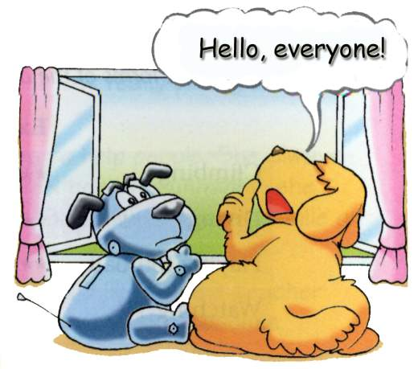
Do you think they need to go to school?

Slide 4

Task2 : Listening

Slide 5

1.Listen and answer :
1. What does Eddie think school is like ?
It is like watching TV, but there are fewer advertisements.

Slide 6
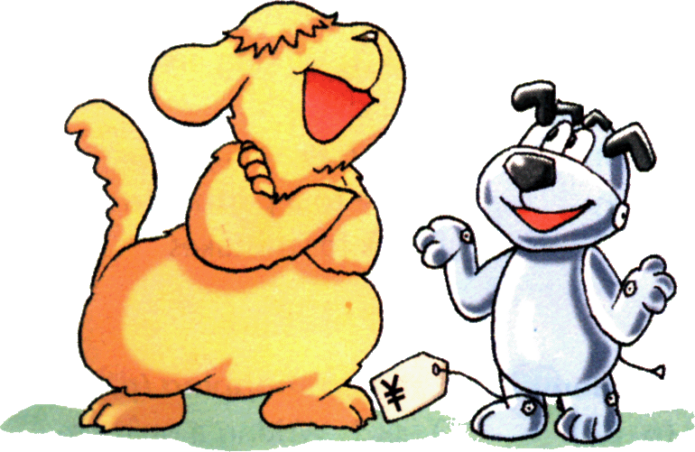
Act it out!
Use different tones and body languages .(语气和肢体语言)
Add your own words to make the dialogue longer and more interesting.（用自己的语言使对话更长、更有趣）.

Slide 7
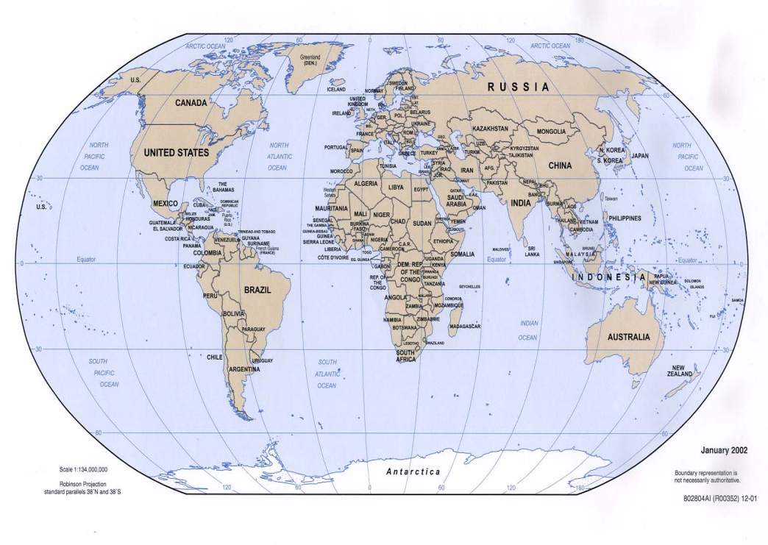
the UK
France
the USA
China
Australia
What countries do you know?
What language(语言) do they speak?

Slide 8



Do you know which countries
the flags stand for?
China
England
the USA
Britain
the UK

Slide 9


Attention:
People speak English in both Britain and the USA. However, sometimes they use different words which mean the same thing.

Slide 10
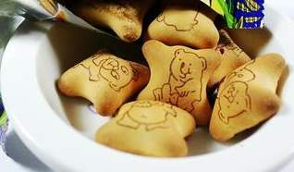
Different words for the same thing:
biscuits
cookies

Slide 11
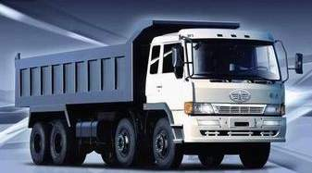
lorry
truck

Slide 12
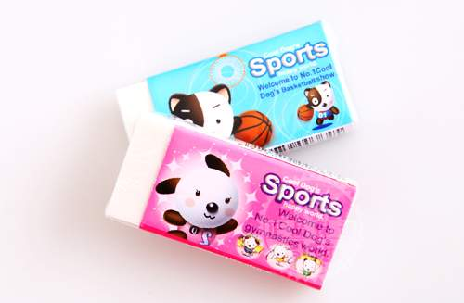
rubber
eraser

Slide 13

football
soccer

Slide 14
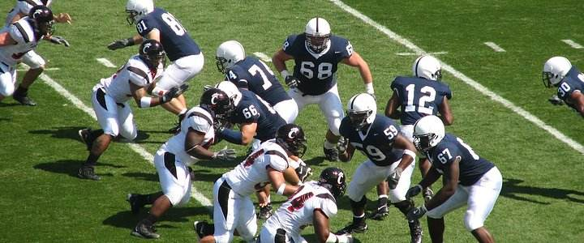
American football

Slide 15
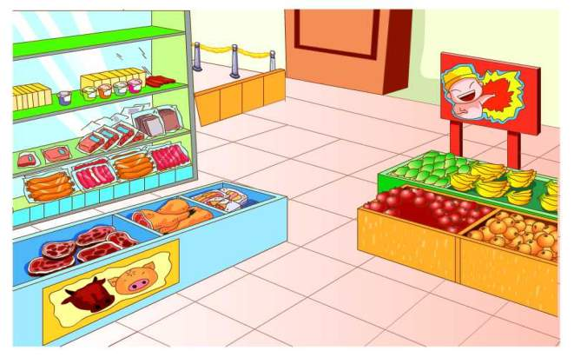
shop
store

Slide 16

holiday
vacation

Slide 17
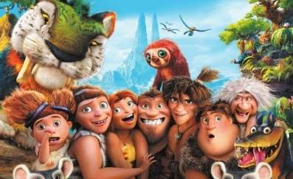
film
movie

Slide 18

New words
British adj. 英国的
biscuit n. 饼干
lorry n. 卡车
rubber n. 橡皮
American adj. 美国的
cookie n. 饼干
truck n. 卡车
eraser n. 橡皮
soccer n. 英式足球
vacation n. 假期
fall n. 秋天
store n. 商店
yard n. 院子
movie n. 电影

Slide 19
Different words for the same thing
Task 3: practice 1
Match the words on the left with the words on the right. Write the correct letters in the blanks.

Slide 20
British English
American English
1 biscuit
2 autumn
3 lorry
4 film
5 football
6 holiday
7 garden
8 rubber
9 shop
d
a. eraser
b. soccer
c. vacation
d. cookie
e. fall
f. store
g. truck
h. yard
i. movie
1 ___
2 ___
3 ___
4 ___
5 ___
6 ___
7 ___
8 ___
9 ___
e
g
i
b
c
h
a
f

Slide 21



Write the correct words under the pictures below.
film
movie
football
soccer
garden
yard

Slide 22


lorry
truck
rubber
eraser

Slide 23
Task 3: practice 2
Underline the British words and write the American words.
Daniel: Hi, Simon. Where are you going?
Simon: I am going to buy a toy lorry for
my cousin in the shop near our
school.
Daniel: I’ll go with you. I’d like to buy
some biscuits.
truck
store
cookies

Slide 24
Simon: Do you have any plans for the weekend?
Daniel: I want to see a film. Shall we go together?
Simon: I’d love to, but the school football team will practise this Saturday. We have an important match this autumn.
movie
soccer
fall

Slide 25
The differences between
British English and American English
Spelling
1. -re和-er 如:
metre/meter
theatre/theater
centre/center
centimetre/centimeter
背景：这些词全部都是从法语中来的（分别是:mètre, centimètre, théa^tre, centre）。
2. our和or 如：
colour/color
favourite/favorite

Slide 26


different spellings
favourite, colour, neighbour | favorite, color, neighbor
centre, theatre, metre | center, theater, meter
traveller | traveler
cheque（支票） | check
practise v. | practice v.

Slide 27
1. What is school like?
like: prep.像… (unlike)
eg: John looks smart, just like his father.
His hat looks like mine.
The noise sounds like crying.
What’s the weather like?
*like: v. 喜欢 （dislike）

Slide 28
2. …there are fewer advertisements.
* a few和few: 可数名词
a little和little:不可数名词
* few—fewer—fewest
little—less—least

Slide 29
Fill in the blanks.
few a few little a little
a little
1. I have ___________ money. I want to buy a pizza for lunch.
2. It is raining too hard. ______ people are in the street.
3. We often have _______ days off for National Day.
4. Hurry up !There is _____ time .
5.Don’t worry .We have _______ time .
Few
a few
little
a little
返回

Slide 30
Practice 3: phrases and sentences
1.得更努力
2.像看电视
3.更少的广告
4.理想学校
5.举行重要的比赛
6.学校是什么样?
7.今年秋天
8.你去哪儿？
have to work harder
be like watching TV
fewer advertisements
an ideal school
have an important match
What’s school like?
this autumn
Where are you going?

Slide 31
9.给我堂兄买卡车
10.在我们学校附近的商店
11.看电影
12.周末计划
13.在本周六练习
buy a truck for my cousin
in the shop near our school
see/watch a film/movie
the plan for the weekend
practise this Saturday

Slide 32
Discussion
1.Can we just sleep and eat ? Why？
2.What should(应该) we do at school?
3.What after-school activities can we do at school?

Slide 33
Proverb 谚语
Reading is to the mind while exercise to the body.
读书健脑，运动强身
Success belongs to the persevering.
坚持就是胜利

Slide 34

Love school, love life

Slide 35

Goodbye

