Slide 1
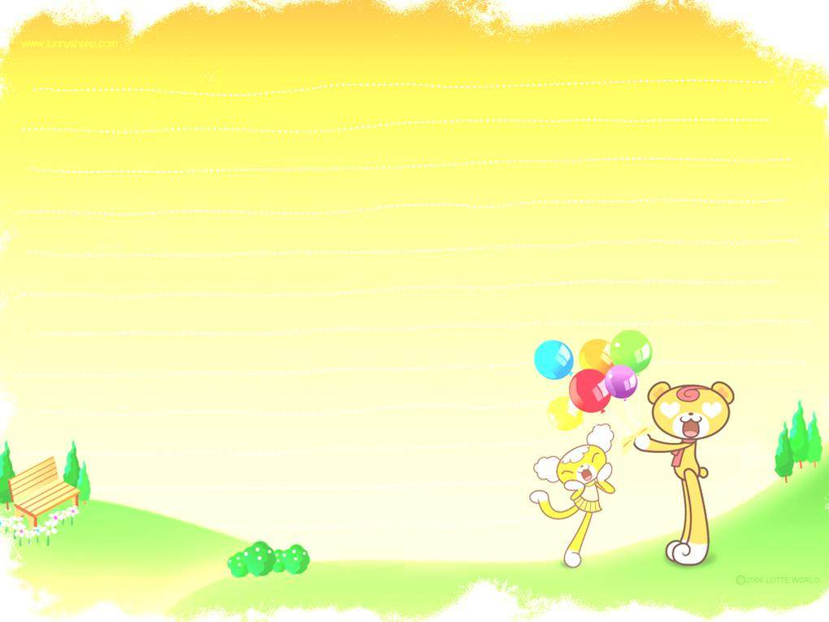

Unit 2 School life
Grammar 1

Slide 2
选择精题：
1. Lucy is very short, but she is __________ than her sister.
A. shorter B. longer C. taller D. older
2. Frank is __________ friendly than his brother.
A. a little more B. a few more C. much D. a little
3. Sam is __________ at Chinese than Jim.
A. good B. well
C. better D. gooder
be good at

Slide 3
4. This one is too large. Can you show me a __________one?
A. larger B. large C. small D. smaller
5. —Do you think March is __________ than January?
—Yes, it’s __________ warmer.
better, a little B. well, much
C. worse, very D. nicer, quite

Slide 4
7. I’m __________ quieter than Susan.
A. little B. few
C. a little D. a few
8. The watch is not __________ beautiful as that one.
A. very B. too
C. so D. more
much ,far ,a lot, even, a little ,still+比较级
be as ...as..., be not so ...as... 同级比较，只用原级。

Slide 5
9. His French isn’t so good as __________.
A: he B: him C:her D: hers
10. Playing baseball is much better than __________ classes.
A. have B. has
C. to have D. having
11. Her bag is newer than __________.
A. mine B. my
C. me D. I

Slide 6
13. Which one is __________, this one or that one?
A. good B. bad C. best D. worse
14. He is __________ than me.
A. older B. elder
C. young D. more younger
15. I think your room is __________ bigger.
A. a lot B. a lot of
C. lots of D. more

Slide 7
16. The __________, the better.
A. much B. many
C. more D. most
17. Do you know who is __________ of the twins?
A. shorter B. heavier
C. the older D. the funny
18. The weather in North China is colder than __________ in South China.
A. \ B. this C. the one D. that

Slide 8
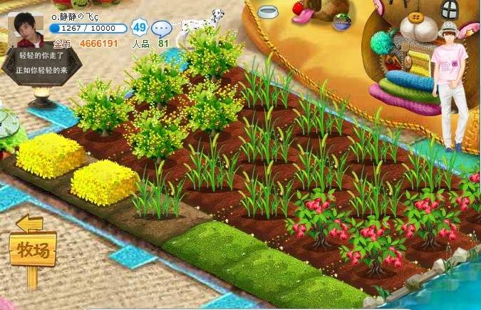
Daniel and Millie have their own farms. They often work on their farms after school. What can they get from their farms?

Slide 9
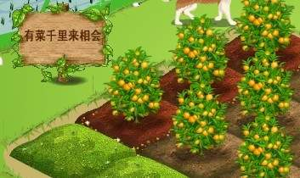
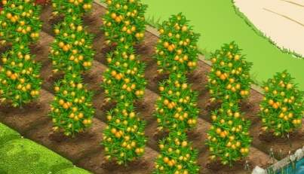
Daniel’s farm
Millie’s farm
→
many
more
Millie has more oranges than Daniel.
more … than 比……多
Daniel has fewer oranges than Millie.
fewer … than 比……少

Slide 10
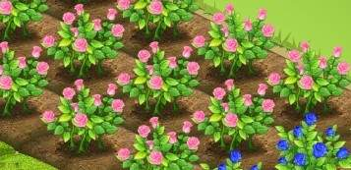
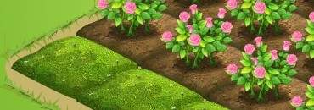
Millie’s farm
Daniel’s farm
Millie has _____ flowers ______ Daniel.
more than
fewer than
Daniel has _______ flowers ______ Millie.

Slide 11
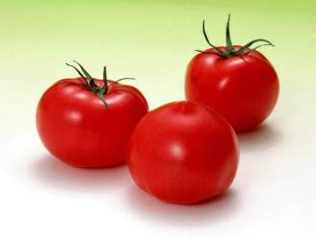
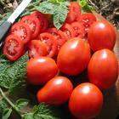
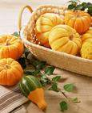
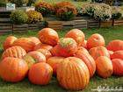
Millie’s farm
Daniel’s farm
more…than
fewer…than

Slide 12
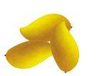
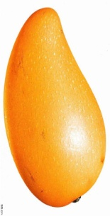
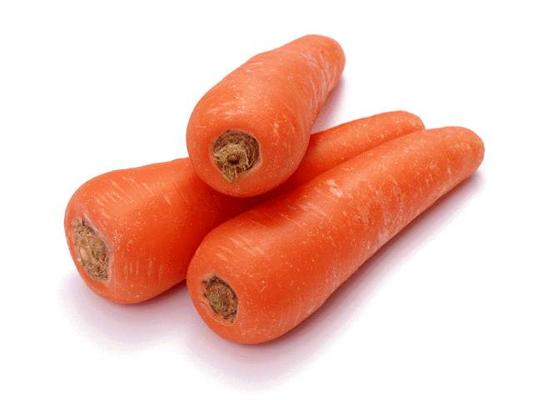
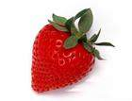
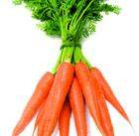
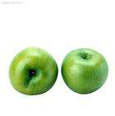
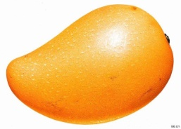
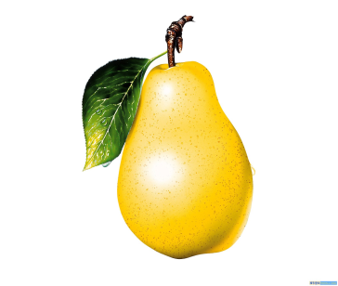
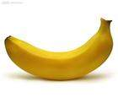
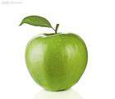
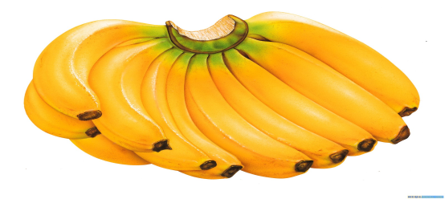
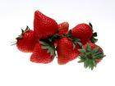
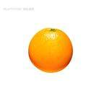


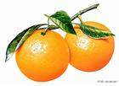
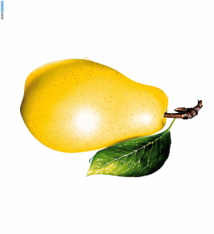

Millie’s farm
Daniel’s farm
Make a conversation like this
A: Can you see carrots on their farms?
B: Yes, Daniel gets more carrots than Millie. Can you see grapes on their farms?
A: Of course, Millie gets fewer grapes than Daniel.

Slide 13
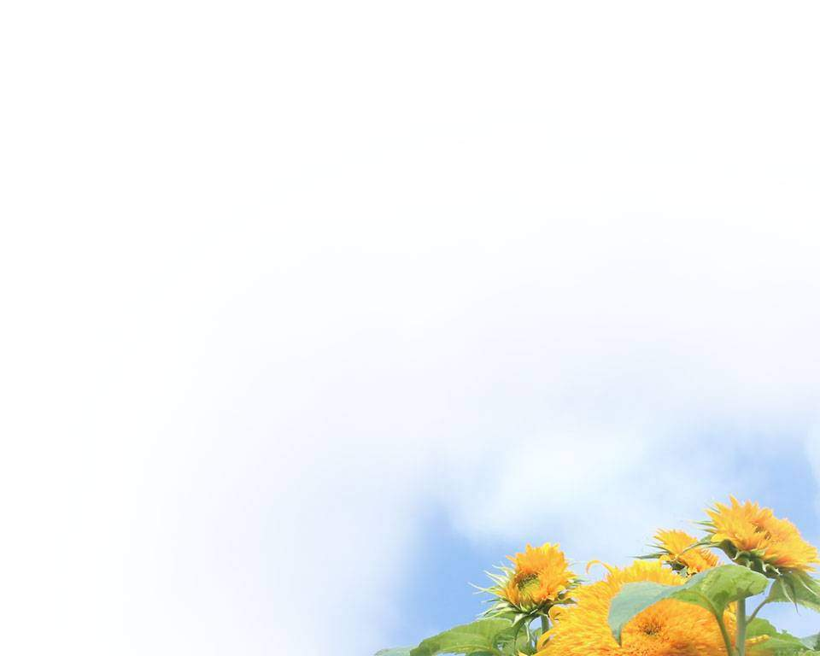
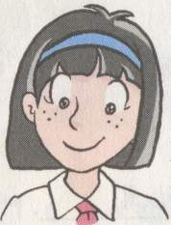
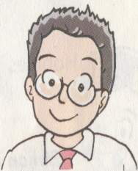
10hours
7hours
more than
Millie spends _______ time on the farm _______ Daniel.
Daniel spends _______ time on the farm _____Millie.
less than
less …than 比…….少

Slide 14
￥100
￥80
Millie can get_______ money _______Daniel.
Daniel can get _______money ________ Millie.
more than
less than

Slide 15
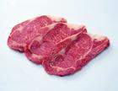
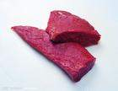





Let's compare!
more…than less…than
Daniel Millie
meat
fish
ice-cream
juice

Slide 16

Comparing two things:
work out
the rule
两者在数量上的比较，可以用下列结构：
more
fewer
+ countable nouns
+ than
可数名词
more
less
+ uncountable nouns
+ than
不可数名词

Slide 17
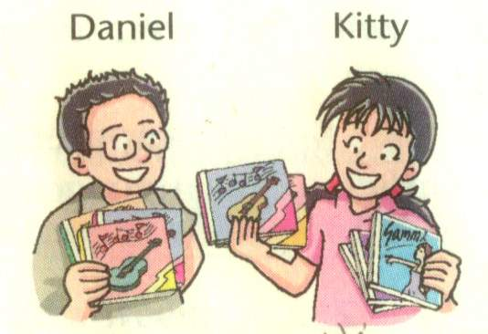
Comparing their CDs
Kitty has ______________ Daniel.
more CDs than
Daniel has _____________ Kitty.
fewer CDs than

Slide 18
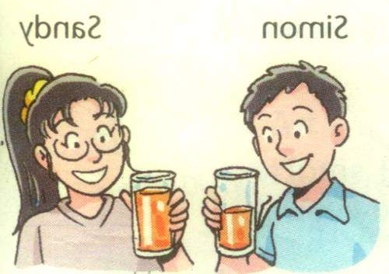
Comparing their juice
Sandy
Simon
Sandy _________________________Simon.
has more orange juice than
less
Simon has ____ orange juice ____Sandy.
than

Slide 19
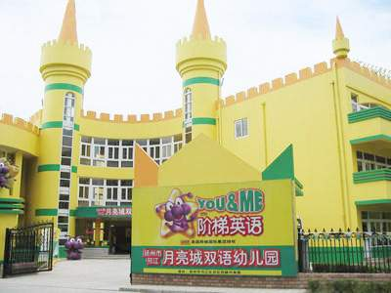
Beijing Sunshine Secondary School

Slide 20


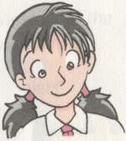
Subjects
7
9
6
Millie studies many subjects.
Daniel studies more subjects than Millie.
Kitty studies the most subjects.
many—more—the most

Slide 21
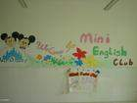

clubs
3
2
1
Millie joins a few clubs.
Daniel joins fewer clubs than Kitty.
Kitty joins the fewest clubs.
few—fewer—the fewest

Slide 22
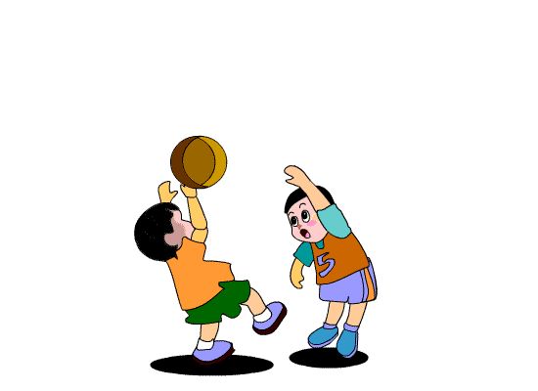
free time
3hours
2hours
1hour
Millie has a little free time.
Daniel has less free time than Millie.
Kitty has the least free time.
little-- less--least

Slide 23

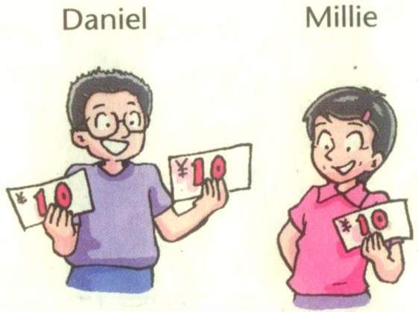
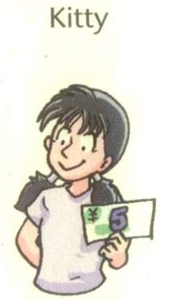
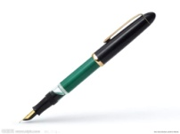
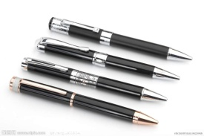

Helping Hands Club
Comparing their pens
Kitty has the most pens of the three.
the fewest
Daniel has ___________pens of the three.

Slide 24
Helping Hands Club
Comparing their money
Daniel has the most money of the three.
Kitty has ________ money of the three.
the least

Slide 25
Comparing more than two things:
三者或三者以上在数量上比较，可用最高级。
the most
the fewest
+ countable nouns
the most
the least
+ uncountable nouns
Remember
many—more—the most
much—more—the most
few—fewer—the fewest
little—less—the least

Slide 26
Look at the table below and complete the sentences.
Subjects | 6 | 8 | 12
Clubs | 3 | 2 | 4
Free time each day | 4 hours | 3 hours | 1 hour
Nancy
John
Daniel
John studies _____ subjects than Nancy, but he studies ______ subjects than me. I study the _____ subjects among the three of us.
more
fewer
most

Slide 27
Look at the table below and complete the sentences.
Subjects | 6 | 8 | 12
Clubs | 3 | 2 | 4
Free time each day | 4 hours | 3 hours | 1 hour
Nancy
John
Daniel
more
2. Nancy is in _____ clubs than John, but she is in _____ clubs than me. John is in the ______ clubs among the three of us.
fewer
fewest

Slide 28
Look at the table below and complete the sentences.
Subjects | 6 | 8 | 12
Clubs | 3 | 2 | 4
Free time each day | 4 hours | 3 hours | 1 hour
Nancy
John
Daniel
3. I have ____ free time than John, but Nancy has _____ free time than John. Among the three of us, I have the ____ free time and Nancy has the ____ free time.
less
more
least
most

Slide 29

An interview
A reporter from Changzhou TV wants to know the life in your free time.
Activities | A | B | C
Books | 10 | 5 | 6
Clubs | 2 | 4 | 3
TV time | 2 hour | 3 hours | 4hours
Sports time | 30 minute | 1 hour | 20 minutes
Hello! Everyone ,here is a report about the life in summer holiday, A read the most books ,but he joined the fewest clubs, C spent the most time on TV and the least time on sports. I think it’s not very good for heath….

Slide 30
句子翻译。
1.米莉吃饭比丹尼尔多，但喝水比他少。
Mille eats_________ rice than Daniel, but she drinks_________ water than him.
2.在我们班上，凯特的故事书比玛丽少，但梅的故事书最少。
In our class, Kate has________ storybooks than Mary, but May has the_________.
3.你的作业最少，而我的最多。
You have the_________ homework, and I have the _________homework.
4.在一班的所有学生中，他的自由时间最少。
Among all the students in Class1, he has the _________ _________ time.
5.我的钱没你的多，但我的朋友比你的多。
I have _________ money than you, but I have _________ friends than you.
more
less
fewer
fewest
least
most
least
free/spare
less
more

Slide 31

Grammar B

Slide 32
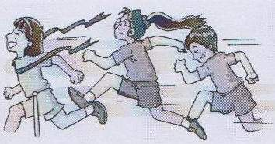
Comparative and superlative adverbs
We can form comparative and superlative adverbs in the same way we form comparative and superlative adjectives.
Amy Sandy Millie

Slide 33
Millie came third in the race. She ran fast.
Sandy came second in the race. She ran faster than Millie.
Amy came first in the race. She ran the fastest.

Slide 34
We form comparative and superlative adverbs like this:
Adverb | Comparative | Superlative
Most short adverbs | + er | + est
hard high | harder higher | hardest highest

Slide 35
Adverb | Comparative | Superlative
Long adverbs | more + | most +
quickly carefully | more quickly more carefully | most quickly most carefully

Slide 36
Adverb | Comparative | Superlative
Irregular adverbs | replace the word | replace the word
well badly far | better worse further/father | best worst furthest/farthest

Slide 37
My classmates
Complete the sentences with the correct forms of the words in brackets.
1. Sandy draws _____ (well). She draws _____ (well) than any other student in my class. She draws ____ (well) of us all.
well
better
best

Slide 38
2. David jumps ____ (high). He jumps _______ (high) than any other of my classmates. He jumps _________ (high) in my class.
3. Amy swims ____ (fast). She swims _____ (fast) than all my other classmates. She swims _________ (fast) in my class.
high
higher
the highest
fast
faster
the fastest

Slide 39
4. Millie writes ______ (quickly). She writes ____________ (quickly) than the other students in my class. Millie writes ______________ (quickly) of us all.
quickly
more quickly
the most quickly

Slide 40
Language points
1. come first/second /third
first, second, third 作副词用
2. She draws better than any other student in my class.
any 指任何一个， 名词student用单数
= She draws better than the other
students in my class.
= She draws the best in my class.

Slide 41
Exercises
改错。
1. Mr. Smith eats the fewest beef.
2. Tom has least sheep of them.
3. Mary has the more bread than her classmate.
least
the fewest

Slide 42
less
4. The students in China have little free time than those in the UK.
5. Cindy has less friends in his new school than in his old school.
fewer

Slide 43
1. Sandy喝的水比Simon少。
翻译下列句子。
Sandy drinks less water than Simon.
2. Daniel学的科目比John多。
Daniel studies more subjects
than John.
3. Millie的中国朋友比Daniel多。
Millie has more Chinese friends
than Daniel.

Slide 44
4. 李雷是我们班跳的最远的。
Li Lei jumps __________ in my class.
=Li Lei jumps _____ than ________________ in my class.
=Li Lei jumps _____ than ________________ in my class.
the farthest
farther
the other students
farther
any other student

Slide 45

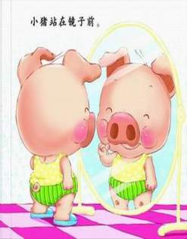
Enjoy school life, enjoy every day!

Slide 46
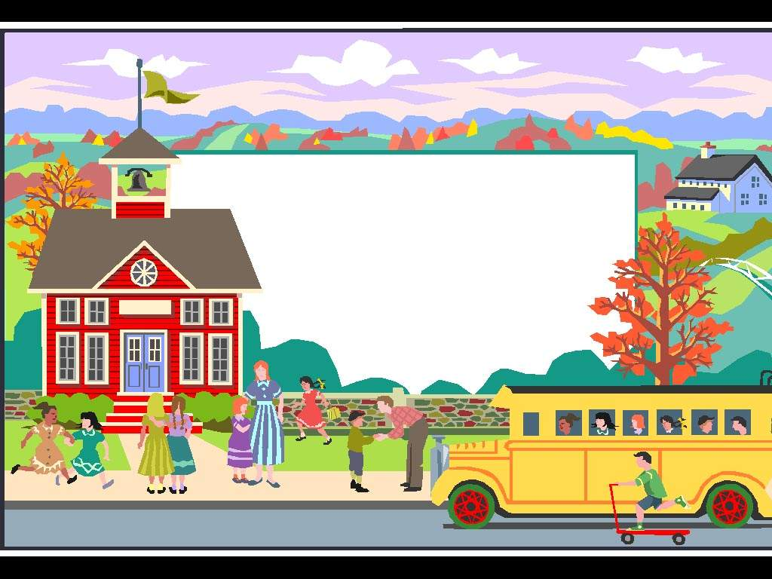
May you
a happy school life!

Slide 47

Good bye！

