Slide 1
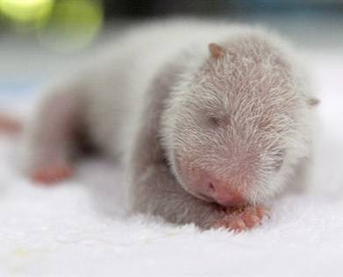
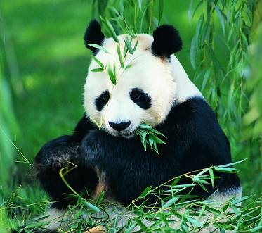
Unit 5
Wild animals
Reading2

Slide 2

Language points

Slide 3
1. Eight months later, she was not a small baby any more …
not … any more ＝ no more 没有，不再
He didn’t come here any more.
＝He no more came here.
他不再来这儿了。
He is not a child any more.
= He is no more a child.
他不再是个孩子了。

Slide 4
2.in the beginning =at first
1. In the beginning we thought we'd never get it all arranged. 在开始的时候，我们以为不会把它全安排好。
2. In the beginning I felt very lonely in London. 起初，我在伦敦觉得非常孤独。

Slide 5
3.face 的用法
1. 用作名词，表示“脸”，注意其前连用介词的大致情形：
(1) 表示打在脸上，通常用介词 in。如：
He hit me in the face. 他打了我的耳光。
His wife slapped him in the face. 他妻子打他耳光。
(2) 表示面部表情等，通常用介词 on。如：
He had a surprised expression on his face. 他脸上露出了惊讶的表情。
He came with a smile on his face. 他微笑着走来。
比较：He came with a smiling face. 他微笑着走来。
2. 用作动词，用于本义，表示“朝向”，可用作及物或不及物动词。如：
Turn round and face me. 转过身来面对着我。
The window faces (on) the street. 窗户对着街道。
【注】用作引申义，表示“面临”“正视”等，通常只用作及物动词。如：
He faced the danger bravely. 他勇敢地面对困难。

Slide 6
4. For example, it is very difficult for pandas to have babies, …
It is difficult/hard/easy for sb. to do sth.
对某人来说，做某事很难/容易
It is not easy for such a little boy to learn a foreign language.
对于这样小的男孩而言，学外语不容易。
It's very hard for him to study two
languages.
对他来说学两门外语是很难的。

Slide 7
5.live on 以...为食，住在...上
1. It was becoming more and more difficult to live on his salary.
他越来越难以靠他的工资维持生计了。
2. I live on the ground floor.
我住在一楼。

Slide 8
6.become smaller and smaller
“比较级 + and + 比较级”或“more and more +原级”表示“越来越……”
如：It becomes warmer and warmer when spring comes.
春天来了，天气变得越来越暖和了。
It is getting cooler and cooler.天气越来越凉爽。
The wind became more and more heavily 风变得越来越大。
Our school is becoming more and more beautiful. 我们的学校变得越来越美丽。
“the +比较级……, the+比较级”，表示“越……越……”。
The more money you make, the more you spend.
钱你赚得越多，花得越多。
The more，the better.越多越好。

Slide 9
7.as a result
★as a result是一个习惯短语，意为“因此”“结果”。如：
① He didn’t practice, and as a result he lost. 他没有练习，所以输了。
② He fell off the bike and hurt his leg yesterday. As a result he had to be away from school for two or three months. 昨天他从自行车上掉了下来，摔伤了腿。因此他不得不休学两三个月。
③ The traffic was very heavy and as a result we didn’t arrive on time. 交通十分拥挤，因此我们没能准时到达。
★as a result of意为“因为”“由于”“„„的结果”，用来作状语。
如： He was late as a result of the heavy snow. 他迟到是由于大雪所导致的。
★result用作名词，意为“结果”“效果”“后果”“比赛的结果”“(考试)成绩”等。如：
The result of the match was a draw. 这场比赛的结果是平局。（不分胜负）
I heard the football results on the radio. 我在广播中听到了足球比赛的结果。

Slide 10
8.in danger
1. You will be in danger if you walk on a railway line.
如果你在铁路轨道上行走那是很危险的。

Slide 11
9.take action
take action 采取行动；提出诉讼
eg: We have to take action.
我们必须采取行动。
3. We had to take action to protect the gaint pandas.
我们必须采取措施保护大熊猫。
take action to= do something to do sth

Slide 12
10.right away 立刻、马上
He did not reply to her question right away
他没有马上回答她的问题。
11.make laws制定法律
First of all, we must make laws.
首先必须立法。

Slide 13
12.Can you translate the following sentences?
protect
及物动词，保卫，保护。后面跟名词或代词作宾语。
Protecting wild animals is very important
for us.
对我们来说，保护野生动物是很重要的。
When I am in danger, my parents always
do their best to protect me.
当我遇到危险时，父母总是尽力保护我。

Slide 14
2) protect … from (against) sth.
保护……不受侵害。对于较小的事通常用from，而对于较大的事常用against。
The umbrella can protect us from the rain.
伞能保护我们不被雨淋。
We should protect our country against the attack.
我们应该保护我们的国家不被侵犯。

Slide 15
根据所给中文完成句子。
他穿了雨衣以防被雨淋。
He wore a raincoat to _______ himself
_____ the rain.
2. 动物是怎样保护自己的？
How do animals _______ __________?
3. 他们挤在一起，免受风吹。
They huddled together to _______
themselves _______ the wind.
protect
from
protect
themselves
protect
from

Slide 16
13.none 的用法
1)可与of连用；
2)谓语动词用单或复数；
3)具体指什么人或物；
4)一般用来回答how many +n,how much +n及含any+n引起的疑问句。
1)None of us have/has seen him.
2)——How many students are there in the room?
——None.
3)——Is there any water in the thermos?
——None.
4)——How much money do you have on you?
——None.

Slide 17

14. . However, we do believe that where
there is Xi Wang, there is hope.
然而，我们坚信熊猫在，希望就在。

Slide 18


请点击

Slide 19

I. 根据汉语提示及句子意思写出单词。
mean
1. What does this word _____ (意思是)?
2. “He’s gone away for six months,” she
said _____ (伤心地).
3. Williams ______ (面临) a serious
problem at the moment.
4. She’s going to study _____ (法律) at
university.
5. She went to the shop to get some
oranges but they had _____ (没有一个).
sadly
faces
law
none

Slide 20
II. 根据汉语提示完成句子。
1. 她生于2000年。
She ________ in 2000.
2. 一开始，我很喜欢我的工作，但现在
我很厌烦这工作。
I enjoyed my job ______________,
but I'm bored with it now.
3. 我上学时只能靠粗茶淡饭过活。
I had to ______ bread and water
when I was a student.
was born
in the beginning
live on

Slide 21
4. 因此，他过了个愉快的假期。
__________, he had a happy vacation.
5. 他有生命危险。
His life was _________.
6. 我们必须在它蔓延到其他区域前采取
行动处理问题。
We must __________ to deal with the
problem before it spreads to other areas.
7. 请立刻把它打印出来。
I want it typed __________, please.
As a result
in danger
take action
right away

Slide 22
III. 单项选择。
She got up to get some sleeping pills but found there was ______ left at home. (2012江苏无锡)
A. nothing B. none
C. something D. nobody

Slide 23
— How many birds can you see in the
tree?
— ______. All the birds have flown
away. (2012江苏徐州)
A. None B. No one
C. Nothing D. A few

Slide 24

Preview
To preview Grammar
1) Using may for possibility
2) Using verbs + to-infinitives

Slide 25



Thank you!

