Slide 1
Unit 4
Do it yourself
Task

Slide 2
What happened to the cat when Suzy’s cousin finished painting the whole living room blue?
Could Suzy put the books on the shelf made by her cousin? Why?
Why did Suzy’s cousin feel unhappy when Suzy advised him to take a course in DIY?
Is Suzy also weak at DIY?

Slide 3
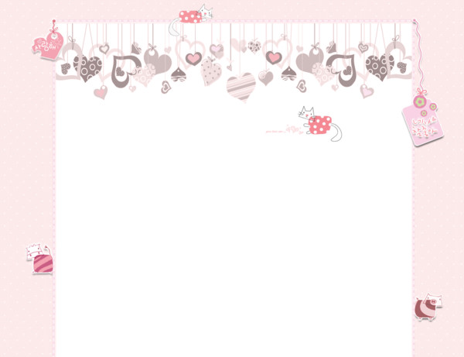
Free talk
If your mother’s birthday is coming, what gift are you going to give her?

Slide 4
a birthday cake

Slide 5
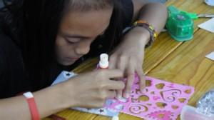
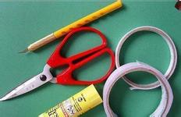
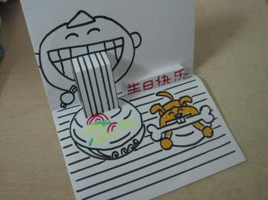
Make a birthday card zxxk

Slide 6
Listen carefully and answer the questions
What did Suzy want to make her mother?
A birthday card.
2. What’s on the card?
There are some red, blue and pink roses and a
sentence on it.
3. How long did they spend making the card?
It took them two hours to finish it.

Slide 7
Read carefully and answer the questions
Why didn’t Suzy make the card at home?
Because she wanted to make it secret.
2. What did Sandy help with?
Sandy helped Suzy with the drawing.
3. What mistakes did Suzy keep making when she was making the card?
She kept spelling the words wrong.
4. What colour did she colour the roses?
She coloured the roses red, blue and pink.
5. What happened to the house and the two girls?
There was paint on everything: the table, Sandy’s books,
Suzy’s hands and face.

Slide 8
Language points
1. Mum’s birthday is coming, so I decided to make her a birthday card by myself.
(1) Mum’s birthday is coming.
用现在进行时表示马上要发生的动作或事情。
公交车马上要来了。
The bus is coming.
——Lucy, can you come and help me?
——Ok, mum. I .(come)
am coming

Slide 9
Language points
1. Mum’s birthday is coming, so I decided to make her a birthday card by myself.
(2) decide to do sth. 决定去做某事
decide not to do sth. 决定不去做某事
我决定周末做个手工。
I decided to do a DIY job at the weekend.
Tom 决定不玩火柴了。
Tom decided not to play with matches.

Slide 10
Language points
1. Mum’s birthday is coming, so I decided to make her a birthday card by myself.
(3) make sb. sth. 给某人制作某物
make sth. for sb.
类似的词还有：
buy sb. sth. = buy sth. for sb.
cook sb. sth. = cook sth. for sb.
与 to do 结构要正确区分。

Slide 11
Language points
2. ……because I wanted to keep it secret.
(1) keep a secret / keep secrets 保密
(2) keep it secret 使它（保持）秘密（状态）
keep + sb. / sth. + adj.
让我们的教室保持干净。
Let’s keep our classroom clean and tidy.

Slide 12
Language points
3. I planned to make the card with some roses on it.
(1) plan to do sth. 计划做某事
(2) plan not to do sth. 计划不做某事
plan —— planned ——planning
(3) with some roses 带玫瑰花的卡
一张带相片的贺卡
a card with a picture

Slide 13
Language points
4. We had fun working together.
(1) have fun doing sth. 做某事很快乐
(2) have a great time doing sth.
Look! The students are having a great time
(play) on the playground.
5. Lots of things went wrong during that time.
(1) go wrong 出错
似乎所有事情都出错了。
Everything seemed to go wrong.
It seemed that everything went wrong.
playing

Slide 14
Language points
6. I kept spelling the words wrong.
我一直拼错单词。
7. I coloured the roses red.
colour sth. + adj. = paint sth. + adj.
万圣节的时候，人们把脸涂成各种颜色。
At Halloween, people paint / colour their faces different colours. Zxx，k

Slide 15
Language points
8. I cut out a picture of colourful balloons and stuck it on the cover.
我剪出一张有彩色气球的图片把它贴到封面上。
(1) cut out
(2) stick A on B
请把这张时刻表贴到墙上。
Please stick the timetable on the wall.

Slide 16
Language points
9. When I completed the card, there was paint on everything.
complete= finish
paint v. 涂
paint n. 颜料 （不可数）
10. This is the first card（I made for Mum）.
I made for Mum 充当 the first card 的定于从句，翻译成：这是我给我妈妈制作的第一张贺卡。

Slide 17
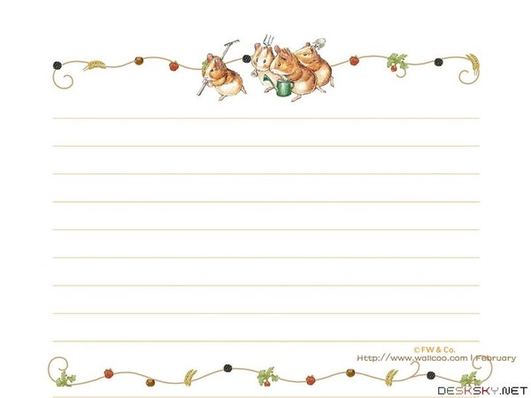
The reason why Suzy made a birthday card.
Para1:
Para 2:
Para 3:
Para 4:
How she made the card.
What happened in the end.
Suzy’s hope.

Slide 18
The reason why Suzy made a birthday card.
Para1:
Useful expressions:
1. I decided to ……by myself.
2. I …… because……

Slide 19
Para 2:
How she made the card.
Useful expressions:
1. ……helped me.
2. We had fun working together.
3. It took ……to finish
4. I made some mistakes when……

Slide 20
Para 3:
What happened in the end.
Useful expressions:
1. Finally / In the end……
2. When I completed ……，……

Slide 21
Para 4:
Suzy’s hope.
Useful expressions:
1. This is the first ……
2. I hope …… will like it / them.

Slide 22
1. 决定（不）做某事
2.让它保密
3.计划做某事
4.做某事很有趣（2种）
5.出错
6.不断做某事
7.拼错单词
8.把某物涂成红色
9.把某物贴在封面上
decide (not) to do sth.
keep it secret
plan to do sth.
have fun/a great time doing sth.
go wrong
keep doing sth.
spell the word wrong
colour / paint sth. red
stick sth. on the cover
10.我为我妈妈做的第一张贺卡
the first card I made for Mum

Slide 23
Work in groups of four.
Write an article about a DIY job.

Slide 24
父亲节快来了，我决定给父亲做个书架。Daniel来帮我，还带来了工具。请根据下面的步骤完成文章。
1. 在网上订购了材料。（order, building materials);
2. 先看说明书，然后开始工作。
3.我不会使用榔头，丹尼尔教我如何使用。(hammer)
4. 太激动犯了小错误。榔头敲到了手。（hit）
5. 把书架漆成蓝色——我父亲最喜欢的颜色。
6. 完工后，地上、身上都是油漆。

