Slide 1
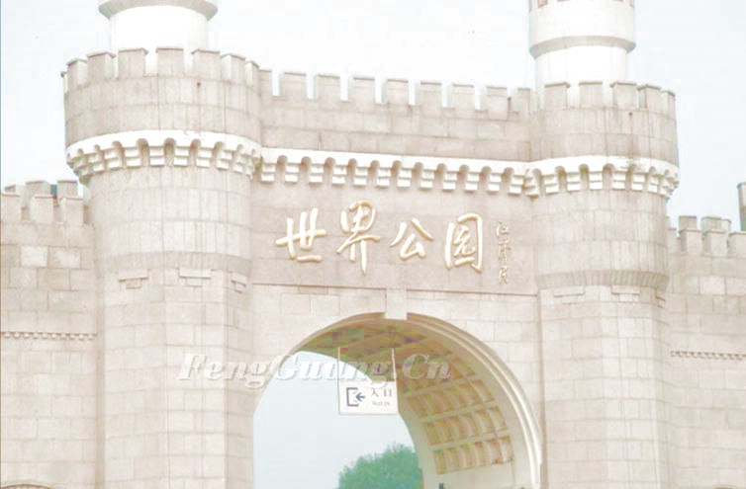
Reading 1
Around the world in a day!

Slide 2
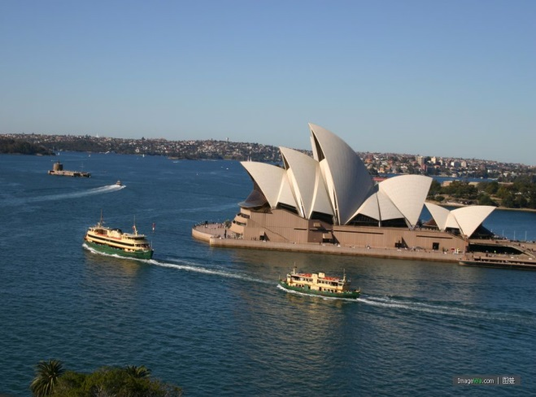
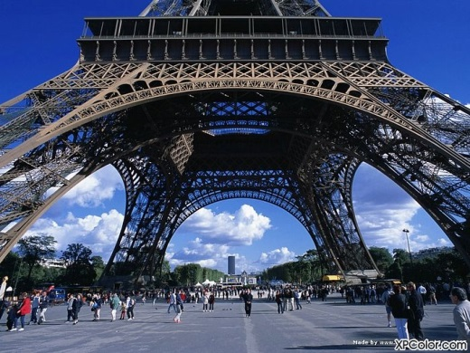
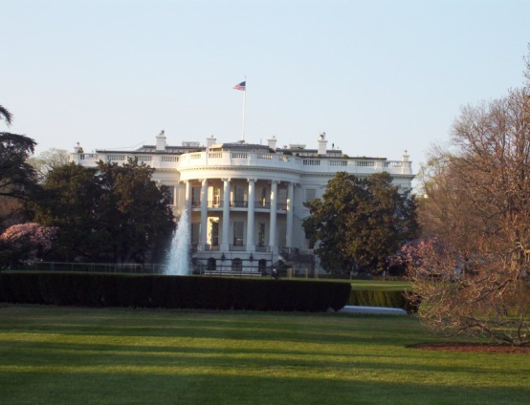
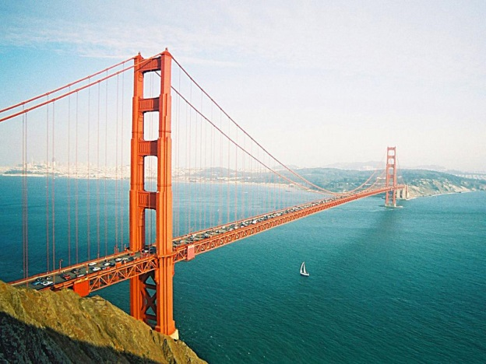
the Opera House
dHow can we visit them in a day?
ream
the Eiffel Tower
the White House
the Golden Gate Bridge

Slide 3
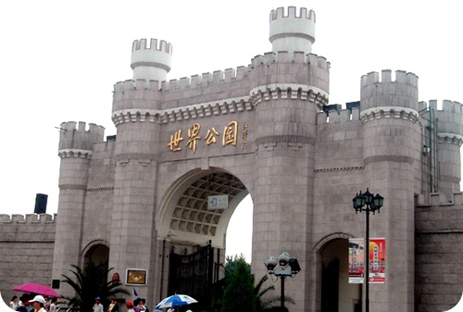
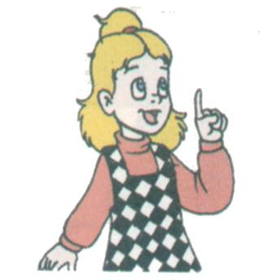
the World Park

Slide 4
Self-learning 1
（1）自学内容: the passage.
（2）自学方法:
Students read the passage, then answer questions.
1.Who writes the email?
2.Where did they visit?
B. Students try to find some new words that they don’t
understand, discuss and learn in groups.
C. Finish Part B1 on Page33. Then check the answers
in groups.
知者加速：Can you make some sentences with some
of the new words?

Slide 5
skimming
1.Who writes the letter?
2.Where did they visit?
Linda
They visited the World Park.

Slide 6
Try to finish Part B1,on P33.

Slide 7
Mini dictionary
1. join
2. journey
3. boring
4. finally
5. arrive at
6. whole
7. main
8. sights
d
a. full
b. get to a place
c. places of interest
d. take part in
e. not interesting
f. a long trip
after a long time
h. most important
f
e
g
b
a
h
c

Slide 8
Self-learning 2
（1）自学内容: Understand the main
idea of the passage.
（2）自学方法:
Read the passage carefully, then try to
find Linda’s different feelings during
the trip. (4 words) Discuss in groups.

Slide 9
the feelings of Linda
Inside the park
amazed
excited
happy
see the model Eiffel Tower
at the school gate
bored
on the way
Notes:
You know much about the trip now.
Could you please tell your friends when Linda and Kitty felt happy, bored, sick, excited, amazed. Why?
Work in pairs. Retell the story.

Slide 10
Self-learning 3
（1）自学内容:Enjoy a passage and read
after the tape.
（2）自学方法:
A. Listen to the tape , try to follow it.
B. Read the passage one para by one
para according to PPT, finish the exercises.
C. Finish Part B2&B3 , check answers in
groups.

Slide 11
Scanning
Read Para1-2 and fill in the table
A trip to the World Park in Beijing
Who
Weather
How
How far
Linda and the Class 1, Grade 8 students
a fine warm day
by bus
two hours by bus

Slide 12
Scanning
Read Para3-5 and answer the questions
What did Linda see in the World Park?
Models of more than a hundred places of interest from all over the world.
small and wonderful
The model Eiffel Tower.
steel, tall
The model Golden Gate Bridge.
great
The song and dance shows.
wonderful

Slide 13
after the trip
1. How can Linda’s mother know more about the
trip?
She can see some photos of the trip on the Internet.
2. Who put the photos on the Internet?
Daniel.
Notes:
It was an amazing day. I want to know more about the trip.
7. How can we know more about the trip?
We can see the photos of the trip on the Internet.
8. Who put the photos on the Internet? Why?
Daniel. He put his photos on it for everyone to look at.
What do you think of Daniel?
I think Daniel is helpful.

Slide 14
Try to finish Part B2&B3 on P33-34.

Slide 15
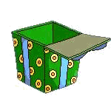
Discussion
Why do people like travelling?
Travelling is not just for fun.
It helps us know people, nature, history…
It can open our eyes, learn more knowledge and
improve ourselves.

Slide 16
The students are talking with Daniel in their QQ Group. Complete the missing parts.

Slide 17
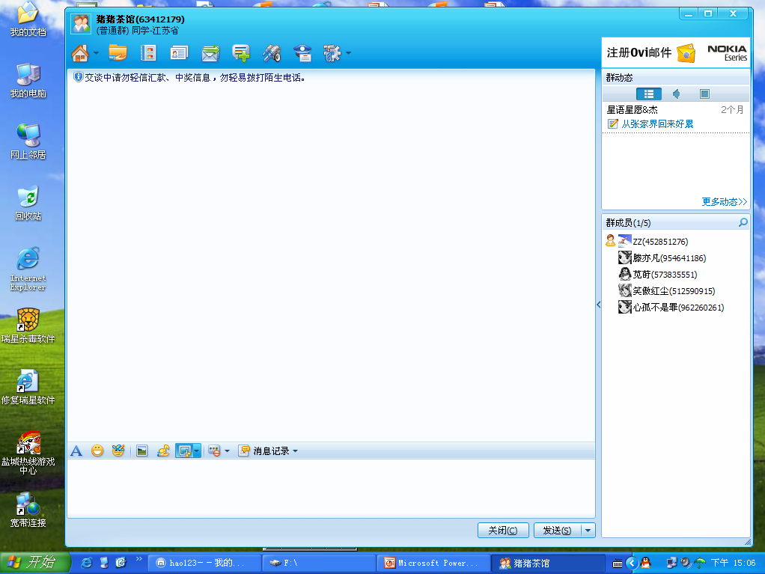
David 19:56:12
Hi, everyone, come out!
Mary 19:56:35
Who did you go with today?
David 19:56:40
I went to the World Park with Linda and my classmates.
Mary 19:56:45
Great. How did you go there?

Slide 18
David 19:57:18
By bus.
Rose 19:57:22
Did Linda enjoy it at the beginning?
David 19:57:58
No, it was boring on the way. There was a lot of traffic.

Slide 19
Rose 19:58:00
How long did it take to get there?
David 19:58:04
Two hours.
Rose 19:58:26
Great! How many models of places of interest are there?
David 19:59:02
Over one hundred.

Slide 20
Peter 19:59:58
Which places of interest did you see?
David 20:00:15
The model Golden Gate Bridge, the model Eiffel Tower and many other interesting places.

Slide 21
Tom 20:01:35
What did you learn from the trip?
David 20:02:18
We learnt a lot about different cultures.
Tim 20:02:35
Do you also feel very excited ?
David 20:02:48
Yes, of course.

Slide 22
Homework
最小作业量
1.熟读文章。
2.大课堂对应练习
知者加速
大课堂上关于本课语言点的讲解和拓展

Slide 23
Thank you!
Goodbye!

