Slide 1
Unit 6 Birdwatching Task
-
-

Slide 2
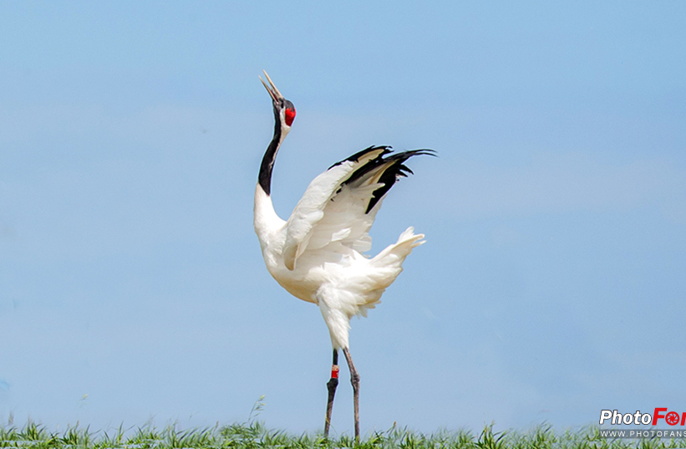
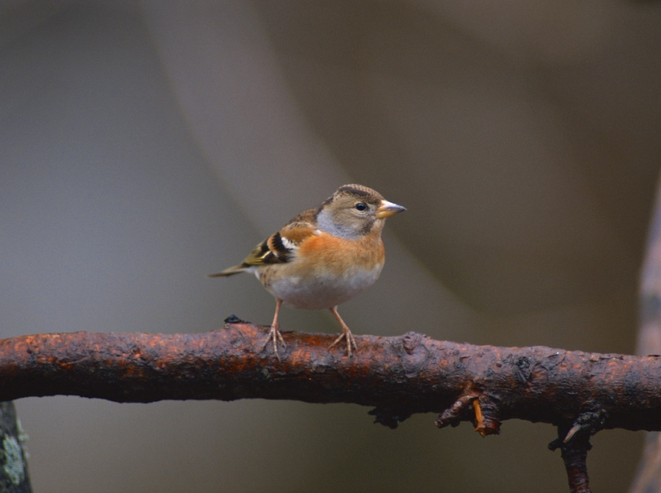
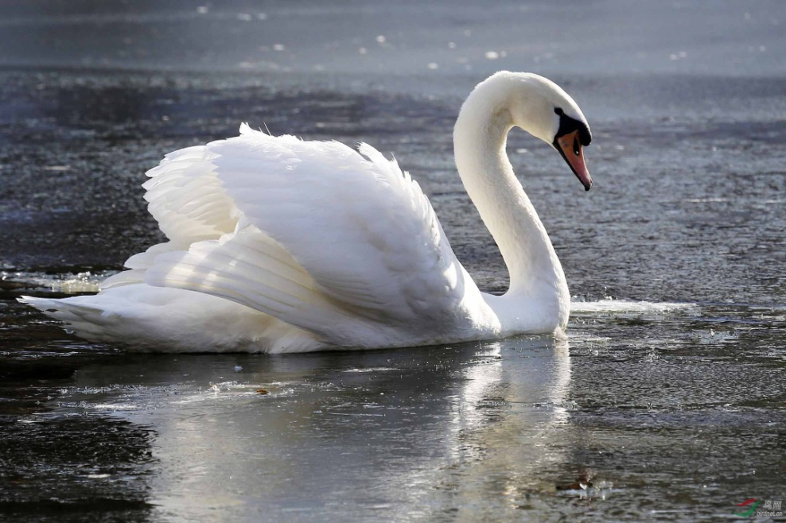
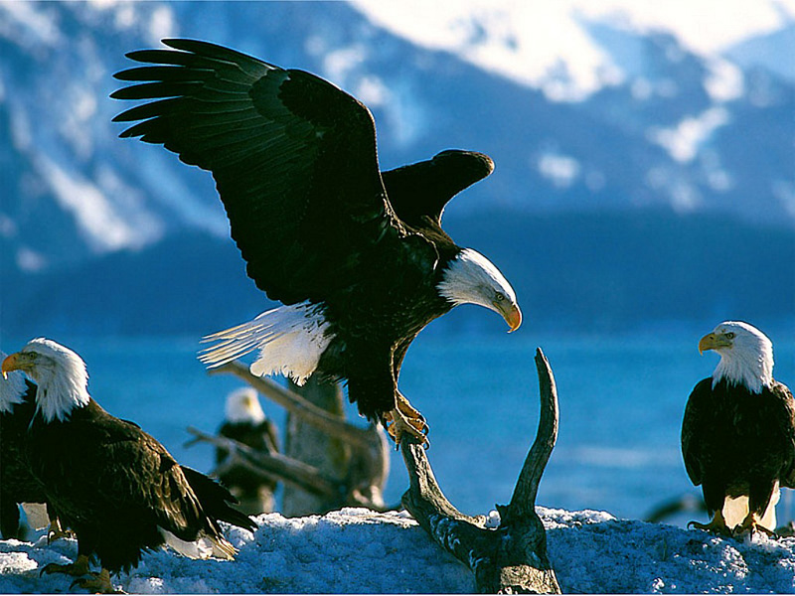
Guessing Games

Slide 3
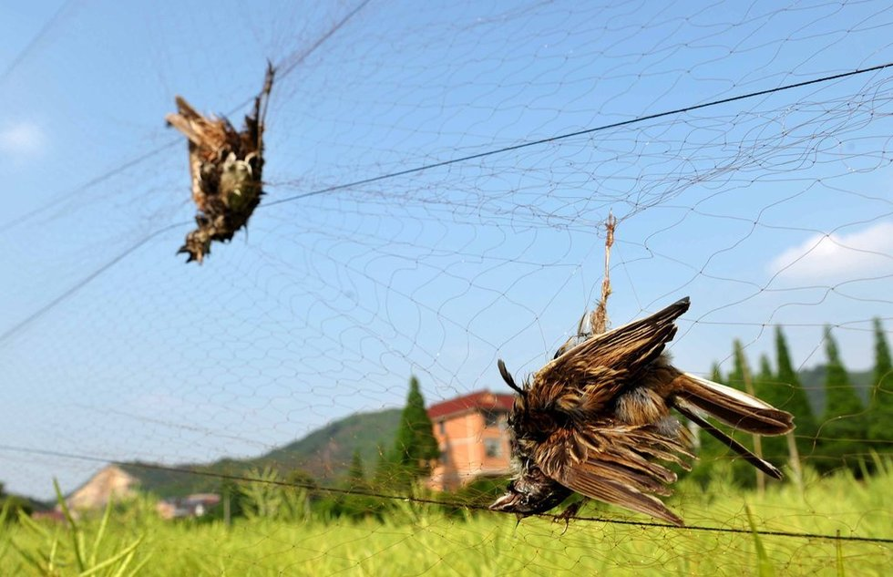
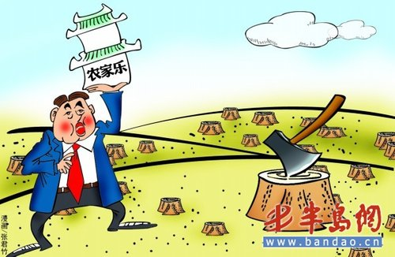
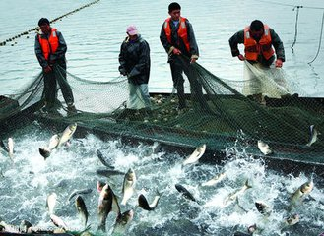
In danger
Overfish 过度捕鱼

Slide 4
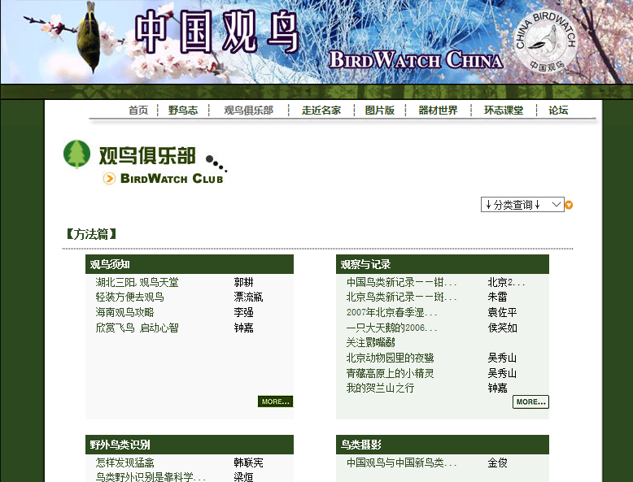

Slide 5
An application form

Slide 6
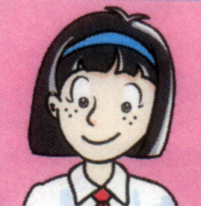
Amy’s application form
Amy
Name
School
Grade
Telephone number
Email
Favourite subject
Interests
Activities to protect wildlife：
Free time
Sunshine Middle School
Grade 8
010-5558 6390
amy@sunshine.com
Biology
Different kinds of plants, birds and animals
The natural world
Know more about birds
Do something to protect them
From 2 p.m. to 5 p.m. on Sundays

Slide 7
An application form
Name
School
Grade
Telephone number
Email
Favourite subject
Interests
Activities to protect wildlife：
Free time

Slide 8
Amy’s application letter
to join
Para1 | She wants ________the Birdwatching Society.
Para2 | She writes about her________, _________, ________ and so on.
Para3 | She wants to _______________ birds. She also thinks it is important ___________them.
Para4 | He/She can ______her or ______her.
school
interests
hobbies
know more about
to protect
call
email

Slide 9
Make a dialogue according to Amy’s application form.
A: Why does Amy write the letter?
B: Because she… What is Amy interested in?
A: She is …If she can be a member of the society, what does she want to do?
B: She … What does she think is important?
A: She thinks …
B: Will the chairperson write back to her?
A: … The chairperson will…

Slide 10
How many paragraphs does it have?

Slide 11
Amy’s activities to protect wildlife
Para1
Para2
The ways to Contact(联系)
Para3
Purpose(目的) of the letter
Para4
Self-introduction(自我介绍)

Slide 12
How to write an application letter ?
1.Clear structure(清晰的结构)

Slide 13
Amy’s application letter
to join
Purpose(目的) of the letter | She wants ________the Birdwatching Society.
Self-introduction | She writes about her_______, ________, _________, ________ and so on.
Amy’s activities to protect wildlife | She wants to _______________ birds. She also thinks it is important ___________them.
The ways to Contact(联系) | He/She can ______her or ______her.
name
school
interests
hobbies
know more about
to protect
call
email

Slide 14
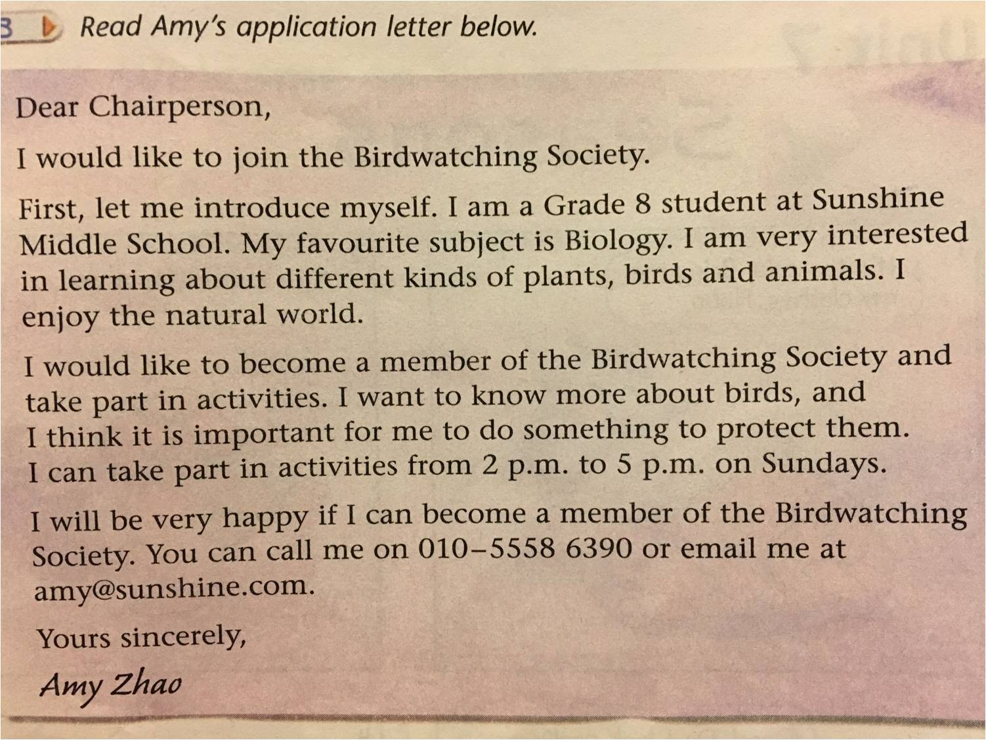
Find good expressions.
Other expressions.

Slide 15
2.Useful expressions
My favourite subject is…
I am interested in…
I show great interest in…
I’m fond of doing sth
I can take an active part in…
I can take part in…actively
I would like to be a member of…
I think it is important for me to…
too…to…

Slide 16
How to write an application letter ?
1.Clear structure(清晰的结构)
2.Useful expressions(常见表达)

Slide 17
Find transitions(过渡语).
not only
but also
Besides
Other transitions (过渡语).

Slide 18
Transitions(过渡词)
表并列：not only…but also…
表列举：for example, that is to say
表补充：besides, moreover, what’s more
表原因：because, because of, as a result of
表结果：therefore, as a result, so
表结论：Generally speaking , in a word, to sum up
表转折：however, yet

Slide 19
How to write an application letter ?
1.Clear structure(清晰的结构)
2.Useful expressions(常见表达)
3. Proper transitions(过渡语)

Slide 20
Writing time: Please write an application letter of your own.
It’s your turn!
Clear structure
Para1 Purpose(目的) of the letter
Para2 Introduce yourself
Para3 Activities to protect wildlife
Para4 The ways to Contact(联系)
Language
Useful expressions
Transitions(过渡词)

Slide 21
Evaluation Criteria评分标准
Are you excellent enough to be a member?
结构(3’) | 文章整体层次分明，共……段。
2. 内容表达(2’) | 文章中运用了优美的词语，例如……
3. 过渡语(1’) | 作者还在文中使用了一些过渡语，如……
4. 准确度(3’) | 文章没有拼写或者语法错误。/如果作者能够……，文章会更好。
5. 书写(1’) | 书写工整。

Slide 22
Evaluation(评价) time
Self-editing: Revise your article by yourselves according to the given criteria(标准)
Peer-editing: Share your article with your partners and evaluate (评价) the articles.
Group-editing: discuss about your articles and choose the best one to share in class

Slide 23
Show time
Who can be the member of the Birdwatching Society?

Slide 24
Birds are our friends.
Protecting birds means protecting ourselves.

Slide 25
Homework
Better your application letter.

