Slide 1
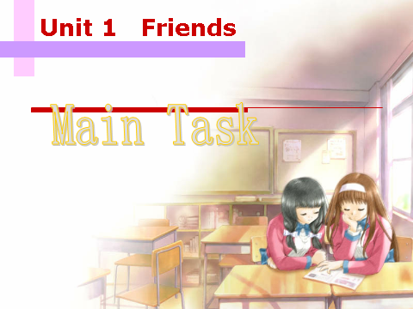
Grammar
Grammar

Slide 2
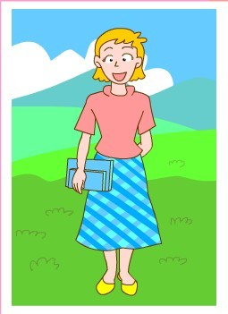
short
adjective (形容词)
Betty has short hair .
Her hair is short.
We can put an adjective _____ a noun
(名词) or ______ “be”。
We use adjectives to describe
someone or something
某人 某物
before
after
a linking verb (连系动词)。

Slide 3
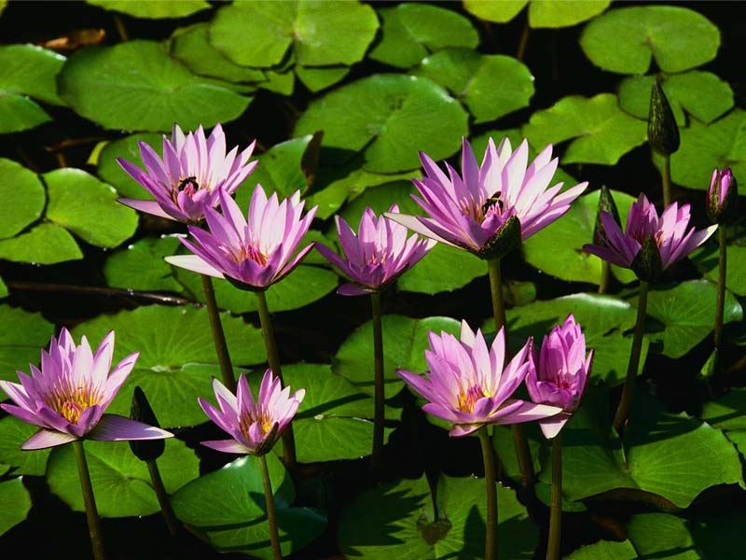
Linking verbs
seem
keep
feel
be
become
get
grow
turn
look
sound
smell
taste
+ adj.
经常出现的：
stay stay heathy /calm
touch Silk touches soft./ The water touches cool.
be /become + n. He became a teacher last year.

Slide 4
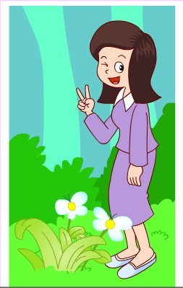
Betty’s hair is short
Betty’s hair is shorter than May’s (hair).
May’s hair is longer than Betty’s (hair).

Slide 5
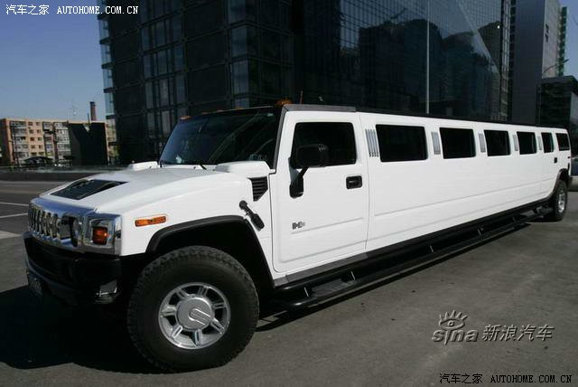
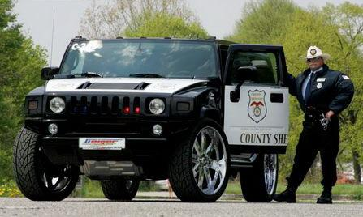
The white jeep is longer than the black one.
The black jeep is shorter than the white one.

Slide 6
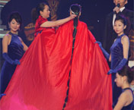
Comparative 比较级
Her hair is longer than mine
Her hair is the longest in the world.
superlative 最高级

Slide 7
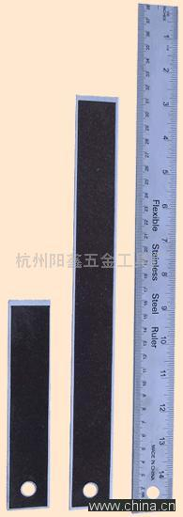
3
Ruler 3 is longer than Ruler 2 .
Ruler 1 is shorter than Ruler 2 .
Ruler 3 is the longest of all .
_______________________
2
_______________________
_______________________
1

Slide 8
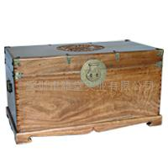
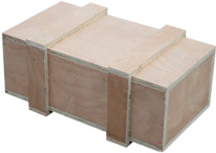
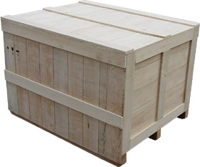
50kg
200kg
400kg
heavy
The first box is______.
heavier
The second box is ______ than the first one.
the heaviest
The third box is ___________of the three.

Slide 9

big
bigger
the biggest

Slide 10
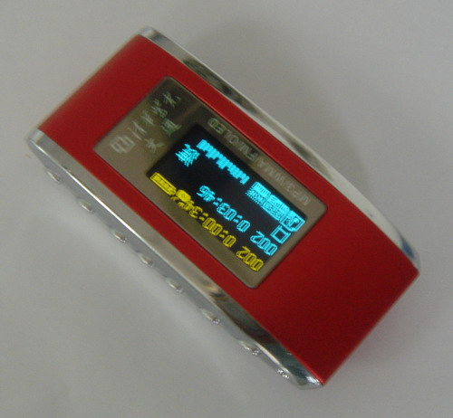
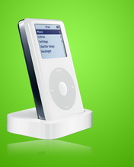
The red MP3 player ________ __________________________
is cheaper than the white one .
The white one is ____________ than the red one.
bigger / nicer
Price: 100 dollars
短：形容词后加 -er,
The white MP3 player is more expensive than the red one.
Price: 200 dollars
长：原形前加 more,

Slide 11
How to form comparatives and superlatives
Short adjectives
Long adjectives
One or two syllables(音节)
Three or more syllables

Slide 12
大多数形容词后加 - er / -est.
以不发音字母e 结尾的形容词加-r / -st.
以辅音字母+y 结尾的形容词,先把y改成i, 然后加-er / -est
以重读闭音节结尾的形容词,先双写最后一个辅音字母, 然后加-er / -est.
tall--taller--tallest small--smaller--smallest
nice --nicer --nicest fine --finer --finest
pretty--prettier--prettiest easy--easier--easiest
slim--slimmer--slimmest big--bigger--biggest

Slide 13
5.多音节的形容词,应在前面加
more / most
beautiful ---more beautiful ---most beautiful
important ---more important ---most important

Slide 14
不规则
good/ well
bad / ill
many
much
little
far
old｛
---better ---best
---worse ---worst
---more ---most
---less ---least
---farther ---farthest
older--- oldest
elder--- eldest

Slide 15
young:
clean:
wide:
close:
healthy:
busy:
sad:
red:
amazing:
far:
bad:
little:
younger youngest
cleaner cleanest
wider widest
closer closest
healthier healthiest
busier busiest
sadder saddest
redder reddest
more amazing most amazing
farther farthest
worse worst
less least

Slide 16
Adjective | Comparative | superlative
1. funny
2. good
3. happy
4. interesting
5. large
6. smart
7. thin
(2)
funnier
funniest
(1)
better
best
(2)
happier
happiest
(3)
more interesting
most interesting
(1)
larger
largest
(1)
smarter
smartest
(1)
thinner
thinnest

Slide 17
少数形容词
既可以加er, est，又可以用more ,most
Page 12 Tip

Slide 18
比较级的特殊用法：
1、在比较级前面加下列单词，表示程度
much, far, a lot, a little, even…
I’m much taller than Tom.
(so, very, quite 修饰原级，不用于比较级前)
2、用and表示越来越…
China is getting more and more beautiful.
It’s getting colder and colder.
3、固定的句式：the+比较级+（句子），the+比较级+
（句子）
The earlier (you know the news), the better (you will feel).

Slide 19
Finish Part A on page 12.

Slide 20
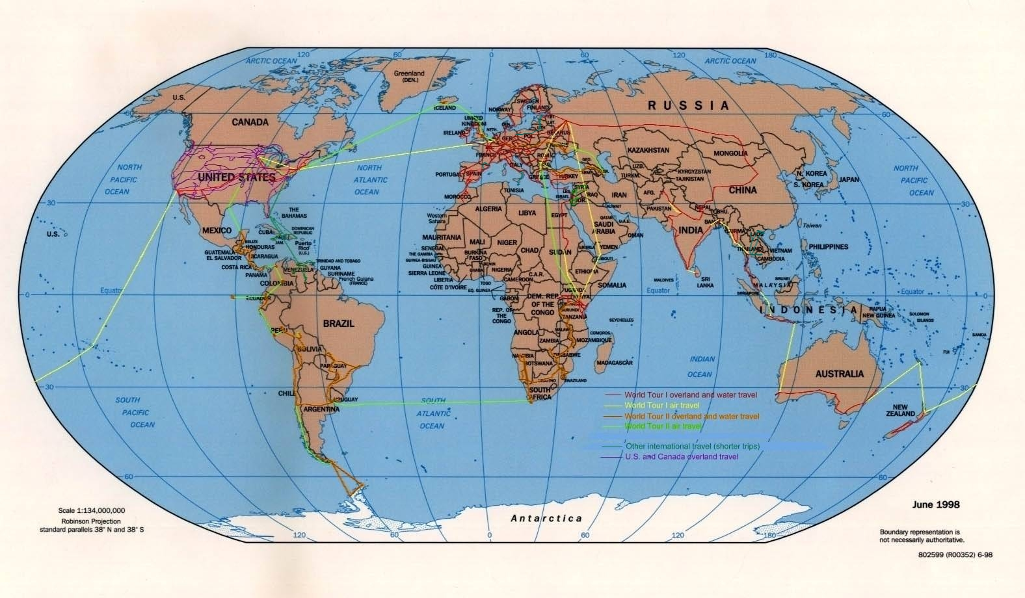
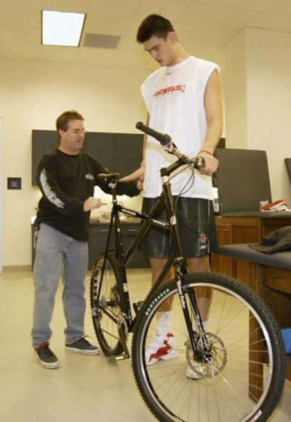
Pairwork
heavy
China, Russia, Japan
big
Which is……?
Who is ……?
delicious
tall

Slide 21
A survey调查
Make a survey in small groups.
Report your results to the class.
Who is the friendliest student
in your group?
Who is the most hard-working student
in your group?
Who is the most polite student in your group?

Slide 22
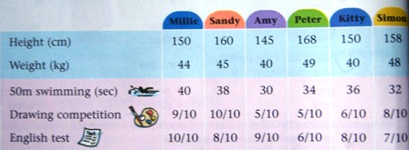
Finish Part B on page 12.

Slide 23
1. The earth is ________(big) than the moon.
The sun is ____________ (big) of the three.
2.‘My Heart Will Go On’ is one of _____________
(popular) songs.
3. Which do you like _______ (well), tea or coffee ?
4.This film is __________ (exciting) than that one.
5. I believe you will study _______ (hard) than last term.
6.Lily had _______ (many) apples than Lucy.But she
had _______ (little) juice than Lucy.
7. It’s ______ (hot) than yesterday.
8. He is __________ (tall) boy of the two.
bigger
the biggest
the most popular
better
more exciting
harder
more
less
hotter
the taller

Slide 24
我们的学校比他们的略大一点。
她比我年轻多了。
我们用更少的钱来做更多的事情。
Our school is a little bigger than theirs.
She is much younger than I (am) / me.
We use less money to do more things.

Slide 25

Let's chant
Good, better, best,
Never let it rest,
Till good is better,
And better is the best.
(rest:停止 till:直到）

Slide 26
Guessing game
Describe a friend in our class.
e.g. She has long hair ……
He is tall ……

Slide 27
Homework
Recite the new words and phrases.
Remember the ...........
Finish the exercise.

