Slide 1
Unit 6 My e-friend （Period 1）

Slide 2
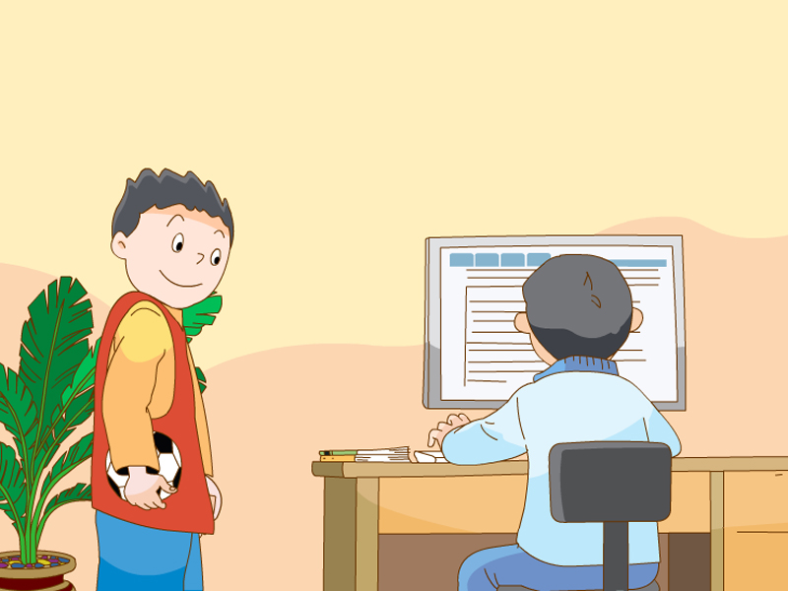
…can… …like / likes…
…have / has… …is / are good at…

Slide 3
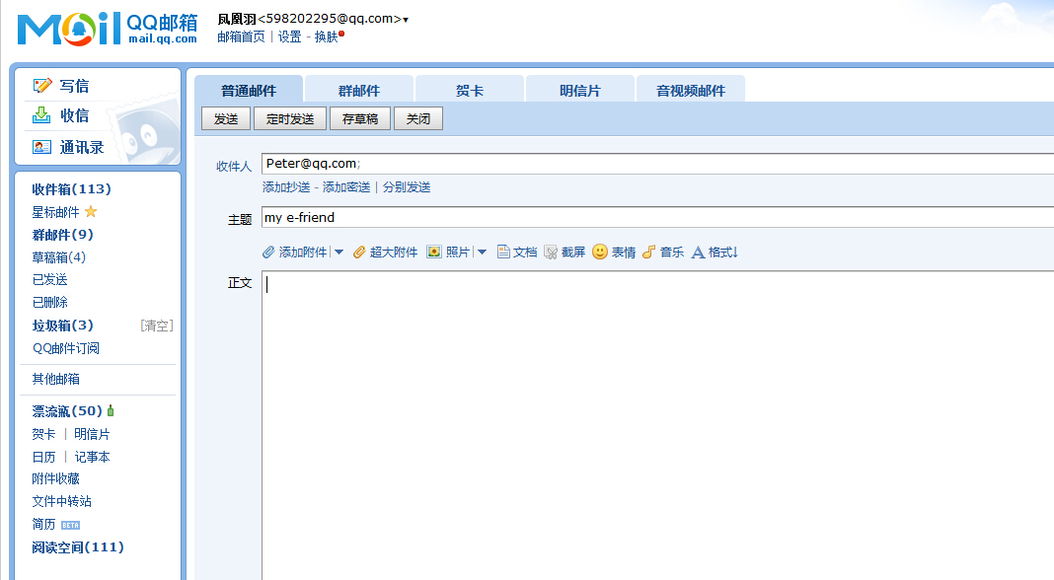
Dear Peter
How are you？How about your Chinese learning？Please write to me quickly.
Yours
Wang Bing
write an email
send 发送
电子邮件
friend

Slide 4
Watch and answer

Slide 6
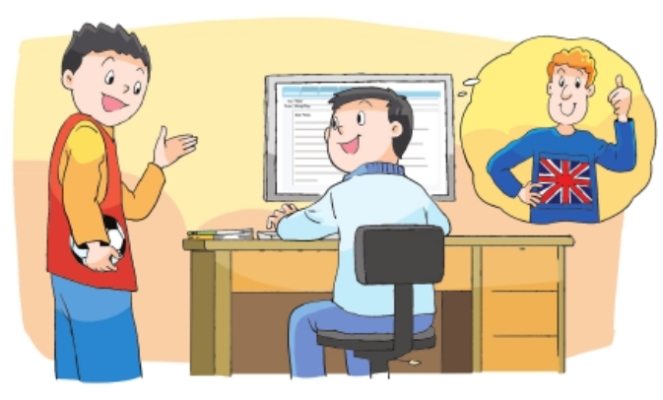
They are talking about Peter.
Wang Bing's e-friend
Notes:
？

Slide 7
Unit 6 My e-friend

Slide 8
Something about “e-” 跟e-有关的单词
e- card
电子贺卡
e-book
电子书
e
electronic电子的
e-bank
电子银行
e- business
电子商务
e-mail
电子邮件
Tips：两种写法都可以
email

Slide 9
Something about Peter 你想知道Peter的哪些情况,能问一问吗？
Is.…?
How…?
Can…?
What…?
Does…?
where…?
…?

Slide 10
Read and find
先自由读Story time,然后划出Peter的相关信息
1.Where does he live?
He lives in the UK(英国).
2.How old is he?
3.What subjects does he like?
4.What does he do after school?
5.What does he like doing?

Slide 11
Liu Tao: Hi, Wang Bing. Let’s go and play football in the
playground.
Wang Bing: Wait a minute, Liu Tao. Let me send this email first.
It’s to my e-friend.
Liu Tao: Who’s your e-friend?
Wang Bing: He’s Peter. He lives in the UK.
英国
give

Slide 12
Read and find
先自由读Story time,然后划出Peter的相关信息
1.Where does he live?
He lives in the UK(英国).
2.How old is he?
He’s 11 years old(岁).
3.What subjects does he like?
4.What does he do after school?
5.What does he like doing?

Slide 13
Liu Tao: How old is he?
Wang Bing:He’s 11 years old.
years old(岁)

Slide 14
Read and find
先自由读Story time,然后划出Peter的相关信息
1.Where does he live?
He lives in the UK(英国).
2.How old is he?
He’s 11 years old(岁).
3.What subjects does he like?
He likes Maths and PE.
4.What does he do after school?
5.What does he like doing?

Slide 15
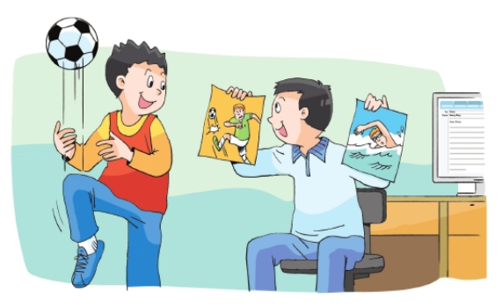
Liu Tao: What subjects does he like?
Wang Bing:He likes Maths and PE.

Slide 16
Read and find
先自由读Story time,然后划出Peter的相关信息
1.Where does he live?
He lives in the UK(英国).
2.How old is he?
He’s 11 years old(岁).
3.What subjects does he like?
He likes Maths and PE.
4.What does he do after school?
He studies Chinese after school.
5.What does he like doing?

Slide 17
Liu Tao: Does he have Chinese lessons at school?
Wang Bing:No, he doesn’t. He studies Chinese after school.
study 学习

Slide 18
Read and find
先自由读Story time,然后划出Peter的相关信息
1.Where does he live?
He lives in the UK(英国).
2.How old is he?
He’s 11 years old(岁).
3.What subjects does he like?
He likes Maths and PE.
4.What does he do after school?
He studies Chinese after school.
5.What does he like doing?
He likes playing football and swimming.

Slide 19
Liu Tao: Does he like playing football?
Wang Bing:Yes, he does. He likes swimming, too.

Slide 20
Listen and repeat
Liu Tao: Hi, Wang Bing. Let’s go and play football in the
playground.
Wang Bing: Wait a minute, Liu Tao. Let me send this email first.
It’s to my e-friend.
Liu Tao: Who’s your e-friend?
Wang Bing: He’s Peter. He lives in the UK.
让我们读书吧！
Tip：
1、跟读课文，注意模仿正确的语音、语调、语气哦！
2、注意阅读记号，可以帮助你读得更好听哦！
Liu Tao: How old is he?
Wang Bing:He’s 11 years old.
Liu Tao: Can he speak Chinese?
Wang Bing:Yes, he can.
Liu Tao: Does he have Chinese lessons at school?
表示降调
表示升调
Wang Bing:No, he doesn’t. He studies Chinese after school.
Liu Tao: What subjects does he like?
Wang Bing:He likes Maths and PE.
Liu Tao: Does he like playing football?
Wang Bing:Yes, he does. He likes swimming, too.
Notes:
读书

Slide 21
Try to read
四人一组，以小组为单位，选择一种喜欢的方式读一读课文。
Read together.
(齐读)
Read in roles.
(分角色读)
…

Slide 22
Try to say
Peter is … e-friend.
He lives in …
He’s … years old.
He .. speak Chinese.
He … Chinese lessons at school.
He studies Chinese …
He likes …
He likes playing …
四人一小组讨论一下，然后选择自己喜欢的方式展示，可以派一名代表说，可以四个人分工说。

Slide 23
Try to describe
试着介绍一下你的好朋友吧！

Slide 24
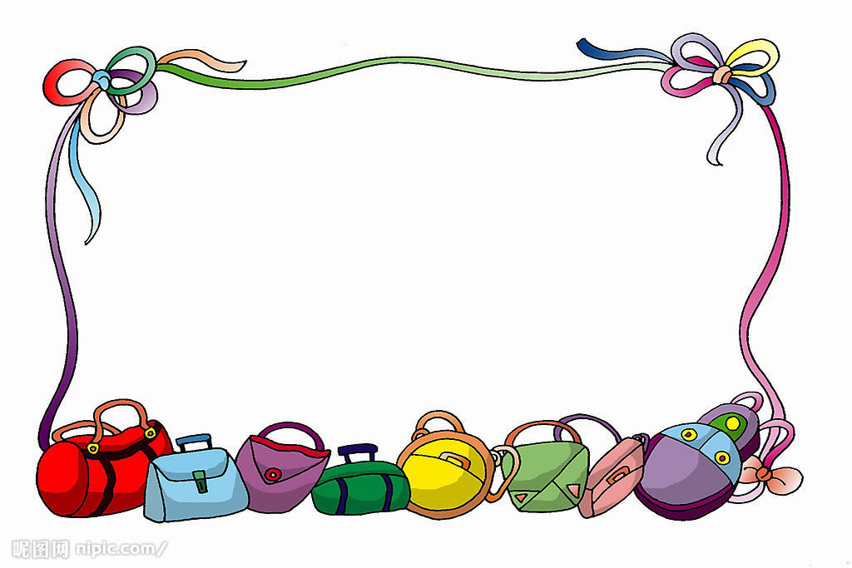
Summary
1、e-…
2、Peter
3、Our friends

Slide 25
1 . Read the story and try to retell it. (读熟Story time并试着复述.)
2 .Describe your friends.（描述下你的朋友，不少于五句话.)
3 . Know more national flags and share with your classmates. (认识更多国旗并和同学们一起分享.)

