Slide 1



译林出版社 四年级上册
Unit4 I can play basketball (Period 1 Story time)
湟里中心小学 范勤霞

Slide 2

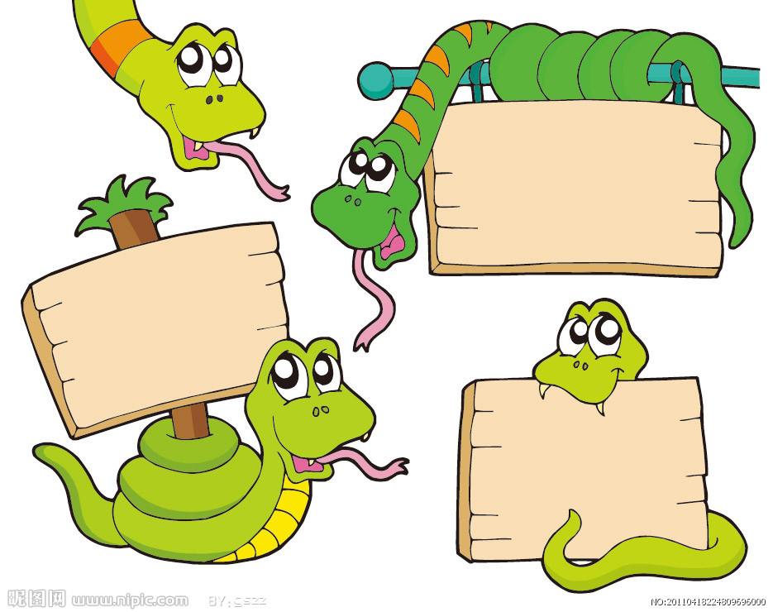

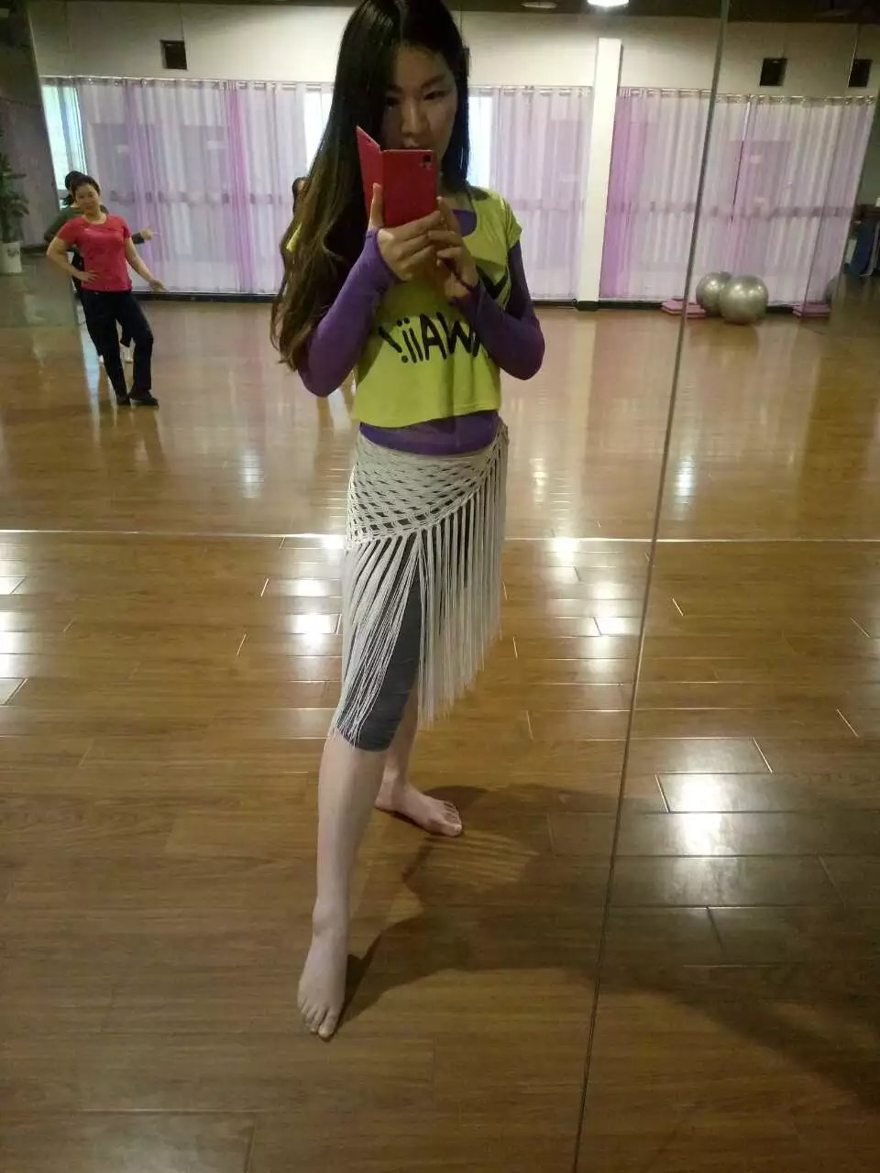
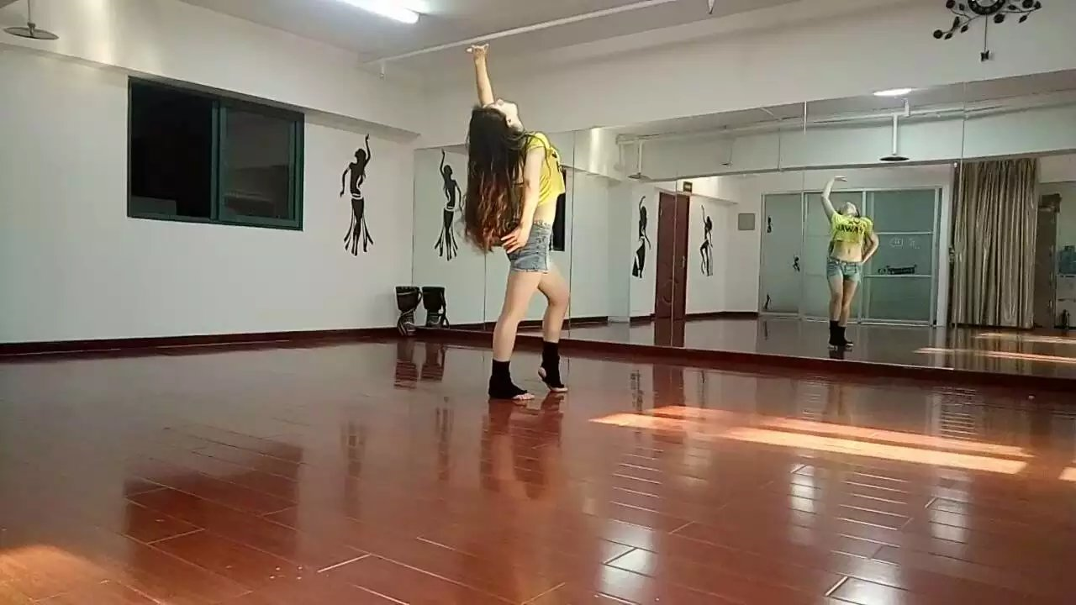

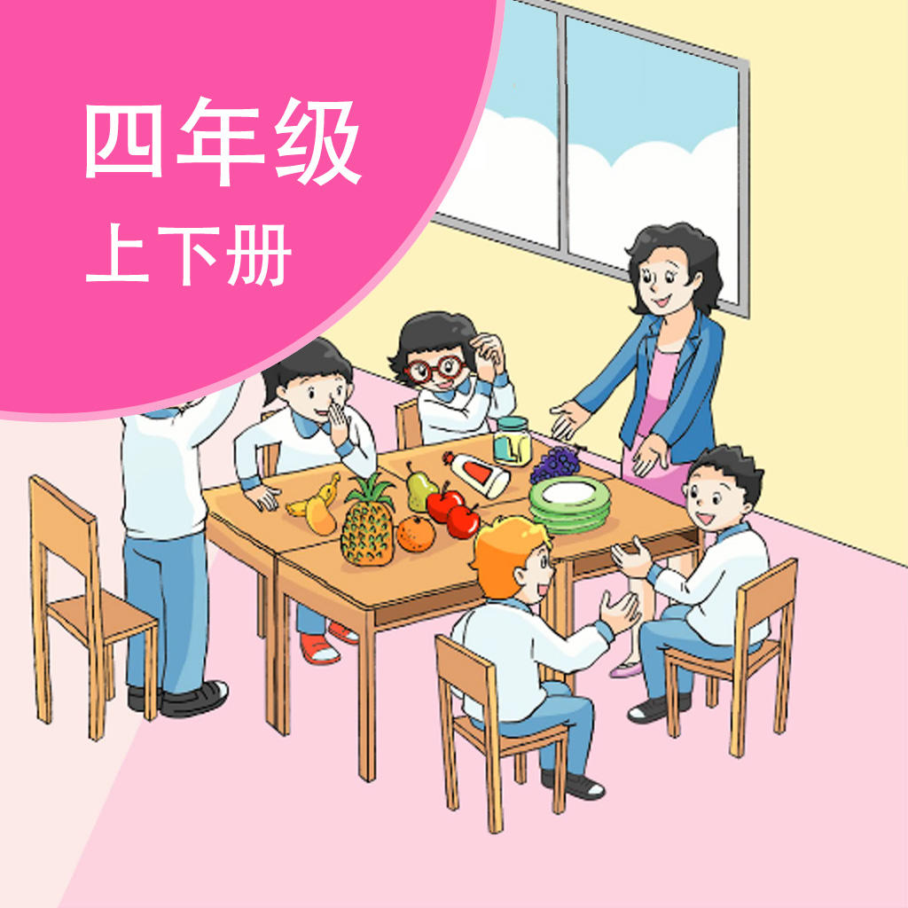

Talk about me.
√
×
√
√
√
You... like/have/can ...
...

Slide 3
Talk about you.
Can you...?
你会.......吗？
Yes, I can.
是的，我会。
No, I can't.
不，我不会。

Slide 4
Talk about you.
I can..., but I can't...

Slide 5
Talk about your friends.
What can you do?
I can...
Can you...? Yes,I do./No,I can't.
What about you?
I can...,but I can't...
xxx/He/She can/can't...

Slide 6

Let's learn
basketball 篮球
play basketball 打篮球

Slide 7
Read and answer.
Try to ask
(自主提问)
What do you want to know?
(你想从标题中了解什么呢？)
Unit 4 I can play basketball
Read by yourselves in 30 seconds,then answer the questions:
(30秒快速阅读课文，找出答案)
Q1.Who is in the story?
Wang Bing , Mike and Liu Tao.
Q2.Who can play the basketball?
Wang Bing and Mike .

Slide 8
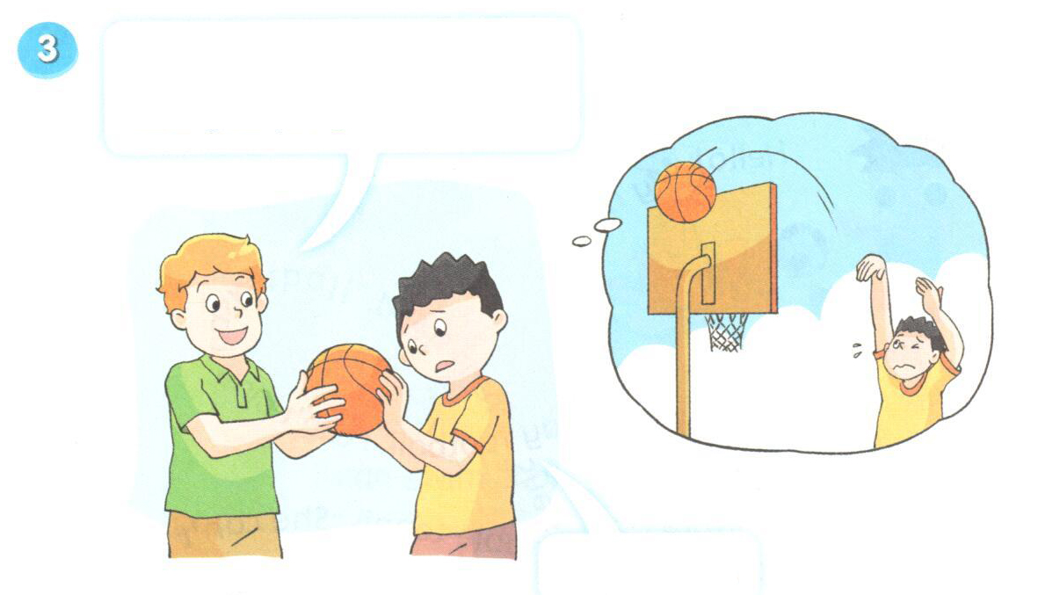

Watch and answer.
Q3:Can Liu Tao play basketball?
What about you, Liu Tao?
Can you play basketball?
No, I can’t.

Slide 9
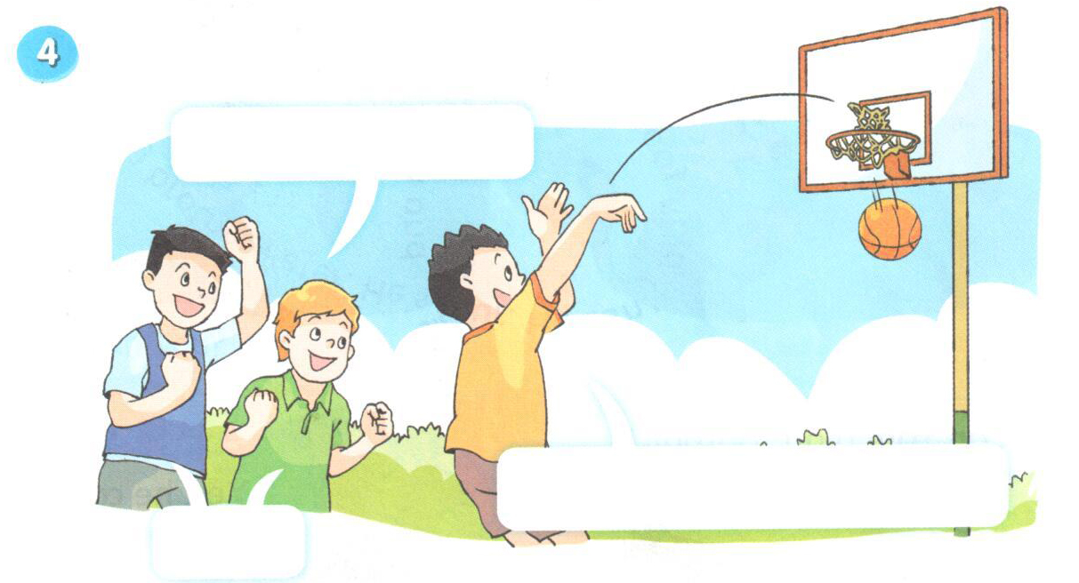
Watch and answer.
Q3:Can Liu Tao play basketball?
Yeah！
I can play basketball！

Slide 10
Watch and answer.
Q4:Who helped(帮助) him?
At first(开始)，
Liu Tao__________ play basketball.
And he is very__________.
can't
sad
At last(最后)，
Liu Tao__________ play basketball.
And he is very__________.
can
happy

Slide 11
Watch and answer.
Q4:Who helped(帮助) him?
Q5:What did they talk to him?
√
A.试一试 B. 没关系
Have a try，Liu Tao.

Slide 12
Don't be shy!Just try!
别害羞，试一试吧！
Come on! 加油！
You can do it! 你可以做到的！

Slide 13
Have a try, Liu Tao.
What about you, Liu Tao?
Can you play basketball?
Yeah. I can play basketball.
Great!
No, I can’t.

Slide 14
Q6:Who can play basketball best(最好的) ?

Slide 15
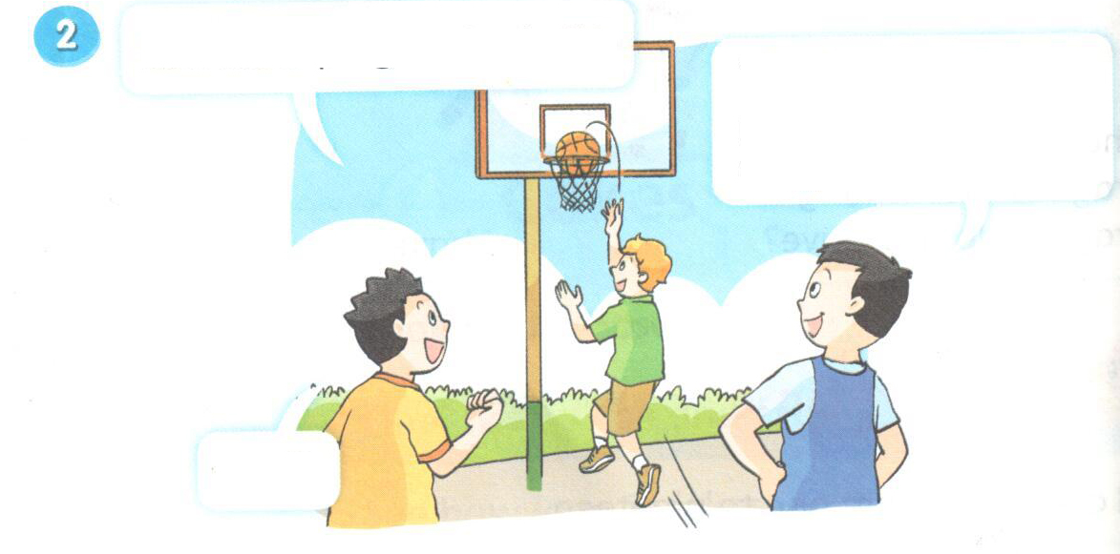
Let's learn.
Q6:Who can play basketball best(最好的) ?
very well
非常好
Yes, he can.
He can play basketball very well.
Look!

Slide 16
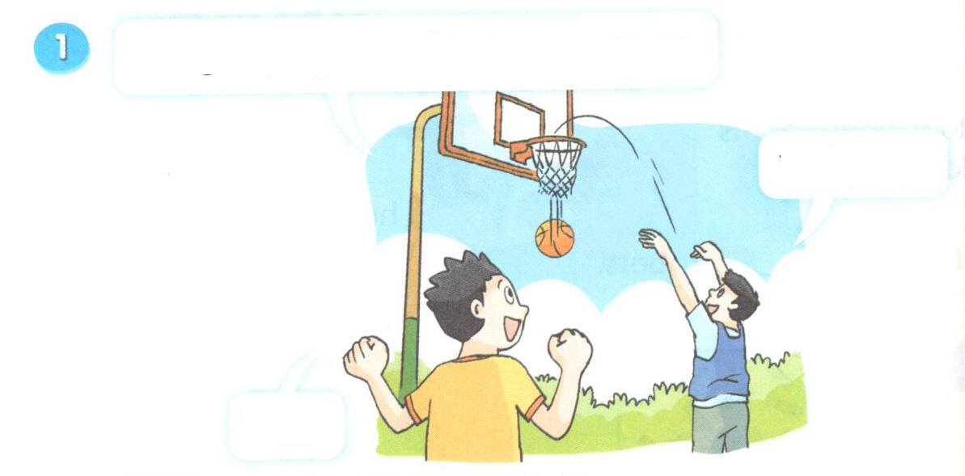
Let's read.
’
’
Can you play basketball, Wang Bing?
’
’
Yes, I can.
’
Nice!

Slide 17
Let's learn.
’
Can Mike play basketball?
’
Yes, he can.
’
He can play basketball very well.
’
Look!
’
Cool!

Slide 18
’
What about you, Liu Tao?
’
’
Can you play basketball?
’
No, I can’t.

Slide 19
’
Have a try, Liu Tao.
’
’
’
Yeah. I can play basketball.
’
Great!

Slide 20
Let's read again.
Pay attention to the pronunciation & intonation.
(跟读的时候请注意语音语调的模仿！)
’
’
Can you play basketball, Wang Bing?
’
’
Yes, I can.
’
Nice!

Slide 21
Let's learn.
’
Can Mike play basketball?
’
Yes, he can.
’
He can play basketball very well.
’
Look!
’
Cool!

Slide 22
Let’s read
’
What about you, Liu Tao?
’
’
Can you play basketball?
’
No, I can’t.

Slide 23
Let’s read
’
Have a try, Liu Tao.
’
’
’
Yeah. I can play basketball.
’
Great!

Slide 24
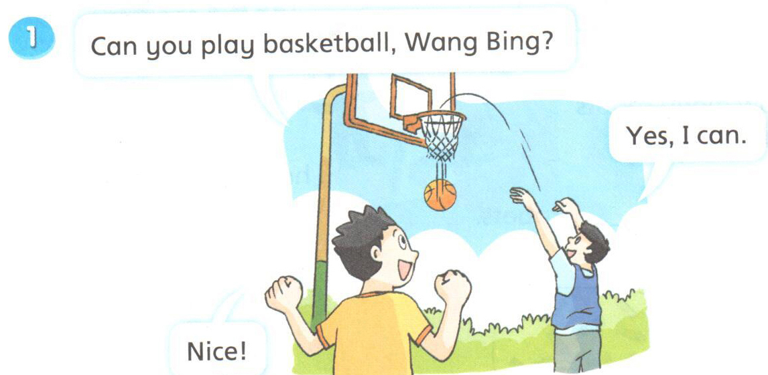
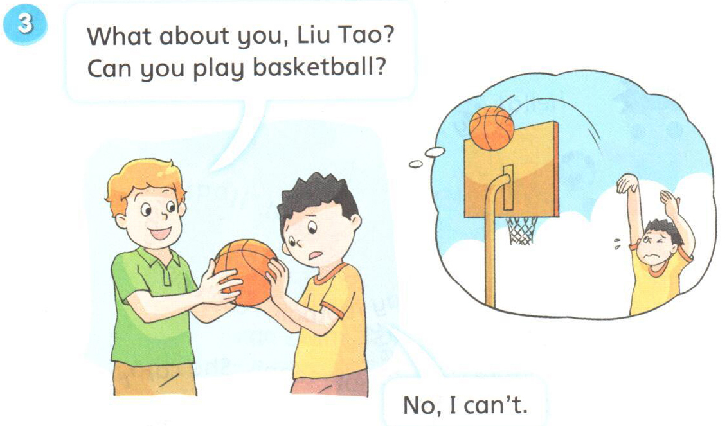
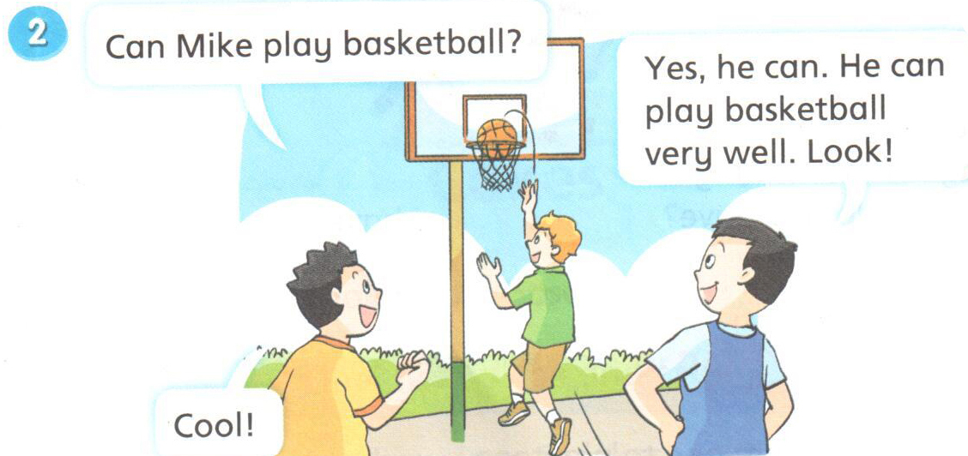
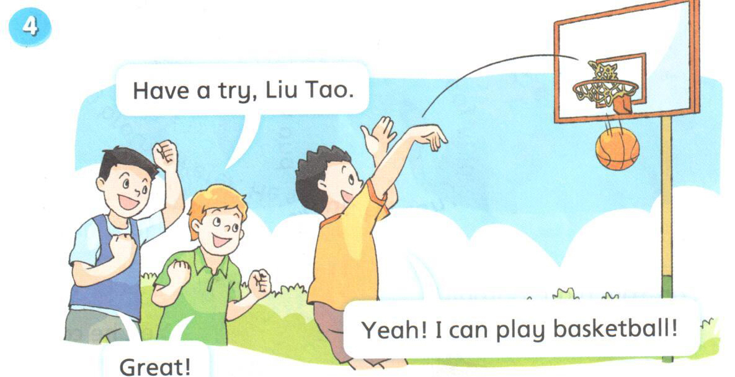
Read or act
Tip：选择一个或多个镜头，加上丰富的表情和动作表演更生动！
Can you …? Yes, …
Can you …? No, …
Can Mike …? Yes, …
Have a … I can …

Slide 25
Try to say.
Unit 4 I can play basketball
Who am I ?(我是谁？)

Slide 26
Believe yourself!相信自己！
Try your best!做最好的自己！

Slide 27

30
Homework
1. Listen and read the story, try to recite it.
听读模仿，尝试背诵。
2.Act the story in groups.
小组内表演故事，下节课继续表演哟。

Slide 28

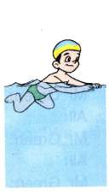
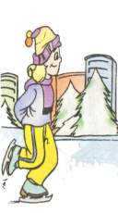
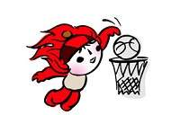
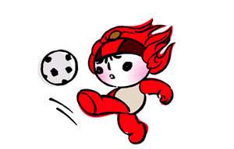
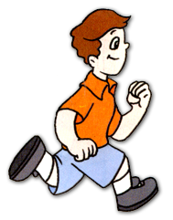
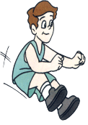
Let's talk
I can ...and...
I can't...
I can't...
But I would like to have a try.
want

Slide 29

Sing a song

Slide 30



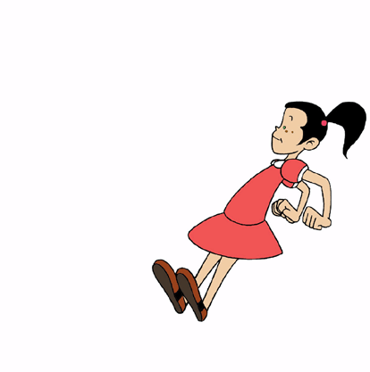




Play a game
Sports time
I can walk.
I can swim.
I can run.
I can jump.
I can sing.
I can play basketball.
I can dance.
Yes, yes,yes, I can.
No, No, No, I can't, but I can try.

Slide 31
Ask and answer
Sports time
basketball 篮球
play basketball 打篮球
A: Can you play basketball?
B: Yes,I can./B: No, I can't.
A: Have a try!(试一试）

Slide 32
Say a chant
Can , can, can you play basketball?
No, no, I can’t .
Try , try , have a try.
Great, great, oh ,yeah.

Slide 33
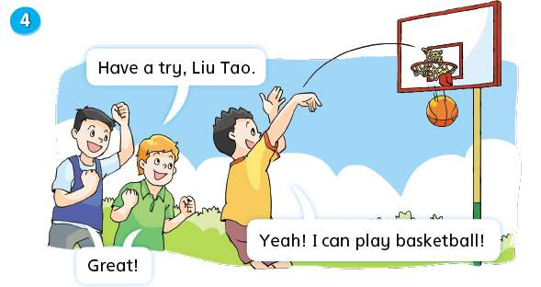
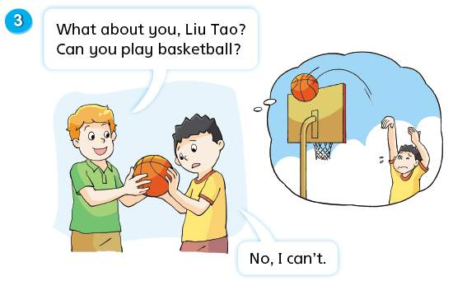
Look and talk
Try to ask
(自主提问)
1.Can Wang Bing play basketball?
2.Can Mike play basketball?
3.Can Liu Tao play basketball, too?
Who ？ Where？
1.Can … play basketball?

Slide 34

Watch and answer
1.Can Wang Bing play basketball?
Yes, he can.
2.Can Mike play basketball?
Yes, he can. He can play it very well.
3.Can Liu Tao play basketball, too?

Slide 35
Read and choose
1. Can Liu Tao play at first(首先)?
Yes, he can.
No, he doesn't think so.(他认为他不会。)
2. Can Liu Tao play at last(最后)?
Yes, he can.
No, he can’t.

Slide 36
Read the story

Slide 37
Read the story
How do Wang Bing and Mike encourage Liu Tao?
have a try
试一试

Slide 38
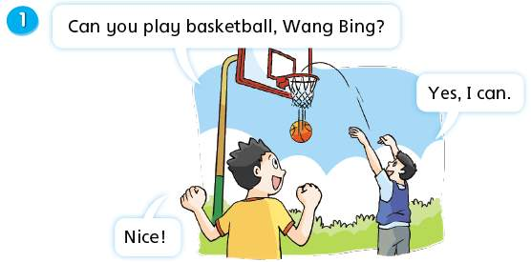
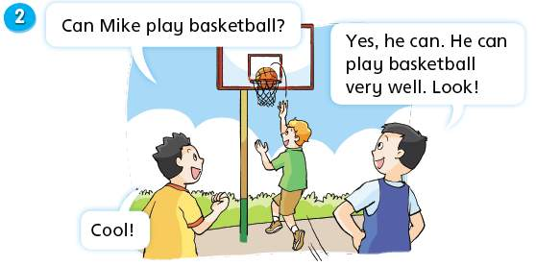
Read it

Slide 39

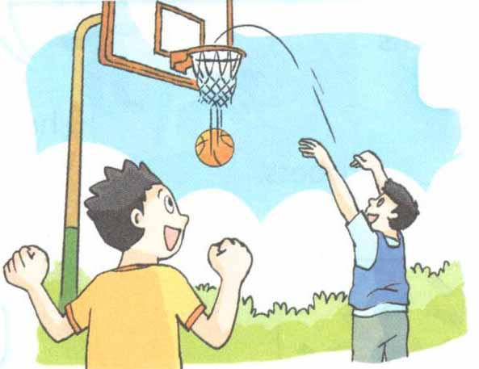
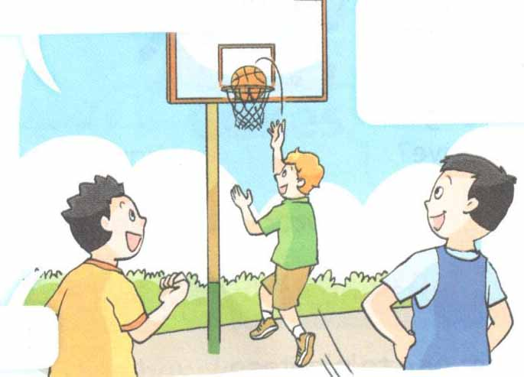
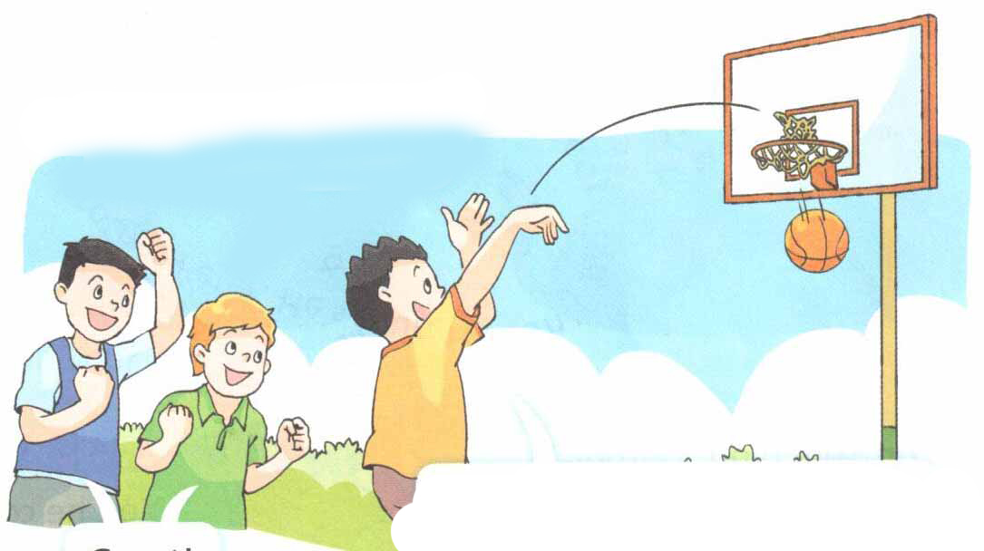


24
Let’s talk
Nice!
Cool!
Good!
Great!

Slide 40
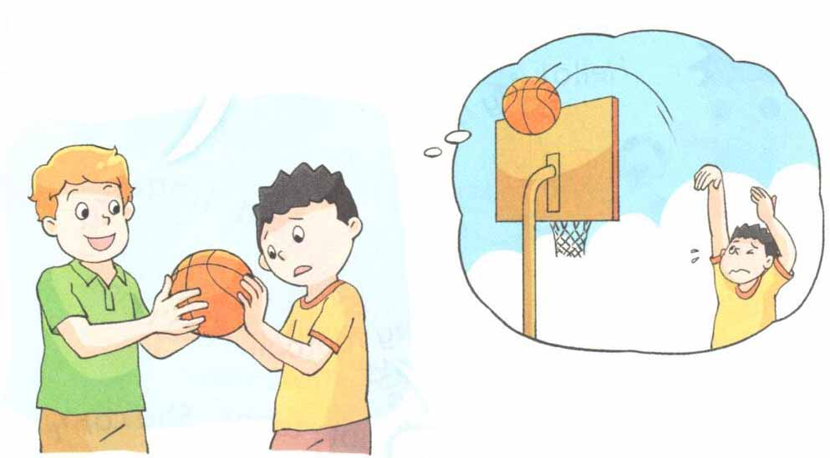

25
Let’s talk
Have a try!

Slide 41
28
Have more try！多练习哦！
Read or act
Nice! /Cool! / Great!
Super! 超级棒！
Tip：选择一个镜头，加上丰富的表情和动作表演更生动！
Can you …? Yes, …
Can you …? No, …
Can Mike …? Yes, …
Have a … I can …

Slide 42


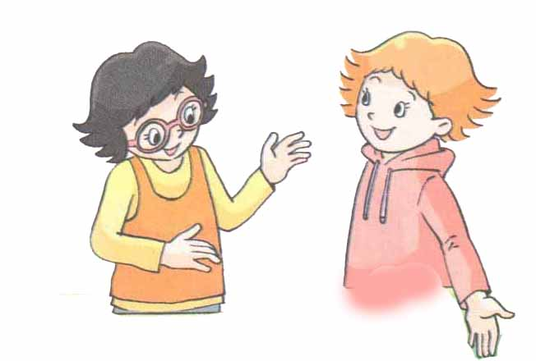


29
Look and talk
运用今天故事里所学的句子来创编一个新对话吧！

Slide 43
30
Homework
1. Listen and read the story, try to recite it.
听读模仿，尝试背诵。
2.Act the story in groups.
小组内表演故事，下节课继续表演哟。
3.Try to make a new dialogue .
运用本课所学句子，尝试创编新对话。

Slide 44
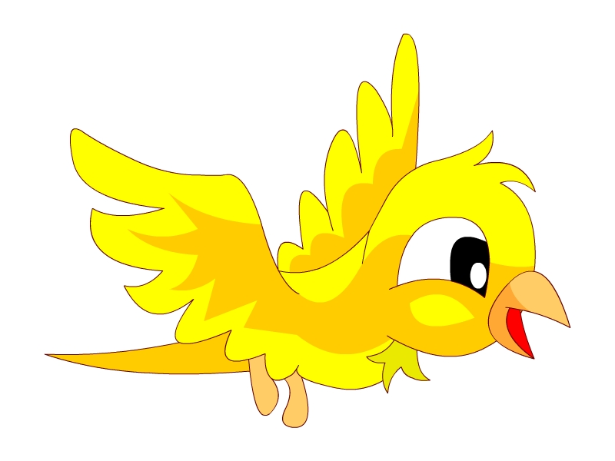





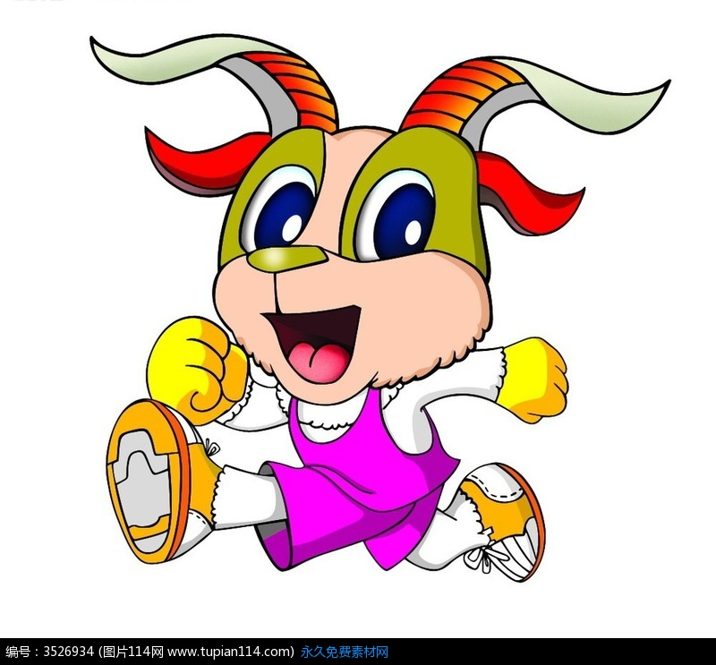
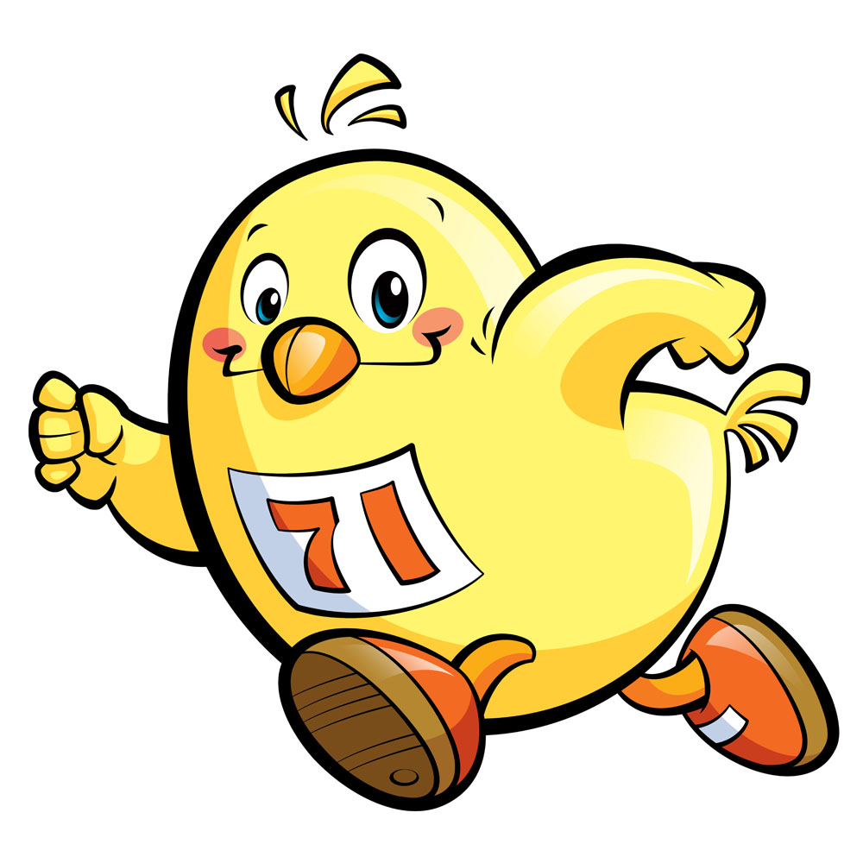



Dicuss:What can they do?
The_____can_____.
fly
能，可以，会
The_____ _____.
can't
不能，不可以，不会

Slide 45
The bird can_____, but it can't_____.
The_____can_____, but it can't_____.

Slide 46

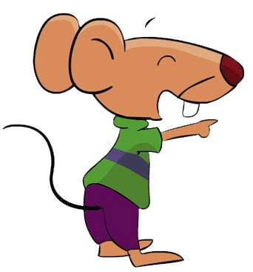
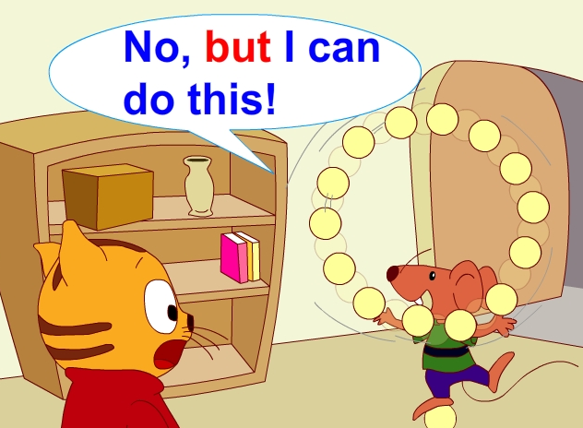
Discuss:What can he do?
Bobby can't______.
welcome
well
好
But he can do this very______.
well指做事情做得好
good指形容人或事物很好

Slide 47
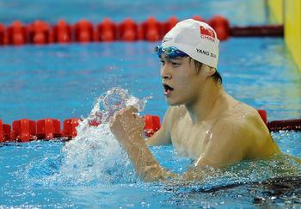
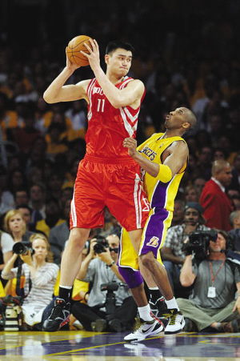

What can he do?
Sun Yang can swim very well.
Yao Ming can play basketball very well.

Slide 48
Discuss:What can you do?
What can you do?
I can...
Can you...?
Yes,I can.
/No,I can't.But I can...very well.
What about you?
I can...but I can't...

