Slide 2
Pre-reading
November，2018
Sunday | Monday | Tuesday | Wednesday | Thursday | Friday | Saturday
 |  |  |  | 1 | 2 | 3
4 | 5 | 6 | 7 | 8 | 9 | 10
11 | 12 | 13 | 14 | 15 | 16 | 17
18 | 19 | 20 | 21 | 22 | 23 | 24
25 | 26 | 27 | 28 | 29 | 30
weekdays
Sundays
+
Saturdays
=
weekends

Slide 3
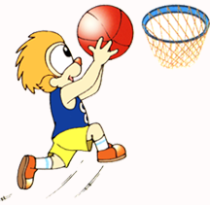
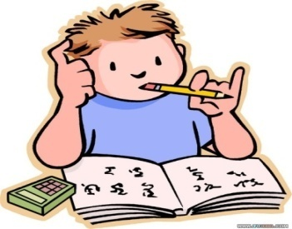
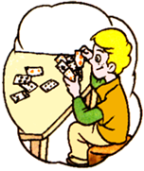
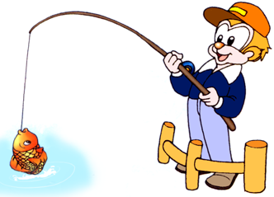
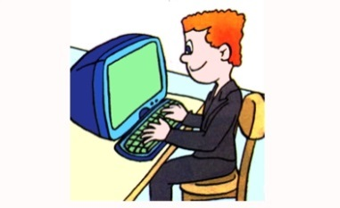
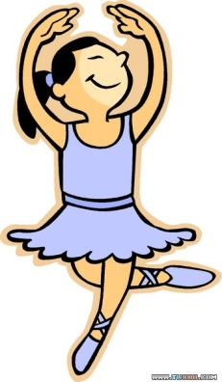
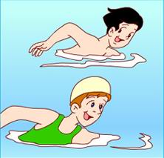
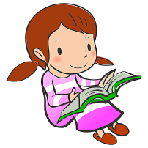
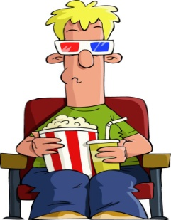
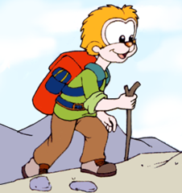
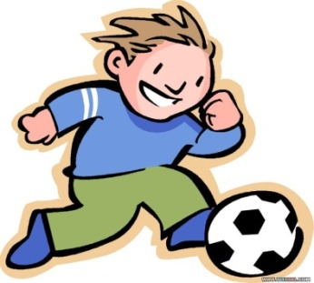
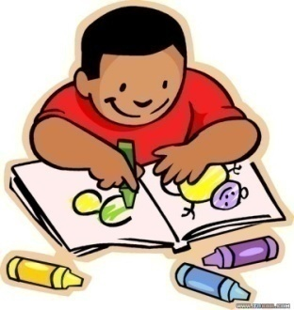
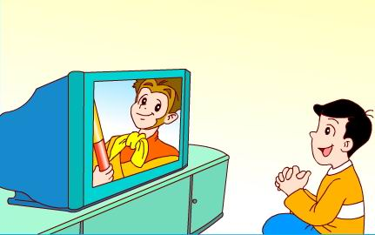
Pre-reading Let’s talk
At weekends, I … .
…

Slide 4
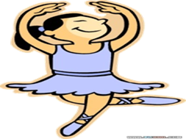
Pre-reading
I
read books.
always
always
usually
I usually chat on the Internet.
watch
at
often
I often go to the cinema.
I sometimes have dancing lessons.
sometimes
November，2018
Sunday | Monday | Tuesday | Wednesday | Thursday | Friday | Saturday
 |  |  |  | 1 | 2 | 3
4 | 5 | 6 | 7 | 8 | 9 | 10
11 | 12 | 13 | 14 | 15 | 16 | 17
18 | 19 | 20 | 21 | 22 | 23 | 24
25 | 26 | 27 | 28 | 29 | 30

Slide 5
Pre-reading Let’s talk
A: What do you do at weekends?
B: I always/usually/often/sometimes…
…

Slide 6
While-reading Watch and answer

Slide 7
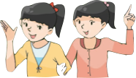
While-reading Watch and answer
at weekends

Slide 8
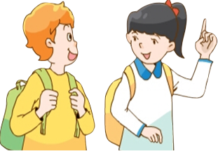
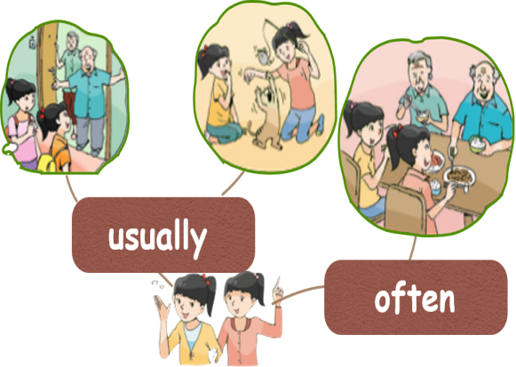
While-reading
What do you do at weekends, Su Hai ?
A. 拜访
B. 参观
I usually visit my grandparents.
Su Yang and I like playing with their
cat Kitty very much. We often have
dinner with our grandparents at
weekends.
visit
How to learn?
A. 快速浏览对话
B. 划出关键词组
C. 圈出频度副词
D. 完成思维导图
（图片或单词词组）

Slide 9
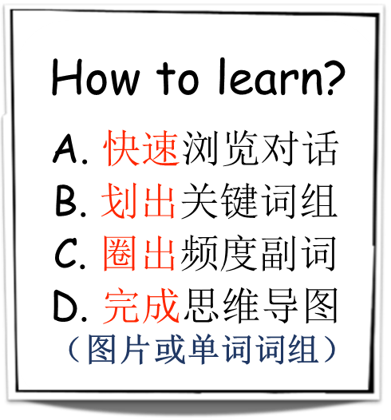
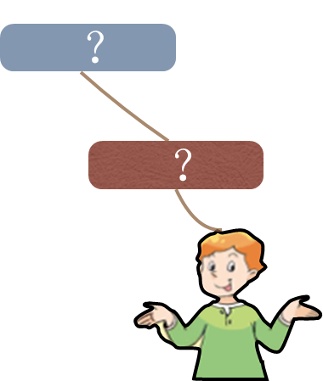
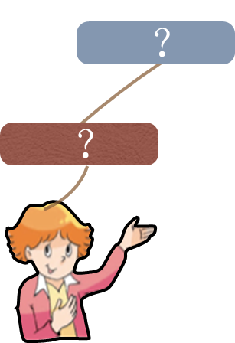
While-reading Read and make
Mike: My grandparents live in the UK. I usually chat with them on the Internet
at weekends.
Su Hai: What does Helen do at weekends?
Mike: She always has dancing lessons. She sometimes goes to the cinema with
her friends.
Su Hai: What about you, Mike?
Mike: I usually play football with Liu Tao at weekends. I sometimes go to the
park with my family. We usually fly a kite and have a picnic there.

Slide 10
While-reading
When we want to retell the story, we can use the table or the chart.
当我我们想要复述故事的时候，我们可以利用表格或者思维导图来进行复述。
usually
sometimes
usually
often
at weekends
always
sometimes

Slide 11
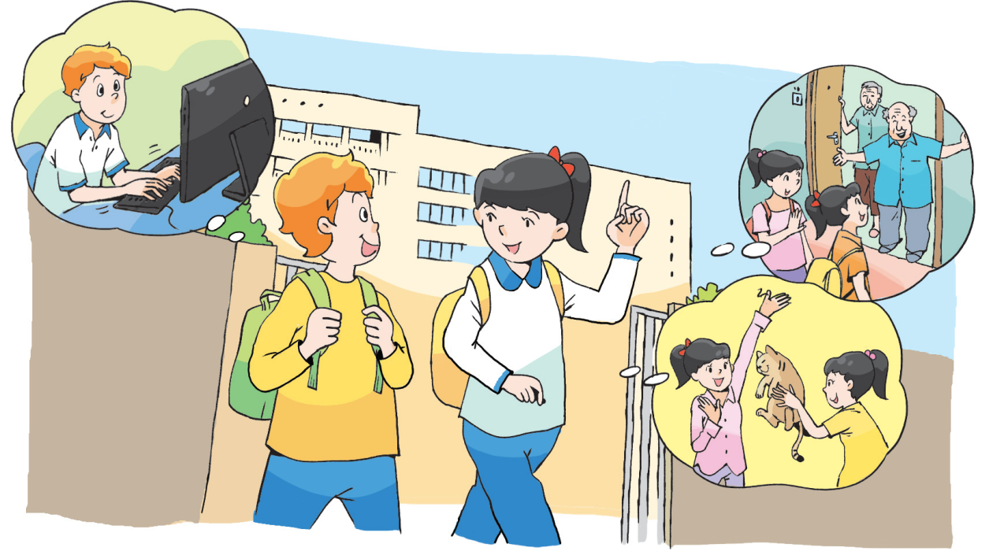
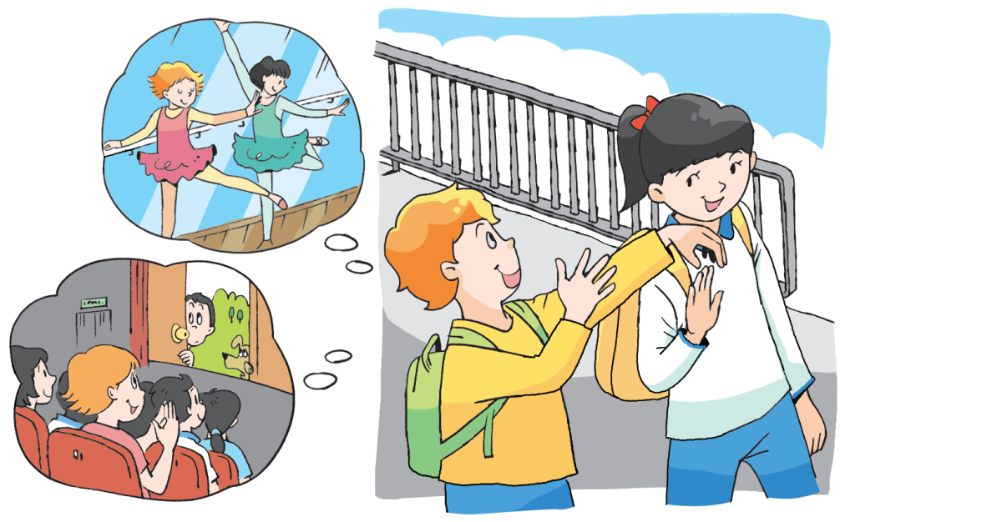
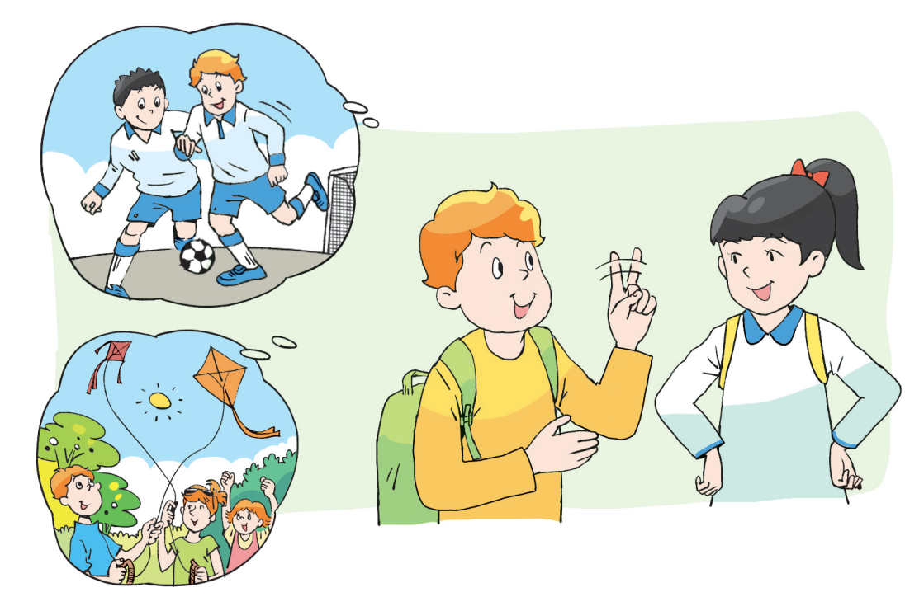
While-reading
When you are reading, try to imitate the pronunciation and intonation.
在朗读课文的过程中，请试着模仿录音中的语音语调。
升调 降调 连读 停顿 重读

Slide 12
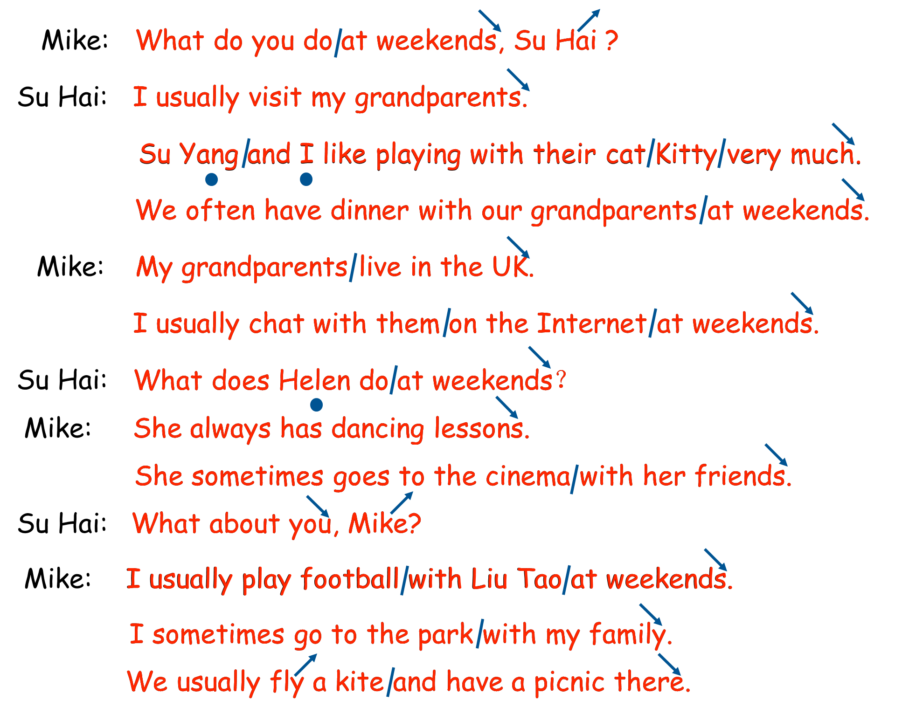
While-reading

Slide 13
While-reading
Reading time:
选择一种方式来读课文。
A.Read by yourself.
自己读课文。
B.Read together.
小组内齐读课文。
C.Read in roles.
分角色朗读课文。

Slide 14
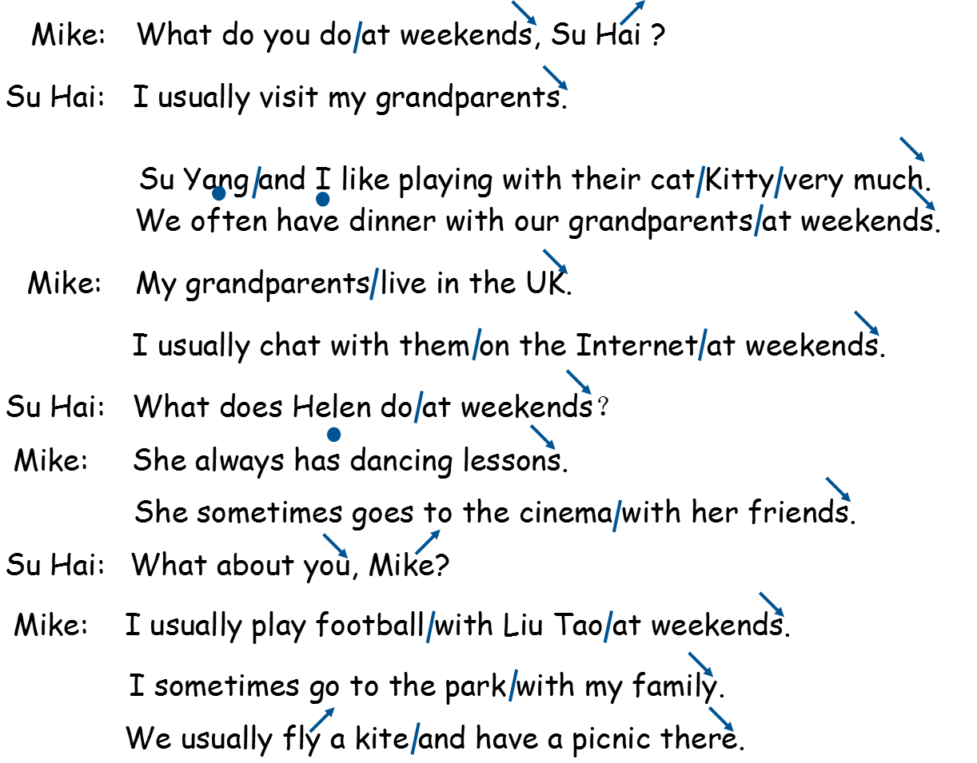
While-reading

Slide 15
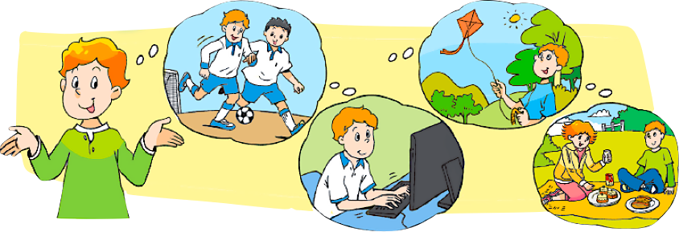
Post-reading
I usually __________ with Liu Tao at weekends. I also _______________________ on the Internet. I sometimes
________ and __________ with my family in the park.
play football
chat with my grandparents
fly a kite
have a picnic

Slide 16
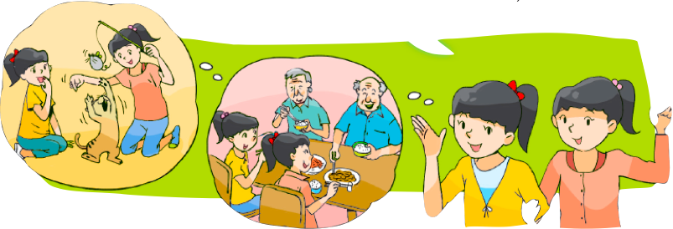
Post-reading
Su Yang and I usually _______________ at weekends.
We _______________ Kitty. We _______________ with
our grandparents.
visit grandparents
play with their cat
often have dinner

Slide 17
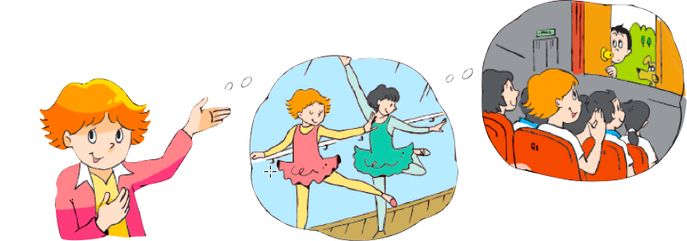
Post-reading
I always _________________ at weekends. I
sometimes _______________ with my friends.
have dancing lessons
go to the cinema

Slide 18
Post-reading Let’s retell
usually
sometimes
usually
often
at weekends
always
sometimes

Slide 19
Post-reading
My weekends
At weekends, I ____________________,
I usually ____________________________,
I __________________________________.
Sometimes, I _________________________.
My weekends are very colourful. And my workdays
are colourful, too. So I should seize the moment,
seize the day.
always read books
chat on the Internet
often go to the cinema
have dancing lessons

Slide 20
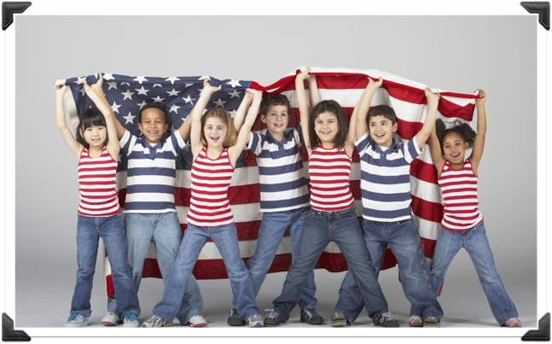

Slide 21
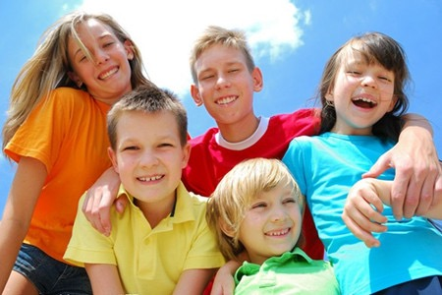

Slide 22
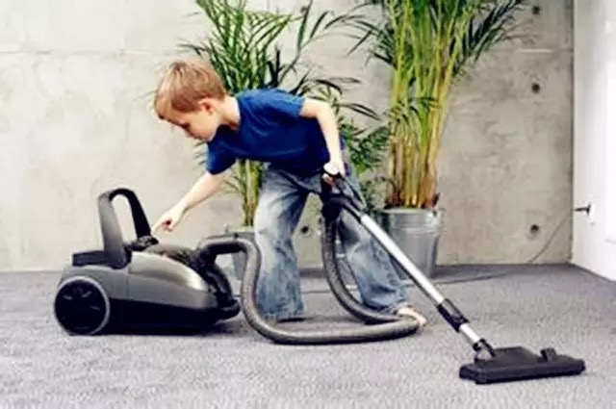
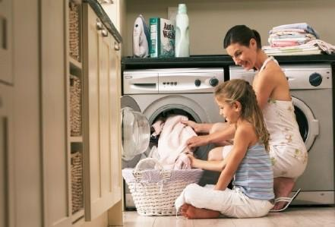

Slide 23
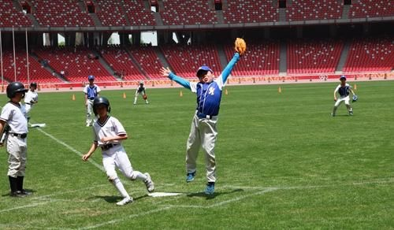
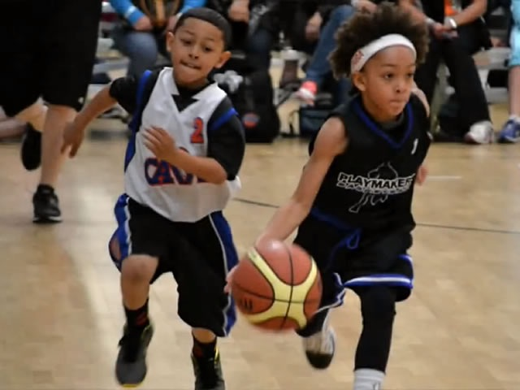
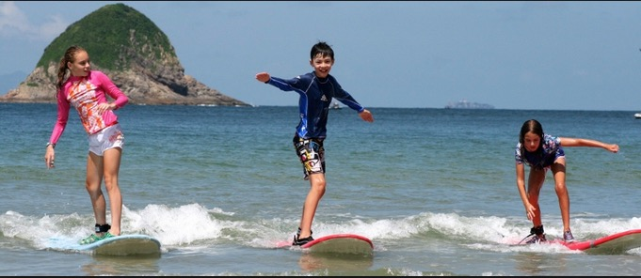

Slide 24
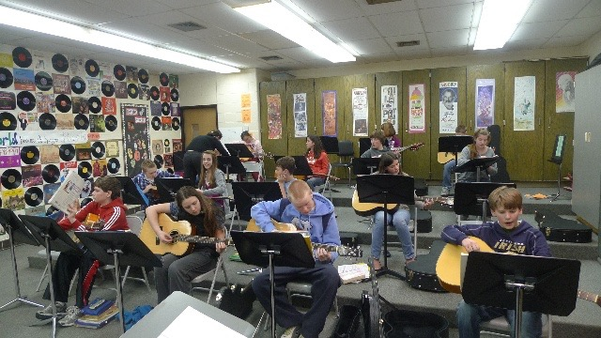
Sometimes, they have lessons like us.

Slide 25
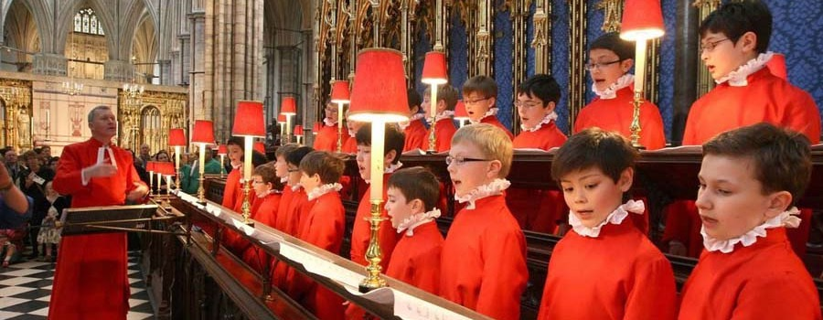

Slide 26
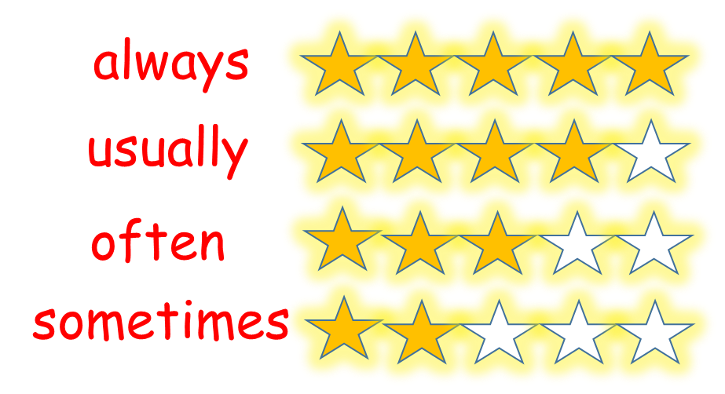
Post-reading Let’s summarize
1. 学习了4个频度副词的用法。
2. 学习了如何谈论周末生活。
Some children always go to the church, they usually sing there, because they are christian.
3. …

