Slide 1
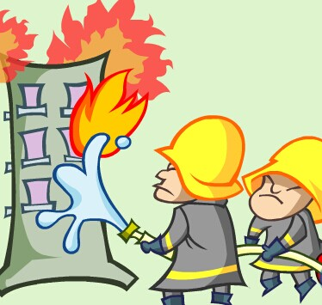

Unit7 Abilities
What a brave young man!
Reading 1

Slide 2
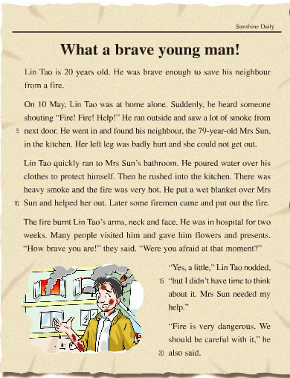
Sunshine Daily
['deɪlɪ]
What’s the name of the newspaper?
2. What was the young man like?
Sunshine Daily.
He was brave.

Slide 3
Abilities
If you want to help others, you need ……
To be a learner
To be a thinker
To be a saver

Slide 4
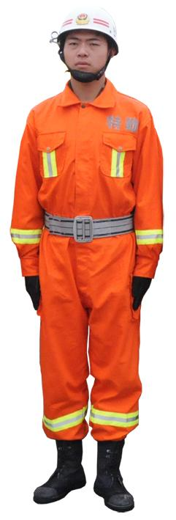
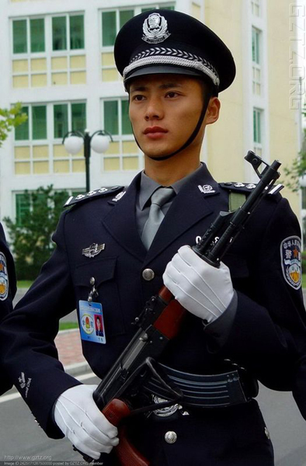
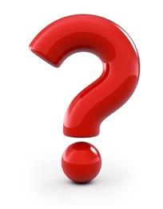
To be a learner
What a brave young man!
fireman
policeman
They can save people from danger.

Slide 5
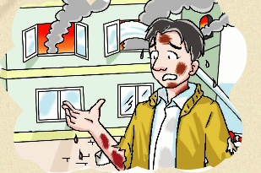
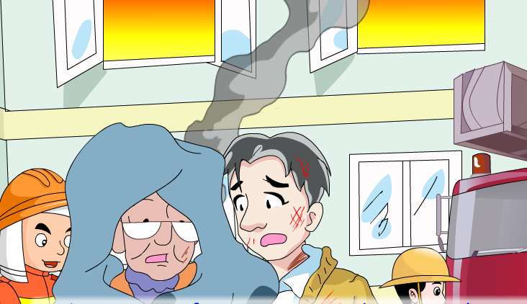
What happened?
What did he do?
A fire happened.
He saved the old lady from the fire.

Slide 6
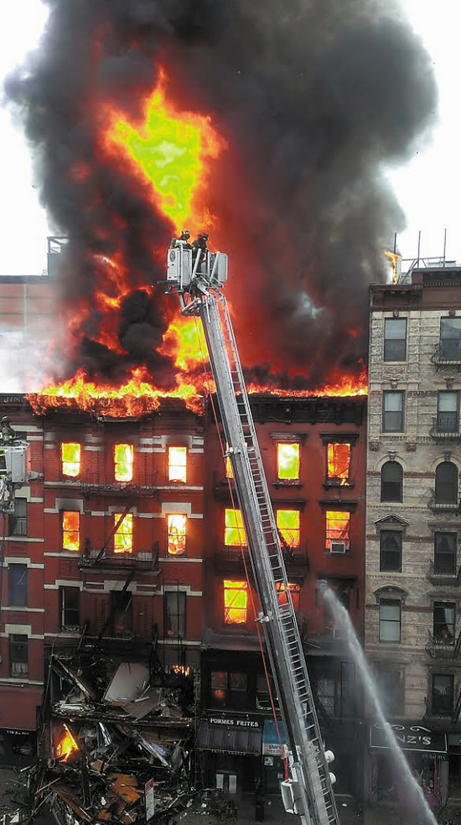
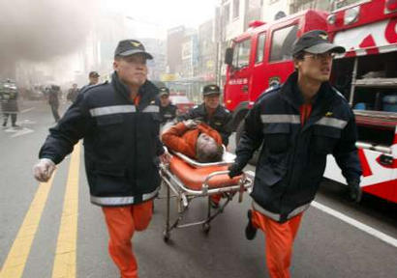
Fire
is dangerous
The building is on fire.
There is a lot of smoke.
It can burn people.

Slide 7
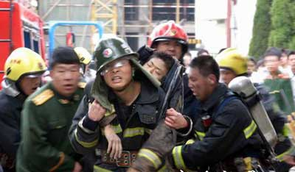
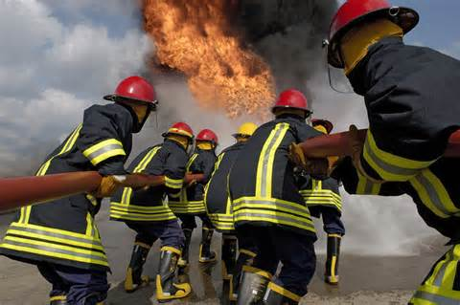
Sometimes, the firemen are hurt.
put out the fire
[hɜːt] adj:受伤的

Slide 8
Important words
brave adj: 勇敢的
fireman n.消防员
save vt. 救，救助
smoke n.烟雾
put out 扑灭
burn vt & vi. 烧伤；烧
hurt adj: 受伤的
badly adv: 严重的，厉害的
protect vt: 保护
Wet adj: 湿的，未干的

Slide 9
Abilities
If you want to help others, you need ……
To be a learner
To be a thinker
To be a saver

Slide 10
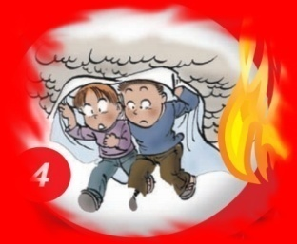
To be a thinker
Task1: Skim(略读) and fill in blanks
Fast-reading
1. 独立完成 2. 两两核对答案 3. 一人展示
Who
When
Where
What
LinTao
Mrs Sun
On 10 May
In Mrs. Sun’s kitchen
Lin Tao saved his neighbour
from the fire.

Slide 11


Careful-reading
Task2: Read by yourselves, and do the exercise “T” or “F”.
para2
1. 独立完成 2. 两两核对答案 3. 一人展示
Lin Tao stayed at home with his friends.
alone
2. LinTao ran outside and saw a lot of
fire from next door.
smoke
kitchen
3. Mrs Sun was in her bedroom when
the fire happened.
4. Mrs Sun couldn’t get out because
she hurt her left leg.

Slide 12
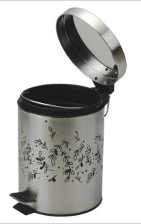
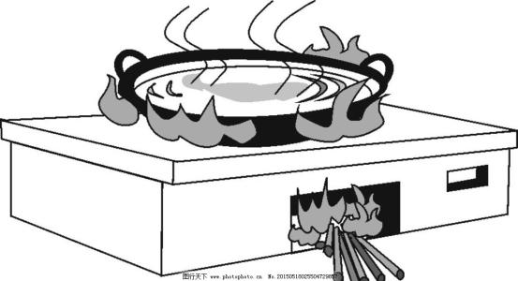
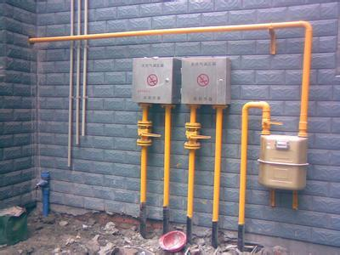
Further thinking
1.小组讨论 2. 一人展示
Why did the fire happen in the kitchen?
stove(炉子)
gas(燃气)
rubbish bin
Advice to Mrs Sun:
Don’t leave the stove on.
Turn off the gas in time.(及时)
Do not put anything hot into the rubbish bin.

Slide 13
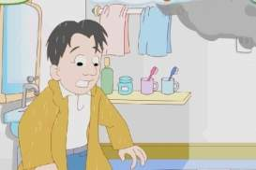
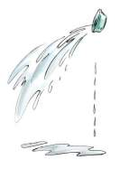
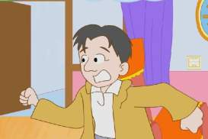
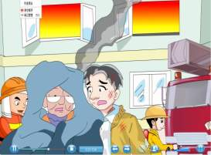
Task3:Read together and fill in the blanks according to the pictures.
Para3
1. 独立完成 2. 两两核对答案 3. 一人展示
ran
1.
Lin Tao_____ to the bathroom.
_____ water ______ his clothes to ______ himself
clever
careful
[pɔː]
pour
over
protect
brave
Walk
Run quickly
2.
rushed into
Lin Tao ________the kitchen
3.
put
over
helpful
Lin Tao ____ a wet blanket _____ her
help out
____her______

Slide 14

Lin Tao is …
brave
careful
clever
helpful

Slide 15
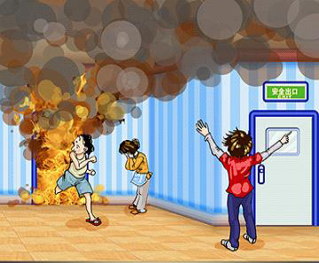
Further thinking
1. 小组讨论 2. 一人展示
Maybe Lin Tao forgot to do something.
Call 119 for help first.
More advice to Lin Tao:
Run out of the fire from the exit.

Slide 16
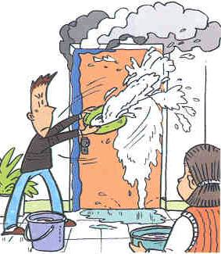
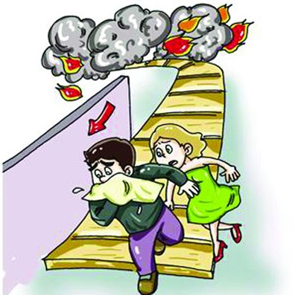
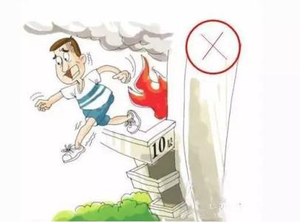
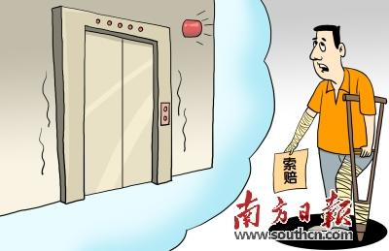
Pour water over the door.
Put a wet towel(毛巾) over his mouth.
Don’t jump from the building.
Don’t take the lift.
lift电梯

Slide 17
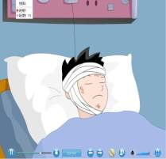
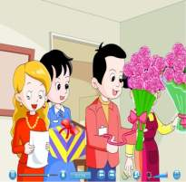
Careful-reading
Task4: Read together and answer.
Para 4~6
1. Was Lin Tao badly hurt in the fire? Why?
Yes. Because he was in hospital for two weeks.
2. What did many people give him?
Flowers and presents.

Slide 18
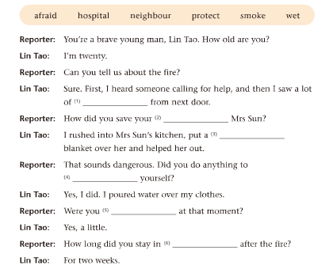
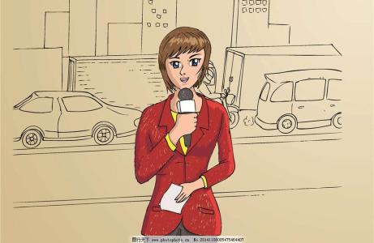
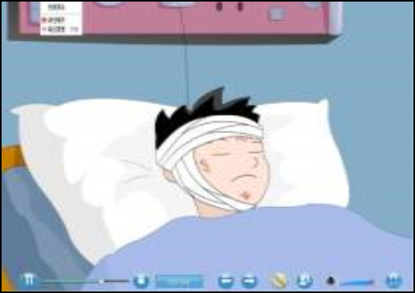
1. 独立完成 2. 两两核对 3. 两人展示
Interview Lin Tao
smoke
neighbour
wet
protect
afraid
hospital

Slide 19
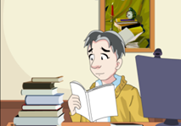
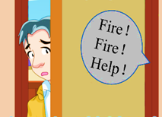
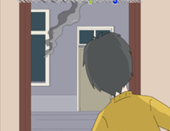
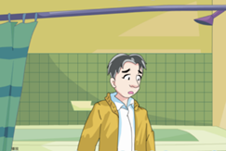
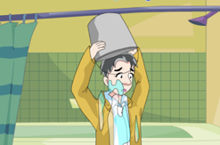
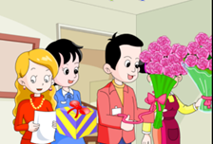
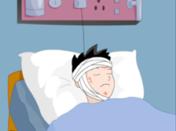
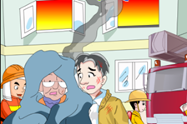
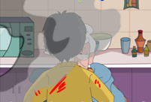
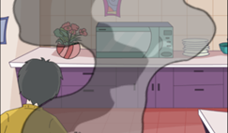
Task5:Retell the story according to these pictures.
Post reading
1. 小组互相复述 2. 一人复述图1-5，另一人呈现图6-10

Slide 20
Abilities
If you want to help others, you need ……
To be a learner
To be a thinker
To be a saver

Slide 21
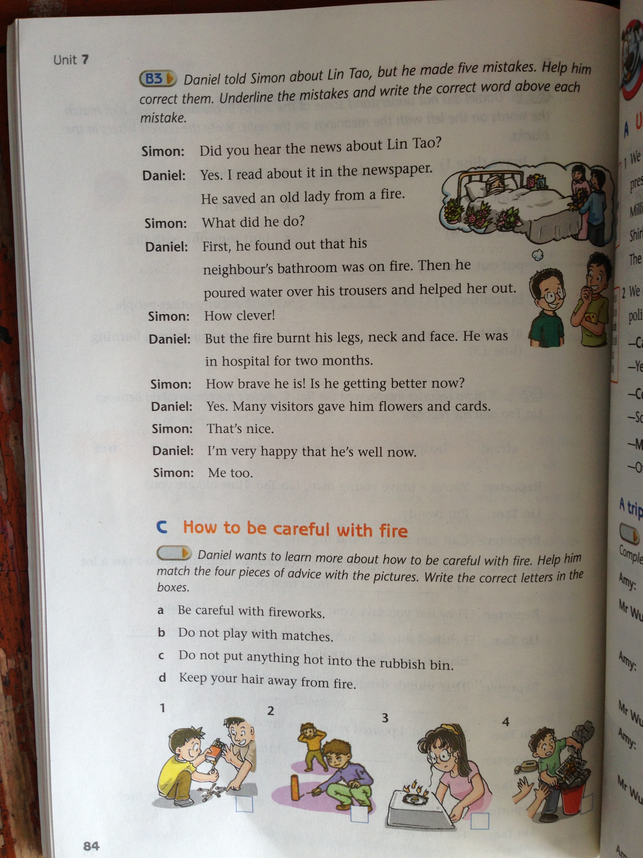
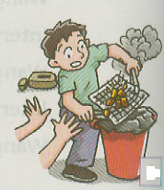
To be a saver
How to be careful with fire ?
Discussion
1. 小组讨论 2.一人展示
a. Be careful with fireworks.
b. Do not play with matches.
c. Do not put anything hot into the rubbish bin.
d. Keep your hair away from fire.
We should (not)…...
b
a
d
c

Slide 22
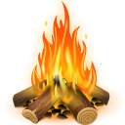
Make a report
We all know that fire is very important. But sometimes if we are not careful with fire, it will be very dangerous. If there is a fire, we should be careful and brave.
First, we can…
Then we can…
We should…
But remember we can’t…
Safety is above all(安全高于一切).

Slide 23

Fire and water have no mercy, human love.
水火无情，人间有爱。

Slide 24
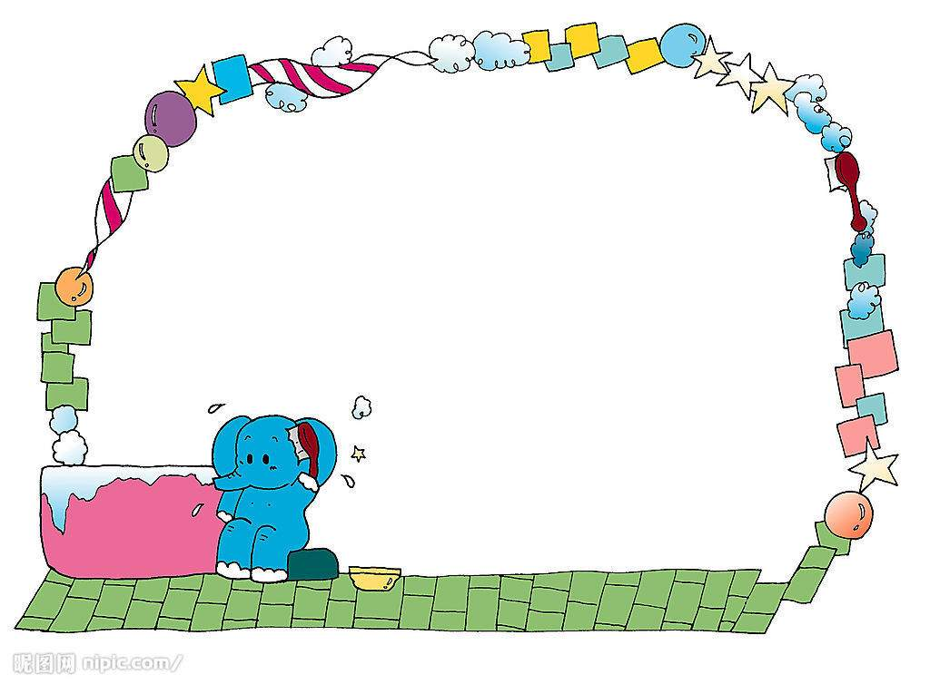
Homework
Tell the story to others.
Tell your family how to be careful with fire.

Slide 25

Thank you !

Slide 26



“T” or “F“?
To prevent fire (防火)
1. 小组讨论 2.一人展示
1. You can throw a cigarette end (烟蒂) on the grass.
2. Be careful when you use candles at home.
3. Try to learn how to use the fire extinguisher(灭火器).
4. If a fire happens, you should call 119 at once.
5. Keep your long hair away from the fire.
6. No smoking in the forest.

Slide 27
If there is a fire ,what should we do?
1. Calm(镇定) down when you meet fire.
2. Call 119 and 110 for help.
3. Close the door and open the window when there is lots of smoke outside.
4. Rush out and take a lift(电梯）to go down.
5. We can pour water over the clothes
when we meet the hot fire.
7. Cover your nose with towels( 毛巾） or
wet cloth when leaving.

Slide 28

Post-reading
Put them into the right order.
2
hear someone shouting “Fire! Fire!”
run to Mrs Sun’s bathroom
help her out of the fire
rush into the kitchen
see a lot of smoke from next door
be in hospital for two weeks
be at home alone
pour water over his clothes
put a wet blanket over Mrs Sun
4
8
6
3
9
1
5
7

Slide 29
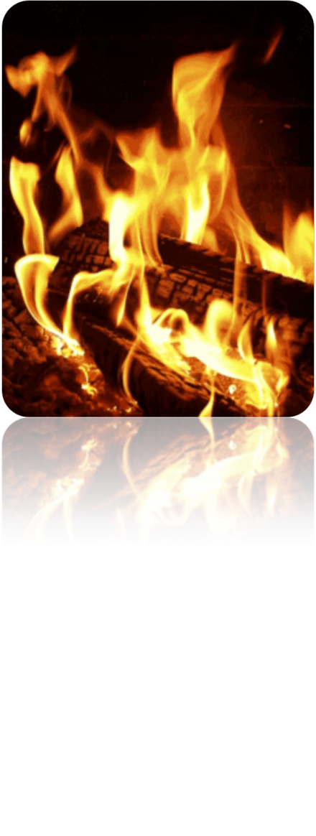
fire

Slide 30
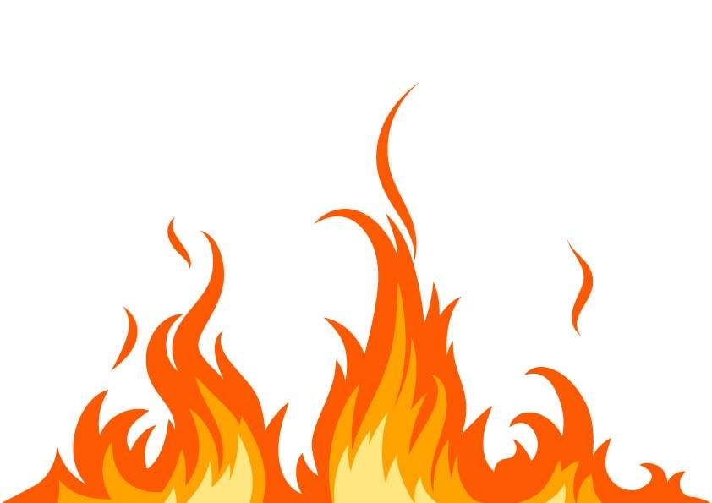
Free talk
What do you think of fire?

Slide 31
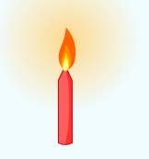
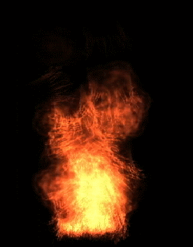

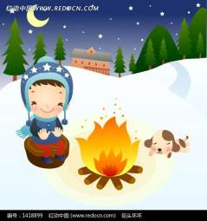

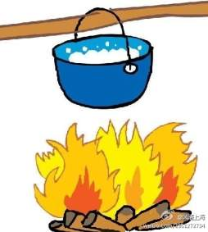
Fire is very important and useful in our life.
What can we use fire to do in our life?
But sometimes fire is dangerous if you are not careful with it.

Slide 32

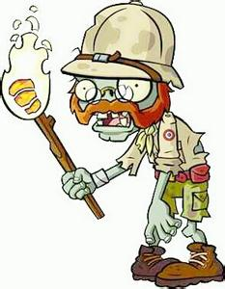
The man was badly hurt.
The fire burnt his arms and face.
He is in hospital now.

Slide 33


If there is a fire, what should we do to protect (保护) ourselves?
Call 119 for help
Shout for help
“Fire!Fire!Help!”

Slide 34



Rush out of the fire quickly.
Put a wet towel over
our mouths.
Pour some water over our clothes or use a wet blanket to protect ourselves.

Slide 35

The firemen will come to save us quickly.
put out the fire
brave and helpful

Slide 36
Match the words with the meanings
Pre-reading
a ran quickly
b just then
c hurt someone with fire
d not afraid
e without any other people
f stop sth from burning
1 brave
2 alone
3 rush
4 put out
5 burn
6 at that moment

Slide 37




Sunshine Daily
Finish Exercise B2 on P83

Slide 38


smoke
neighbour
wet

Slide 39

protect
afraid
hospital

Slide 40



kitchen
clothes

Slide 41


arms
weeks
presents

Slide 42


