Slide 1
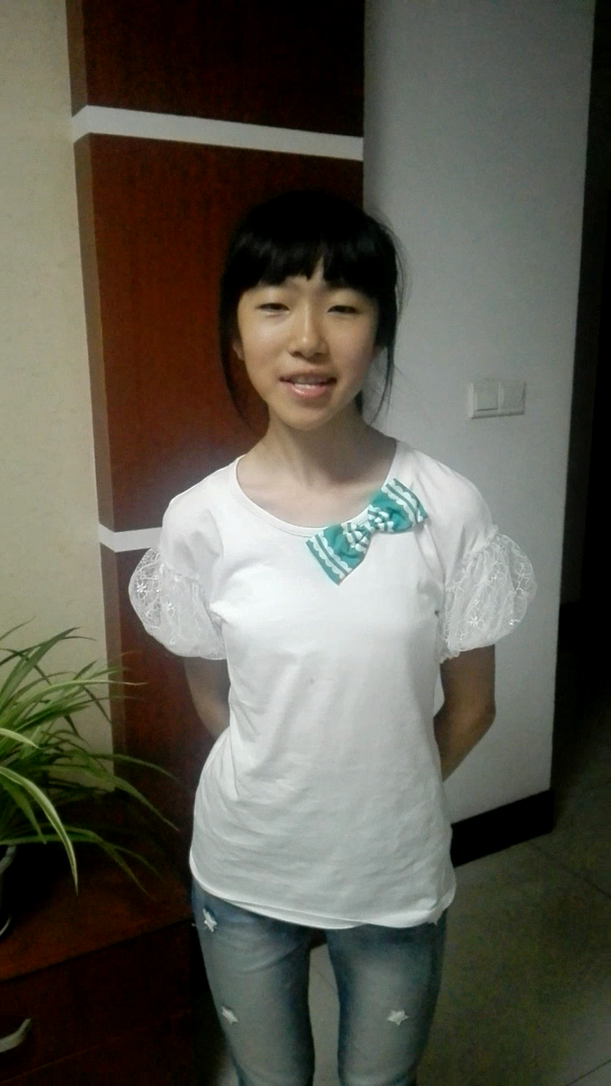

Slide 2
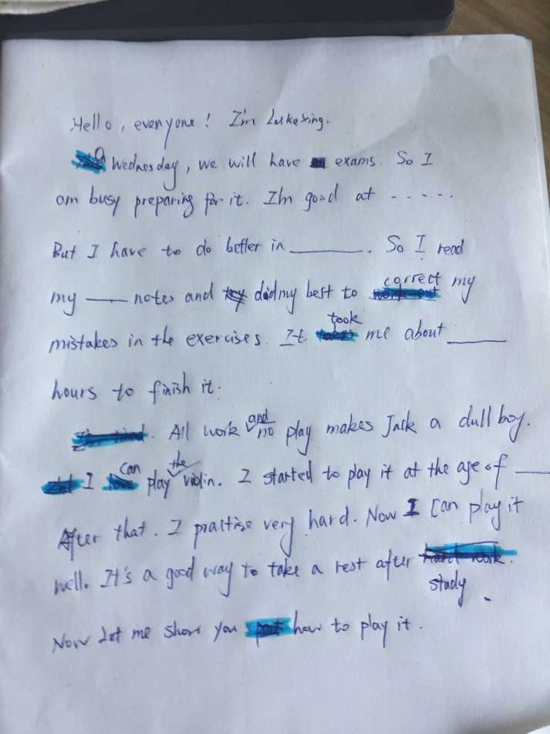
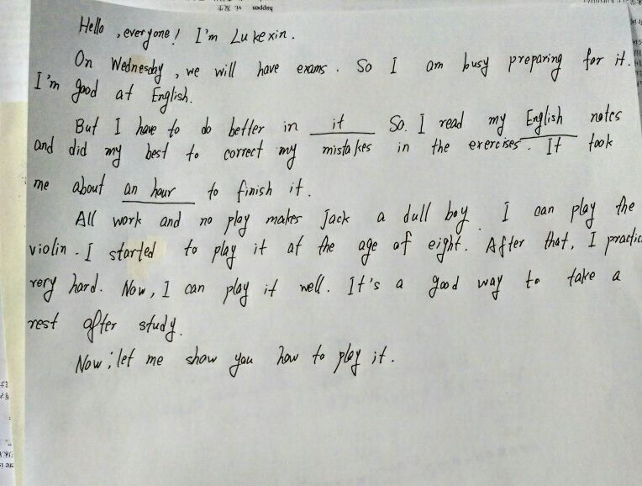
Articles 文章
not careful = careless 粗心的
better 更好

Slide 3
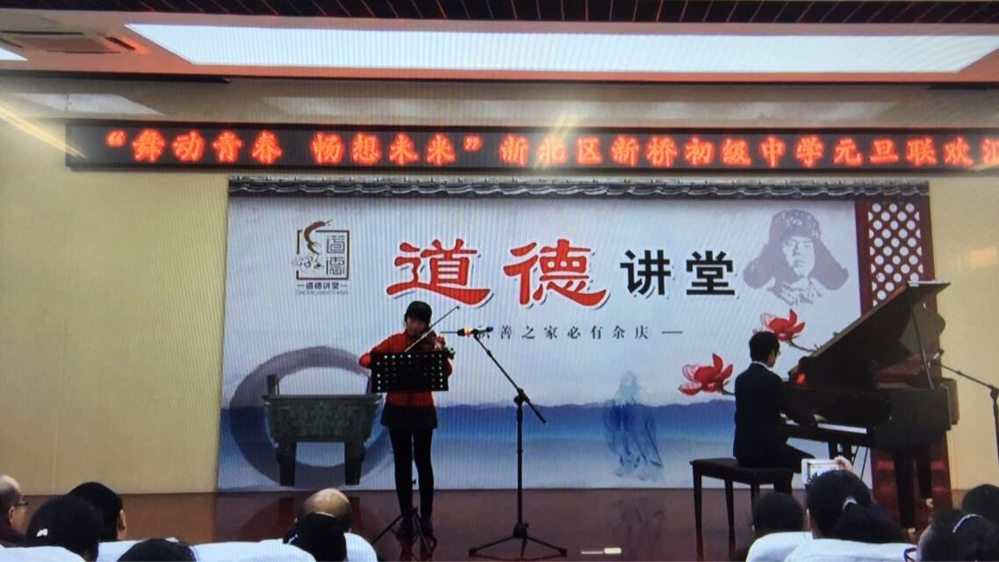
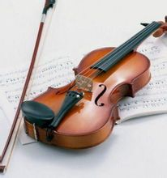
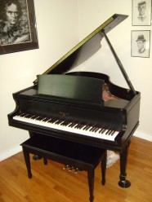
play the violin
拉小提琴
play the piano
弹钢琴

Slide 4
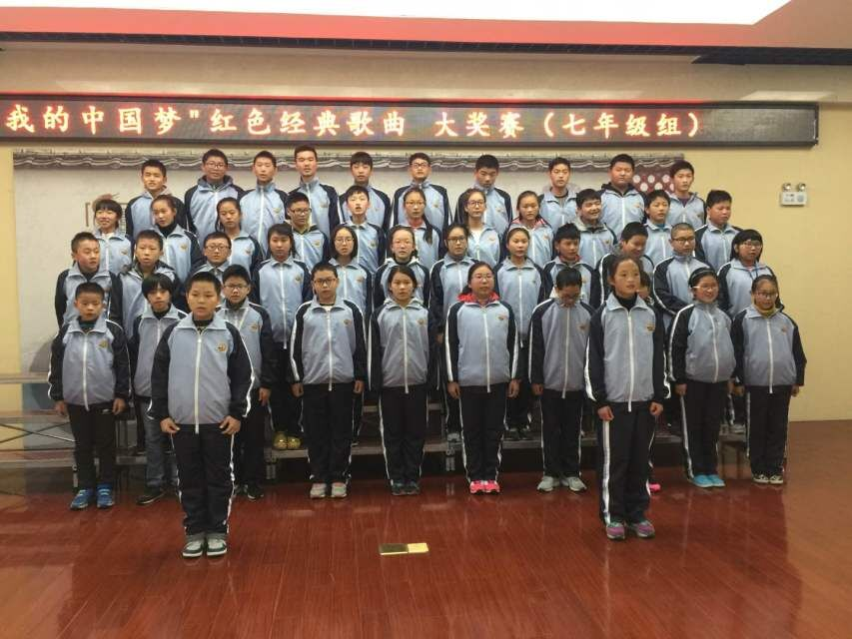
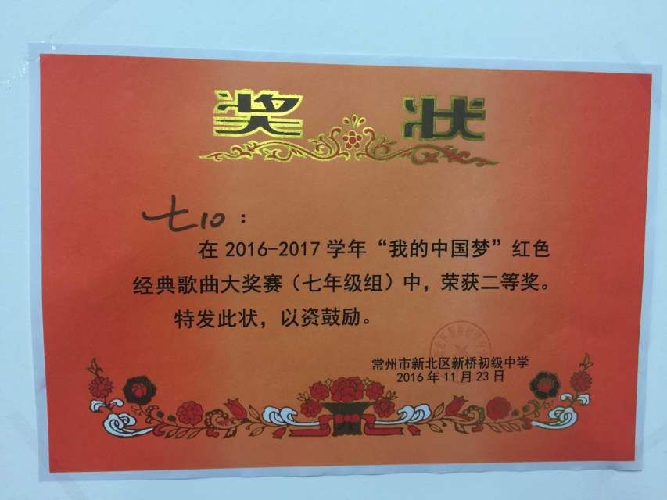
term学期
last term上学期
this term 本学期
be good at
do well in 擅长
work hard on
努力地
do / try one’s best
尽某人最大的努力

Slide 5
New words
term n. 学期
hard adv. 努力地, 费力地
piano n. 钢琴
better adv. 较好，更好
do well in …… 做得好
do/try one’s best 尽某人最大努力
careless adj. 粗心的
article n. 文章

Slide 6
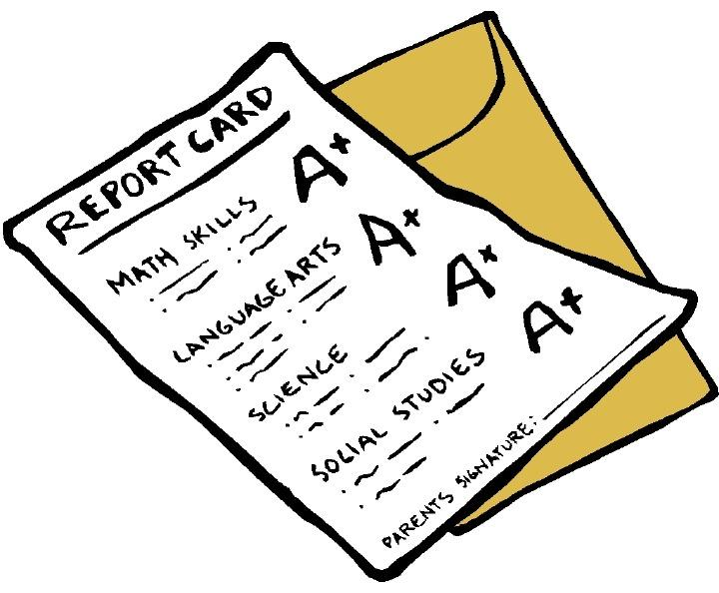
Unit 7 Abilities
Integrated skills

Slide 7


Speak up
Listen and answer:
What can Daniel do?
2. What can Sandy do?
He can play the violin.
She can play the piano.

Slide 8
Speak up
Read and answer more questions :
1. When did Daniel start to do it?
2. When did Sandy start to play the piano?
He started to play the violin at the age of six.
when he was six
She started to play the piano when she was five.
at the age of 5

Slide 9
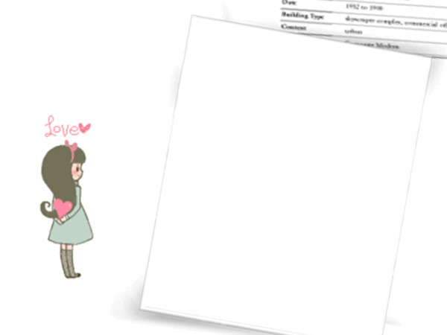



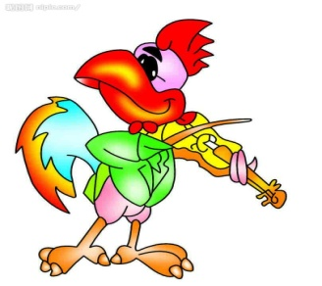

Work in pairs
A: Hello, ×××! What’s your hobby?
B: I like … very much.
A: × × ×, Can you …?
B : Yes , I can.
I started to … at the age of …
when I was … years old
Play the violin
在..岁时

Slide 10


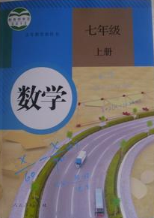


Hobby makes us happy
while study makes us wise !

Slide 11
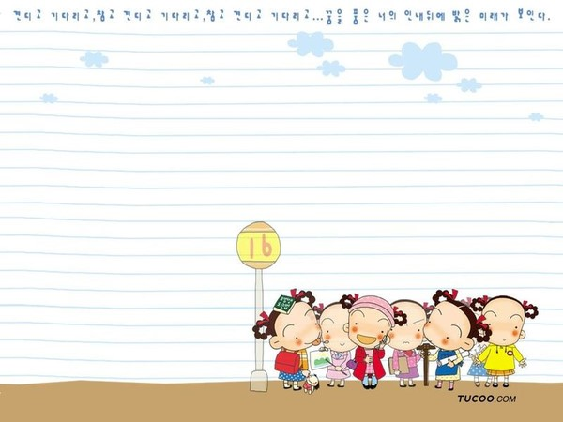
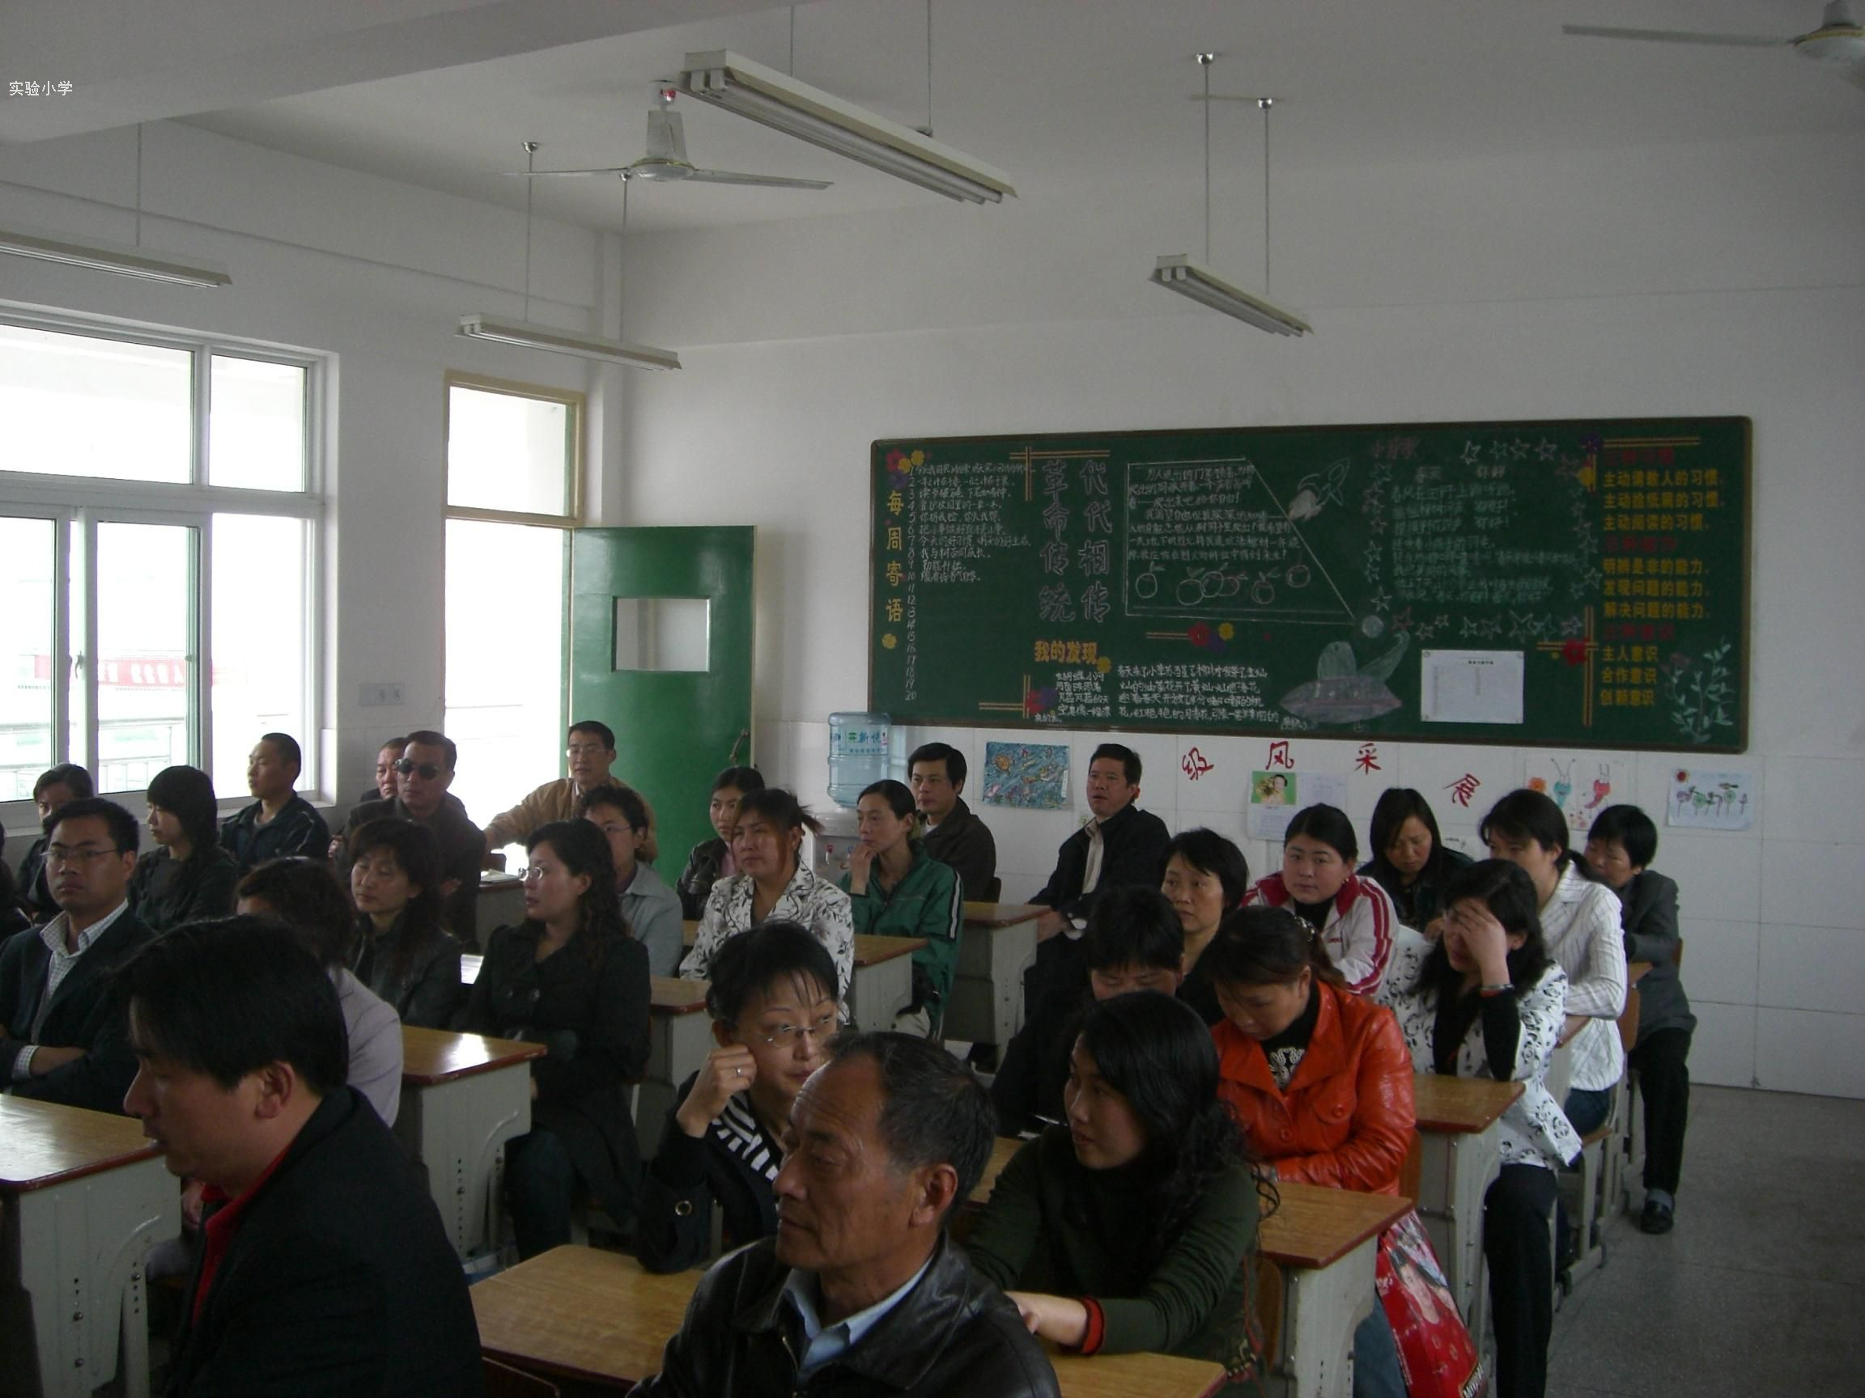
Step 3 meeting parents
parents’ meeting

Slide 12
1对听力内容进行预读
Part A1: Read the report card and answer
(1) Whose report card is this?
(2) What class is she in?
(3) What subjects does she have?
Suzy’s.
In Class 1 , Grade 7.
Chinese ,Maths, English , History and Geography .

Slide 13
1对听力内容进行预读
2根据已有内容对题目进行合理的猜测
Suzy’s report card
Listen and write the correct letters.
C
A Good this term, but she needs to
read more and speak more
Chinese
.
E
Maths
B Suzy loves it and works hard on the subject. She knows a lot about it.
A
English
C Good work. Suzy writes good articles
B
History
D She does not do her best this term
D
Geography
E Good, but sometimes she is careless
= not careful

Slide 14





Suzy’s study:
English
good this term
need to read more and speak more
多看，多说
Maths
good but
sometimes careless
粗心
Chinese
good work write good articles
文章
does not do her best this term
Geography
在某方面努力，勤奋

Slide 15
A2
Pre-listening : complete part of his notes according to A1(根据A1完成部分笔记)
Suzy
Study: good at , Maths, and .
not so good at .
Music: of the Music Club;
plays the piano at school .
Sports: practices every Monday and .
Others: nice and .
Chinese
English
History
Geography

Slide 16
While-listening: Listen and complete the rest of his notes.
Suzy
Study: good at , Maths, and .
not so good at .
Music: of the Music Club;
plays the piano at school .
Sports: practices every Monday and .
Others: nice and .
Chinese
English
History
Geography
member
shows
volleyball
Wednesday
friendly

Slide 17
Post-listening: Complete the report card about Suzy.
Name: Suzy
Class:1 Grade:7
Class teacher: Wu Bing
Suzy is good at Maths. She does well in ___________, and ___________too, but she needs to do better in___________.
Suzy likes music, and she is a of the Music Club. She often plays the piano at___________. She also likes sports, and she plays___________well. She practices hard on___________and ___________after school. I think she will get into the school team next term.
Suzy is nice and . All her teachers and her classmates like her very much.
Chinese
English
History
Geography
member
school shows
volleyball
Monday
Wednesday
friendly

Slide 18
Discussion
How to write the report card
Name: Suzy
Class:1 Grade:7
Class teacher: Wu Bing
Suzy is good at Maths. She does well in ___________, and ___________too, but she needs to do better in___________.
Suzy likes music, and she is a of the Music Club. She often plays the piano at___________. She also likes sports, and she plays___________well. She practices hard on___________and ___________after school. I think she will get into the school team next term.
Suzy is nice and . All her teachers and her classmates like her very much.
subject
Chinese
English
History
Geography
member
school shows
hobby
volleyball
Monday
Wednesday
个性，人品
friendly
personality

Slide 19
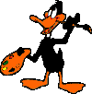
How about you?
Name : Class : Grade :
Good at :
Weak in :
Clubs/teams/groups :
Sports:
Personality :
Some other information:

Slide 20


group work
Discuss
1.talk about your hobbies , study and personality with your partner
2. Write a report about your group member
3.Share it with the whole class

Slide 21
Practice makes perfect !
Good hobbies and good study make us better !

Slide 22

Write down your aim report and make a video like Lu kexing
Prepare for the exam

Slide 23
A report card
素质报告单
 | Chinese | Maths | English | History | 政治 Politics
very good
quite good
Good, careless should listen to the teacher carefully in class
don’t do one’s best should do more exercises
Not good Should try harder
… …(可自由拓展） | Such as : Geography ,Biology (生物）,PE, Art, Music, Computer…

