Slide 1

The world of
phonetics
---Claire

Slide 2
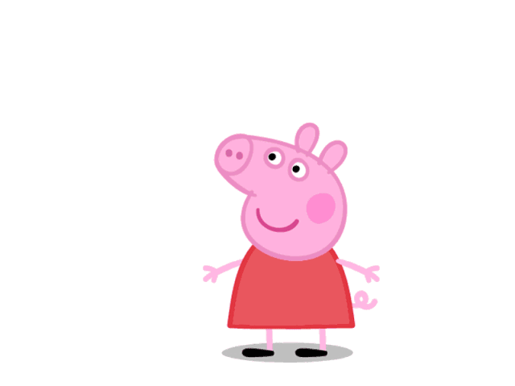
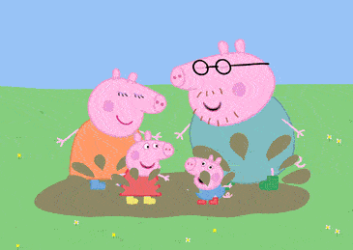
1 Do you know the name of this cartoon ?
Yes. It is Peppa pig./No, I do not.
2 Is she cute (lovely)?
3 Do you like her nose?
4 What does she like doing best?
She likes jumping in muddy puddles best.
她最喜欢在泥坑里跳。
muddy puddles
Notes:
Do you know his hobbies

Slide 3
go, no, hi...
Open syllables （开音节）
name cute like nose she ...
1.一个元音字母+一个辅音字母(r除外)+不发音的e
2. 辅音字母+一个元音字母
相对开音节
绝对开音节
a e i o u 在开音节中发______音：
本身
[ei]
[i:]
[ai]
[əu]
[(j)u:]

Slide 4
Read open syllables
a [ei]
e [i:]
i [ai]
o [əu]
u [ju:]
tape
theme
pipe
rose
mute
a [ei] e [i:] i [ai] o [əu] u [ju:]

Slide 5
Closed syllables （闭音节）
Peppa pig not best jump muddy puddles...
cat pen sit box cup...
一个元音字母+一个/几个辅音字母(r除外)
a e i o u 在闭音节中分别发：
[]
[e]
[I]
[]
[]

Slide 6
fox
Be the fast reactor(快速抢答)
a [] e [e] i [I] o [] u []
luck
sit
think
nest
map
pack
shot
brush
rock
fit

Slide 7

Who is the best friend of “a, e, i, o, u”?
It is Mummy Pig’s Birthday.

Slide 8
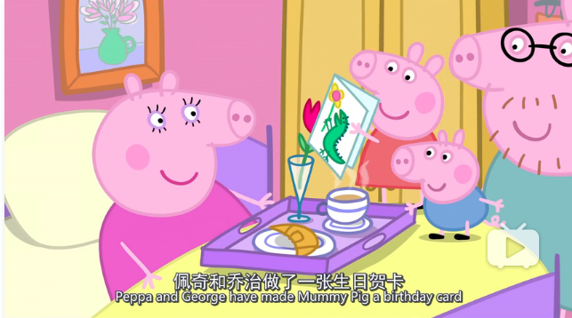
Peppa and George makes her a birthday card.

Slide 9
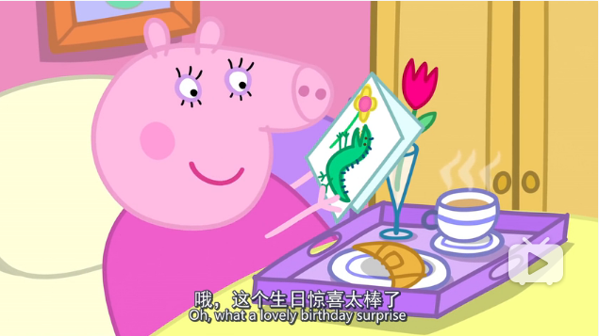
Mummy says:“ What a lovely surprise.（惊喜）”.

Slide 10

To prepare(准备) a purple cake and some balloons(气球), they ask Mummy to stay outside.

Slide 11
Who is the best friend of “a, e, i, o, u”?
R
It is Mummy Pig’s Birthday.
Peppa and George makes her a birthday card.
Mummy says:“ What a lovely surprise.（惊喜）”.
To prepare(准备) a purple cake and some balloons(气球), they ask Mummy to stay outside.
R-syllables(R音节)：
元音字母+r
ar
er
ir
or
ur

Slide 12
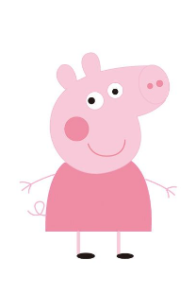
Mummy only likes balloons with R-syllables.
Please help me.

Slide 13
Pick out balloons挑出R音节气球并分类
her
bite
hard
nurse
girl
sport
fun
horse
farm
term
shirt
purple
take
lost
nest
R-syllables(R音节)：

Slide 14
Pick out balloons挑出R音节气球并分类
hard
farm
R-syllables(R音节)：

Slide 15
Pick out balloons挑出R音节气球并分类
hard
her
farm
term
R-syllables(R音节)：

Slide 16
Pick out balloons挑出R音节气球并分类
hard
her
girl
farm
shirt
term
R-syllables(R音节)：

Slide 17
Pick out balloons挑出R音节气球并分类
hard
sport
her
girl
farm
shirt
term
horse
R-syllables(R音节)：

Slide 18
Pick out balloons挑出R音节气球并分类
hard
sport
nurse
her
girl
farm
shirt
term
horse
purple
[:]
[:]
[:]
[:]
[:]
R-syllables(R音节)：

Slide 19
You are so wonderful!棒极了！
Thank you for your help!

Slide 20
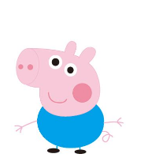
We like different kinds of candies(糖果). But there are too many candies. Please help me.

Slide 21

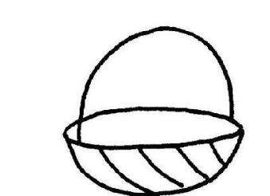
Prepare for the “high-tea”(下午茶)
smart
form
skirt
garden
hurt
party
north
term
verb
third
fur
torch
D’s candies [:]
P&G’s candies [:]
M’s candies
[:]

Slide 22
Thank you for your help. Now the birthday party begins.(生日派对开始了。)

Slide 23
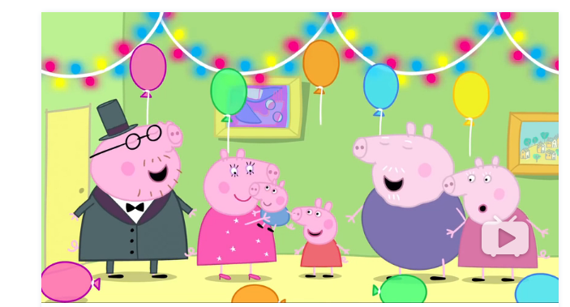
Peppa asks Mummy: “How do you feel today”?
Mummy says: “I feel very warm. And I forgot
what hard work birthdays were. ”我都已经忘记了过生日这么难。
ar在[w]后[:]
or在[w]后[:]

Slide 24
Write & remember
R音节 (r-syllables)
组合 | 发音 | 在[w]后
ar
er
ir
or
ur
car
her
bird
short
purple

Slide 25
Write & remember
R音节 (r-syllables)
组合 | 发音 | 在[w]后
ar
er
ir
or
ur
car
[:]
[:]
her
[:]
bird
[:]
short
[:]
[:]
purple
[:]

Slide 26
辨一辨
ar [:] er [:] ir [:] or[:] ur [:]
ar在[w]后[:]
or在[w]后[:]
( ) world pork
( ) park warn
( ) work dirty
判断下列单词中划线部分读音是否相同，相同请打“S”，不同请打“D”。
D
[:]
D
[:]
[:]
[:]
S
[:]
[:]

Slide 27
拼一拼
1 [d aɪ v] d _ v _ _____
2 [f juː z] f _ s _ _____
3 [l æ m p] l_ mp _____
4 ['m ɑː k ɪ t] m___ ket _____
5 ['w ɜː k ə ] w___ ker _____
6 ['m e m b ə] m _ mber _____
7 ['m e m b ə]+ [ʃ ɪ p]
m _ mber+sh _ p=
i e
开音节
u e
开音节
a
闭音节
ar
R音节
or
R音节
e
闭音节
e i
membership会员
闭音节

Slide 28


Be the best speller
1 spell in a group of 6-8 classmates(6-8人一组)
2 make the phonetics as much as possible(尽可能拼出多的音标)
3 make the phonetics as long as possible, including at least two vowels(尽可能拼出长的音标,至少使用2个元音)
4 share them with others(上前分享和教授音标)

Slide 29

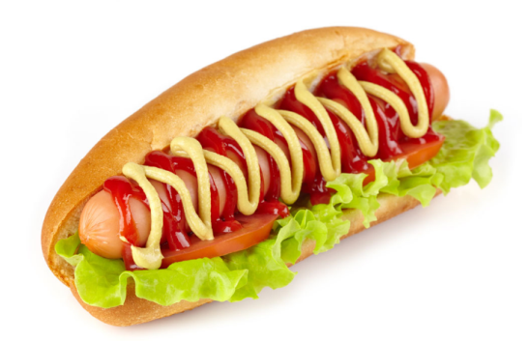
Be the best guesser
---Riddles 谜语
1 /witʃ ˈletə iz ə pa:t əv jɔ: feis/ ?
Which letter(字母) is a part (部分) of your face?
Key: I (eye).
2 /wɔt kaind əv dɔg ˈdʌznt bait (咬) ɔ: bα:k(吠) /?
What kind of dog doesn't bite or bark?
Key: hotdog.

Slide 30

/ wɒt hæz hændz bʌt nəʊ fiːt/
/ ə feɪs bʌt nəʊ aɪz/
/kæn tel ju: 'sʌmθɪŋ/
/meik ju: weik ʌp bʌt dʌz nɒt tɔːk/
What has hands but no feet,
a face but no eyes,
can tell you something,
make you wake up but does not talk?
Key: a clock.

Slide 31
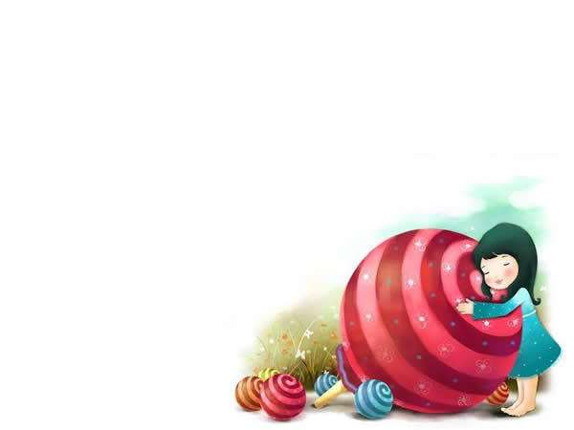
Be the best learner
/ɡʊd 'betə best/
Good, better, best, 好，更好，最好，
/'nevə let it rest/
never let it rest, 永远不要停止，
/til ɡʊd iz 'betə /
till good is better, 直到好变成更好
/ænd 'betə best/
and better best. 更好变成最好。

Slide 32

Homework
Practise speaking for at lease 15 minutes every day.
Find out more new words according to the pronuciation of open syllables, closed syllables and r-syllables.

