Slide 1
Friend
or
Enemy

Slide 2
Buttons on the Internet
Brain storming
❶
Search
❻
maximize
home
page
download
refresh
❹
❽
❸
❺
close
❼
❷
minimize
back arrow

Slide 3
Unit 3 Reading The Effects Of The Internet On Our Lives

Slide 4
What style is this passage?
A novel
An essay
A narration
An argument
Title
Subtitles
postive
negative

Slide 5
Reading an argument
Reading strategy
How does an argument develop?
a. a given specific point
b. a list of the points the person wants to make
c. supporting facts
d. conclusion
(P35)
Central point
Main points
Supporting points
Conclusion

Slide 6
1st speech
Choose the diagram of the structure
①②
①
①
③
④
②③
④
②
③④
⑤
⑤
⑤
A
B
C

Slide 7
Zhu Fei's speech
Central Point:
Main Points
Conclusion
The Internet has positive effects on our lives.
How to support the main points?
Point 1: look for information
Point 2: relate to others
The Internet is a positive tool that helps make our
lives better.

Slide 8
Supporting points
find
abundant information
●
facts
communicate with
look for
information
experts and read articles
●
●
80 %:
search for answers
statstics
find out information about hobbies
Main Points
●
79%:
1.
2.
Young people
can form friendships.
examples
relate to
others
can correspond and
communicate with others.
Disabled people

Slide 9
2nd speech
Draw the diagram of the structure by yourself
①
②
③
④
⑤

Slide 10
Li Lei's speech
Central Point:
Main Points
Conclusion
The Internet has negative effects on our lives.
Point 1: too much unevaluated information
Point 2: affect people's private lives
It is important for us either to limit our use of the Internet,
or to learn how to handle the problems ( it has caused.)

Slide 11
A. examples B. statistics
① In 2003, eBay said that 70% of their problems were with people( who sold things )(that did not exist) or ( who lied about their products.) ( )
②Students are handing in papers using false information ( they found on the Internet.) ( )
③ Now, instead of spending time together in the evenings, some families spend their time apart because one or more members are using the computer . ( )
A&B
A
A

Slide 12
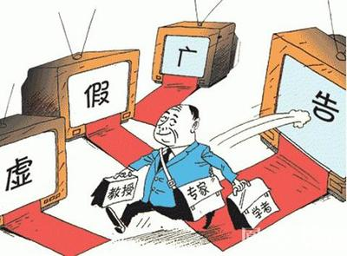
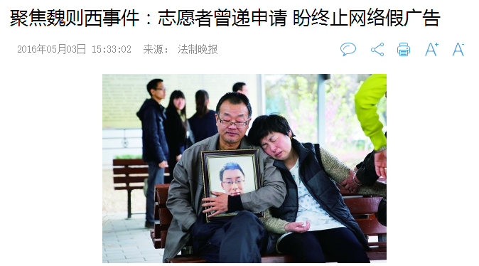
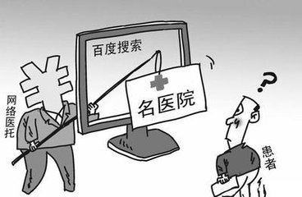
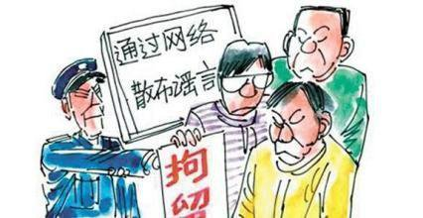
课时练 P104

Slide 13
Discussion
China's Internet regulator said on Monday it would send an investigation team to Chinese search leader Baidu Inc over the death of a university student, who had used the search engine to look for treatment for his cancer.
Wei Zexi, 21, died last month of a rare form of cancer. He had turned to Baidu to look online for the best place for treatment, finding a department under the Second Hospital of Beijing Armed Police Corps which offered an experimental form of treatment that ultimately failed, according to state media.
Before dying, Wei has posted criticism online accusing Baidu of promoting false medical information, as well as the hospital for misleading advertising in claiming a high success rate for the experimental treatment, state radio said.The regulator said in a short statement Wei's case had attracted widespread attention on the Internet.
It, along with the health ministry and State Administration for Industry and Commerce, would investigate Baidu over the case and “handle it in accordance with the law” and publicize its findings.
What measures can be taken to keep the abuse（泛滥） of false information under control?
a. Internet supervision
b. Individual behavior

Slide 14
Internet supervision
Individual behavior
______________________
______________________
______________________
______________________
______________________
______________________
______________________
______________________
______________________
______________________
______________________
______________________
______________________
______________________

