Slide 1
STRESS

Slide 3
Stress:
worry caused by the problems in somebody’s life
Where does stress come from?

Slide 4
financial pressure

Slide 5
u

Slide 6
work pressure

Slide 7
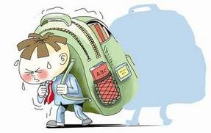
o
study pressure

Slide 8
peer pressure

Slide 9
When will you feel most stressed out？If you are under a lot of pressure, what will you do?

Slide 11
depression

Slide 12
anxiety

Slide 14
Describe one stessful experience you have and how you handle it.

Slide 15
Debate
Stress has more advantages than disadvantages VS
Stress has more disadvantages than advantages

Slide 16
Round1 Both sides state your opinion with supporting details
Round 2 Each side defends your opinion and argues against the other side' s opinions
Round 3 Both sides conclude your opinion

