Slide 1
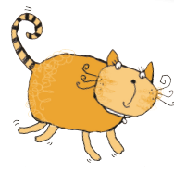


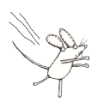
劲松三小
普歌

Slide 2
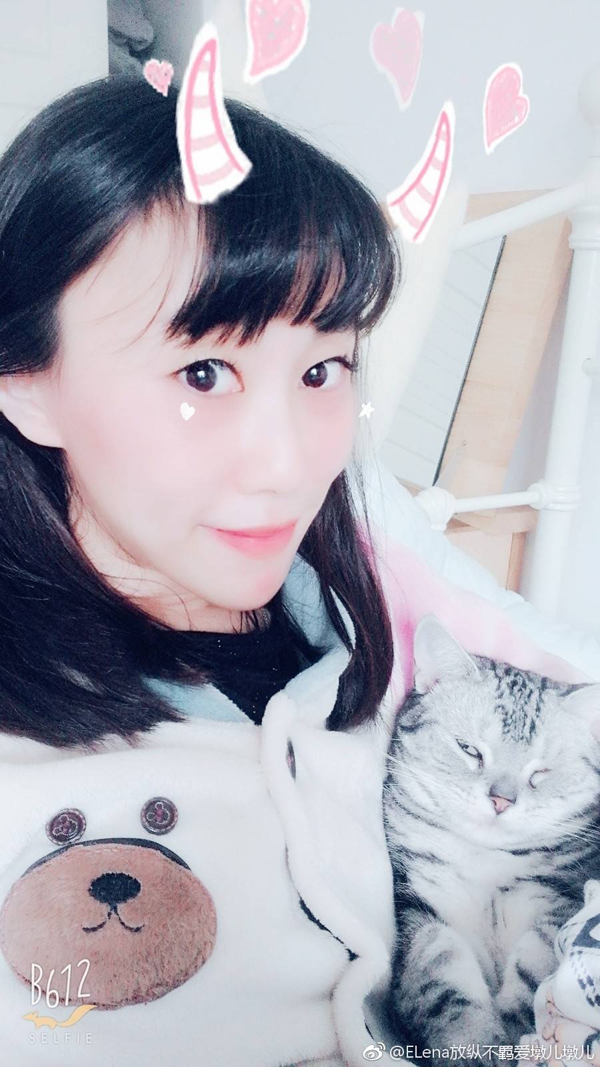
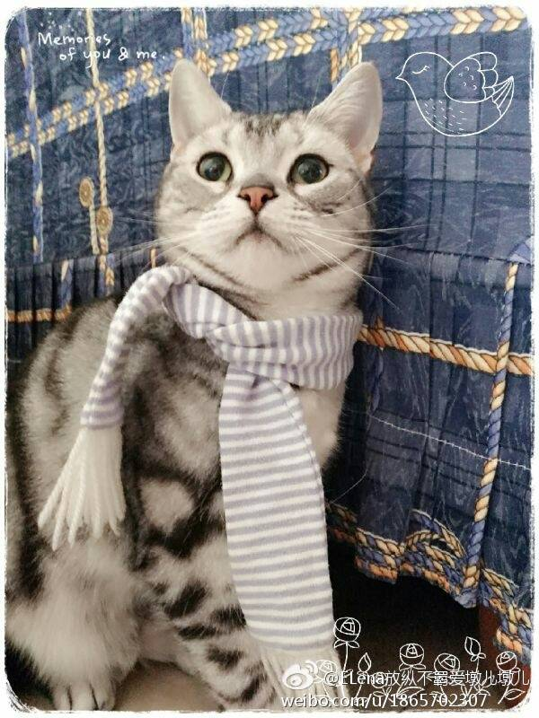
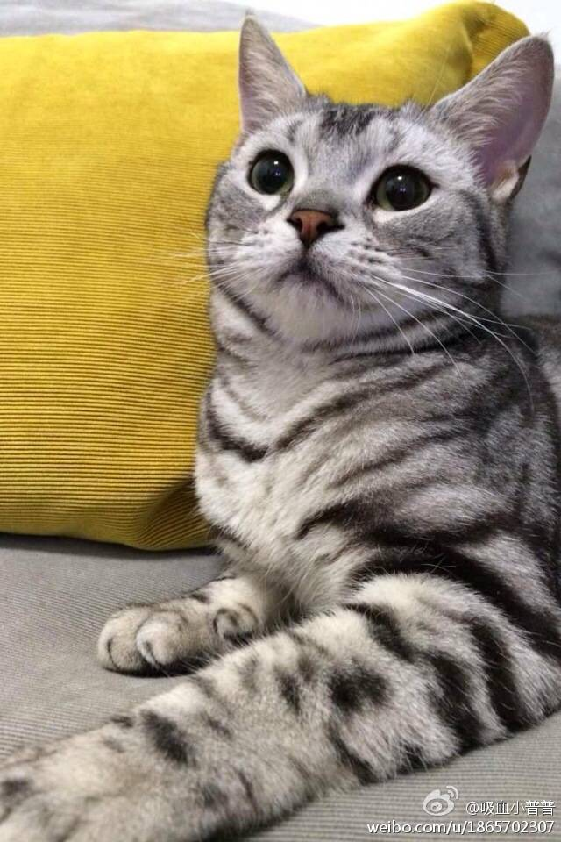
pet
Tiger

Slide 3
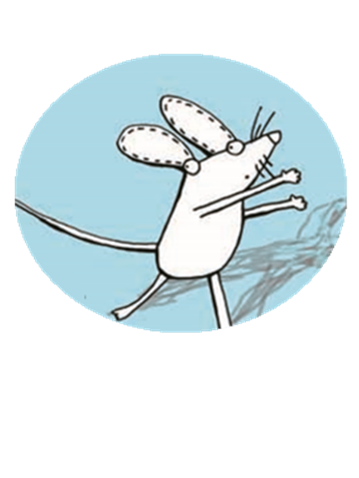

mouse
a new school pet

Slide 4
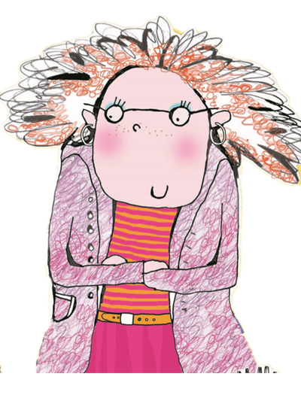
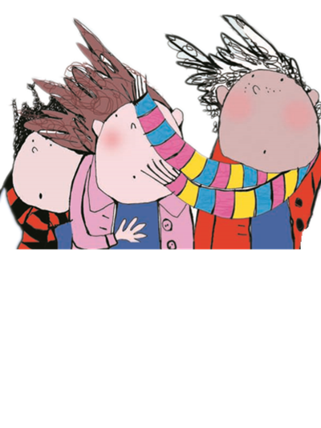

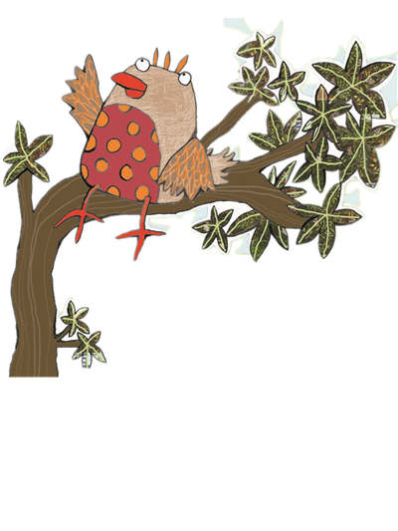
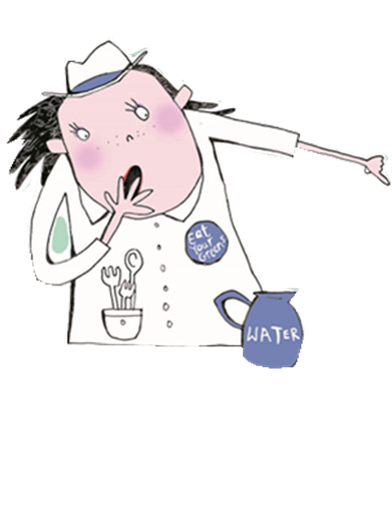
the children
Miss Green
the cat
the dinner lady
the big bird

Slide 5
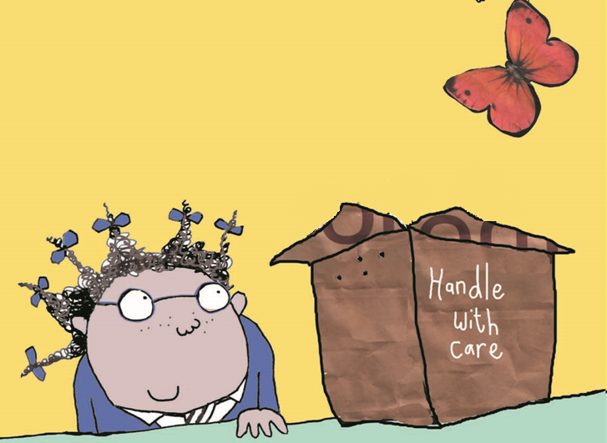
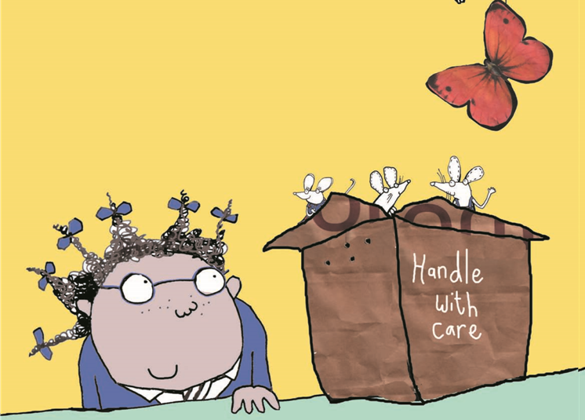
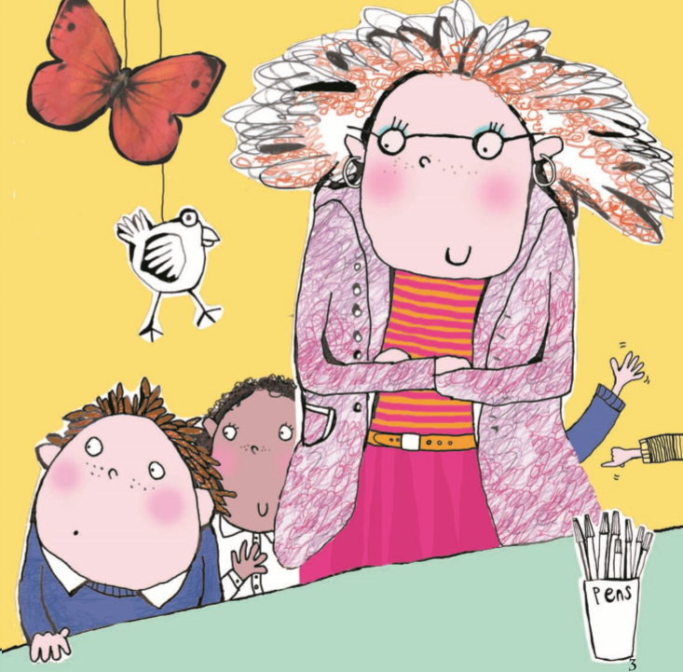

little white mice

Slide 6



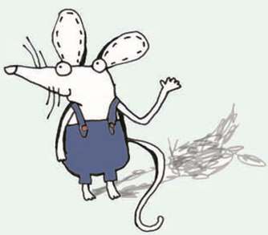
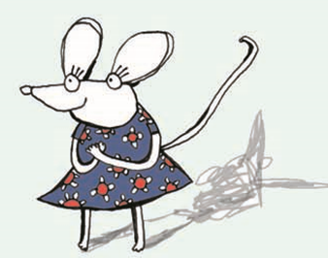
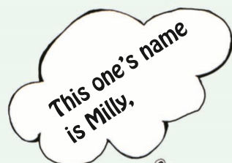


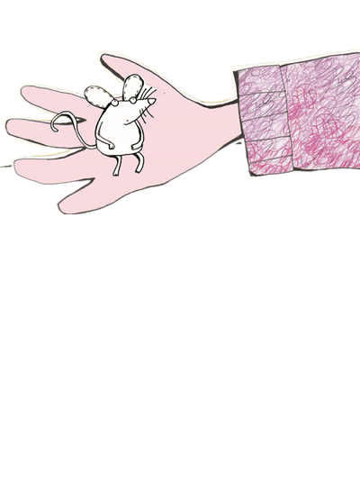
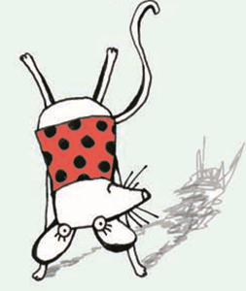
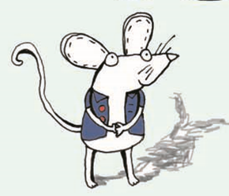


Task1
Q1: How many mice are there?
Q2: What are their names?
Please read P4—P5.

Slide 7
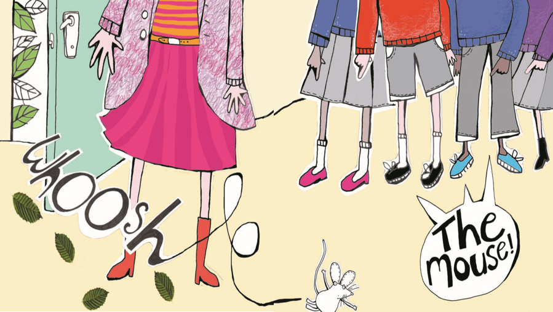


Slide 8
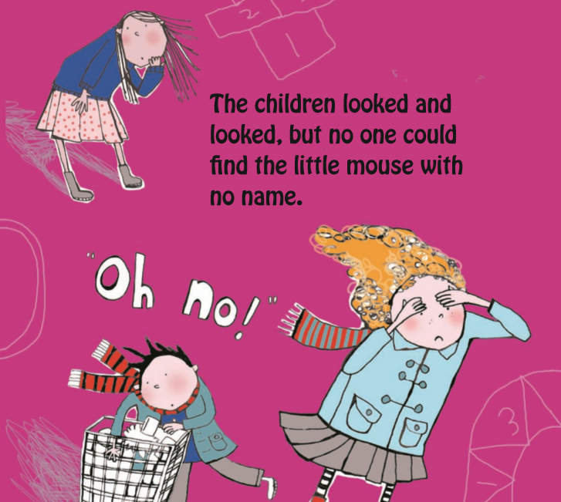


an hour later…

Slide 9
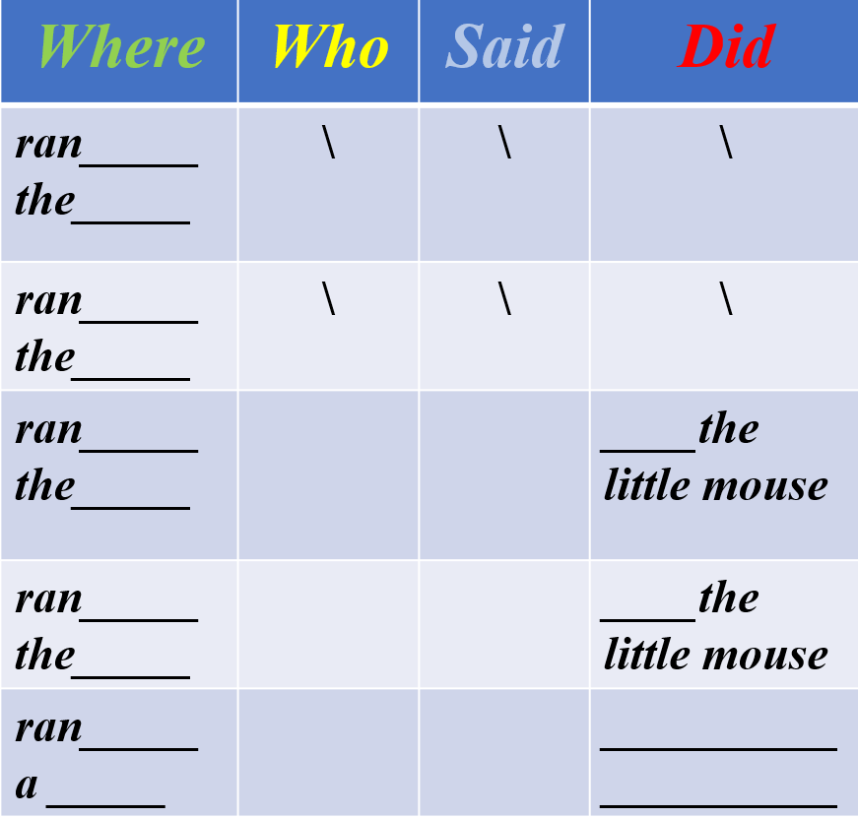
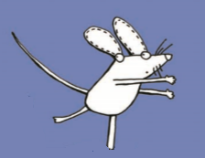
Task2
Please read & talk P8—P17.
1:Where
did he go?
2:Who
found the mouse?
out of
door
4:What did they do?
3：What did they say?

Slide 10
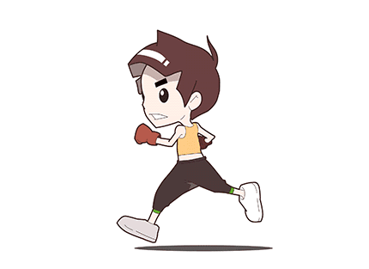
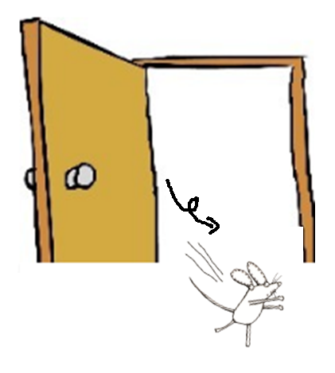
ran out
run--ran

Slide 11

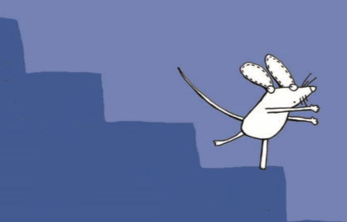
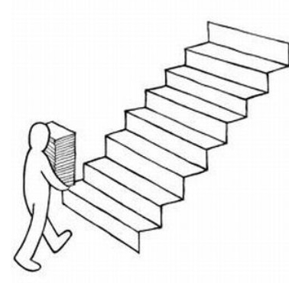
stairs
ran down

Slide 12
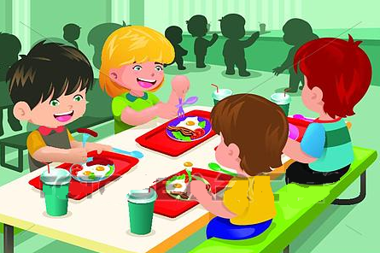
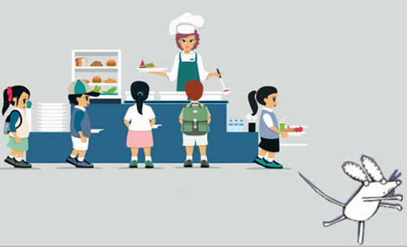
ran into
hall

Slide 13
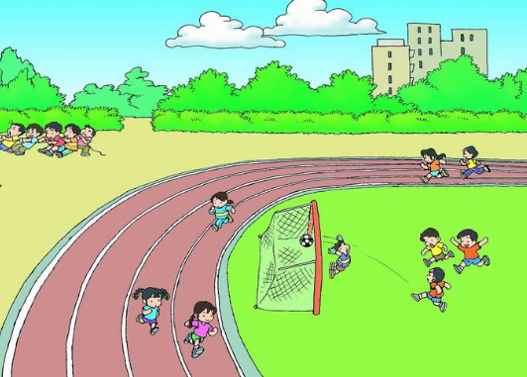
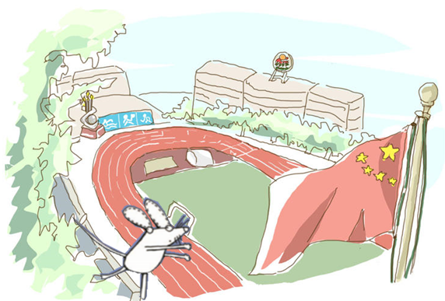
ran into
playground

Slide 14
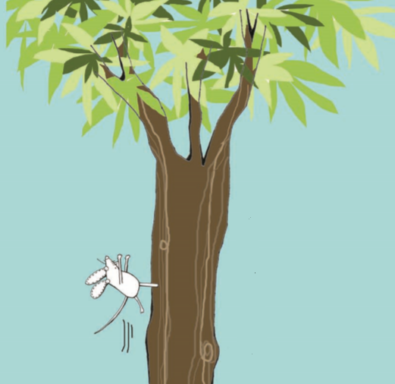
a tree
ran up

Slide 15
where | who | said | did
ran out the door
ran down the stairs
ran into the hall
ran into the playground
ran up to a tree

Slide 17
where | who | said | did
ran out the door | \
ran down the stairs | \
ran into the hall | the dinner lady
ran into the playground | the cat
ran up to a tree | the big bird

Slide 18
where | who | said | did
ran out the door | \ | \
ran down the stairs | \ | \
run into the hall | the dinner lady | The mouse! The mouse!
run into the playground | the cat | The mouse! The mouse!
run up to a tree | the big bird | The mouse! The mouse!

Slide 19
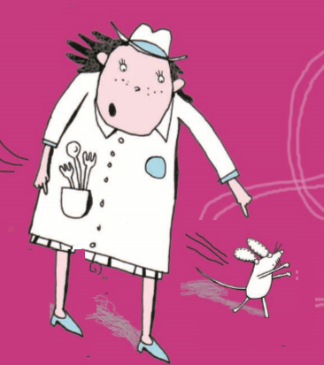
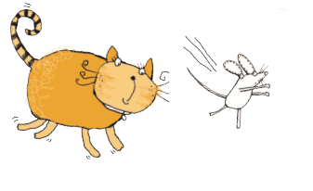
chase--chased

Slide 20
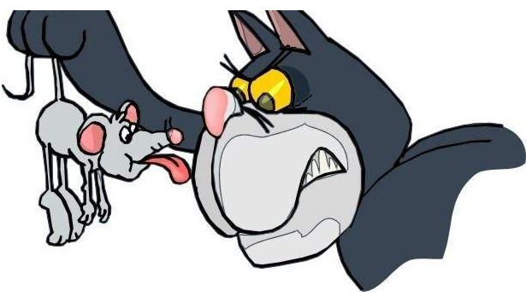
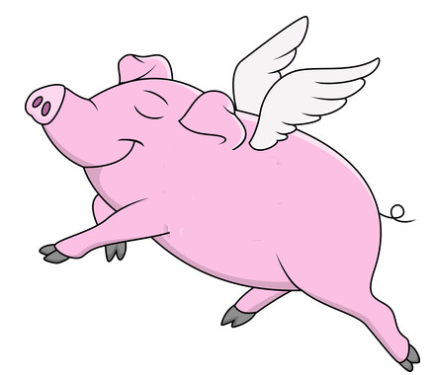
fly--flew
get--got

Slide 21
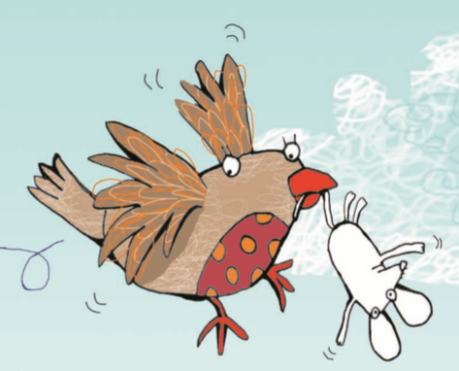
got the mouse
off he flew

Slide 22
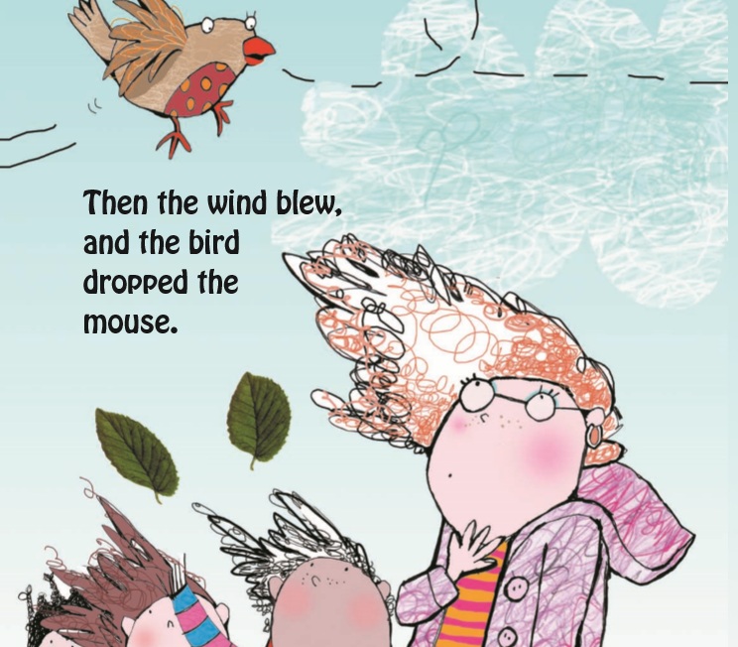
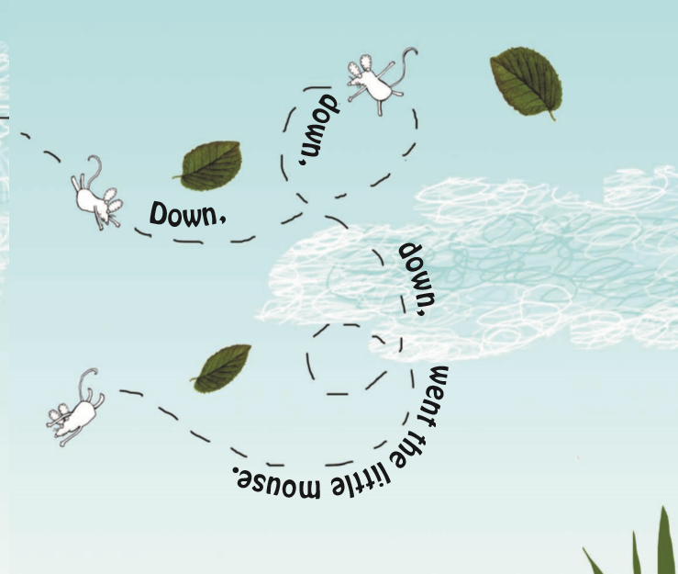

Q: What happen to the little mouse?

Slide 23
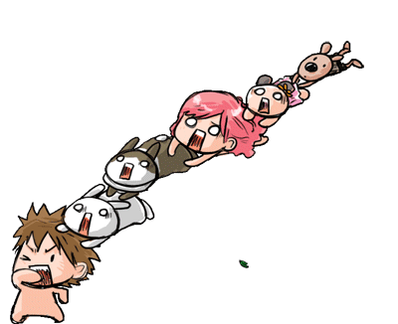
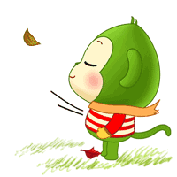
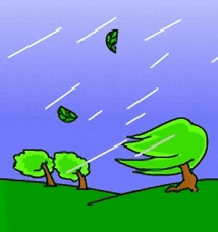
the wind blew

Slide 24
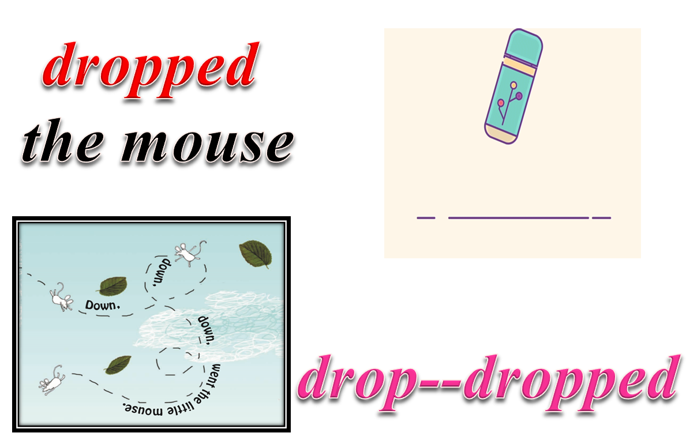

Slide 25
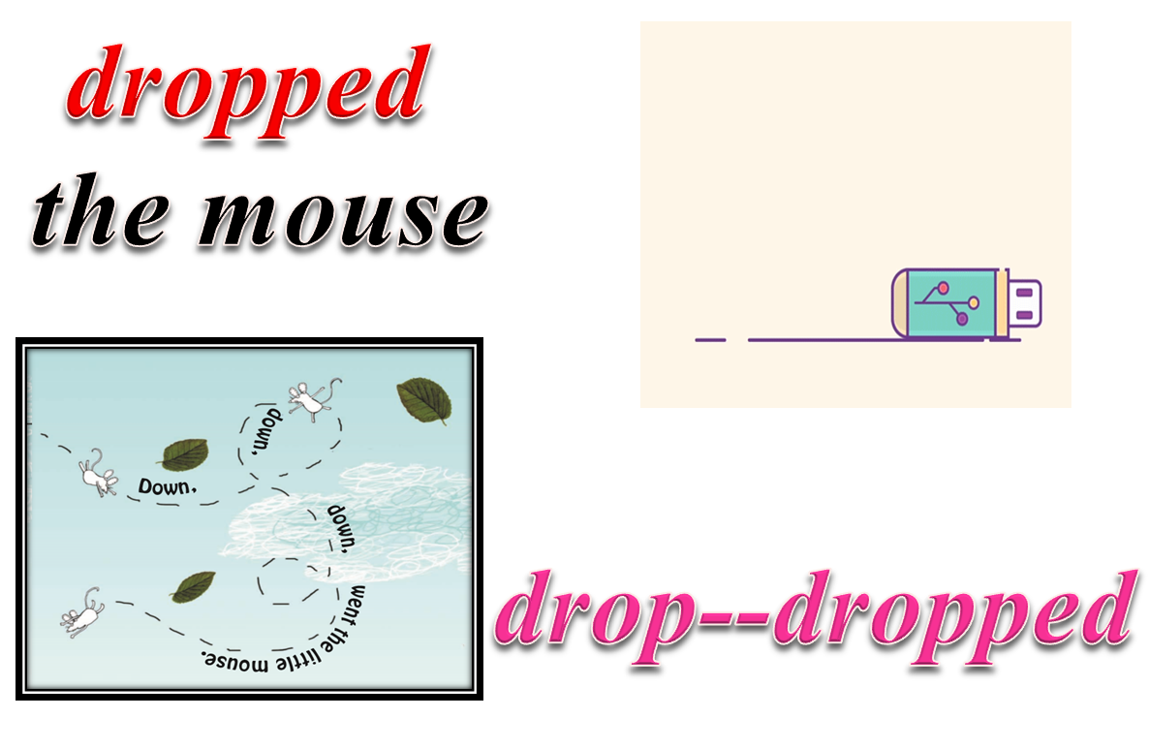

Slide 26
where | who | said | did
ran out the door | \ | \ | \
ran down the stairs | \ | \ | \
ran into the hall | the dinner lady | The mouse! The mouse! | chased the little mouse
ran into the playground | the cat | The mouse! The mouse! | chased the little mouse
ran up to a tree | the big bird | The mouse! The mouse! | got the mouse off he flew dropped the mouse

Slide 27



P6—P18

Slide 28
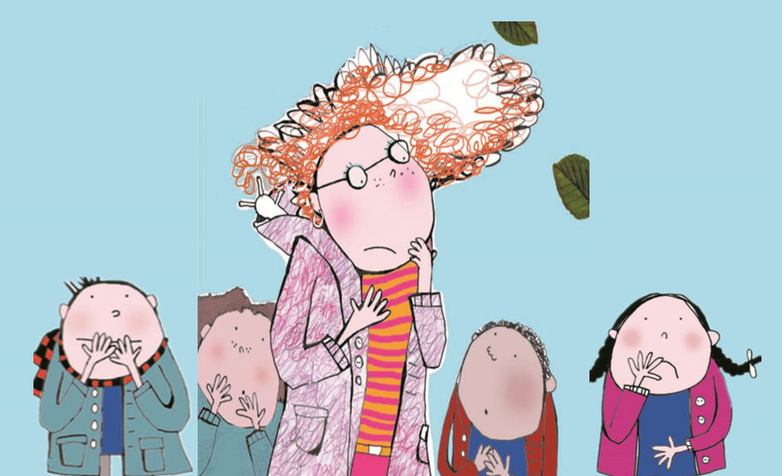
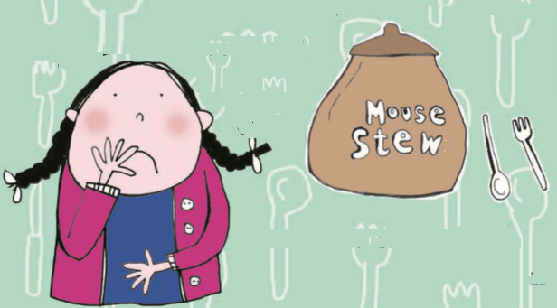
“Poor
little mouse!”
Q: Why were they
so worried ?

Slide 29
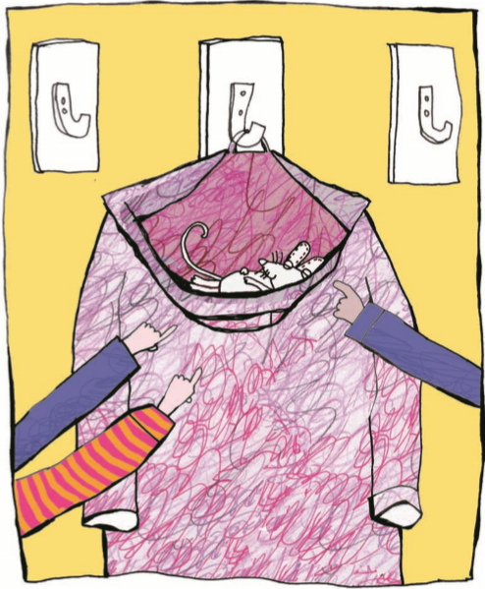
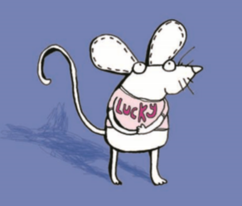
Task3
Read P22—P24.
Q1: Where did children find him?
Q2: Did the little mouse have a name ?
hood

Slide 30
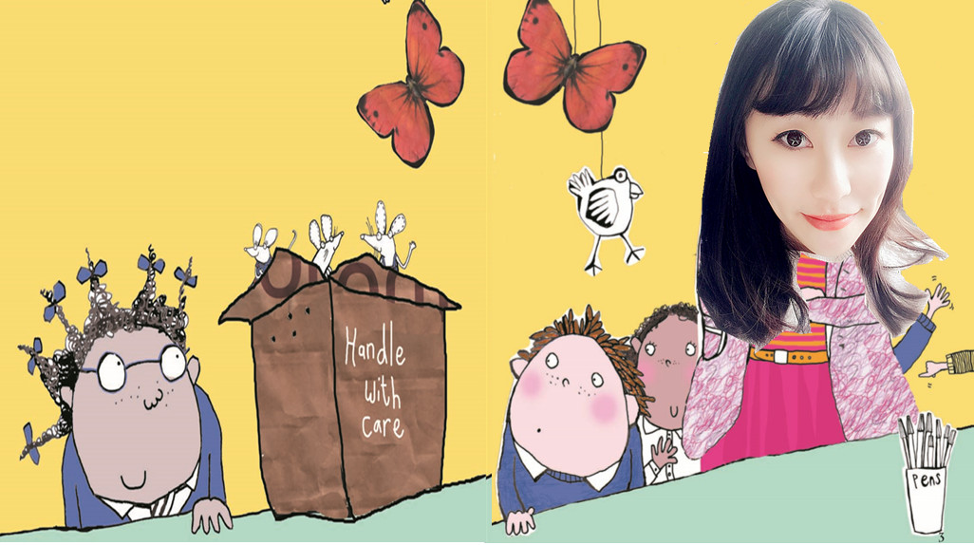

Slide 31
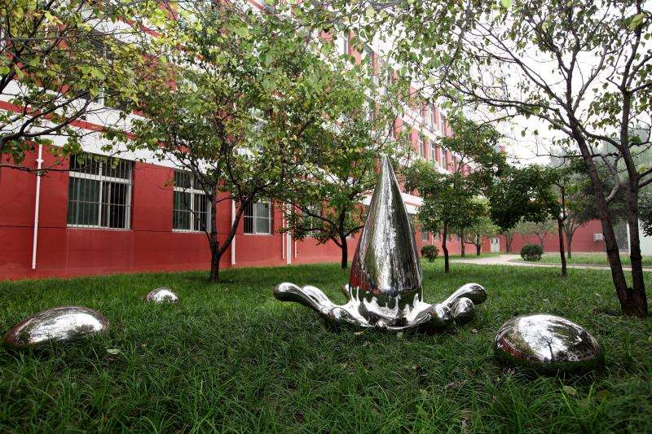






Slide 32


Slide 33

Home work
1:Tell this story to your
parents.
2:Finish your new story.

