Slide 1
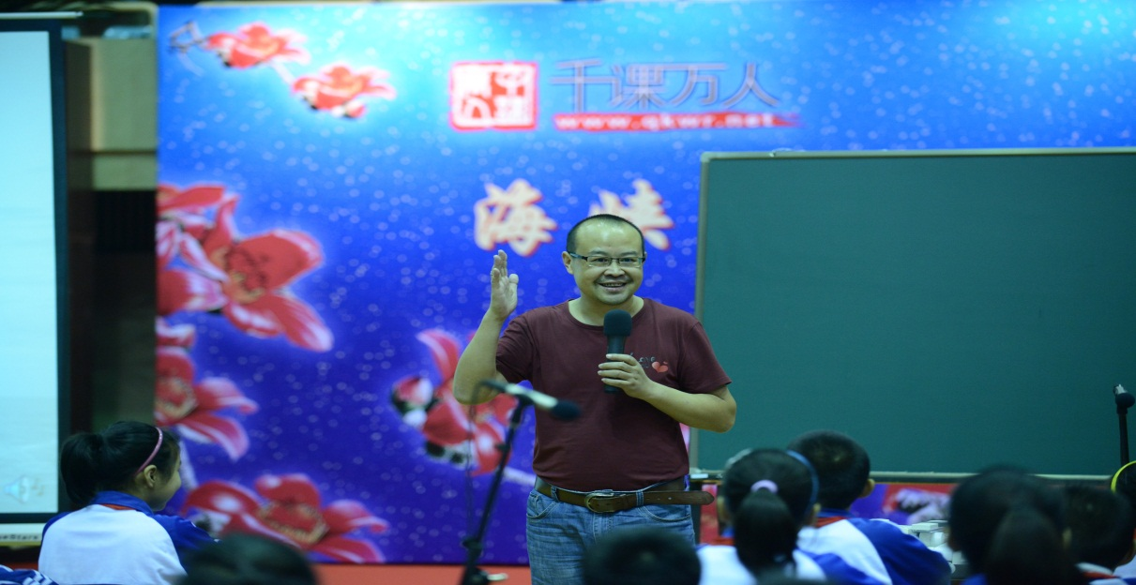
Mr. Tian’s picture
Good morning ！
广东顺德教育发展中心 田湘军

Slide 2
Are you ready?
Are you happy?
If you’re happy and you know it, …

Slide 3
Go to school.
Touch your nose.
Row your boat.

Slide 4
go
O family
hole rose
stone
explode
nose
no so fold
goldfish
o
o_e
row boat
bow
blow
grow throw
soap
coal toast
road moan
ow
oa

Slide 5
Dig holes.
Throw stones.
Eat that toast.
Dry that bowl.
Blow your nose.
Hang that coat up.
Fold those clothes up.
Dry between your toes.
Untie your sister’s bows.
Hold my hand to cross the road.
Her mum moans and moans every day.
Read.
Pay attention to
the O family words.

Slide 6

Moan, moan, moan!
唠叨，唠叨，唠叨
Do you like moaning?
Who likes moaning in your family?
Are you happy if he/she moans at you?

Slide 7

What can you see in the picture?
What is the girl doing?
Notes:
单词拼读问题处理完之后，开始故事讲解。
老师指着封面图画问学生：
What do you see in the picture?
Do you like fish?
What is the girl thinking?
Does the girl like fish?
Why?(这个问题为引出下文做铺垫)———let's see!(转下一张PPT)
7

Slide 8
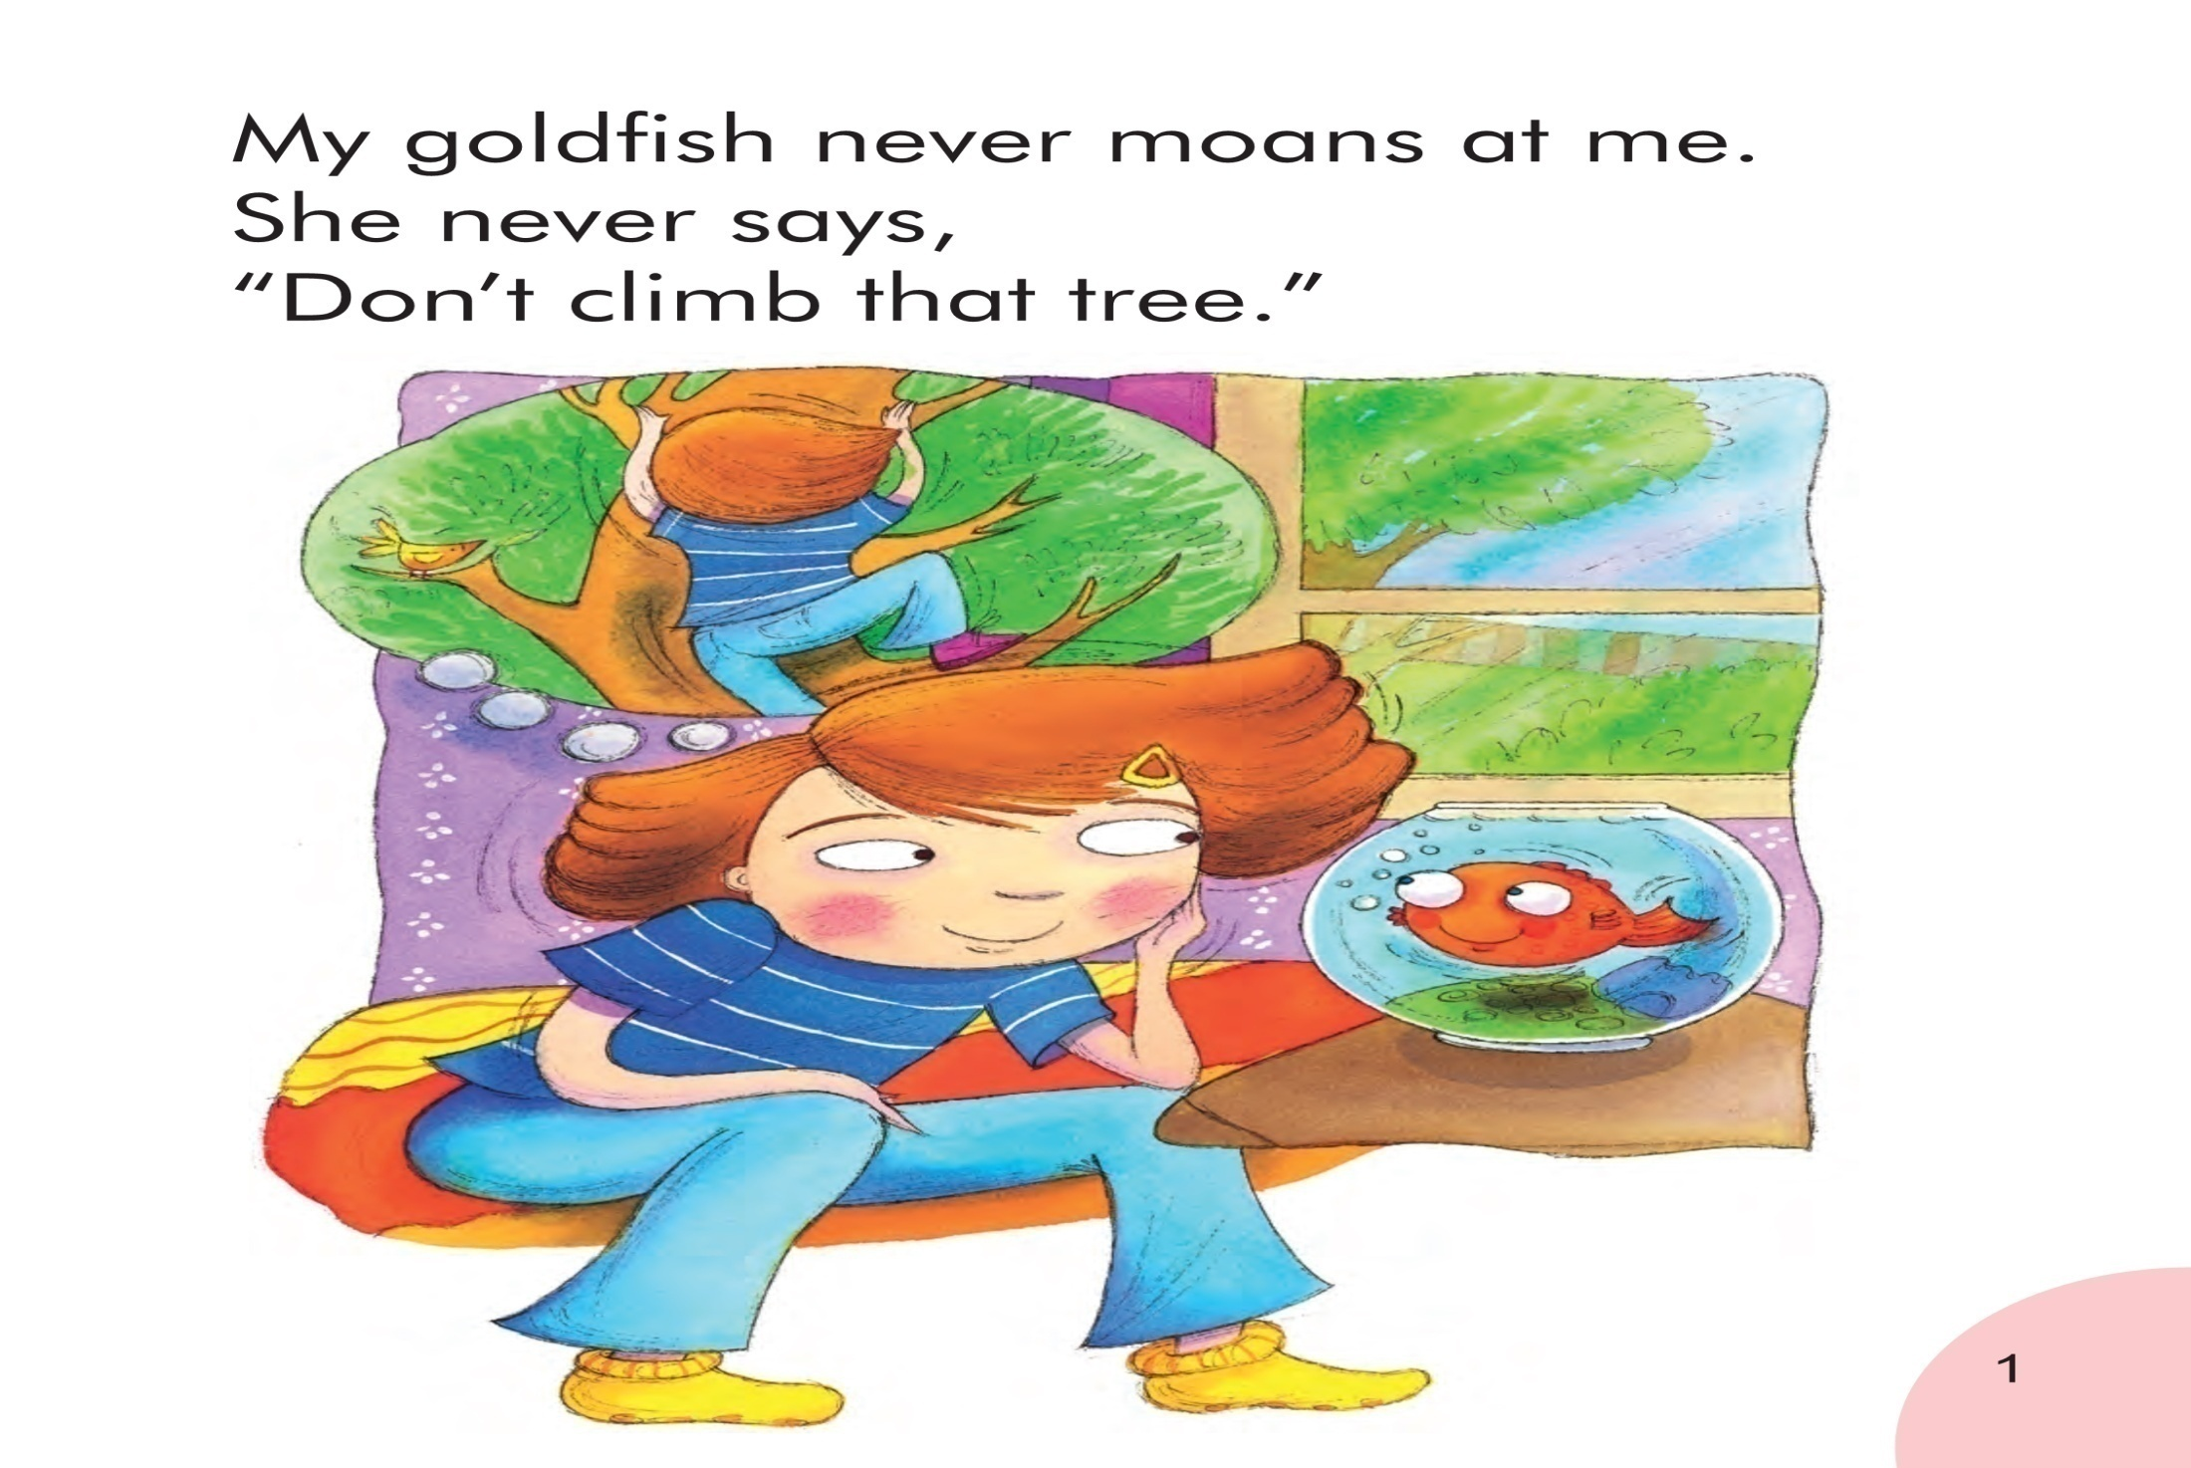

Notes:
Now let's see why does the girl like fish?
老师指着第一句话，带着孩子一起说第一句话，讲never和moans at.（提醒孩子注意oa的发音和用法）
老师指爬树的图片问：What is the girl doing?
老师带学生一起回答：Climbing the tree! 同时老师指着PPT上的“climb that tree”
Do you always climb the trees?
If you climb the tree,what will your mother say?
老师指最后一句话带学生一起读。边读边做摆手的动作。
（注意：1.老师重点讲解画圈的单词goldfish(合成词) moans。2.讲完本页后播放音频，让学生模仿跟读，一定还要让孩子模仿语音语调）

Slide 9
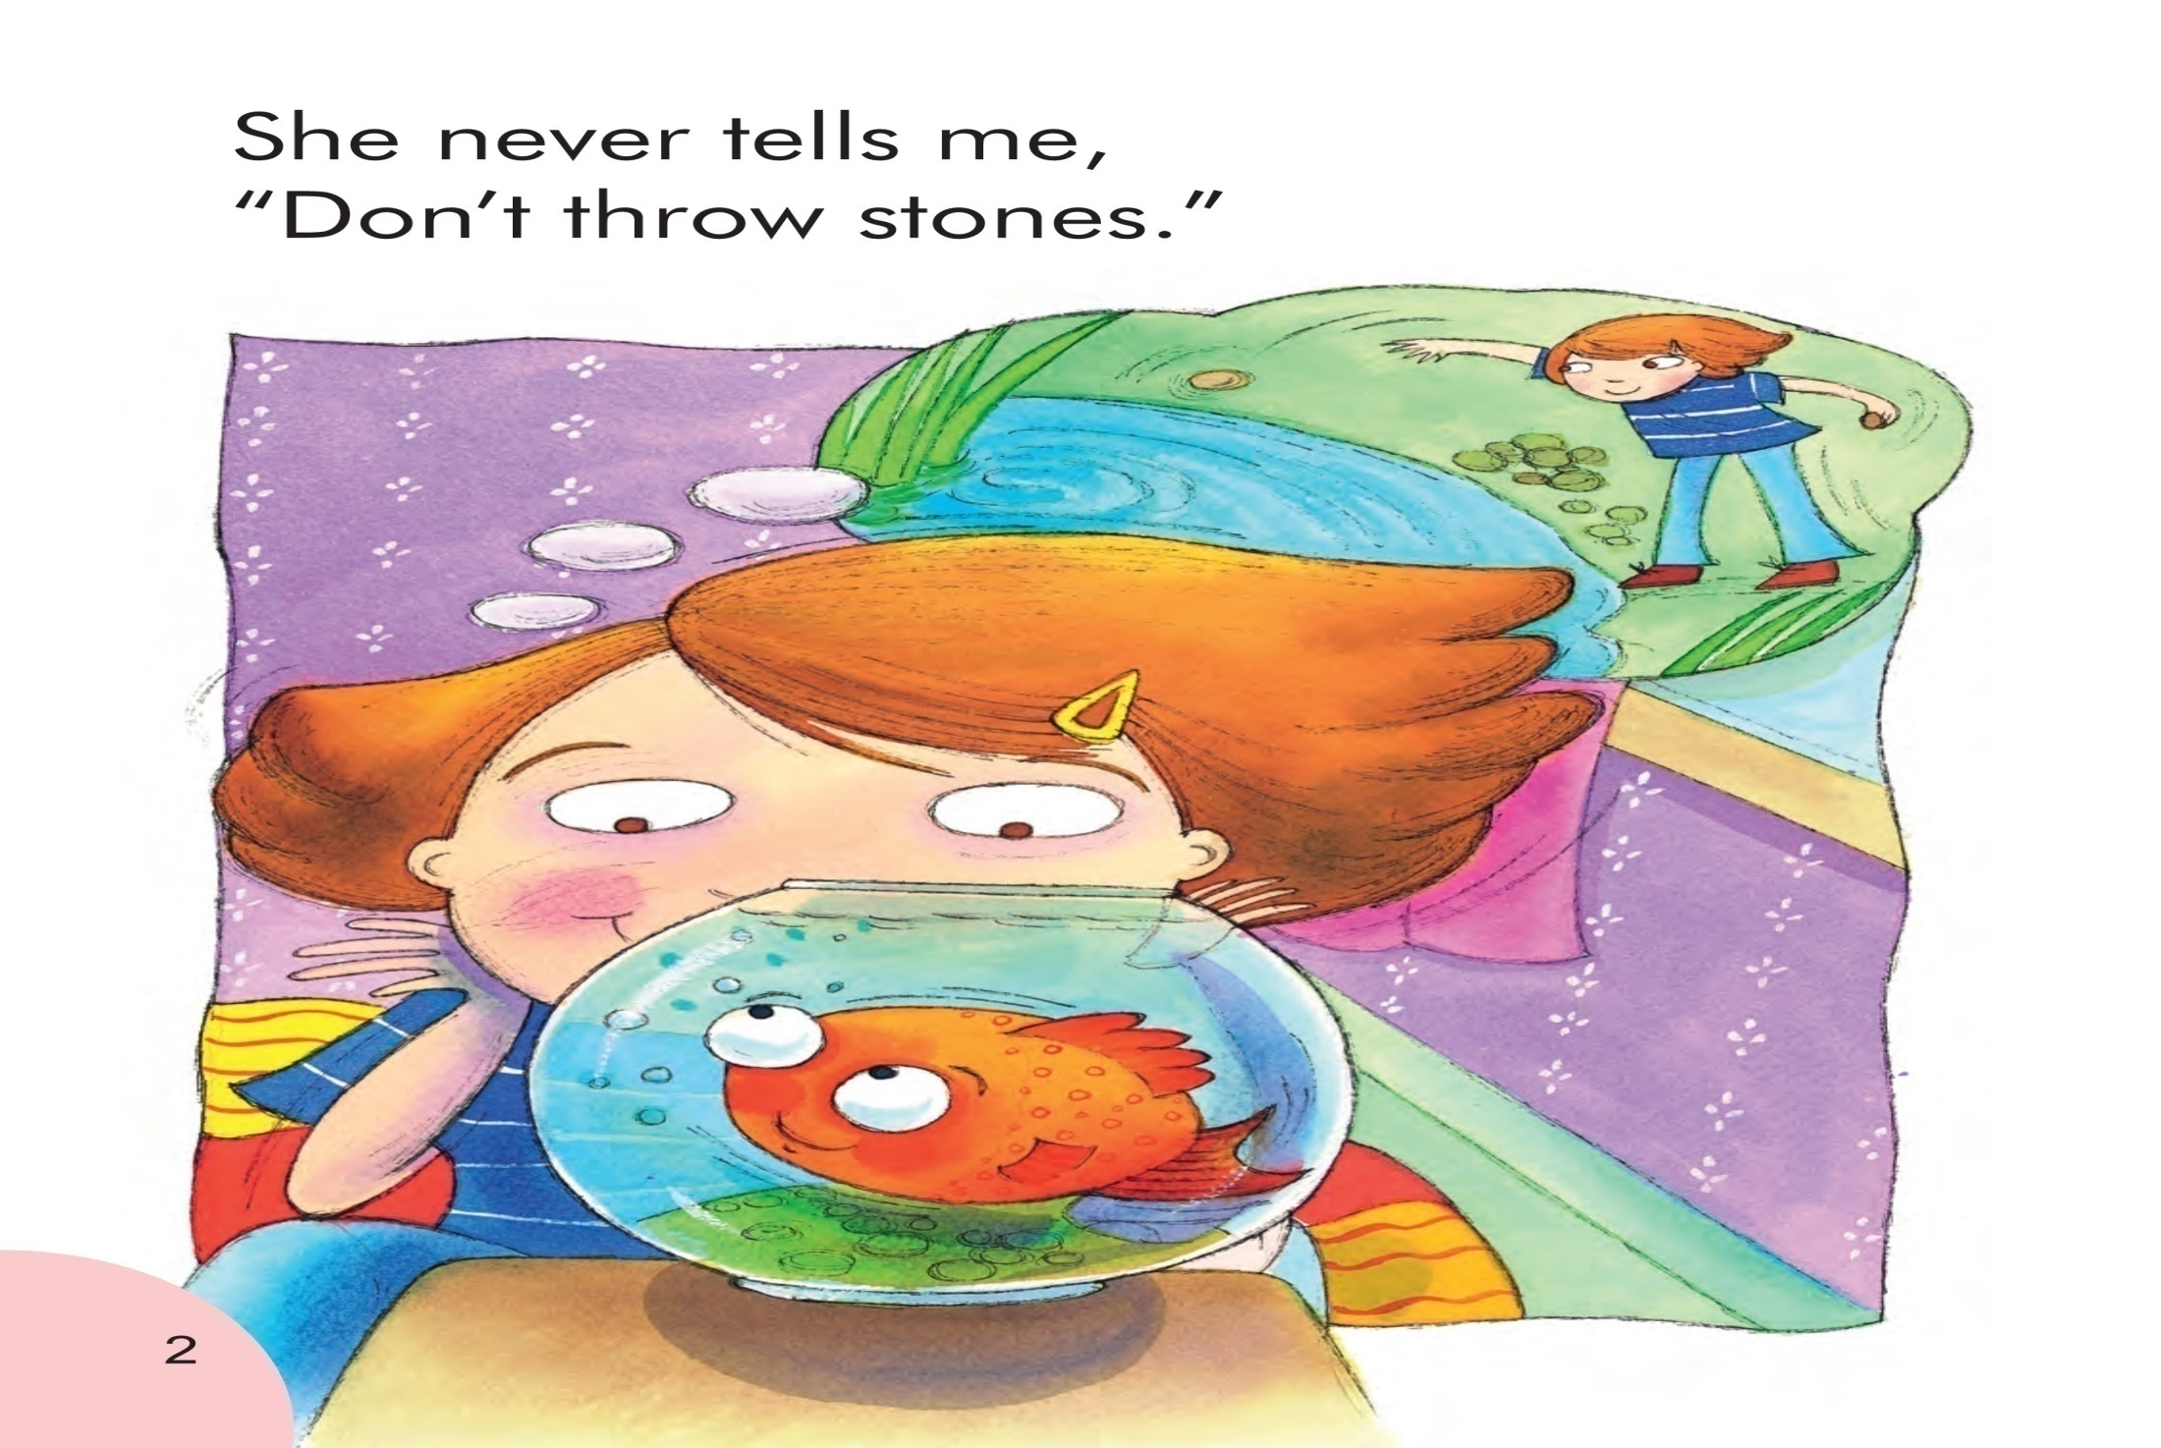
Notes:
老师指扔石子的图片，问：What is the girl doing?
指第二句，带孩子说：She is throwing stones.（提醒孩子注意o-e的发音和用法）
Do you always throw stones?
What if you throw stones into the river?
（注意：1.老师重点讲解画圈的单词throw stones。2.讲完本页后播放音频，让学生模仿跟读，一定还要让孩子模仿语音语调）

Slide 10
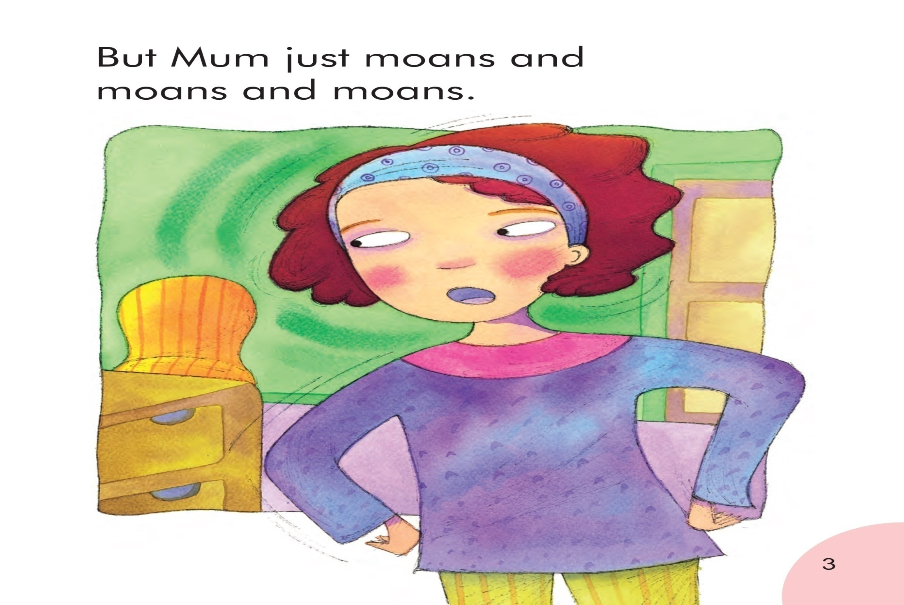
Notes:
Let's see, what will her mother do?
老师指句子带孩子一起读。
Is she the same with your mother?
How does your mother moan at you?
Let‘s see what does her mother say?(引出下一页ppt)
（注意：1.老师重点讲解画圈的单词moans。2.讲完本页后播放音频，让学生模仿跟读，一定还要让孩子模仿语音语调）

Slide 11
What does Mum moan about?

Slide 12
What does Mum moan about?
Discuss with your partners
and guess what Mum wants the girl
to do or not to do.

Slide 13
Notes:
单词拼读问题处理完之后，开始故事讲解。
老师指着封面图画问学生：
What do you see in the picture?
Do you like fish?
What is the girl thinking?
Does the girl like fish?
Why?(这个问题为引出下文做铺垫)———let's see!(转下一张PPT)
13

Slide 14
Notes:
Now let's see why does the girl like fish?
老师指着第一句话，带着孩子一起说第一句话，讲never和moans at.（提醒孩子注意oa的发音和用法）
老师指爬树的图片问：What is the girl doing?
老师带学生一起回答：Climbing the tree! 同时老师指着PPT上的“climb that tree”
Do you always climb the trees?
If you climb the tree,what will your mother say?
老师指最后一句话带学生一起读。边读边做摆手的动作。
（注意：1.老师重点讲解画圈的单词goldfish(合成词) moans。2.讲完本页后播放音频，让学生模仿跟读，一定还要让孩子模仿语音语调）

Slide 15
Notes:
老师指扔石子的图片，问：What is the girl doing?
指第二句，带孩子说：She is throwing stones.（提醒孩子注意o-e的发音和用法）
Do you always throw stones?
What if you throw stones into the river?
（注意：1.老师重点讲解画圈的单词throw stones。2.讲完本页后播放音频，让学生模仿跟读，一定还要让孩子模仿语音语调）

Slide 16
Notes:
Let's see, what will her mother do?
老师指句子带孩子一起读。
Is she the same with your mother?
How does your mother moan at you?
Let‘s see what does her mother say?(引出下一页ppt)
（注意：1.老师重点讲解画圈的单词moans。2.讲完本页后播放音频，让学生模仿跟读，一定还要让孩子模仿语音语调）

Slide 17
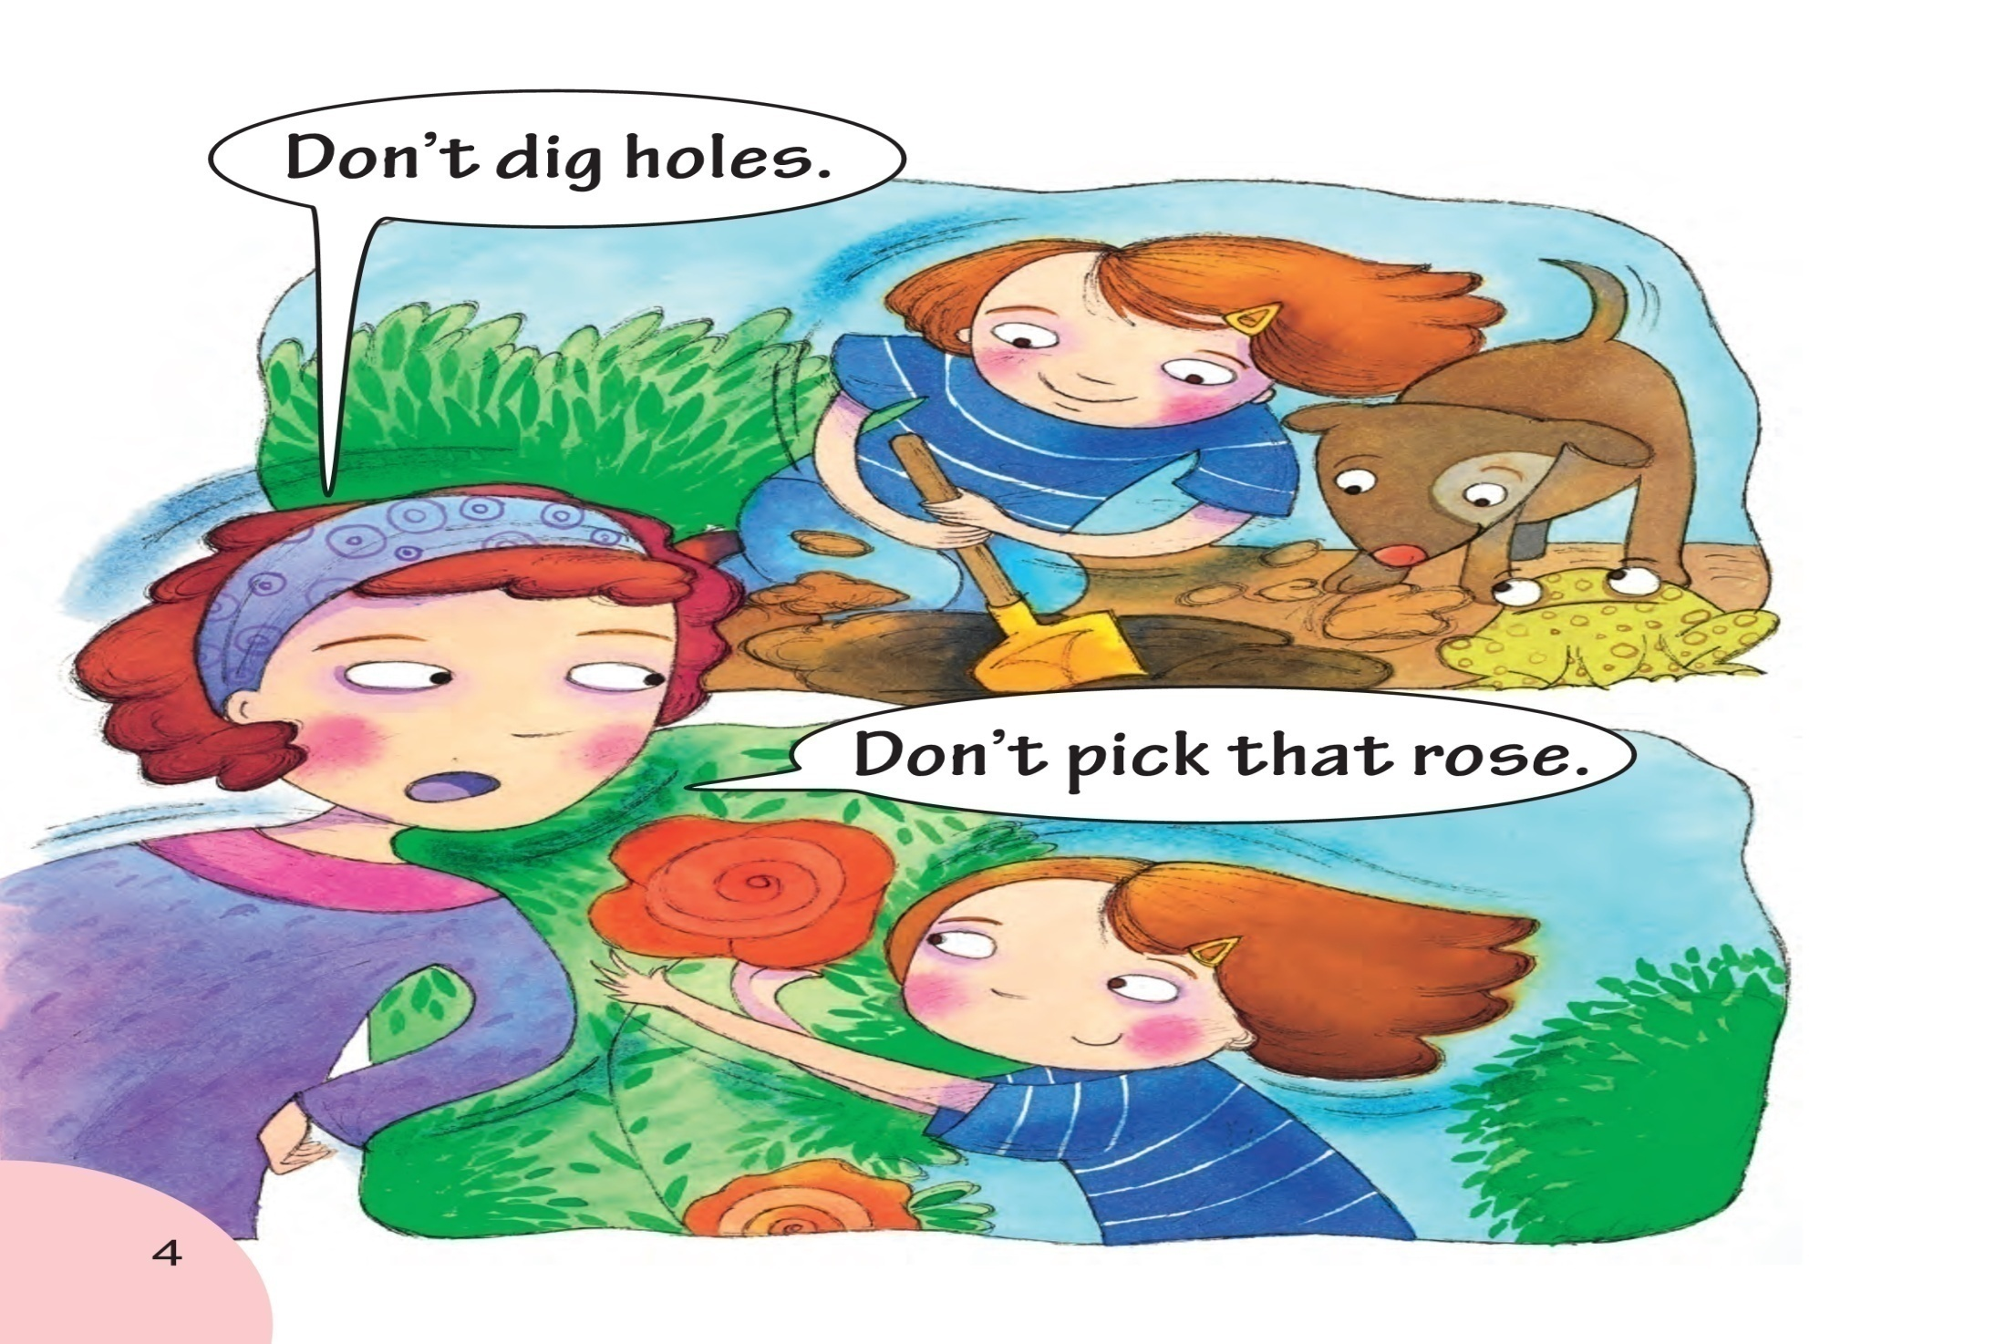
Notes:
老师指挖洞的图片，
What is the girl doing now? Guess, what does she want to do? Why does the girl dig holes?
But what does her mother say?
老师指摘花的图片，
What is the girl doing now? Guess, what does she want to do? Why does the girl pick that rose?
But what does her mother say?
（注意：1.老师重点讲解画圈的单词holes rose。2.讲完本页后播放音频，让学生模仿跟读，一定还要让孩子模仿语音语调）

Slide 18
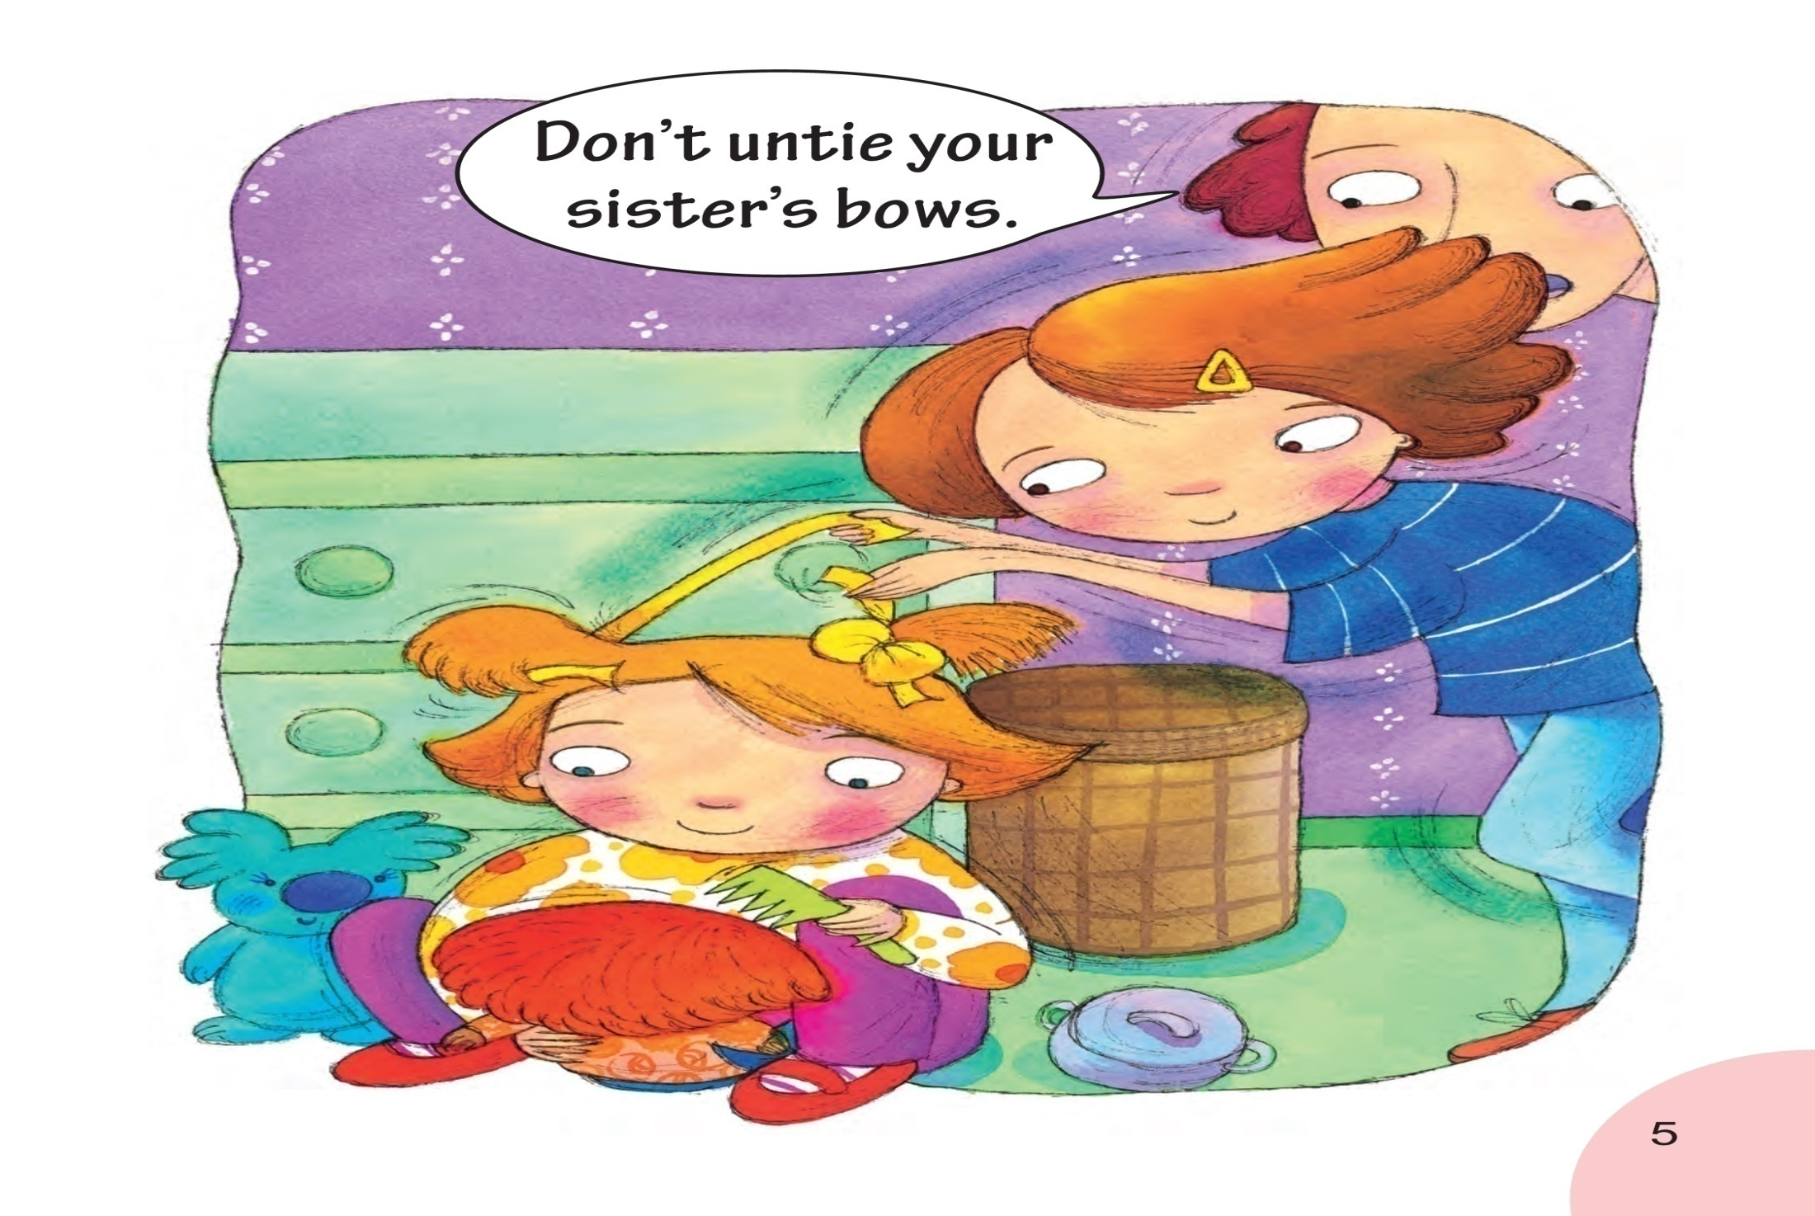
Notes:
老师指图片，
What is the girl doing now? Guess, what does she want to do? Why does the girl untie her sister's bows?
But what does her mother say?
（注意：1.老师重点讲解画圈的单词bows。2.讲完本页后播放音频，让学生模仿跟读，一定还要让孩子模仿语音语调）

Slide 19
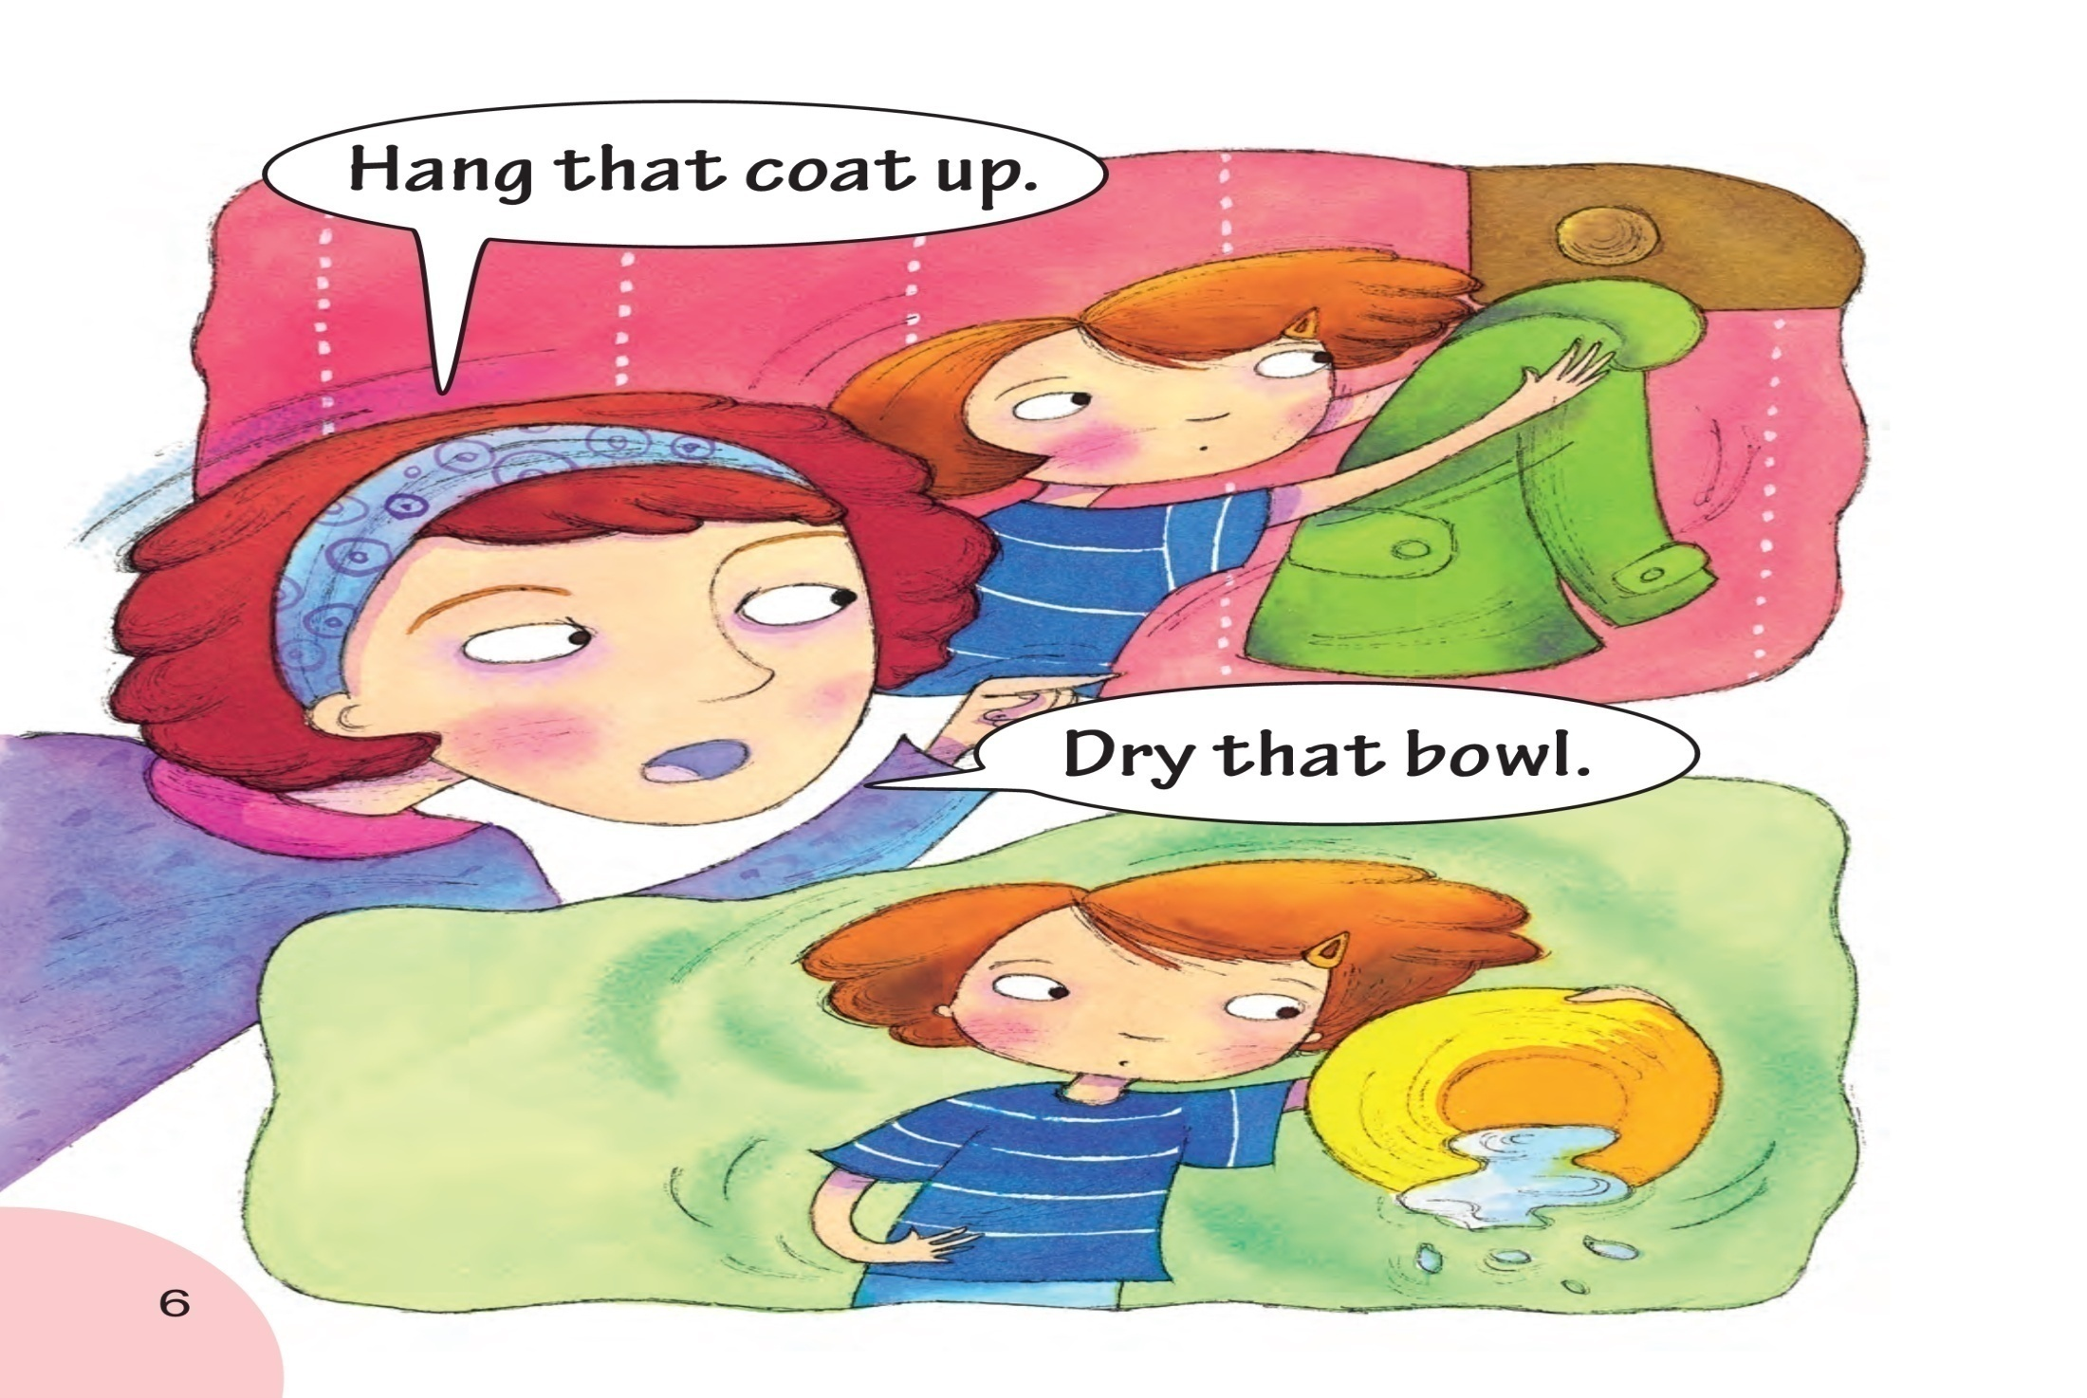
Notes:
And does your mother always tell you what you should do? What does she say?
Let's see what does her mother tell her what to do?
老师做挂衣服的动作，问What am I doing? 然后指着第一句话，带学生一起读
Can you hang your coat?
老师做擦碗的动作，问What am I doing? 然后指着第二句话，带学生一起读
Can you dry the bowl?
（注意：1.老师重点讲解画圈的单词coat bowl。2.讲完本页后播放音频，让学生模仿跟读，一定还要让孩子模仿语音语调）

Slide 20
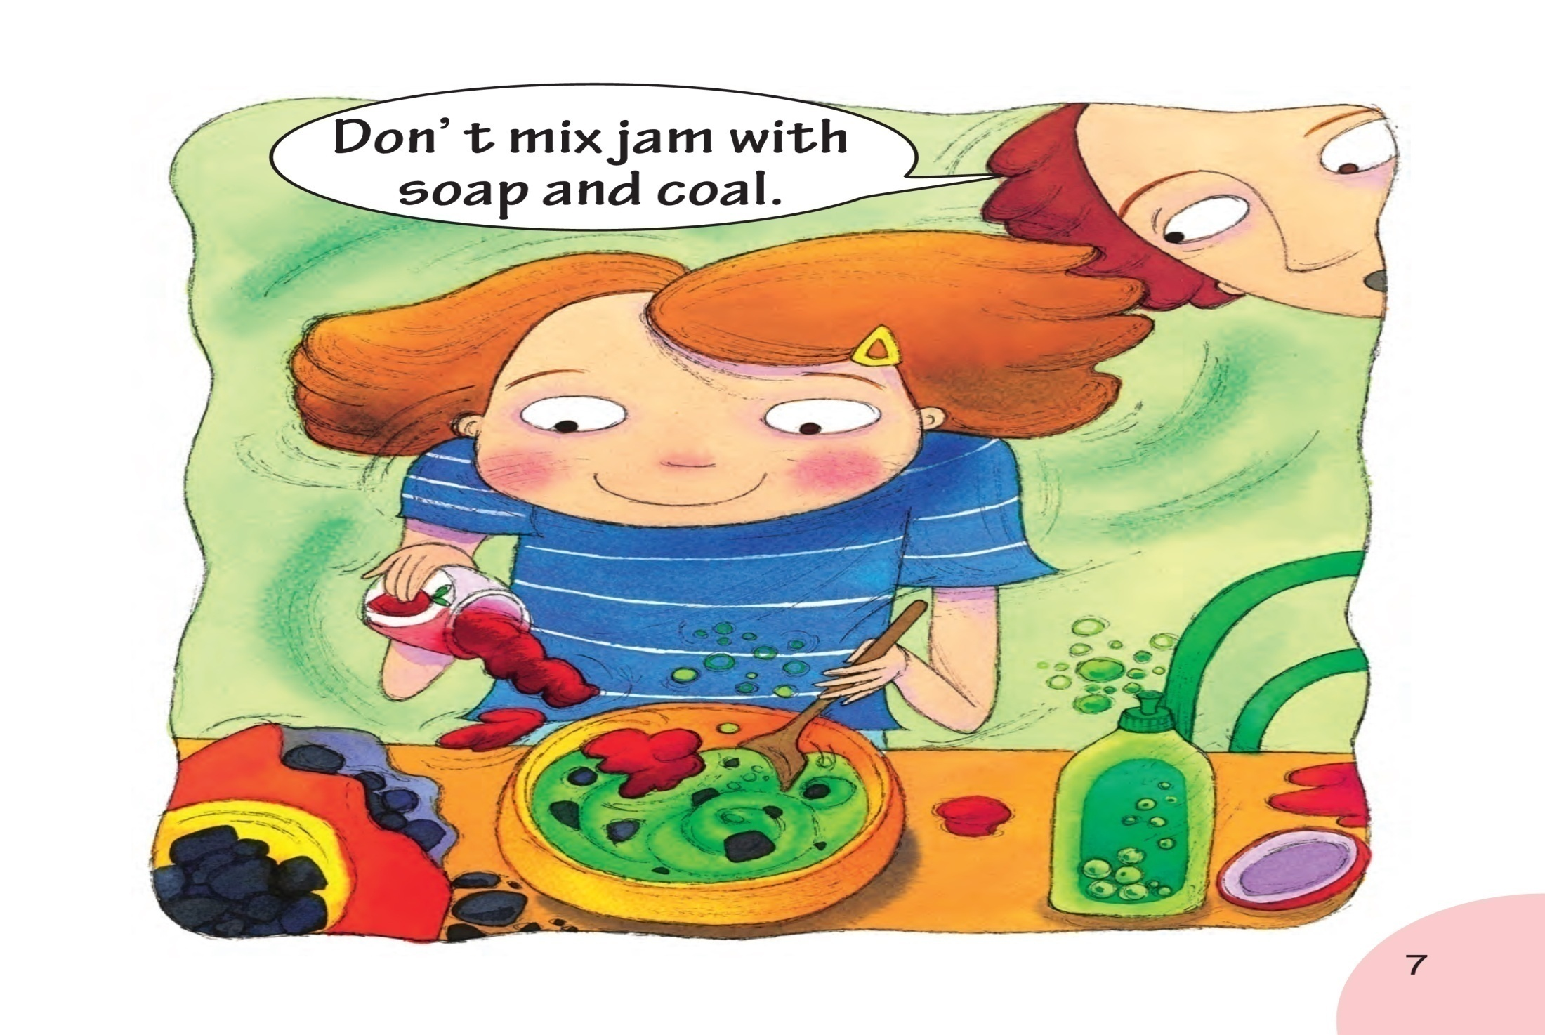
Notes:
Wow, what is the girl making?
What are they? (老师指着盘子里的东西问孩子) What do you do with the soap?预设学生回答：We wash clothes with soap.
What color is the coal?What do you do with the coal?预设回答：We burn fire with soap.
And she mix them.(老师做惊讶恶心的样子)
然后指句子带学生一起读相应的单词，着重讲oa的发音规律。
（注意：1.老师重点讲解画圈的单词soap coal。2.讲完本页后播放音频，让学生模仿跟读，一定还要让孩子模仿语音语调）

Slide 21
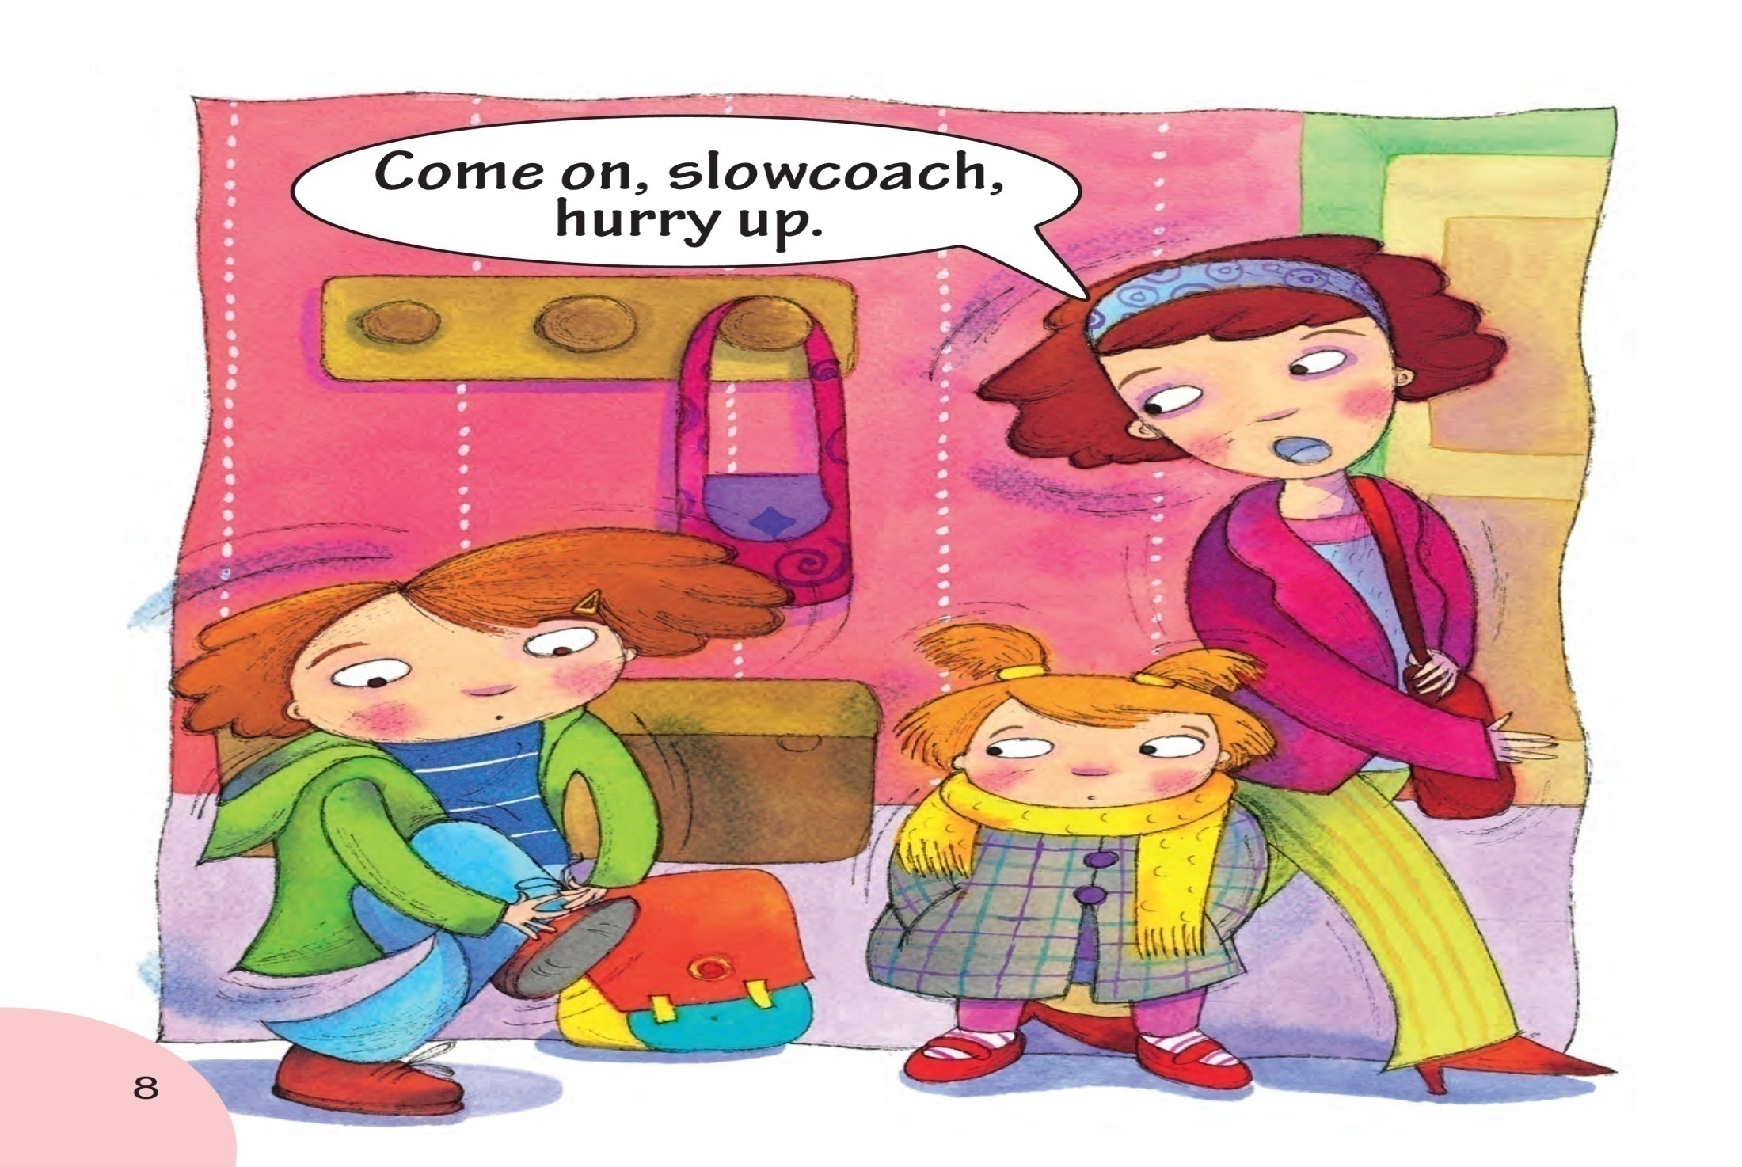
Notes:
老师指着图片说：What are they going to do?
Maybe they plan to go shopping or to go to the park…
Let’s see, mother and her sister are ready, but what is the girl doing?
Yes she is still putting on her shoes.
So her mother calls her a slowcoach and let her hurry up.
What is slowcoach? A person who is always slow. He eats slowly. He wash his face and hands slowly. He write his homework slowly. He does everything slowly.老师配合每句话做相应的动作时缓慢而迟钝。Are you a slowcoach?
（注意：1.老师重点讲解画圈的单词slowcoach。2.讲完本页后播放音频，让学生模仿跟读，一定还要让孩子模仿语音语调）

Slide 22
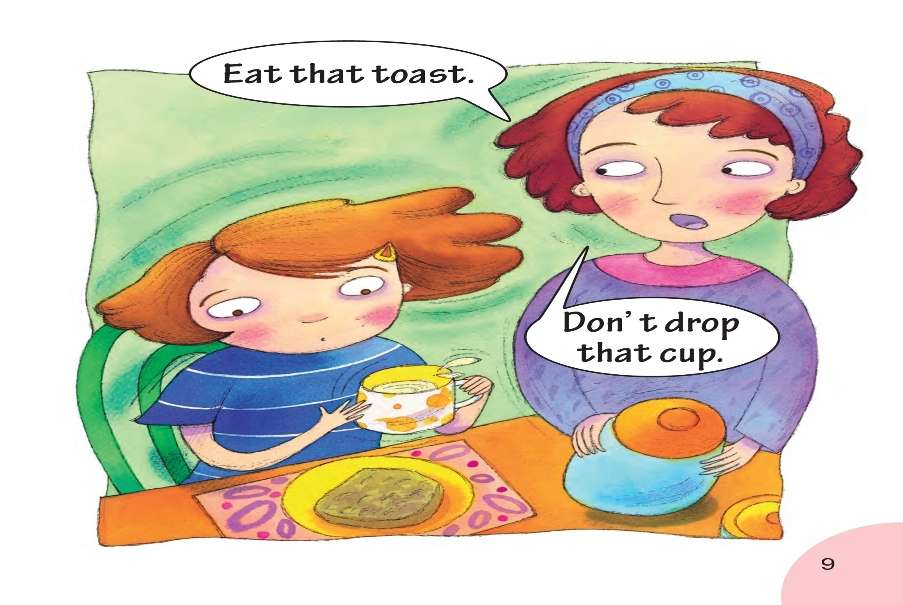
Notes:
What is the girl doing now?
老师指着吐司面包说:She is eating the toast.
And what does her mother say?
老师指着妈妈说的句子带学生一起读。
老师做掉东西的动作，让学生感受drop这个词。
（注意：1.老师重点讲解画圈的单词toast。2.讲完本页后播放音频，让学生模仿跟读，一定还要让孩子模仿语音语调）

Slide 23
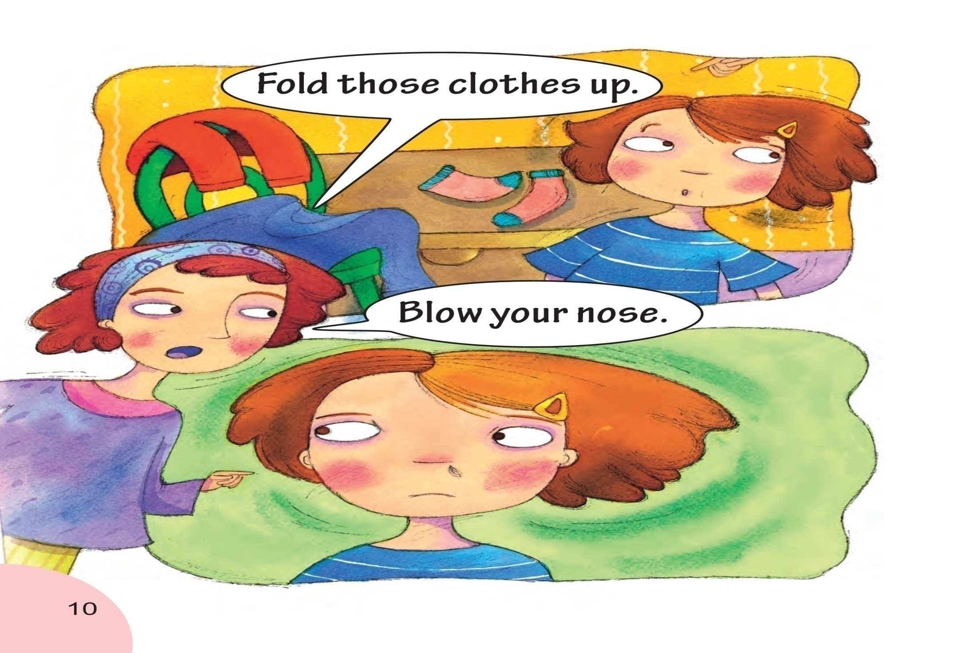
Notes:
(老师指上面这幅图)Where is the girl now?
Yes she is in her room.
And how is her room? Is her room tidy? No,there are so many clothes.
What does her mother say?
Does your mother say that to you?
(老师指下面这幅图的鼻涕)What is it? Haha, maybe she gets a cold. What does she look like?
What does her mother say?
Does your mother say that to you?
（注意：1.老师重点讲解画圈的单词Fold those clothes blow nose。2.讲完本页后播放音频，让学生模仿跟读，一定还要让孩子模仿语音语调）

Slide 24
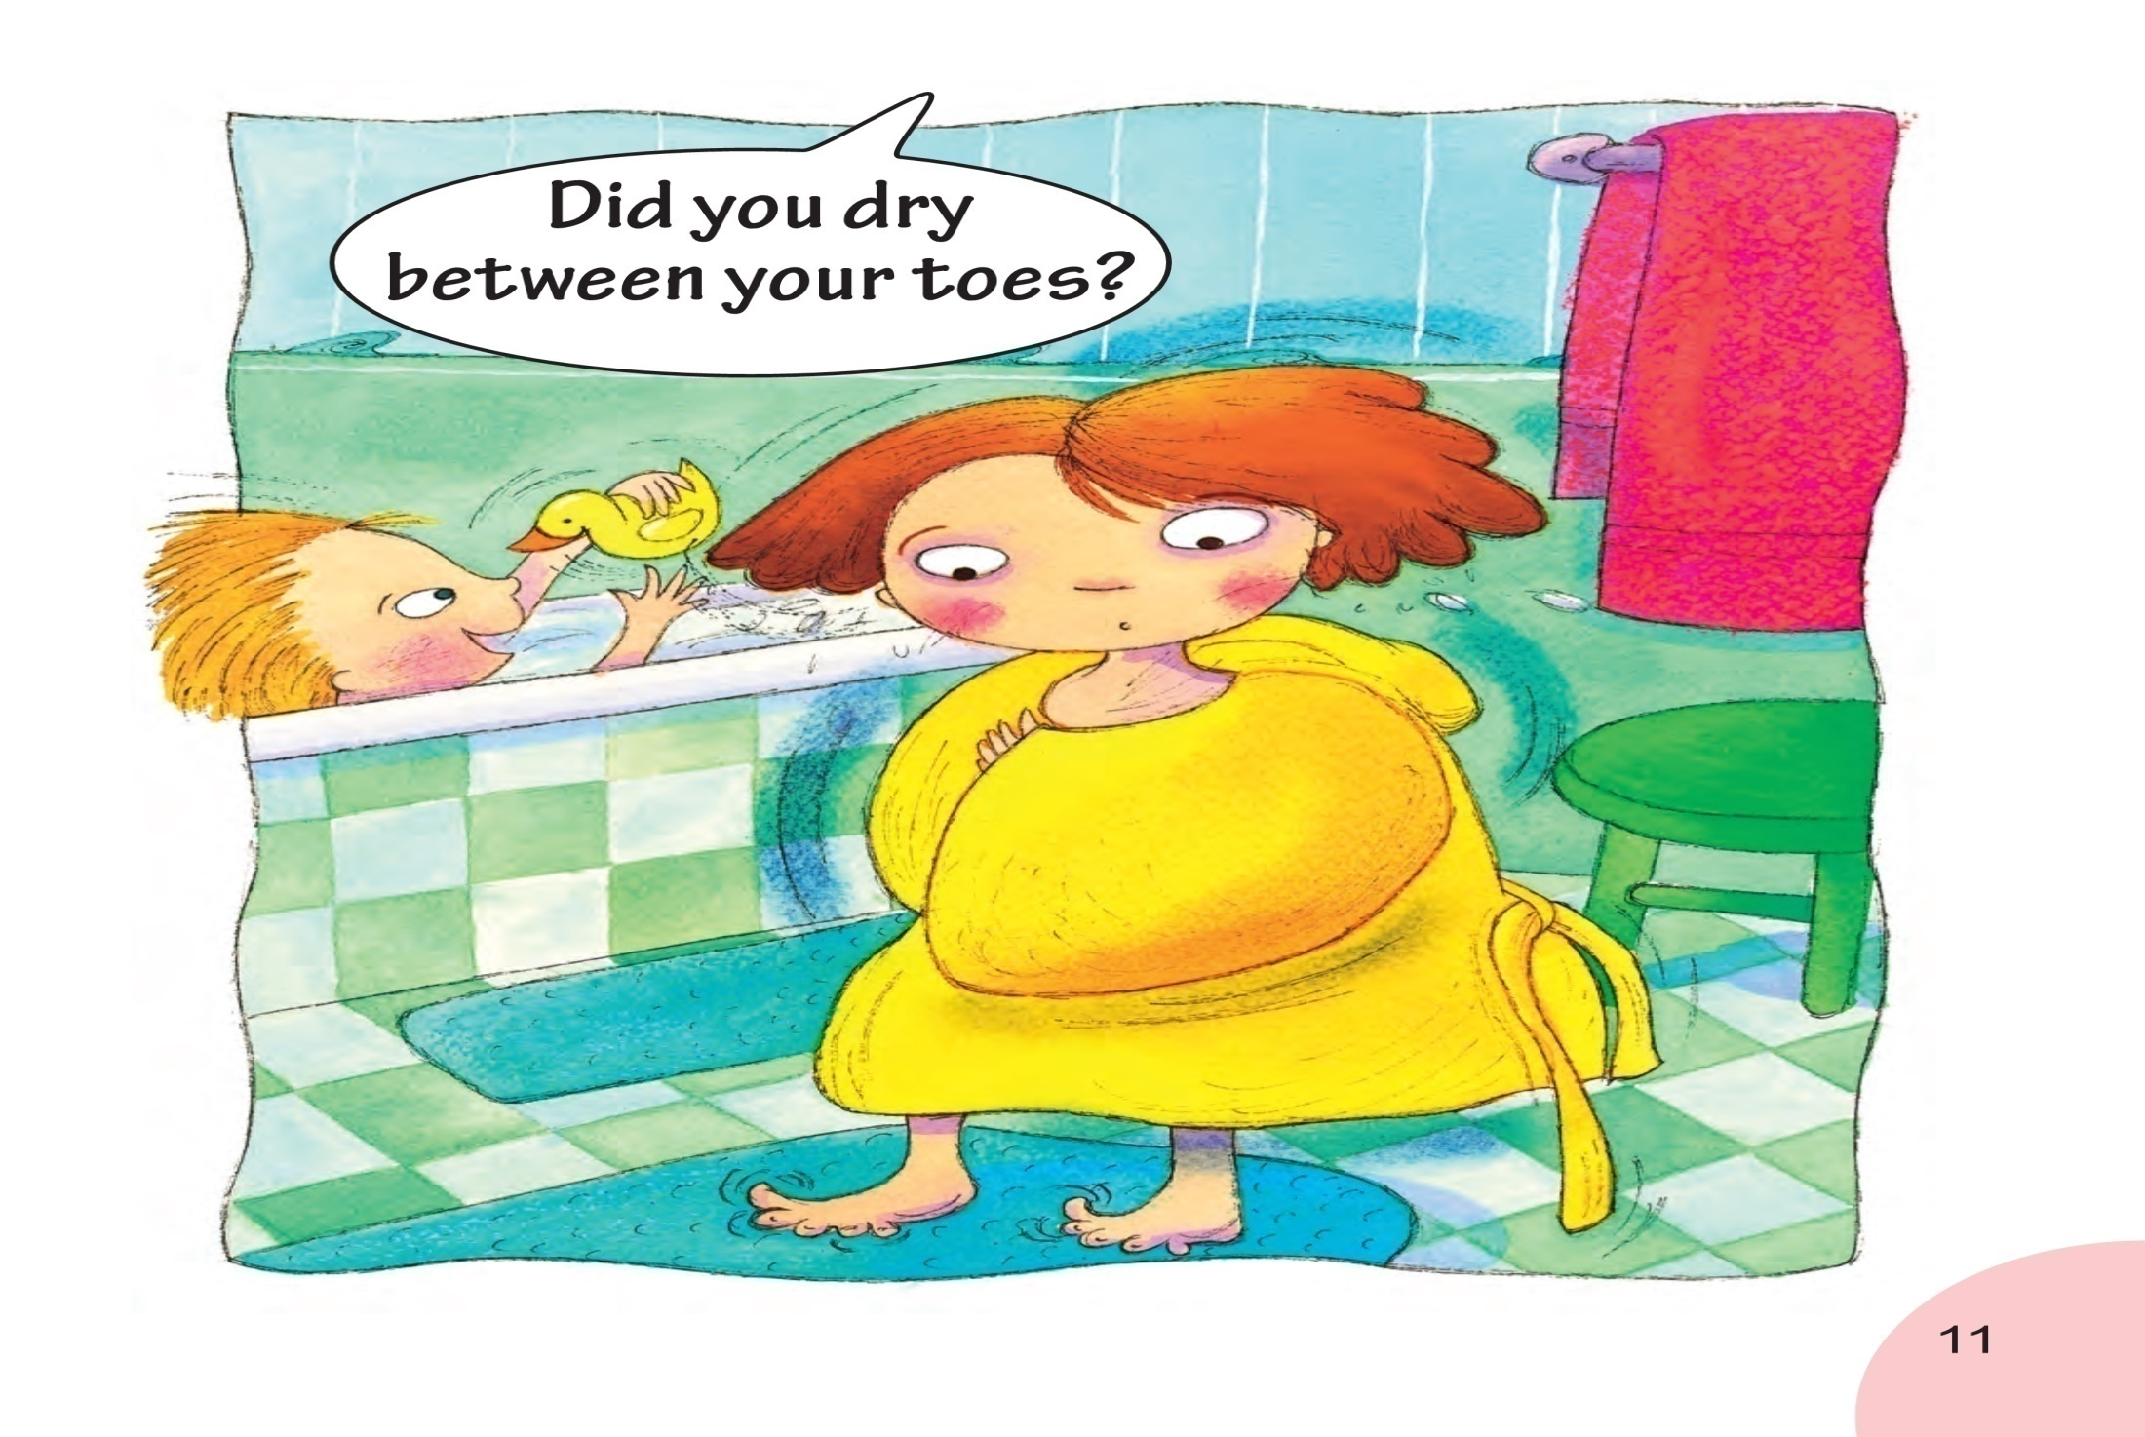
Notes:
Now she is taking a bath , and what is she doing?
----Playing!
So what does her mother say?
Do you always play while you are taking a bath?
What will your mother say to you?
（注意：1.老师重点讲解画圈的单词toes。2.讲完本页后播放音频，让学生模仿跟读，一定还要让孩子模仿语音语调）

Slide 25
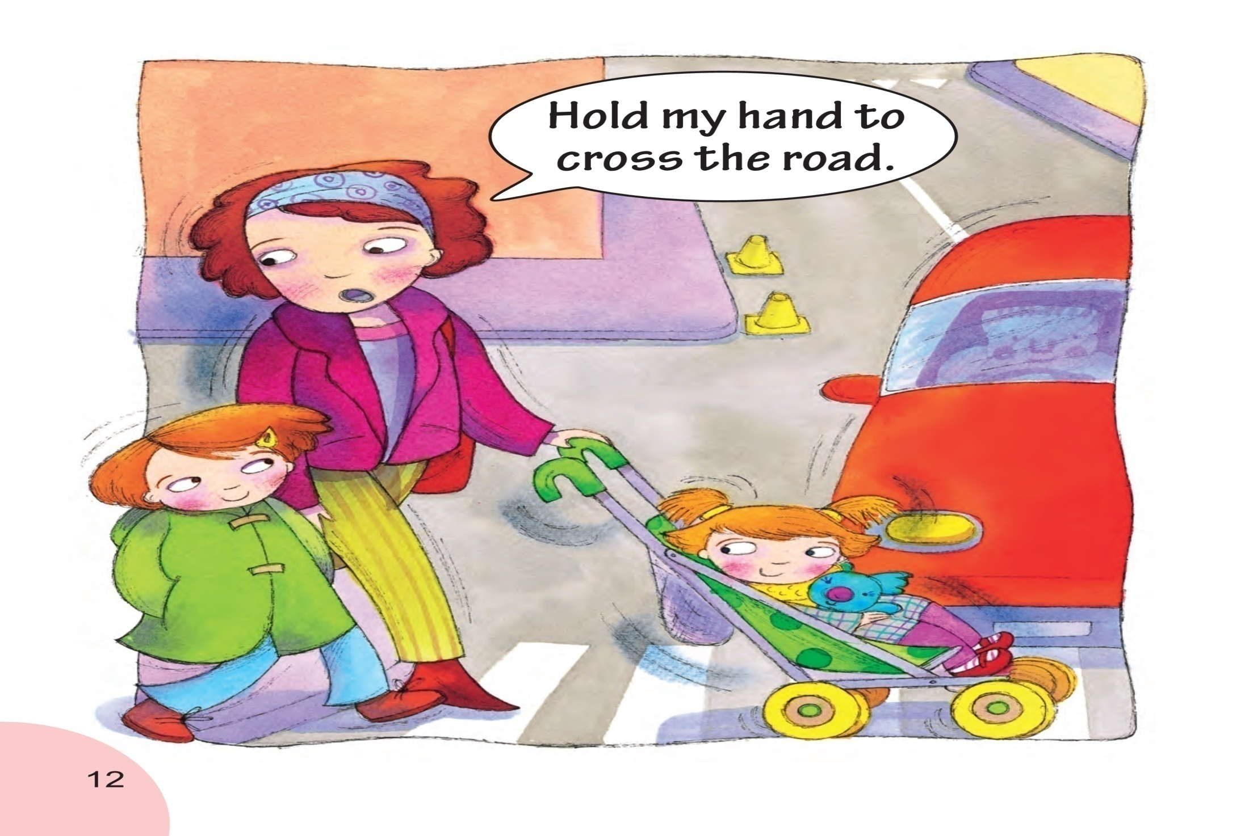
Notes:
Where are they now?
老师指着road这个单词带孩子一起读
And they are going cross the road.
When you are a child, did your mother hold your hand to cross the road?
And let’s see, what does her mother say?
（注意：1.老师重点讲解画圈的单词hold road。2.讲完本页后播放音频，让学生模仿跟读，一定还要让孩子模仿语音语调）

Slide 26
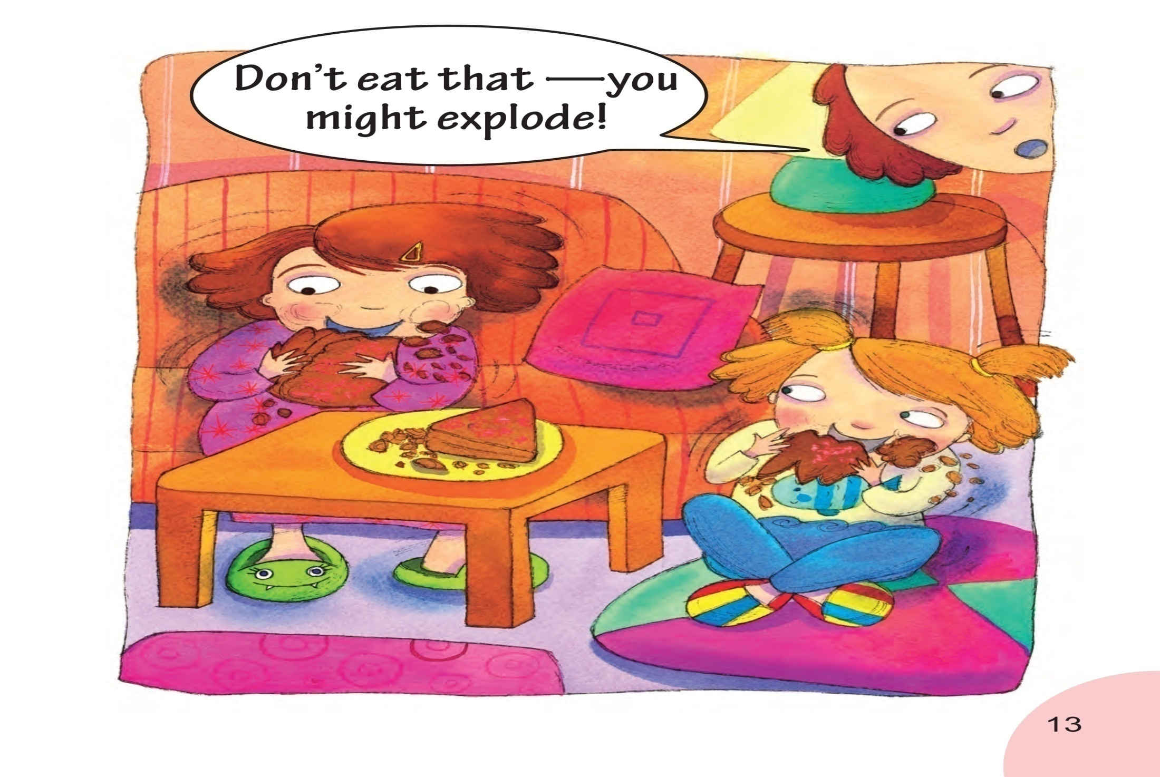
Notes:
Wow, what is the girl doing now?
She is eating snacks!
Do you like to eat snacks?
What is the snack?---chocolate pie
Do you like to eat it?
But you shouldn’t eat too much. Do you know why?
老师指着句子带孩子一起说，because you might explode. What does explode mean? It means someone becomes fat suddenly.老师做突然变胖的手势。Do you want to be a fat boy or a fat girl?
（注意：1.老师重点讲解画圈的单词explode。2.讲完本页后播放音频，让学生模仿跟读，一定还要让孩子模仿语音语调）

Slide 27
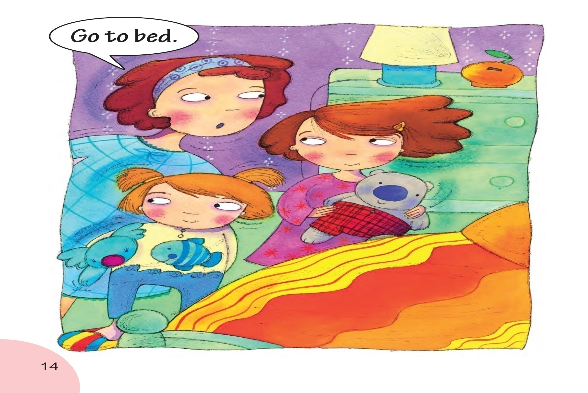
Notes:
When is it?
It is late at night.
What is the girl doing? Does she want to go to sleep now?
It’s time to sleep, so what does her mother say?
（注意：讲完本页后播放音频，让学生模仿跟读，一定还要让孩子模仿语音语调）

Slide 28
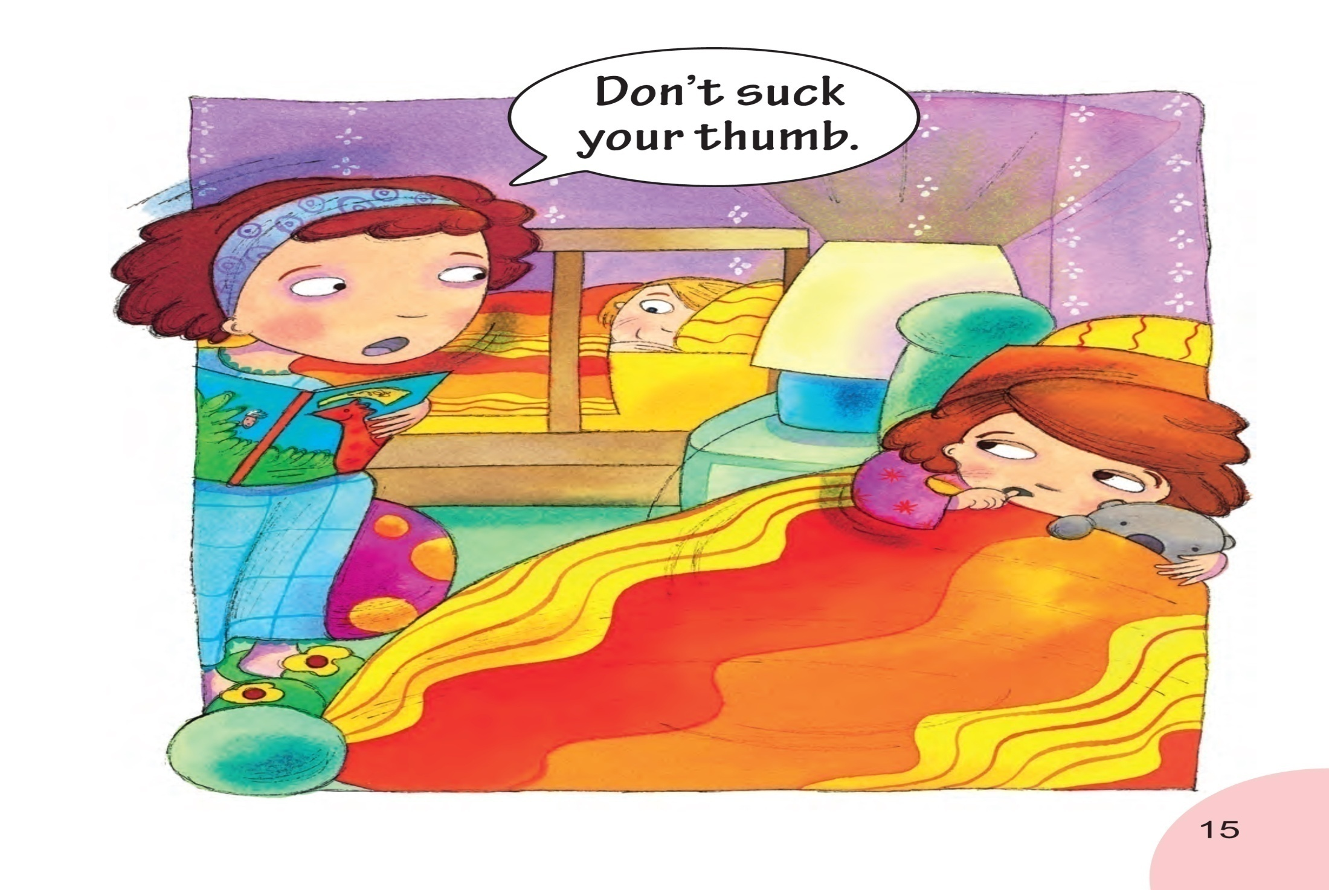
Notes:
But she has a bad habit, what’s that?----stuck thumb.
So what does her mother say?
Do you like to stuck your thumb?
（注意：讲完本页后播放音频，让学生模仿跟读，一定还要让孩子模仿语音语调）

Slide 29
Think and answer.
What does the girl wish?
The girl wishes her goldfish was her mum.
Why does the girl wish her goldfish was her mum?
Because her goldfish never moans at her.

Slide 30
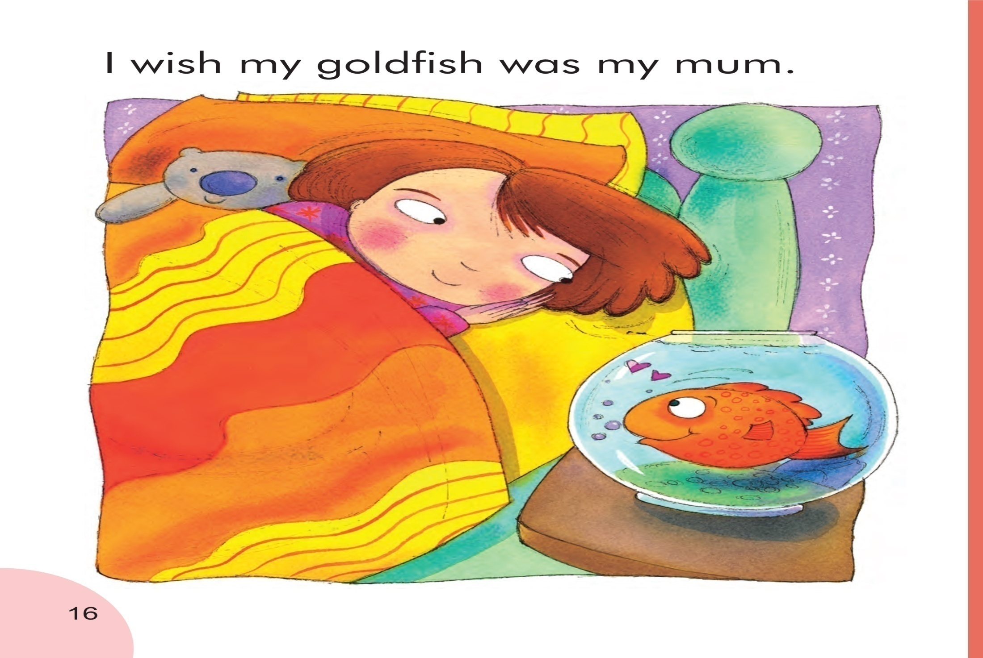
Notes:
At last , what does the girl wish?
老师指句子带学生一起读
Why?
Do you want a fish be your mother?
Why?
Does your mother moan at you? Do you like your mother?
（注意：1.老师重点讲解画圈的单词goldfish。2.讲完本页后播放音频，让学生模仿跟读，一定还要让孩子模仿语音语调）
30

Slide 31
Task Time
Work in pairs or groups and discuss:
Why does Mum moan at us?
What should we do when Mum
moans at us?
小组讨论：
妈妈为什么对我们唠叨呢？
如果妈妈对我们唠叨，我们应该怎么做？

Slide 32
Mum moans at us because she loves us.
She cares about us.
We should understand our mum.
Grow fast so that our mum will not worry about us.

Slide 33
Are you happy in my English class?
Do you want to MOAN at me?
Haha, let’s …

Slide 34
What does Mum moan about?
To do
Hang that coat up.
Dry that bowl.
Come on.
Hurry up!
Eat that toast.
Fold those clothes up.
Blow your nose.
Dry between your toes.
Hold my hand to cross
the road.
10.Go to bed.
Not to do
1. Don’t climb that tree.
2. Don’t throw stones.
3. Don’t dig holes.
4. Don’t pick that rose.
5. Don’t untie your
sister’s bows.
6. Don’t mix jam with soap
and coal.
7. Don’t drop that cup.
8. Don’t eat that.
9. Don’t suck your thumb.

