Slide 1
The Odd pet

Slide 2
Magic Phonics

Slide 3
r
u
n

Slide 4
s
i
t

Slide 5
h
o
p

Slide 6
b
e
g

Slide 7
s
w
i
m

Slide 8
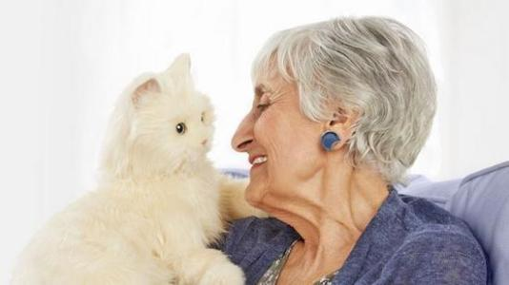
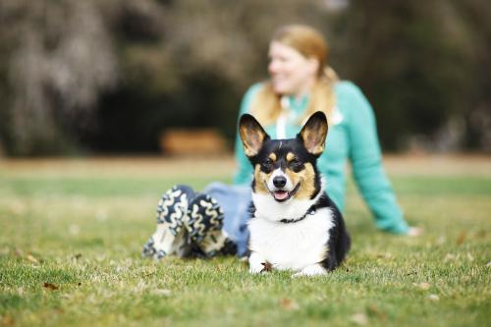
Word Riddle
一起来猜个字谜吧。
e
t
P
pig
bed
tap
big
bad
map

Slide 9
Julia Donaldson

Slide 10
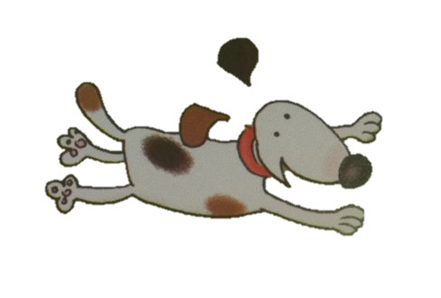
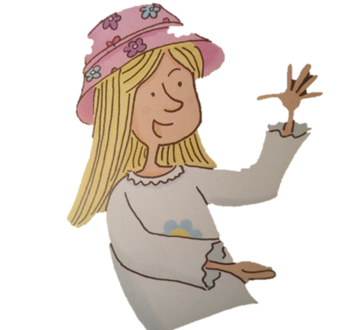
Who has the odd pet?
Read p1-p3.
Kim
Jim
Viv
This is _______.
He/She has a _______ .

Slide 11
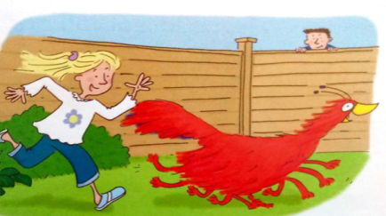
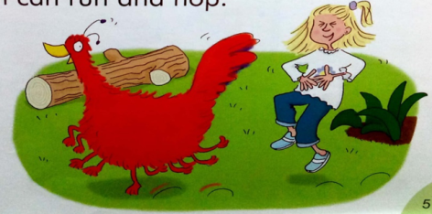
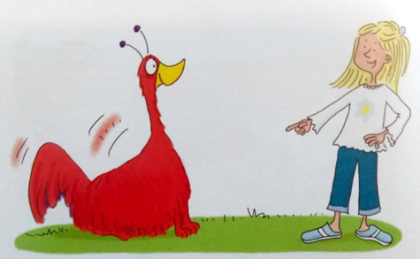
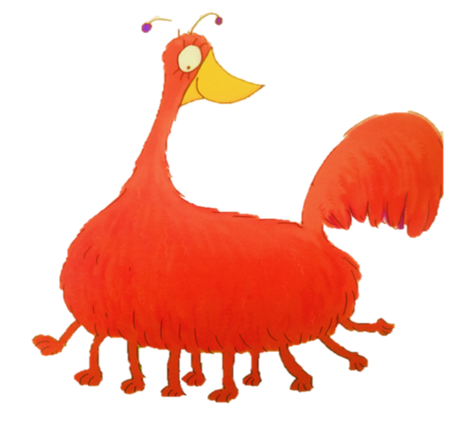
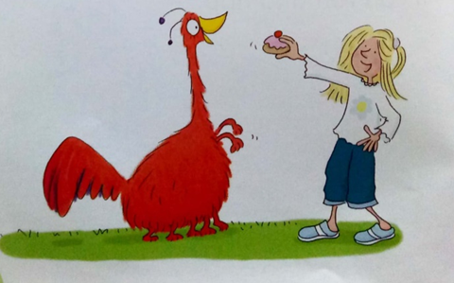
What’s odd about “zog”
zog 奇怪在哪？
Read p4-p6,find out the answer.

Slide 12
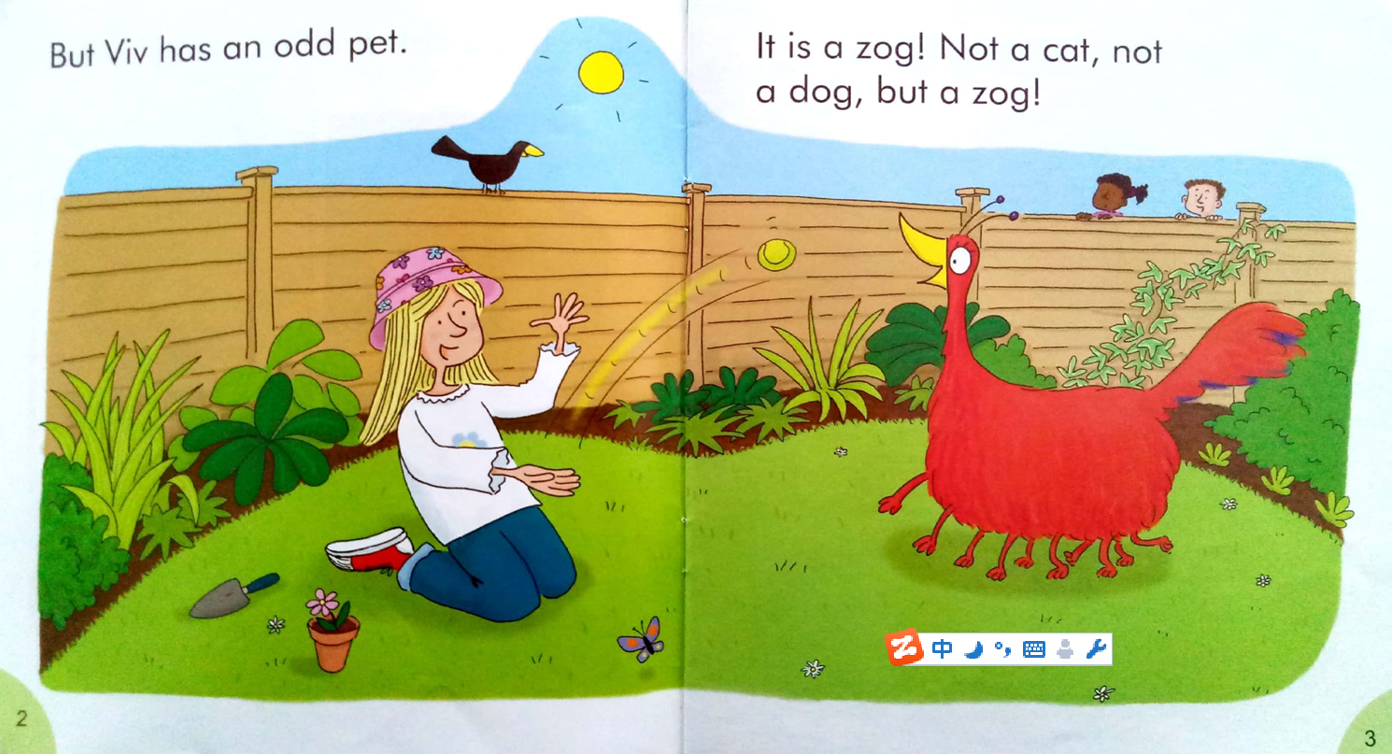
What games do they play?
想象下，Viv和Zog平时会玩什么？

Slide 13
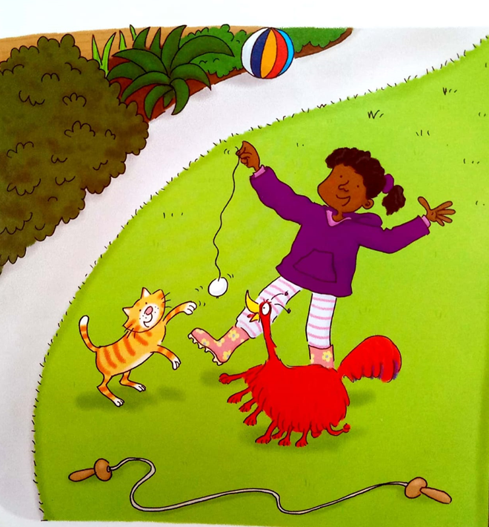
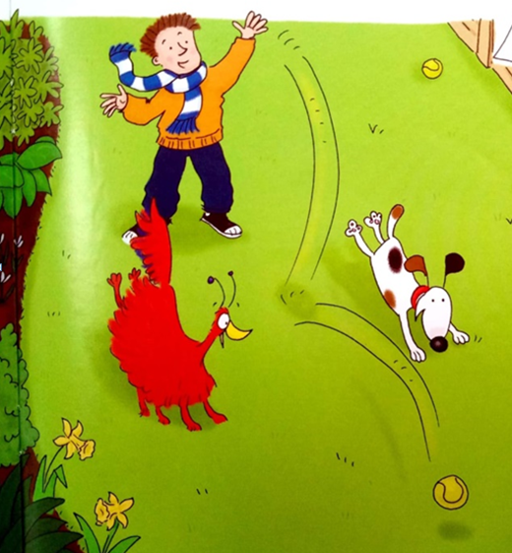
One day , Kim has … Jim has…

Slide 14
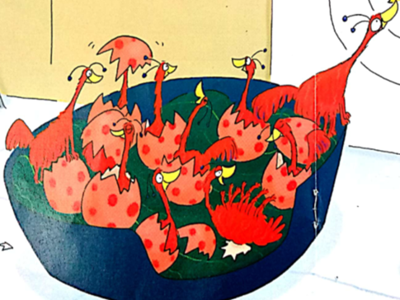
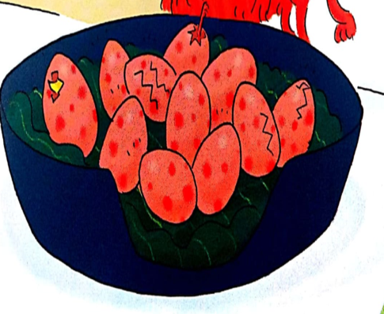
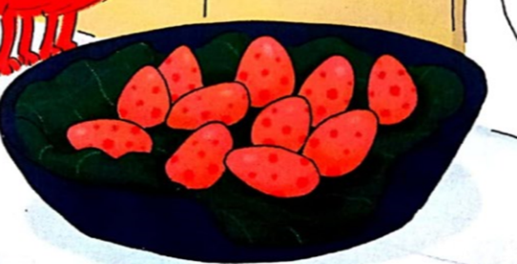
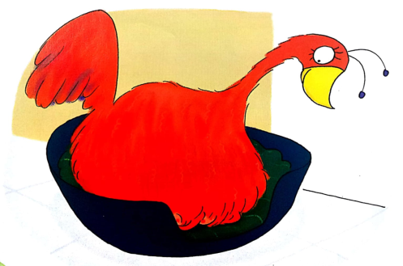
What happened
Read p7-p13,order the pictures.

Slide 15
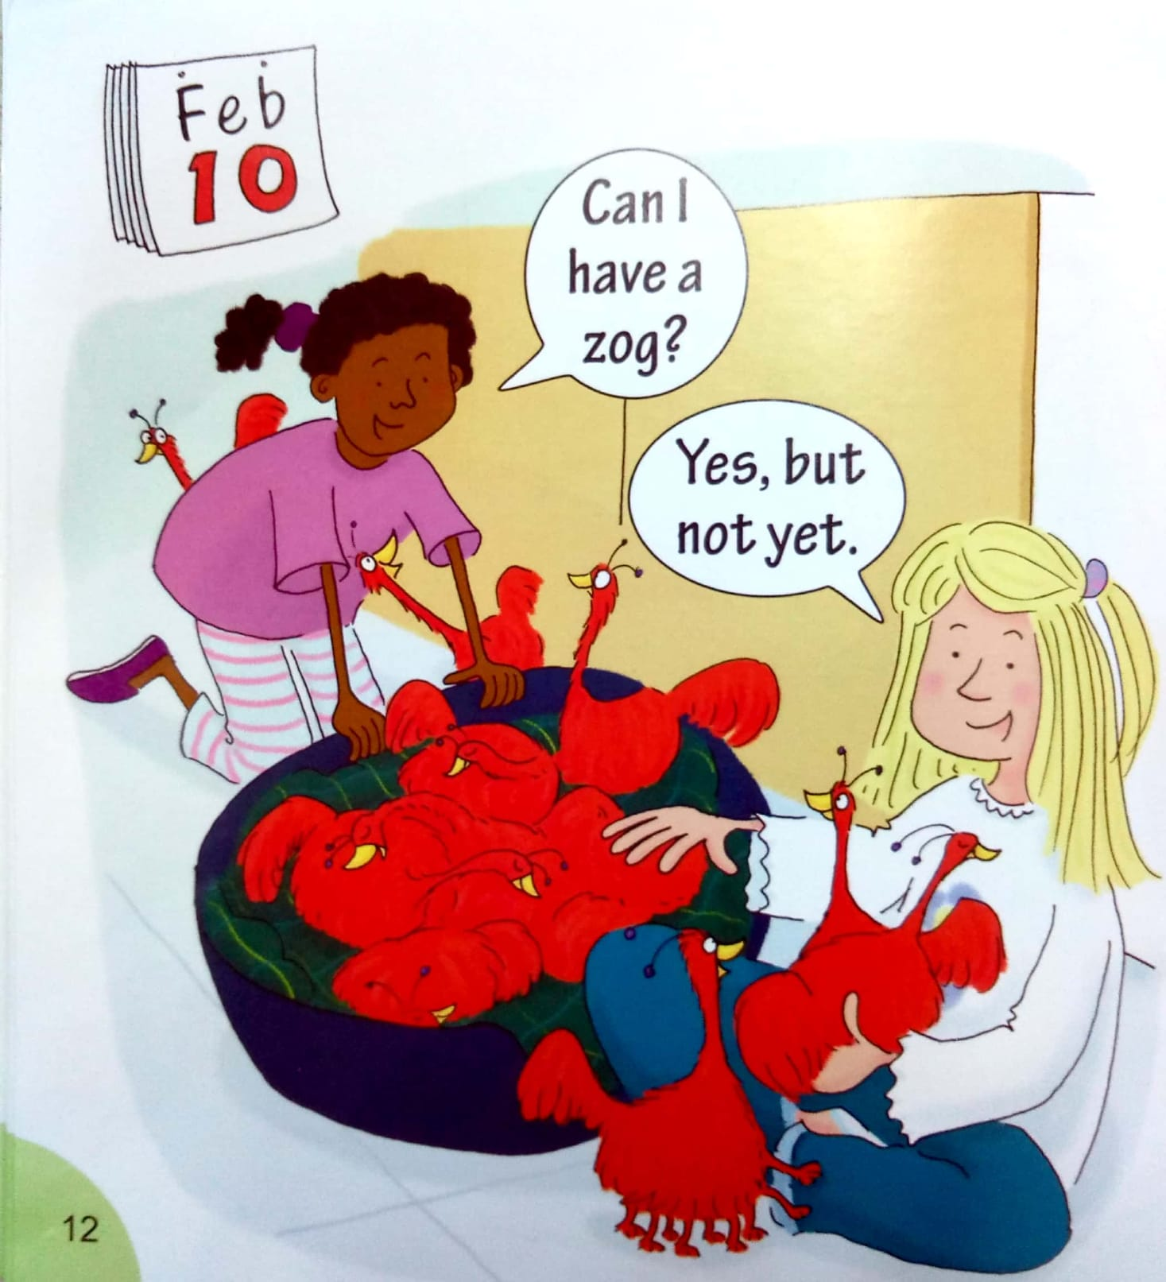
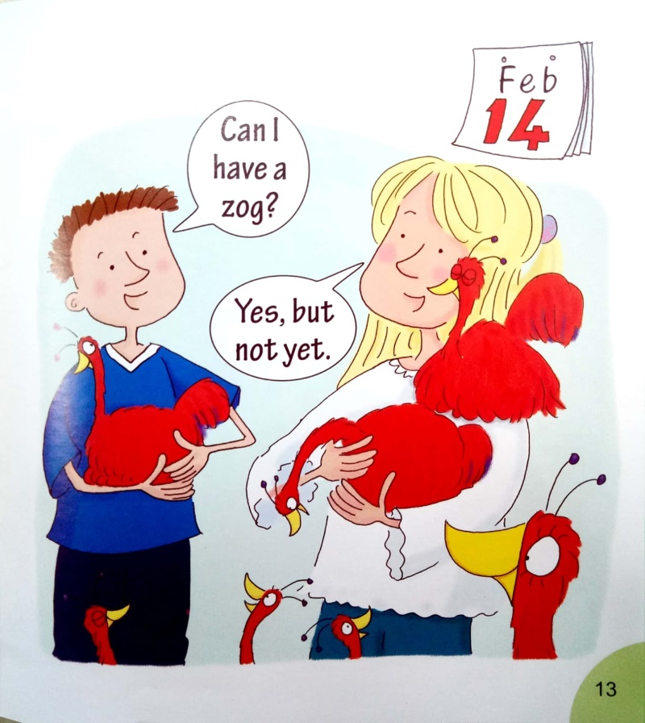
讨论：为什么Viv说“好的，但是还不行！”

Slide 16
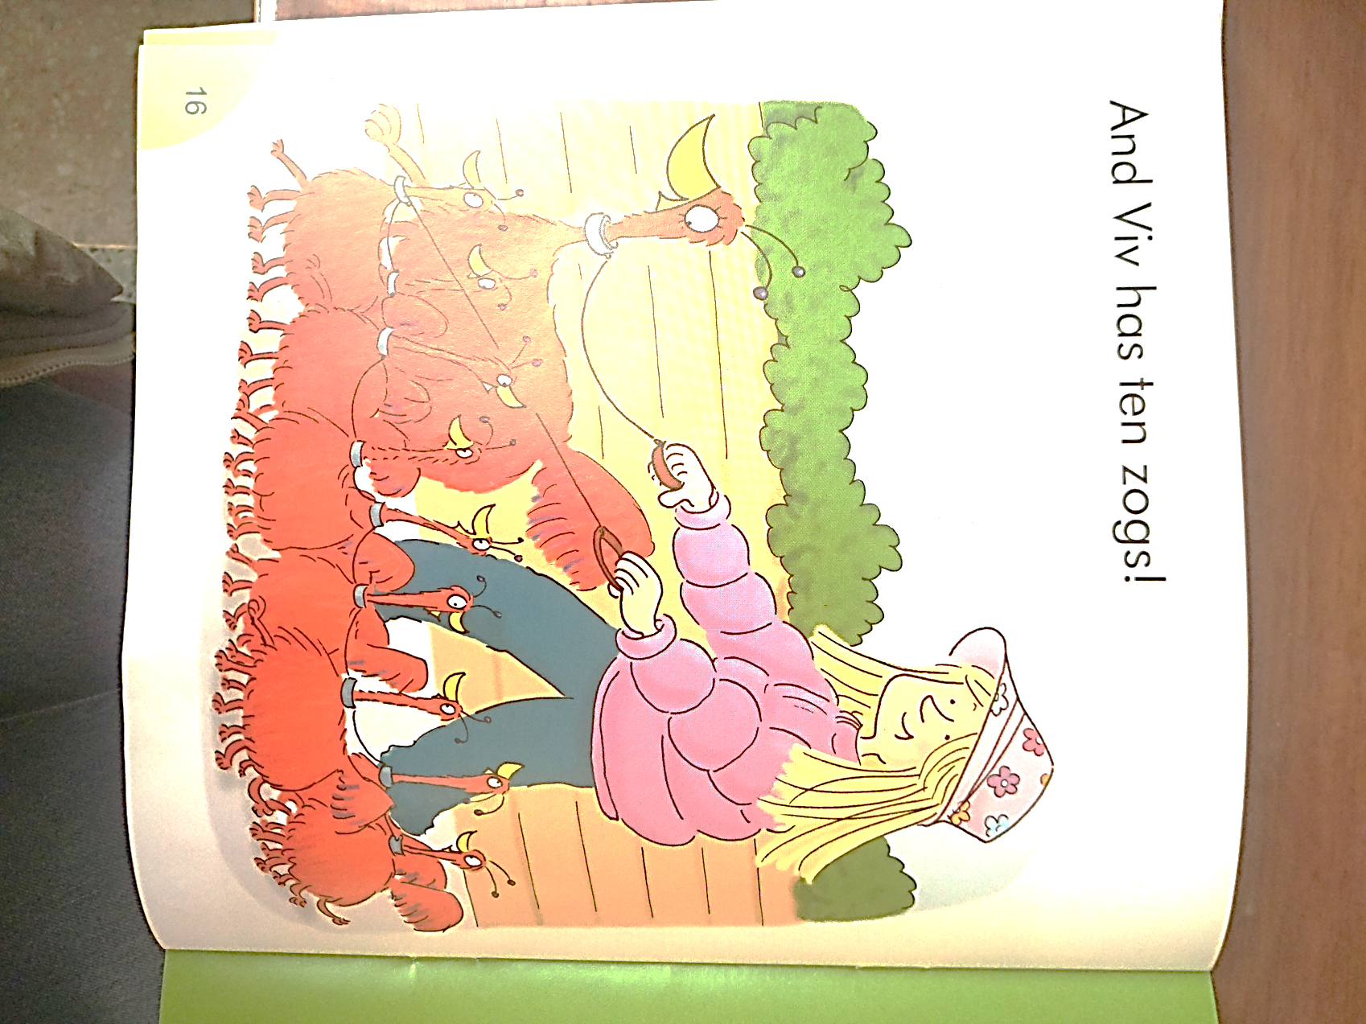
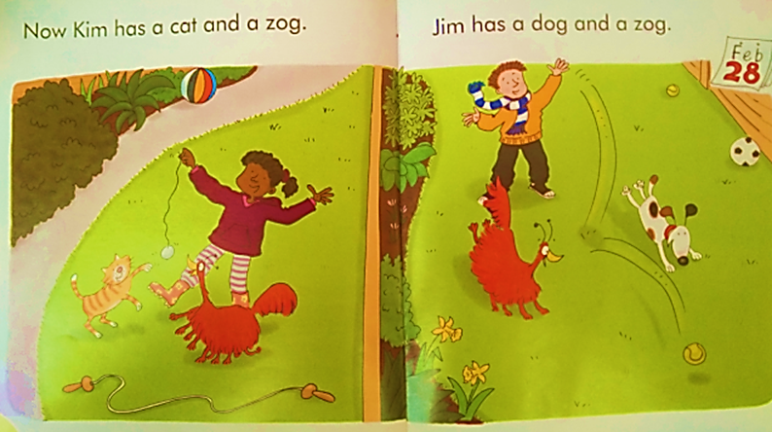
Sharing is a pleasure.
分享就是快乐。

Slide 18
Read!
选自己最感兴趣的部分读一读。
Act!
发挥想象演一演有趣的章节。
Retell!
结合板书讲一讲故事。

Slide 19
Homework
Listen to the tape and read the book.
Share the story with your family and friends.
Enjoy Stories, Enjoy Reading.
Notes:
I strongly recommend you doing this before writing your book.

Slide 20
Kim has a . Jim has a . But Viv has a . It has legs and eggs.
Then, there’re lots of .
At last, Kim has a and a .
Jim has a and a .
And Viv has .
Retell the story.
cat
dog
zog
ten
eleven
zogs
cat
zog
dog
zog
ten zogs

Slide 21
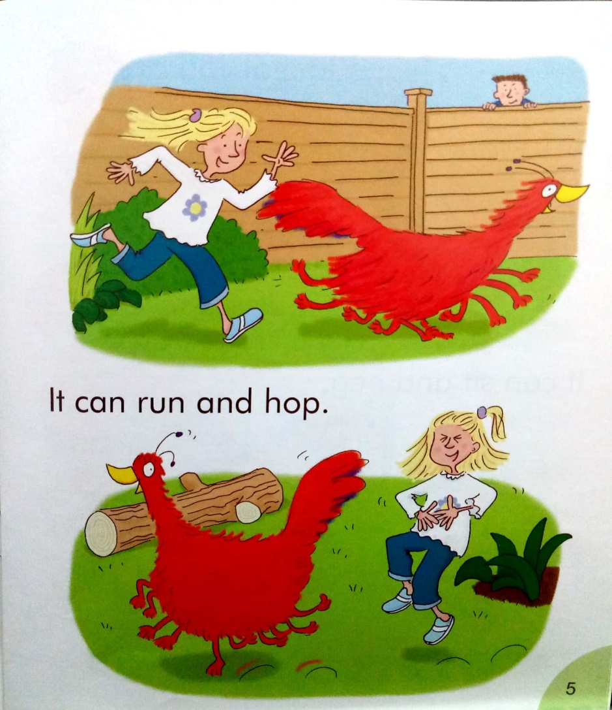
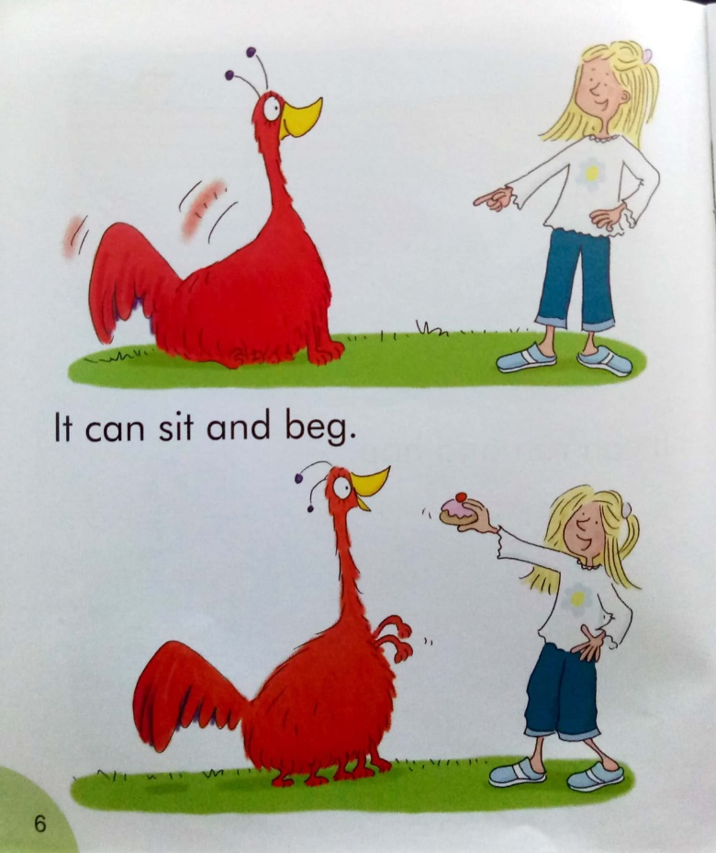

Slide 22
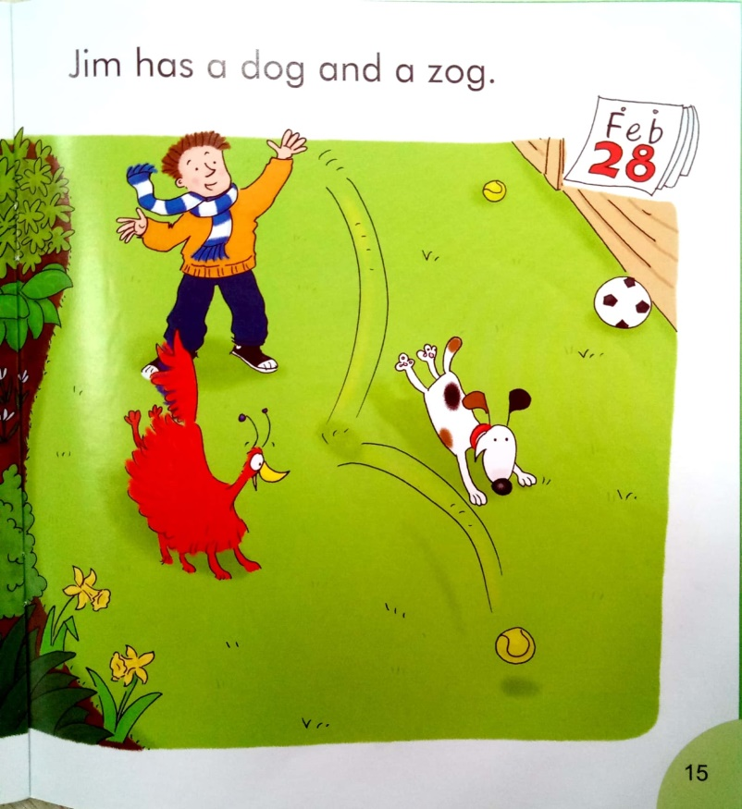
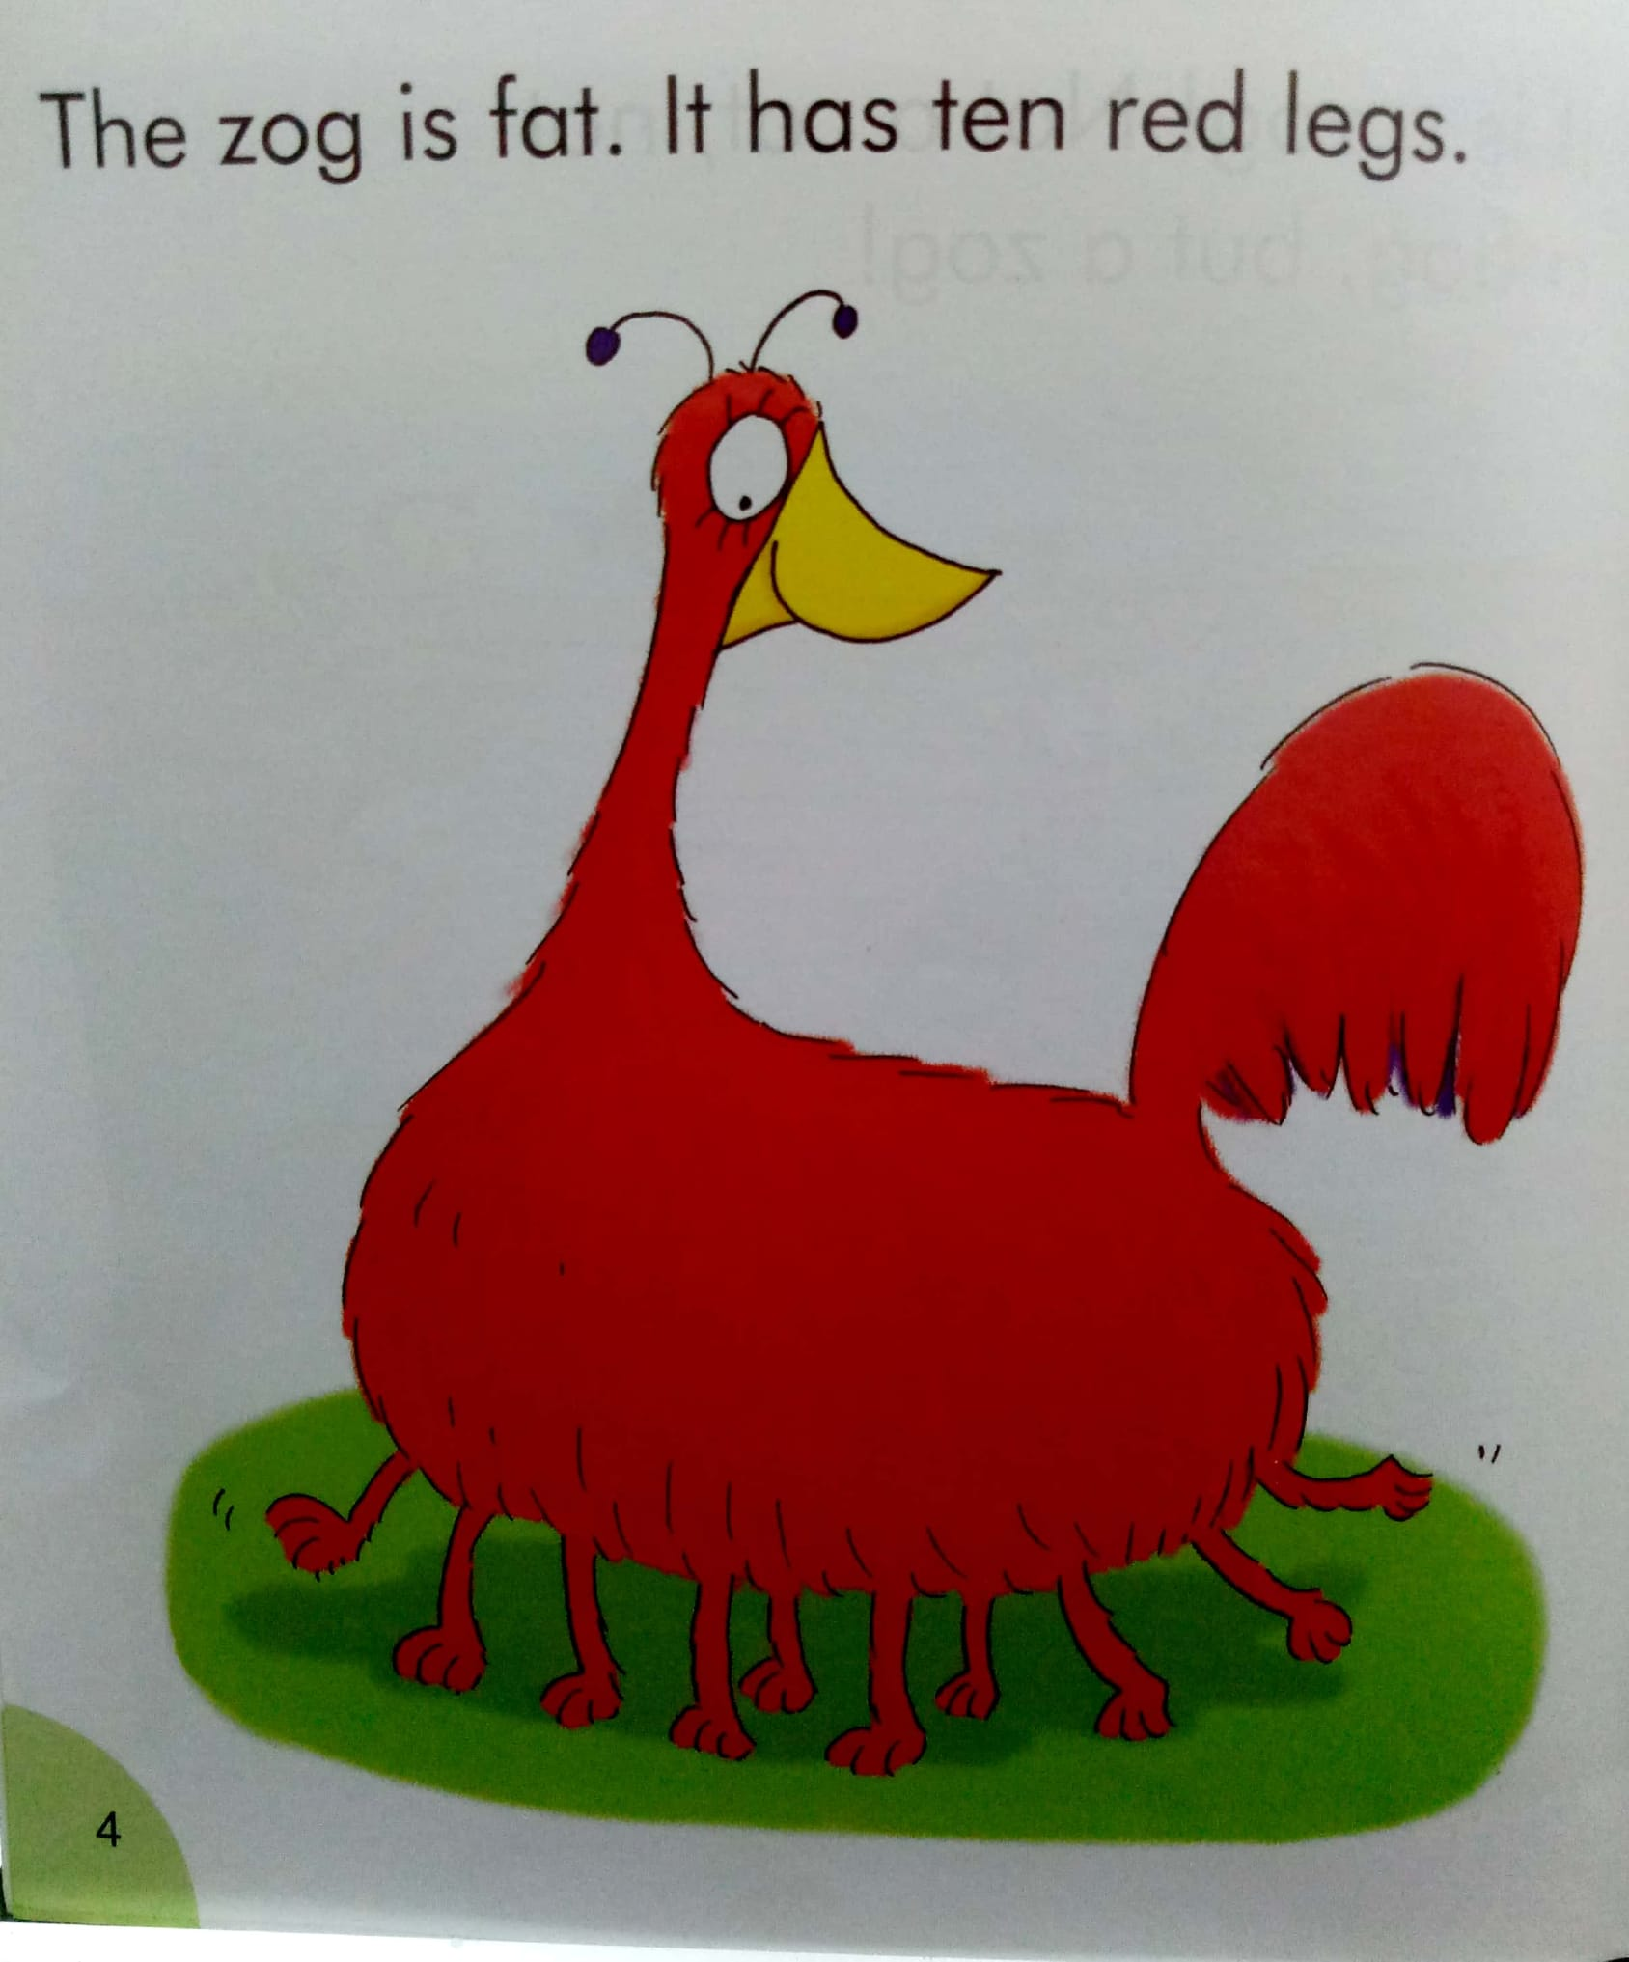
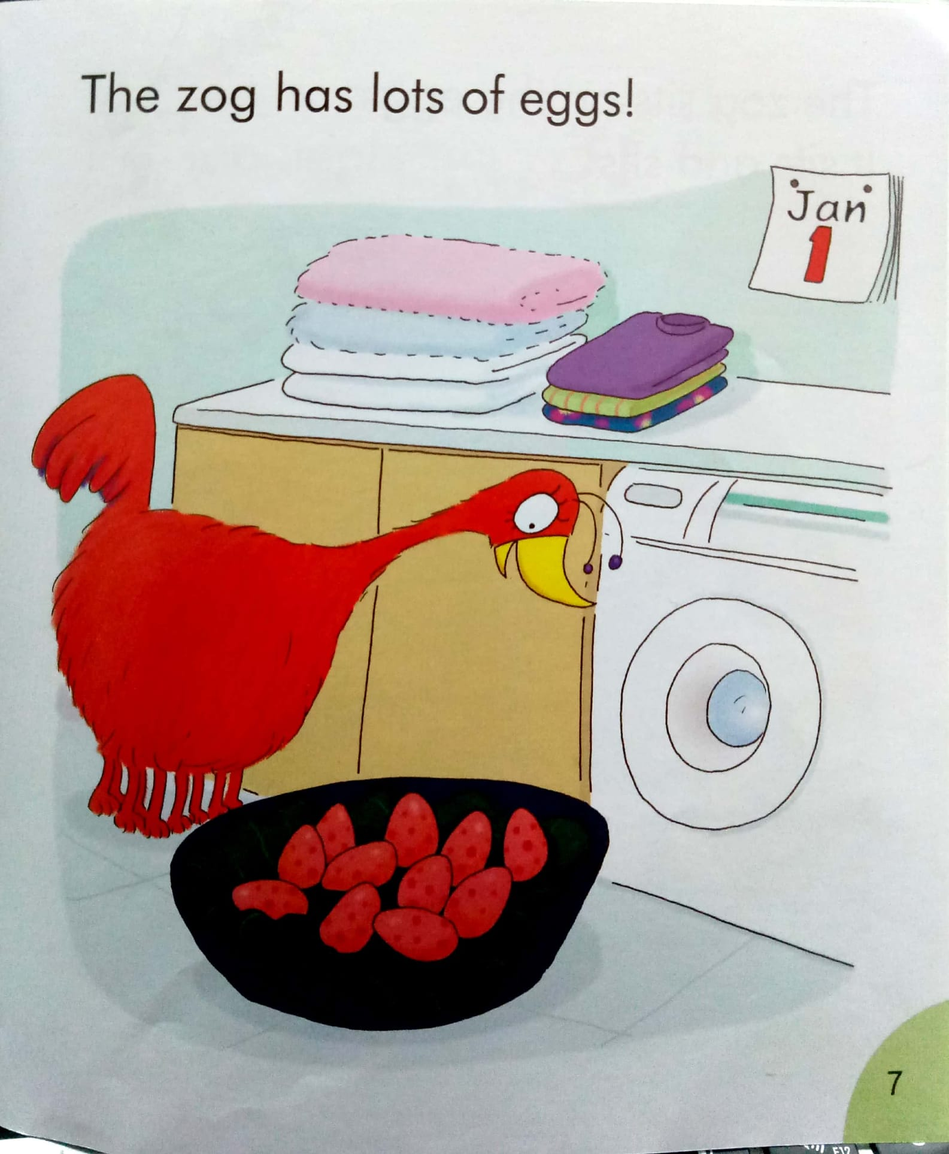
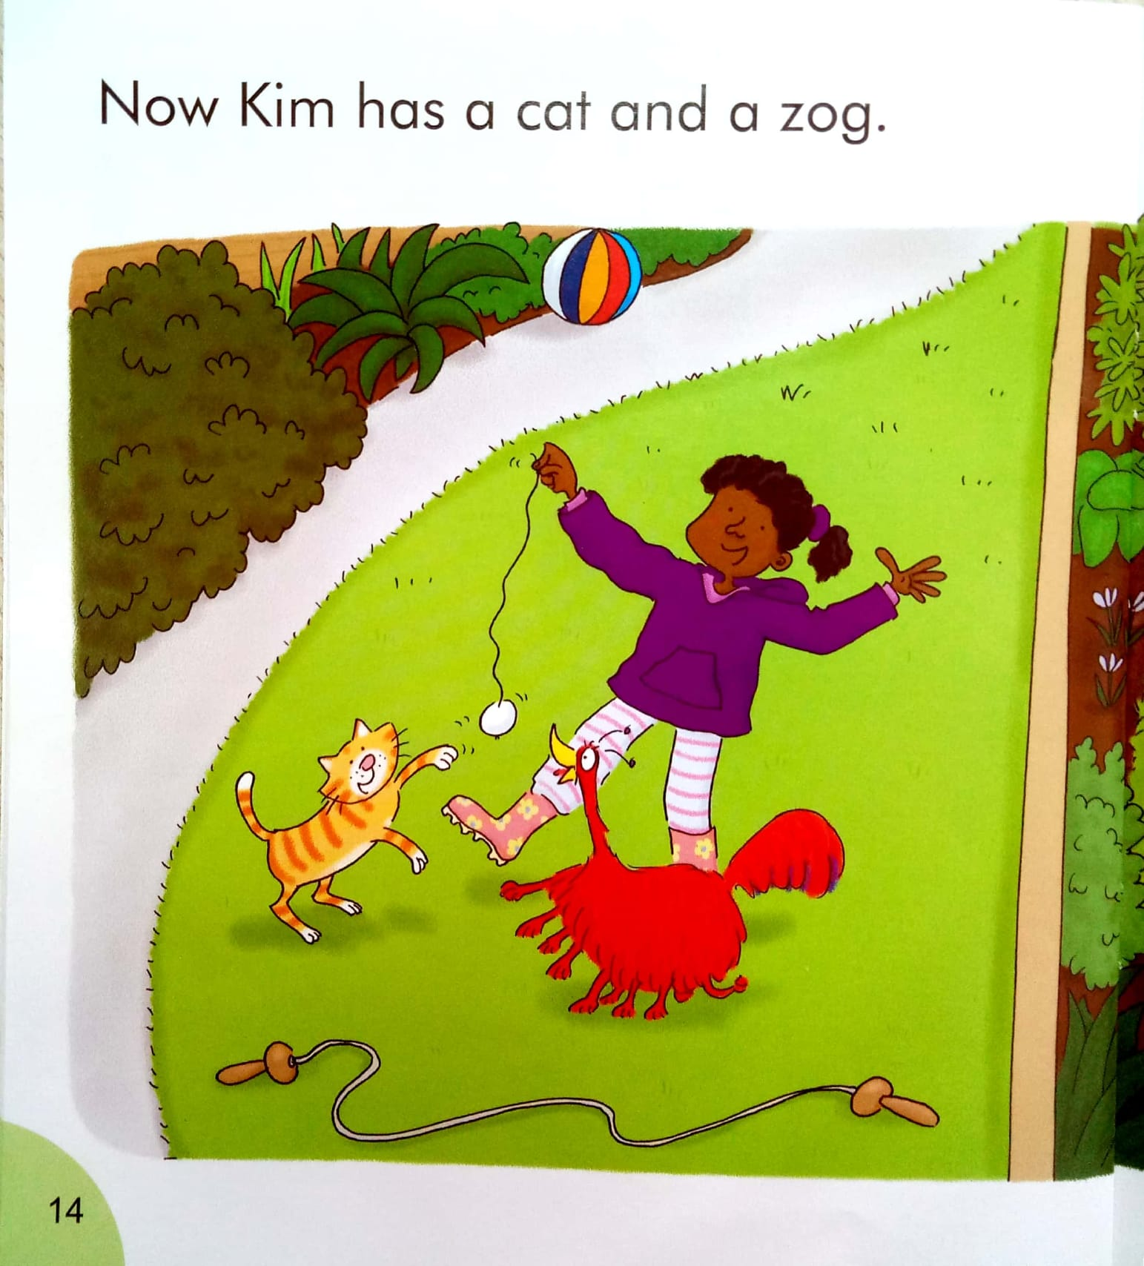
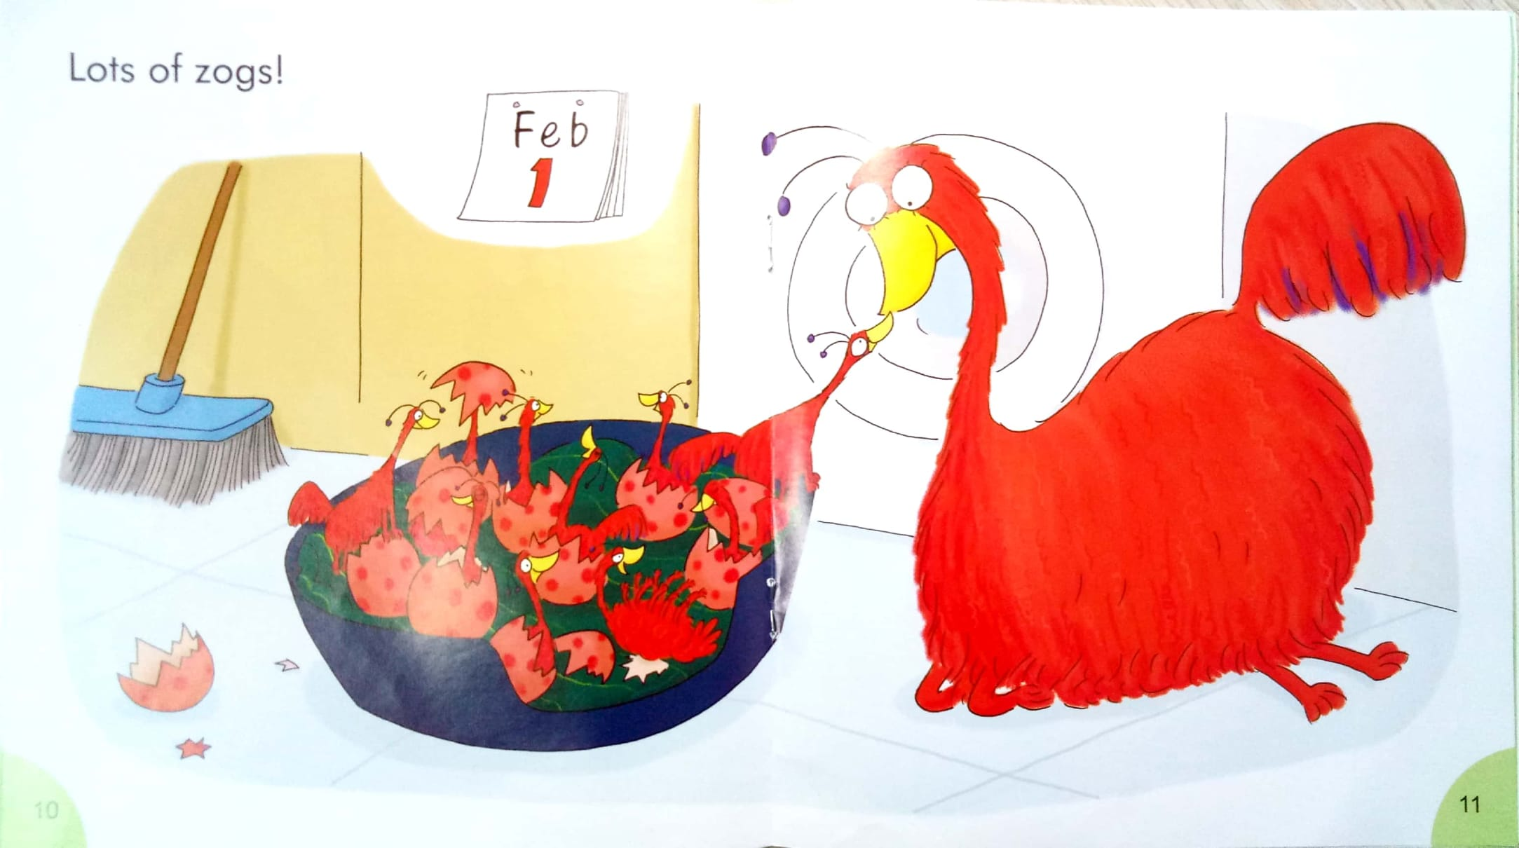
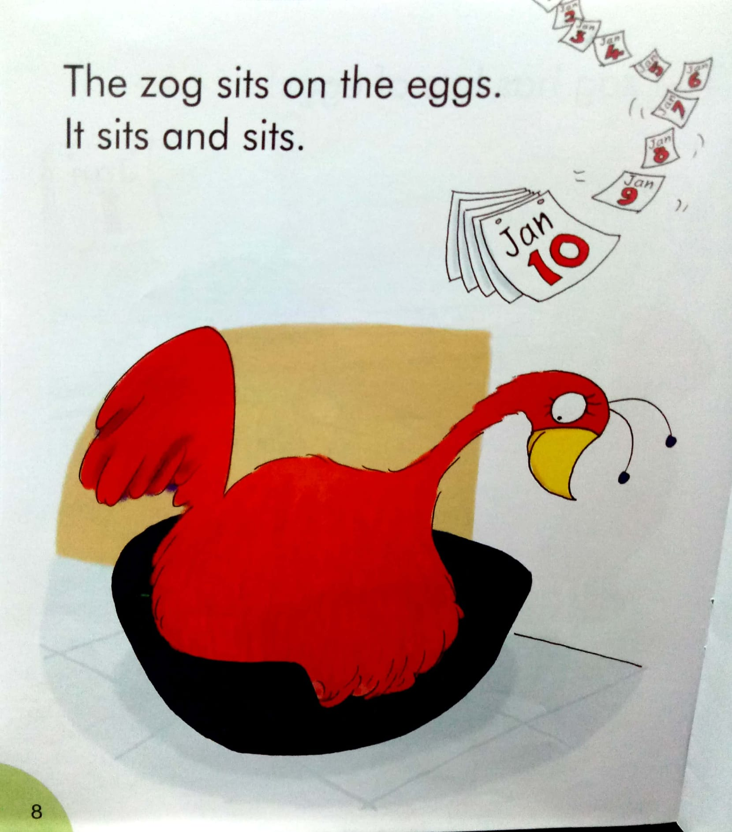
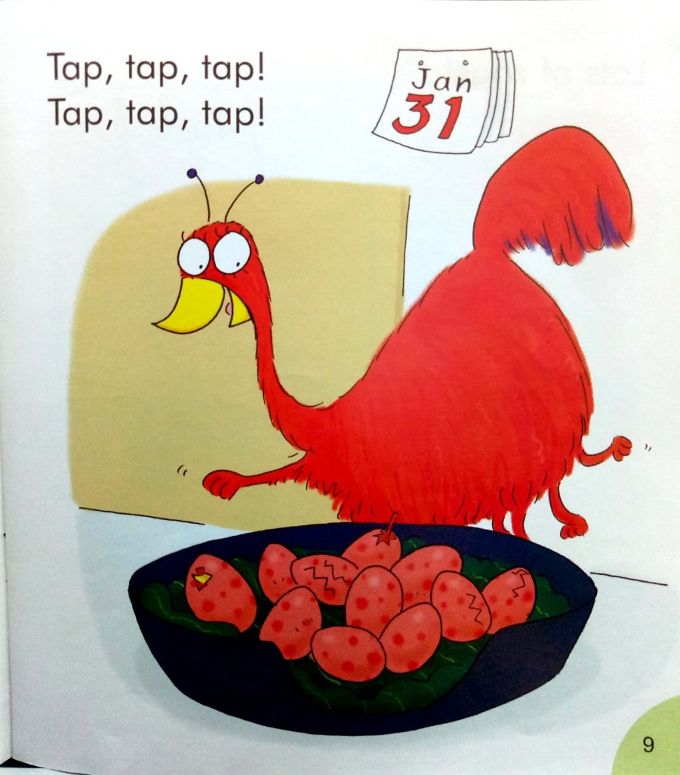

Slide 24
One day , Kim has … Jim has…

Slide 25
http://www.kuwo.cn/artist/content?name=%E5%84%BF%E7%AB%A5%E8%AF%BB%E7%89%A9

Slide 26
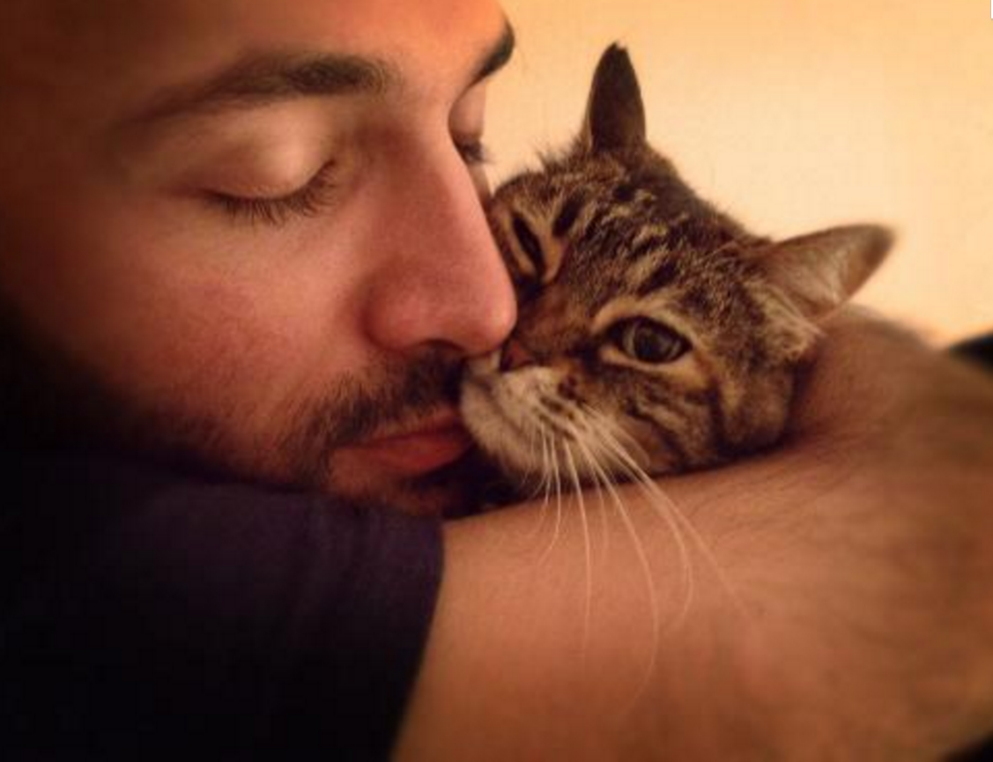
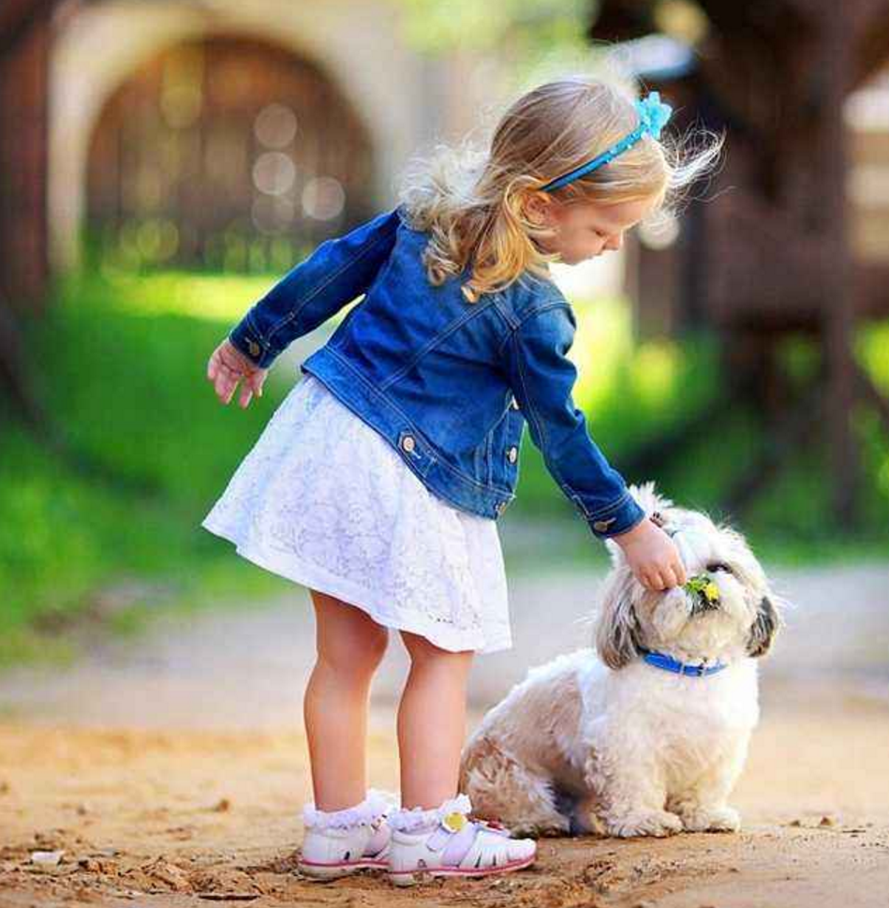
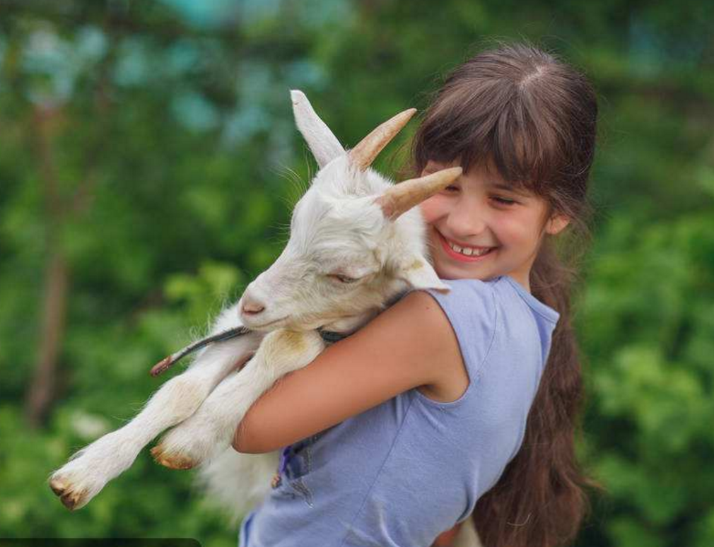
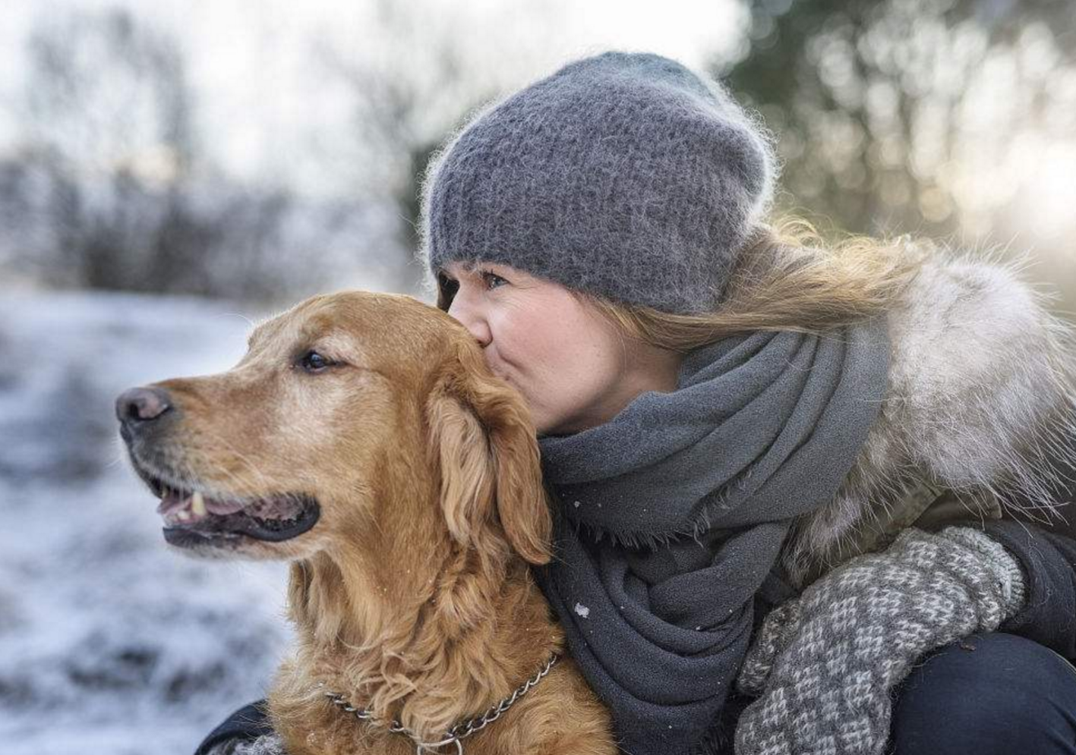
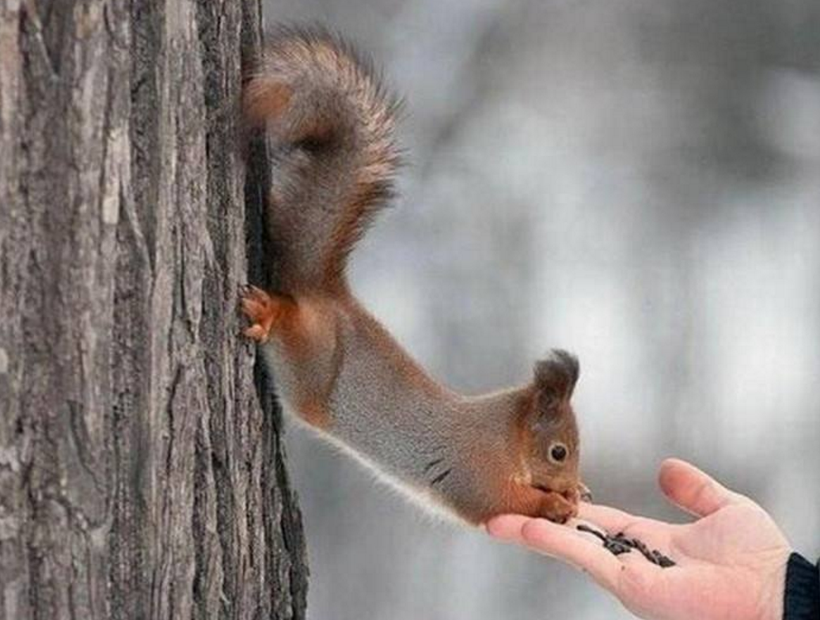
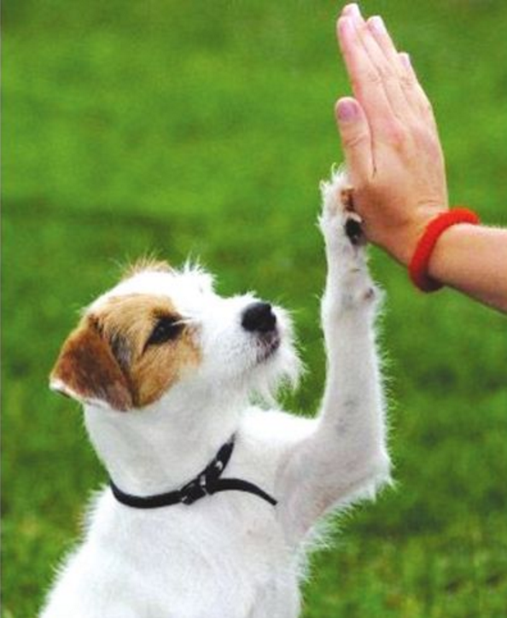
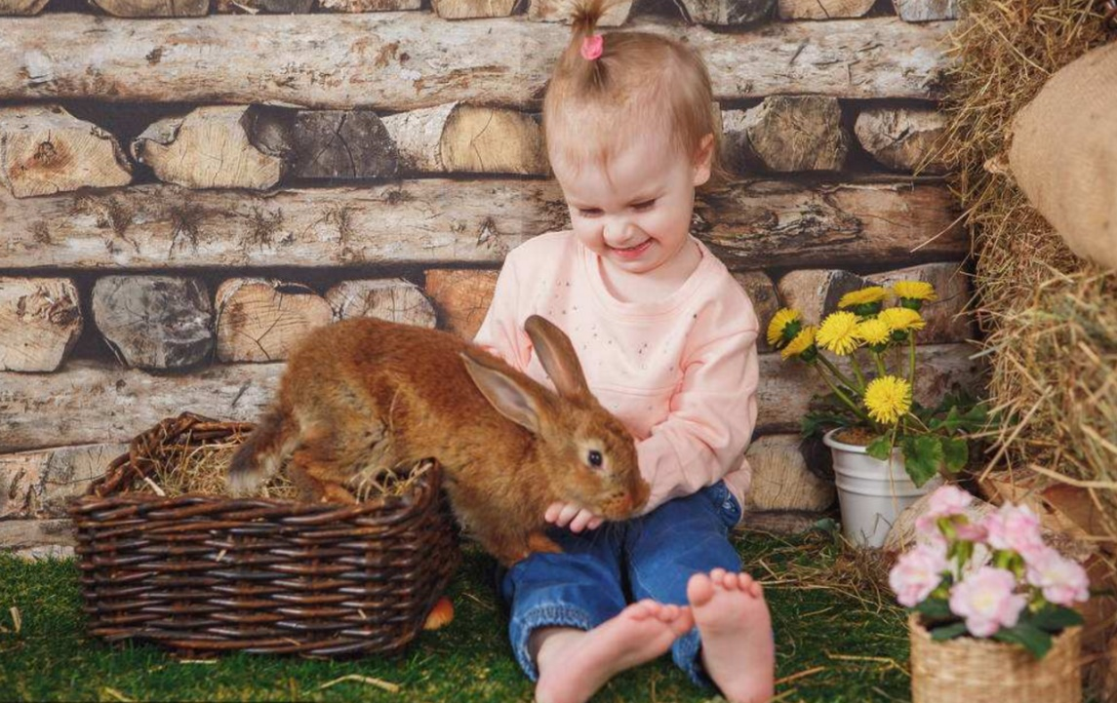
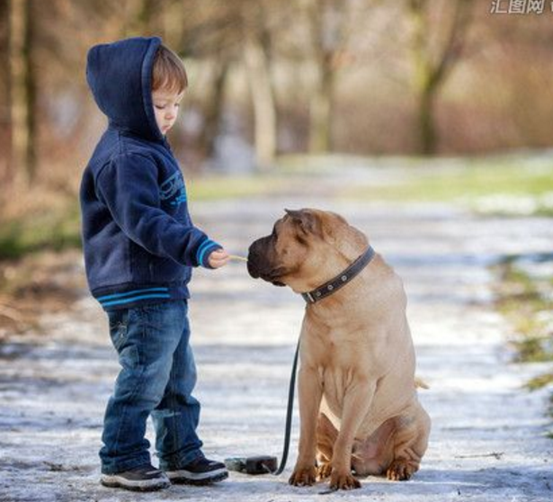

Slide 27
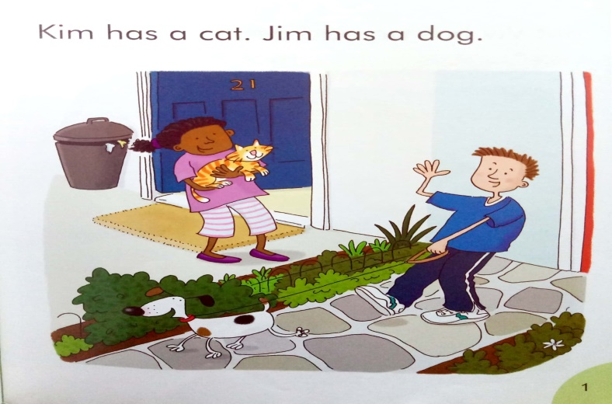

Slide 28
家有宠物视频
http://video.eastday.com/a/170818201507313485334.html
取一小断
http://v.youku.com/v_show/id_XMzQzMjMyNDQ5Mg==.html
http://v.youku.com/v_show/id_XNDk3MzMzMDUy.html

Slide 29
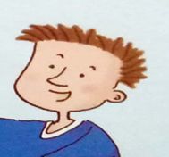
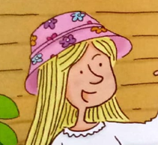
Read and find
Read P 1-3。
This is _______.
She has a _______ .
This is _______.
He has a _______ .
This is _______.
She has a _______ .

Slide 30
e
t
m
p
S
i
o
c
a
u
r
b
g
l
d
i
f
h

