Slide 1
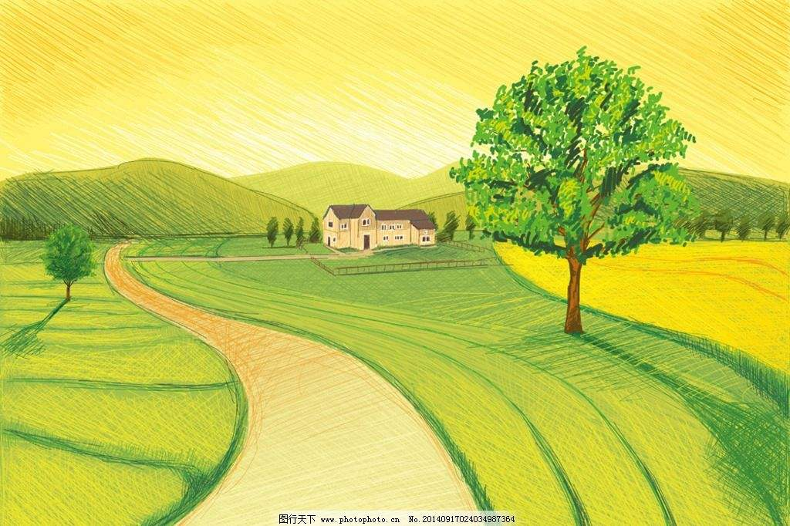
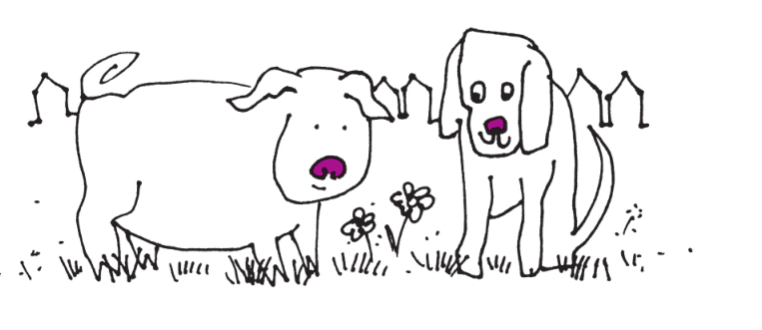
Notes:
I have some ideas and you tell you what you think of

Slide 2
M
J
____
____
i
g
a
g
Notes:
How many sounds did you hear?
What are they?
1st? 2nd? 3rd?
you gonna see lots of words with ig and ag in the story.

Slide 3
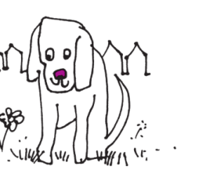

blend
Let’s
b
ig
b
ag
Notes:
so, it’s very important to read the word with ig and ag quickly.
let’s practice.

Slide 4
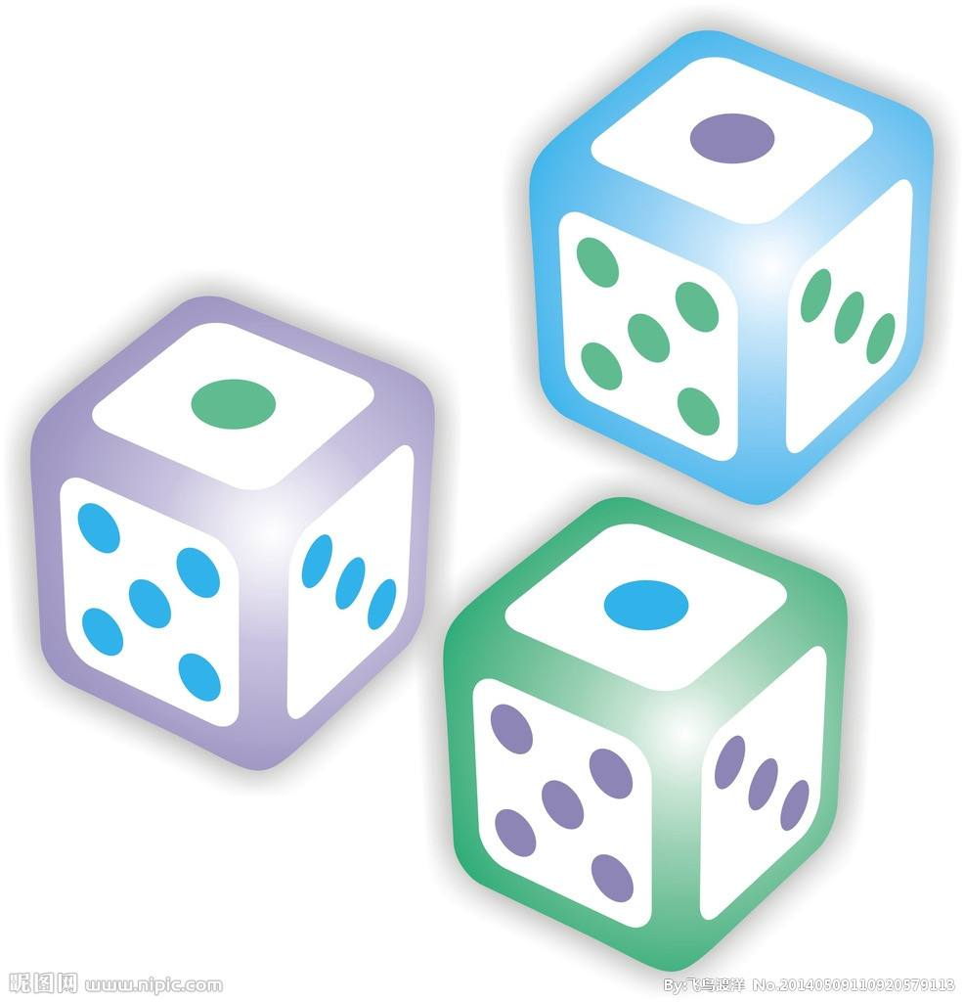

& Read it
Roll it
ig
ig
ag
d
m
j

Slide 5
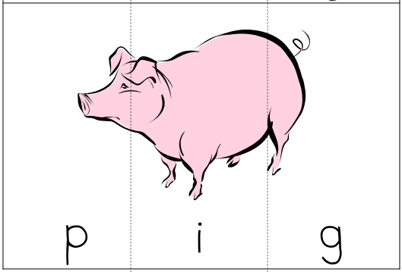
1st sound?
What’s

Slide 6
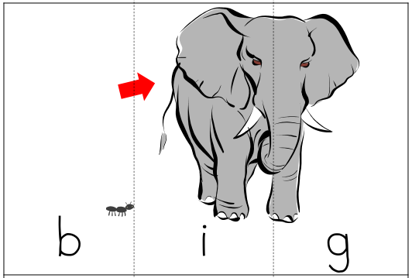
1st sound?
What’s

Slide 7
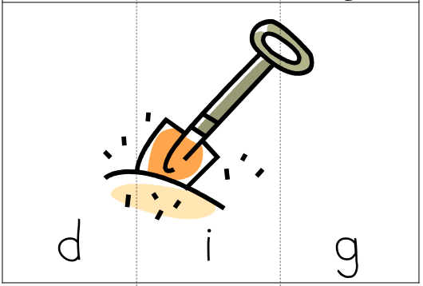
1st sound?
What’s

Slide 8


Slide 9


Slide 10

& Think
Read
1
What can Jig/Mag do?
2
How many matches?
3
Who did win?

Slide 11

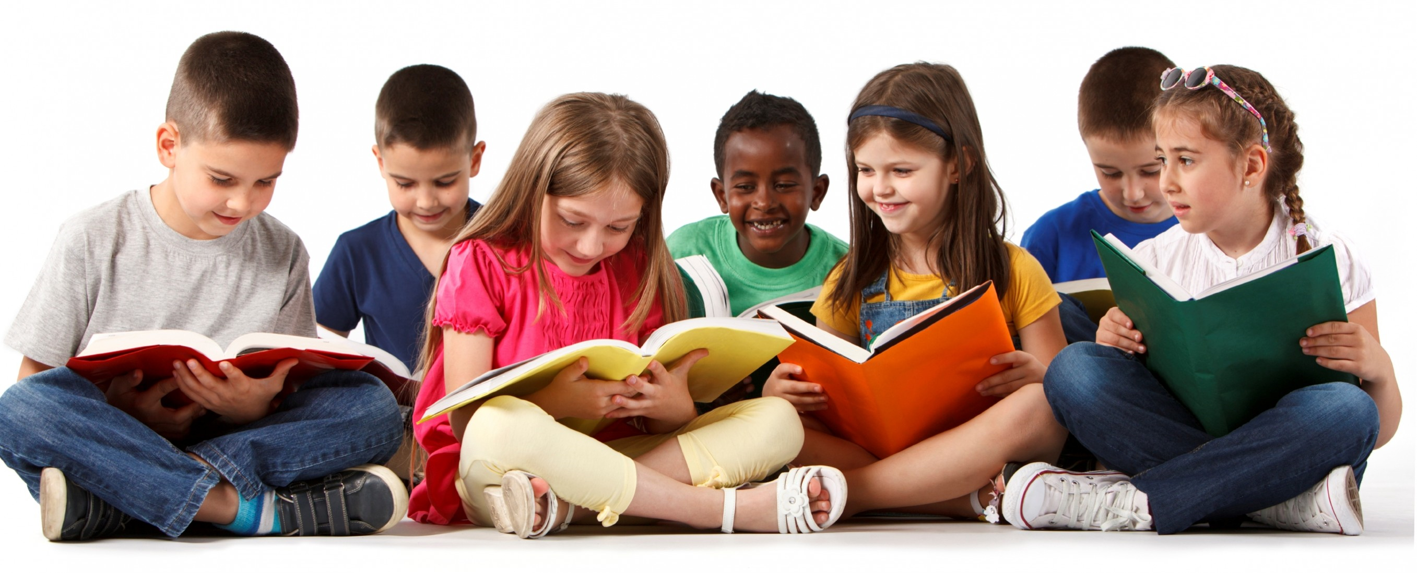

Slide 12
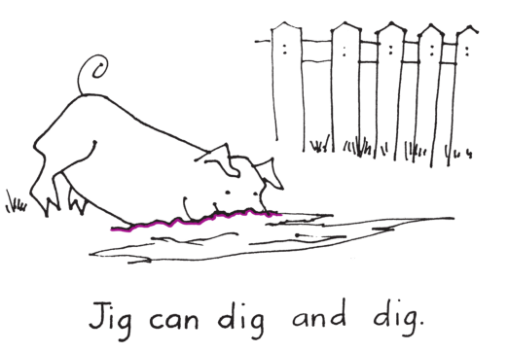
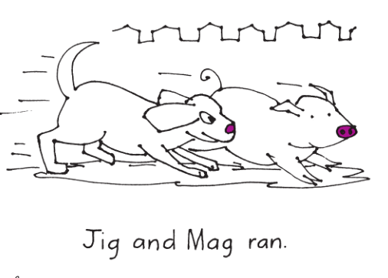
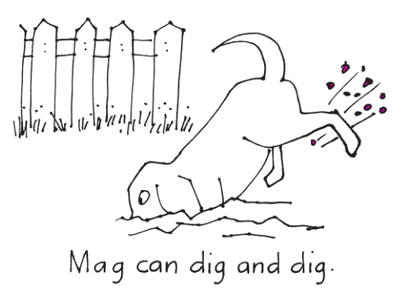
& Think
Read
1
What can Jig/Mag do?

Slide 13
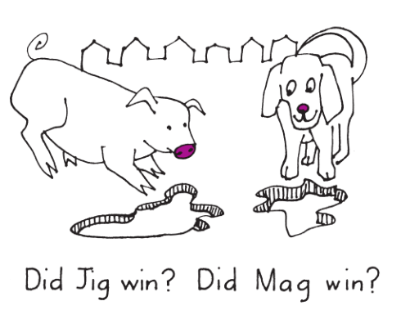
& Think
Read
2
How many matches?

Slide 14
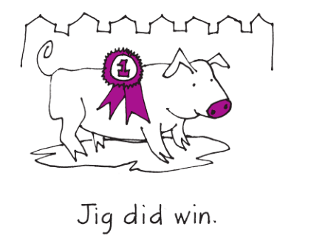
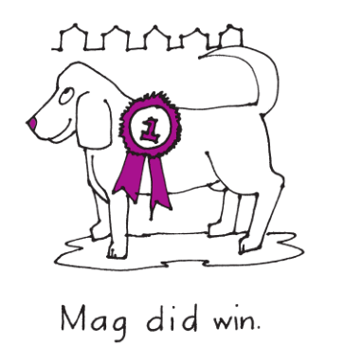
& Think
Read
3
Who did win?

Slide 15
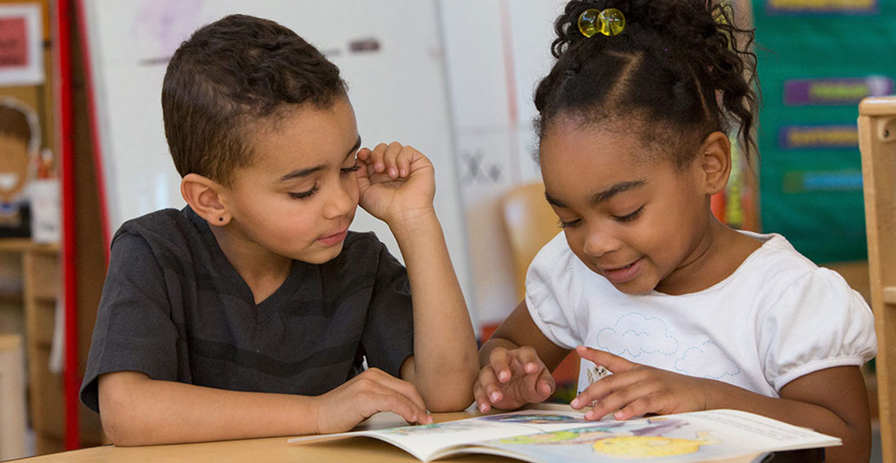
in pair
Read

Slide 16
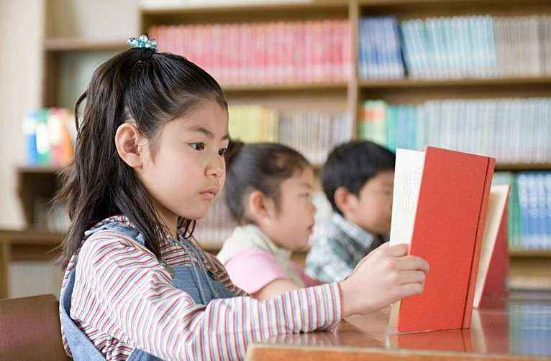
& Read
Listen

Slide 17
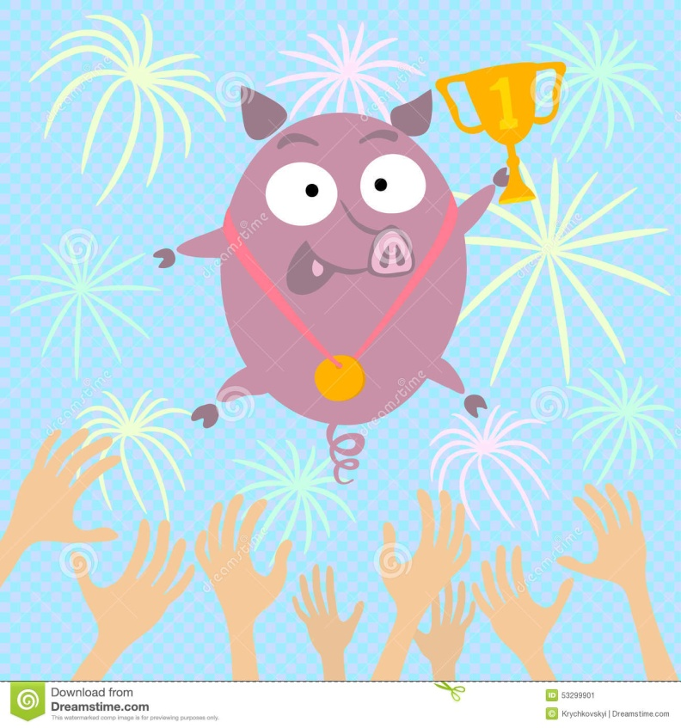


Everyone has his strong points. Every dog has its day.
How many winners?
尺有所短，寸有所长。
win
Notes:
Can we say Jig is better than Mag?
Can we say Mag is better than Jig?
They are all the best.

Slide 18
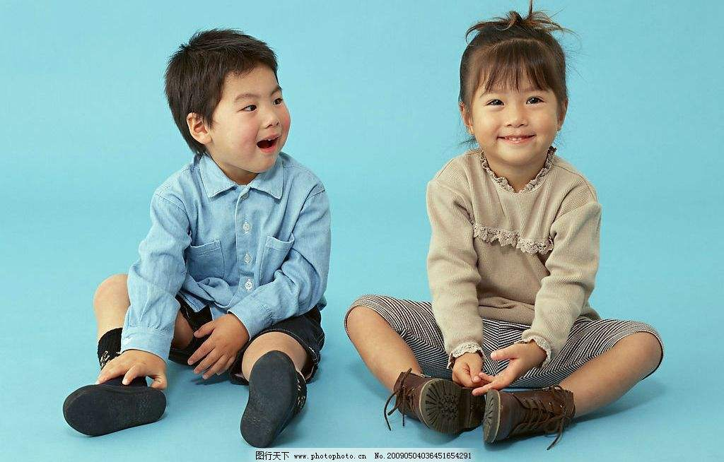
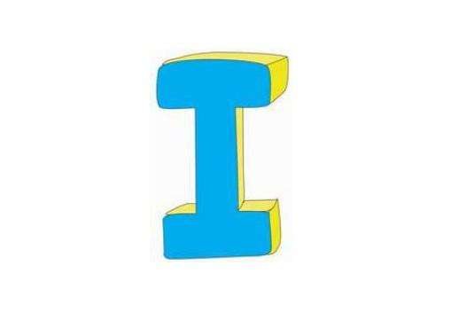
talk
Let’s
She cannot, but she can dance well.
I can sing very well.

Slide 20


Slide 21

Homework
Listen to the audio and read the book.
Sing the song.
Write your own story.
Notes:
I strongly recommend you doing this before writing your book.

Slide 22
Eat a lot
1
Like sleeping
Fat
5
2
Pig
Like bone
1
Dig well
Can run
Jump high
Friendly
4
3
5
2
Dog
Can dig
Run fast
4
3

