Slide 1
9AUnit6 Grammar
Banshang Middle Schol
Wei Aihua

Slide 2
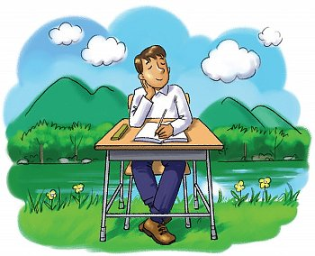
Free Talk
What will you do if you are happy?
If I am happy,
I will …
Notes:
If you are happy, what will you do ?
If I am happy, I will show you around the zoo.
I will show you around the zoo if I am happy.

Slide 3
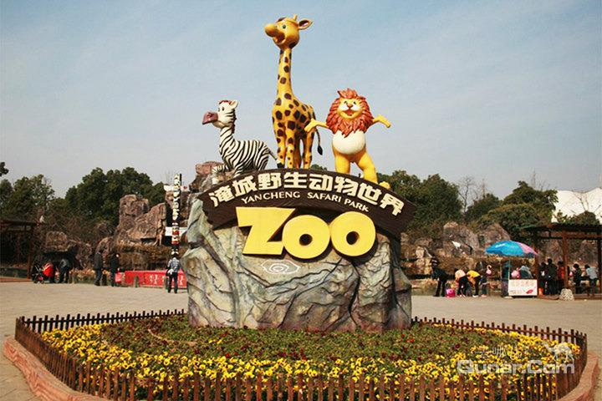
If I am happy, I will show you around Yancheng zoo.
Notes:
If I have a ten-day holiday, I will go to Beijing zoo. Do you want to go with ma? Oh , I nearly forget Amy. Amy is my friend she loves wild animals very much? She must want to go with us.
Where is Amy?
Ah-ha, she is thinking aobut animals in the classroom.

Slide 4
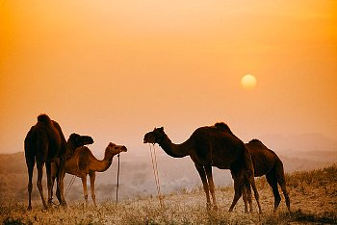
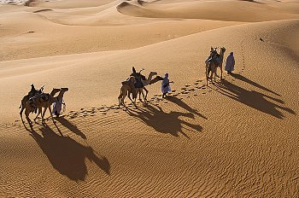
What will you see if you go to Yancheng zoo?
If I go to Yancheng zoo, I will see camels.
I will see camels if I go to Yancheng zoo.

Slide 5
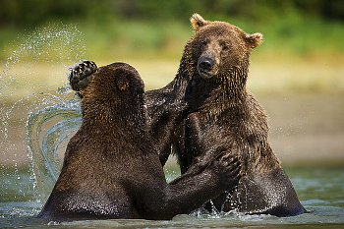
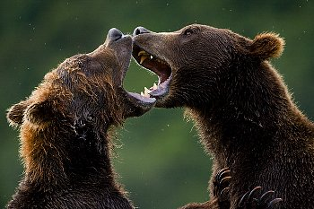
What will you see if you go to Yancheng zoo?
If I go to Yanchen zoo, I will see bears.
I will see bears if I go to Yancheng zoo.

Slide 6
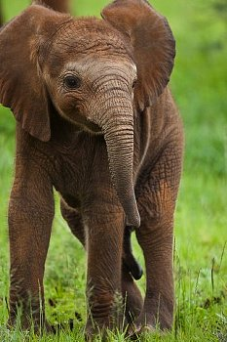
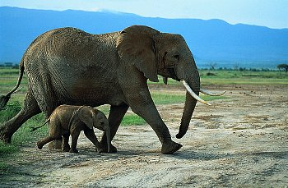
What will you see if you go to Yancheng zoo?
If I go to Yancheng zoo, I will see elephants.
I will see elephants if I go to Yancheng zoo.

Slide 7
Summary I
Conditional Sentences(条件状语从句）
If you are a football fan,
If you are an animal-lover,
If you enjoy solving mysteries,
you will not want to miss this week's programme.
you may feel sad about it.
you might like this film.
If–clause (一般现在时）
,
Main-clause(一般将来时）
If-clause(从句) Main clause（主句）
.
Main-clause(一般将来时）
If–clause (一般现在时）
Rules
comma
,
We need a ___________________( comma, full stop) after the ‘if’-clause when it is the first part of a sentence.
simple future tense
一般将来时
simple present tense
一般现在时
Notes:
These sentences are called conditional sentences. The first parts are called if –clauses. The sen

Slide 8
Summary II
在if引导的条件状语从句中，主句除了用一般
将来时之外，还可含有can,may,might,must
等情态动词。如：
You must see the doctor if you are ill.
If you enjoy solving mysteries,you might like
this film.
在if引导的条件状语从句中，主句也可含有祈
使句。如：
If you get scared easily,do not watch it!

Slide 9
If you are a football fan, you will not want to miss this week’s programme.
If you enjoy solving mysteries,you might like
this film.
If you get scared easily, do not watch it!
主句用一般将来时
will+ do
may/might+ do
If 从句用一般现在时
主句含有情态动词
主句为祈使句

Slide 10
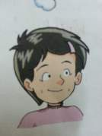
Have a try:
A1
√
If I (go, will go) to the Reading Club this afternoon, I (do not have,
may not have) any time to watch TV.
2. If Simon (gets, will get ) home too late, he (miss, will miss) his
favourite cartoon.
3. If Amy (completes, will complete) all her homework quickly, she
(watches, will watch) the chat show.
4. If Daniel (takes, will take) part in the game show, he (wins, might
win) a prize.
5. If Sandy (finds, will find) a programme interesting, she (introduces,
will introduce) it to us
√
√
√
√
√
√
√
√
√
Notes:
Of course , it is impossible for Amy to go to North Africa and walk through the rainforest to see wild animals.
What other places can we see wild animals? There will be a class trip to Beijing zoo next week. She decides to go to Beijing zoo. Now she is writing a report to tell her parents why she wants to go to Beijing zoo. Let’s help her.

Slide 11
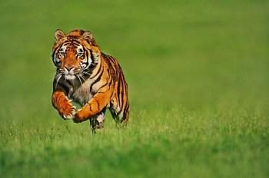
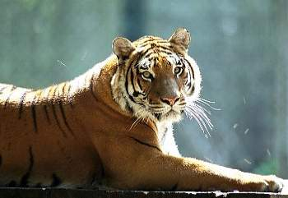
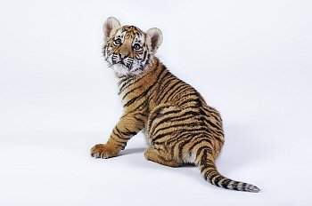
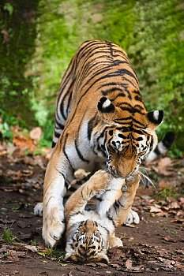
1. Tigers will live as a family
a. if they live in the wild.
2. Tigers will hunt for their own food
b. if they have babies.
Match the sentences 连线

Slide 12
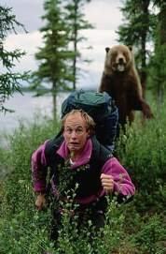
Choice
--- What will a bear do if it is in danger?
---If a bear is in danger, it ________________.
will attack people
A.
B. will be afraid
C. will shout
---If you meet a bear in the wild, what will you do ?
--- I will________________if I meet a bear in the wild.
A. climb up the tree
B. stay there and hold my breath(屏住呼吸) for a few seconds
C. run the other way

Slide 13
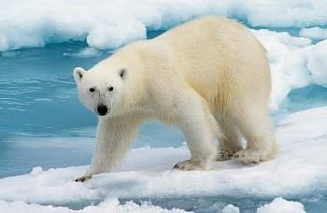
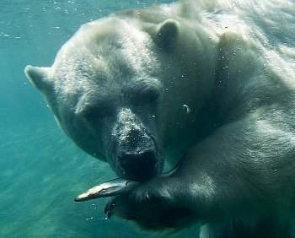
Ask and Answer
What will a polar bear do if it is hungry ?
catch fish from water
If a polar bear is hungry, it will catch fish from water.

Slide 14
A2 :
attack catch hunt live protect walk
Dad: What will a bear do if it is in danger?
Millie: If a bear_____________, it ___________________ people.
Dad: What will a polar bear do if it is hungry?
Millie: If a polar bear _______________, it _______________fish
from the water.
Dad: What will elephants do if they are thirsty?
Millie: If elephants ______________, they _____________ till
they find a river.
Dad: What will tigers do if they live in the wild?
Millie: Tigers _________________ for their own food if they
_________________.
Dad: What will tigers do if they have babies?
Millie: Tigers __________ as a family if they ________________.
Dad: What will male wolves do if there is danger?
Millie: Male wolves __________ their families if there ________.
is in danger
will attack
is hungry
will catch
are thirsty
will walk
will hunt
live in the wild
will live
have babies
will protect
is danger
Notes:
Amy learnt a lot about wild animals in Beijing zoo . When Amy returns home from Bejing zoo, her father wants to know hou much information about wild animals she got. . Her father is asking her some questions . Help her finish the answers.

Slide 15
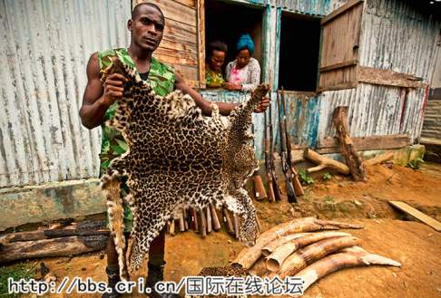
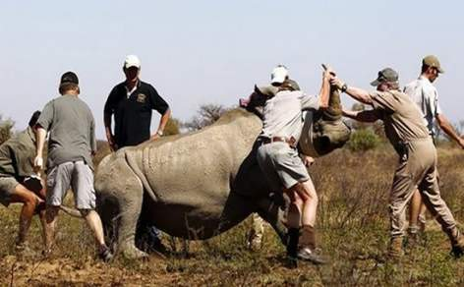
Many animls are in danger,
and why?
The situation will continue unless humans stop hunting them for their fur and bones.
Notes:
Let’s go to Beijing zoo with Amy, OK? Let’s go.

Slide 16
Unless=If… not
We can use unless to say that something
can only happen or be true in a particular
situation.
The situation will continue unless humans
stop hunting them for their fur and bones.
if
The situation will continue ____humans
_____stop hunting them for their fur and
bones.
don’t
Notes:
Let’s go to Beijing zoo with Amy, OK? Let’s go.

Slide 17
Unless=If… not
除非
1、unless的意思是_________,相当于___________
2、在unless引导的条件状语从句中，主句常用_________时，从句一般用_______时。
if...not
一般将来
一般现在
Notes:
Let’s go to Beijing zoo with Amy, OK? Let’s go.

Slide 18
Exercises
1.除非他打电话我，否则我就去.
I will go ________he telephones .
2.不要离开房子除非我叫你离开.
Don’t leave the house ______I tell you to .
Don’t leave the house ____I _____ tell you to.
3. 除非你尽力了，否则你将不会实现梦想。
_____ you try your best, you won’t realize your dream.
4.你马上离开就不会迟到。
You will be late ______ you leave right now.
unless
The unless-clause can come first
or
after the main clause.
I will go _____he _______telephone .
if
doesn’t
unless
if
don’t
Unless
unless

Slide 19
A trip to a film and TV studio
Match them
a unless you take your own food with you
b you will not need to take the minibus in the studio.
c you will not have to take an umbrella with you.
d unless the traffic is very heavy.
e unless you have little interest in it.
f you will travel around it with a tour guide.

Slide 20
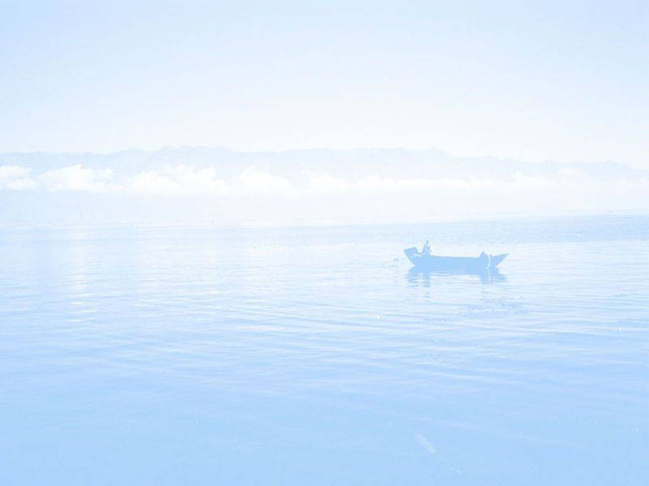
A trip to a film and TV studio
Unless the weather report says it is going to rain,
_________________________________________
a unless you take your own food with you
b you will not need to take the minibus in the studio.
c you will not have to take an umbrella with you.
d unless the traffic is very heavy.
e unless you have little interest in it.
f you will travel around it with a tour guide.

Slide 21
A trip to a film and TV studio
2. We will arrive at the studio around 9:30 a.m.
_________________________________________
a unless you take your own food with you
b you will not need to take the minibus in the studio.
d unless the traffic is very heavy.
e unless you have little interest in it.
f you will travel around it with a tour guide.

Slide 22
A trip to a film and TV studio
3. Unless you already know the studio very well,
_________________________________________
a unless you take your own food with you
b you will not need to take the minibus in the studio.
e unless you have little interest in it.
f you will travel around it with a tour guide.

Slide 23
A trip to a film and TV studio
4. You will buy your lunch at the restaurants in the studio,
_________________________________________
a unless you take your own food with you
b you will not need to take the minibus in the studio.
e unless you have little interest in it.

Slide 24
A trip to a film and TV studio
5.Unless you are tired,
_________________________________________
b you will not need to take the minibus in the studio
Work out the rule
present
We use the simple ____________ tense
in the unless-clause.
e unless you have little interest in it.

Slide 25
拓展一：条件状语从句和其它句型的变换
1. if引导的条件状语从句的复合句中，当主句和从句的
主语均为you时，可转换为“祈使句，and+简单句”或
“祈使句，or+简单句”
You can pass the exam if you work hard.
=_________，and you will pass the exam.
Work hard
If you don’t hurry up, you will be late again.
= Hurry up, _______ you will be late again.
or

Slide 26
2. 借助介词with 或without来转换。
例如:
If you help me, I’ll finish my job soon.
=_____ your help, I’ll finish my job soon.
如果你帮我，我将很快完成我的工作。
If there is no water, fish may die.
=Fish may die _______ water.
如果没有水，鱼可能会死。
With
without

Slide 27
同义句转换
1.Run fast, or you’ll be late for school.
_______ you _______ _______ fast, you’ll be
late for school.
2. Don’t come if I don't telephone.
Don’t come_________ I telephone.
3. If you don't help me, I can't work out the problems.
I can't work out the problems __________ ______ ________.
If don’t run
unless
without
your
help

Slide 28
拓展二：在其他句式中的运用
Can you tell me if I can go to a good senior high school?
Lucy asked if there was a bank near here.
if引导宾语从句时，作“是否”讲，常放在动词ask 、see 、say 、know和find out等后面。一般情况下，常与whether换用，在口语中多用if.

Slide 29
Summary:
主 句 if /unless+ 从句
一般将来时
祈使句
+
if/unless
+
一般现在时
情态动词+原形
要领:unless = if …not

Slide 30
链接中考
I don’t know if he ____ tomorrow. If he ___ , I will take him to visit our city. A. comes, comes B. comes, will come C. will come, comes D.will come, will come
第一个if表示是否引导宾语从句，时态根据tomorrow ,所以用将来时。第二个if表示如果， 主将从现，所以if从句用一般现在时。

Slide 31
Practice
1.You will fall behind others____ you don't work hard.
A. when B.if C. though D.because
2. The flowers ______ grow well if they ________.
A. won't; don't water often
B. don't; are often watered
C. don't; don't water often
D. won't; are not often watered
√
√

Slide 32
3.You will catch a cold _____________.
A. if you will not put on more clothes
B. if you put on more clothes
C. until you put on more clothes
D. unless you put on more clothes
4. ---I don't know if he ___ to Kate's birthday party?
--- He's sure to go if he ________.
A.goes; knows B. will go; knows
C. goes; will know D.go; konw
√
√

Slide 33
同义句转换吗（每空一词）
1. He won't be late unless he is ill.
He won't be late __________ he ________ ill.
2. If you don't run fast, you'll be late for school.
_______ ______, ______ you'll be late for school.
if
isn't
Run
fast
or

Slide 34
同义句转换
3.Take enough money with you, and you can buy the CD.
You can buy the CD _____ ______ ______ enough money with you.
4.If there is no water,none of us can live.
None of us can live __________ _________.
if
you
take
without
water

Slide 35
Teacher's word:
If you have a dream, what will you do?
If I have a dream, I will work harder and harder.
Keep trying, and never give up!

Slide 36
Homework
Finish the exercise in the workbook;

