Slide 1
Unit 2
What a day!
Period 3
王礼蓝

Slide 2
Unit 2 What a day!
Let's share
A: What day was it yesterday?
B: It was…
A: How was the weather yesterday?
B: It was...
A: What did you do yesterday?
B: I ...

Slide 3
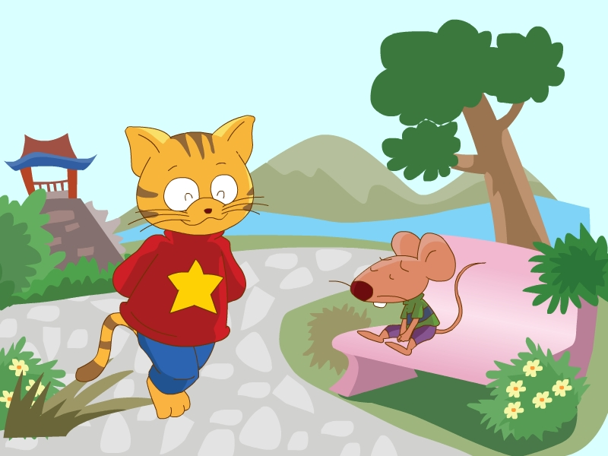
Unit 2 What a day!
Guess
What did they do?

Slide 4
Unit 2 What a day!
Watch and choose
Why was Bobby sad?
A. No one played with him.
B. He lost his new kite.
C. He couldn't fly kites.

Slide 5
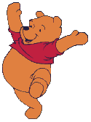
Unit 2 What a day!
Watch and choose
Why was Bobby sad?
A. No one played with him.
B. He lost his new kite.
C. He couldn't fly kites.
lose丢失
lost
[u:]
[ɒ]

Slide 6
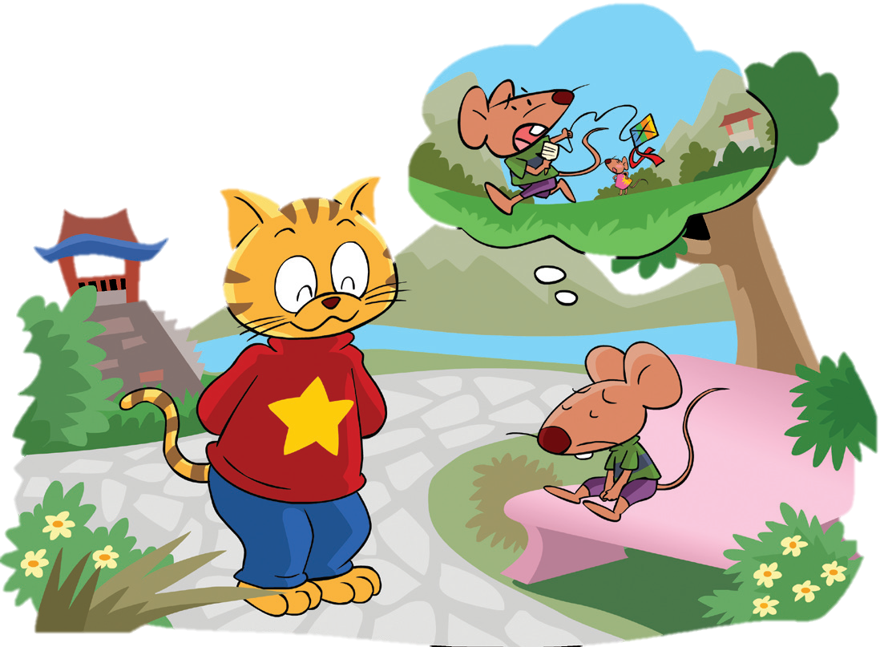
Unit 2 What a day!
Read and answer

Slide 7
Unit 2 What a day!
[ aʊ ]
1. Where were Sam and Bobby?
2. What did Tina and Bobby do this morning?
3. Was it windy in the park?
4. Where did they fly the kite? Why?
5. What happened at last（最后）?
6. Why did Sam have the kite?

Slide 8
Unit 2 What a day!
[ aʊ ]
1. Where were Sam and Bobby?
They were in the park.
2. What did Tina and Bobby do this morning?
They flew Bobby’s new kite in the park.
3. Was it windy in the park?
No, it wasn't.

Slide 9
Unit 2 What a day!
[ aʊ ]
4. Where did they fly the kite? Why?
They flew the kite on the hill. Because it was windy there.
[ɪ]
小山
5. What happened at last（最后）?
happen 发生
[æ]
The kite flew too high and they couldn’t hold onto it. It flew away.
hold 握住
[ǝʊ]
6. Why did Sam have the kite?
hold onto 抓紧
He found it near the hill.
find --- found
[aʊ]

Slide 10
Unit 2 What a day!
Reading time
Read after the tape.
(跟读)
Read in pairs.
(同桌读)
Read and act with your partners.
(表演动画)

Slide 11
What did you do last Sunday, Miss Wang?

Slide 12
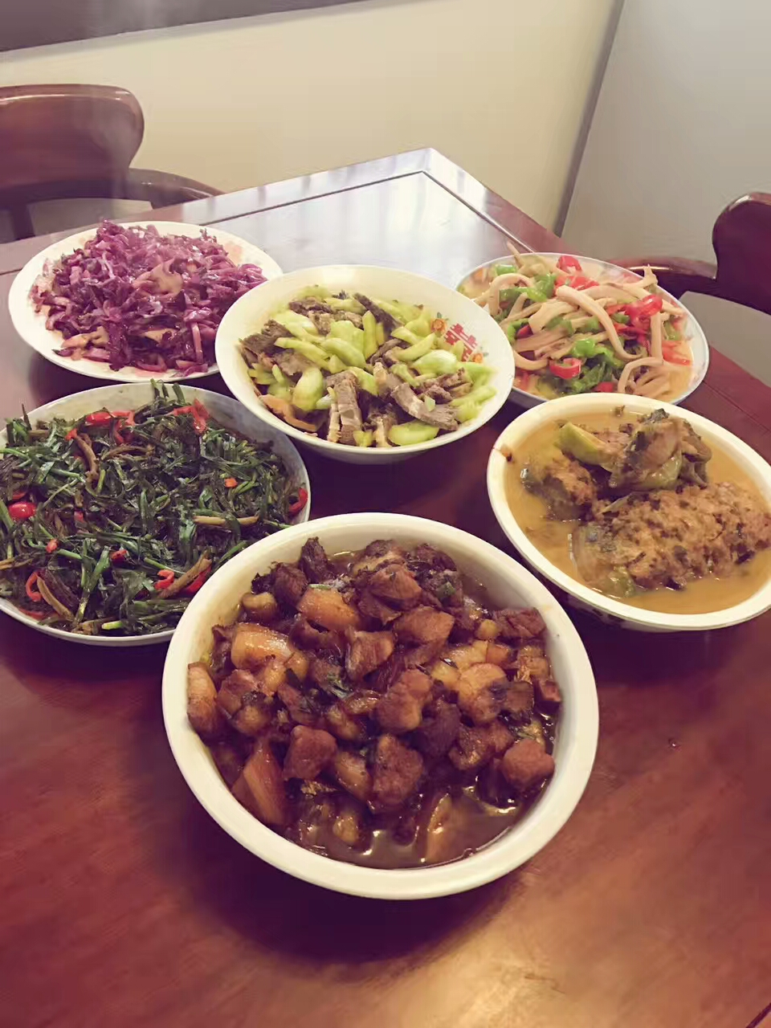
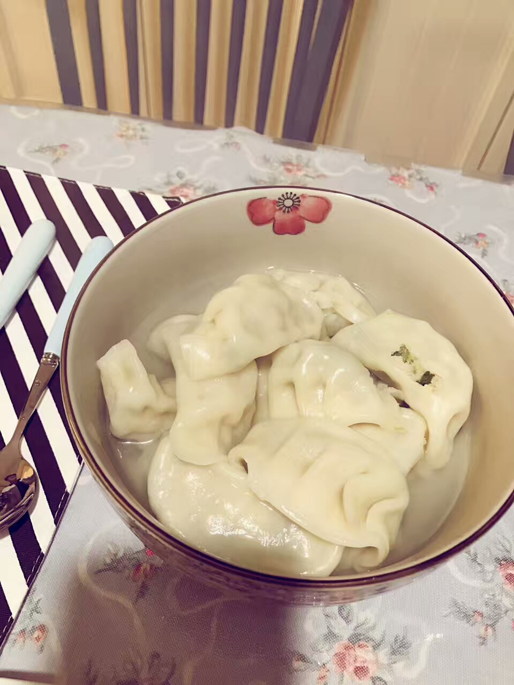
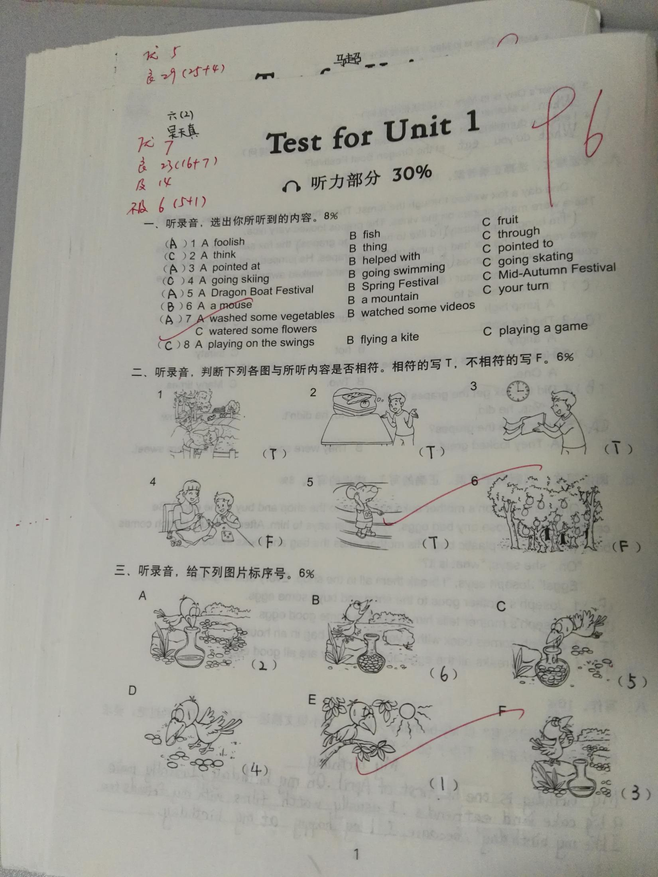
Sunday, 17th Sept.
I got up at 8:00. I had breakfast with my parents. Then I marked your examination papers in the morning. I was tired.
I cooked dumplings.
At 10:30, it was time to cook lunch.
In the afternoon, I went shopping with my friends.
We bought a lot of things. Then we watched a film in the cinema. We enjoyed the film.
In the evening, I went to bad early because I had to go to work on Monday.
What a busy and wonderful day!

Slide 13
Sunday, 17th Sept.
I got up at 8:00. I had breakfast with my parents. Then I marked your examination papers in the morning. I was tired.
At 10:30, it was time to cook lunch. I cooked dumplings.
In the afternoon, I went shopping with my friends.
We bought a lot of things. Then we watched a film in the cinema. We enjoyed the film.
In the evening, I went to bad early because I had to go to work on Monday.
What a busy and wonderful day!
时态：一般过去时

Slide 14
Homework
1. Finish writing your diary.
2. Read and act Cartoon time with your friends.

Slide 15
Thank you！

