Slide 1
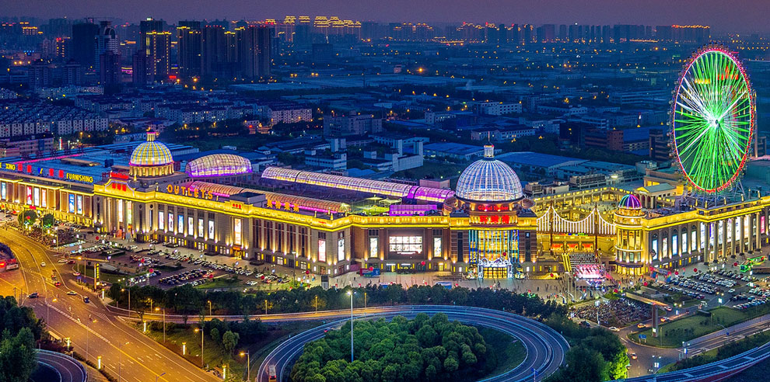
Global Harbor

Slide 2
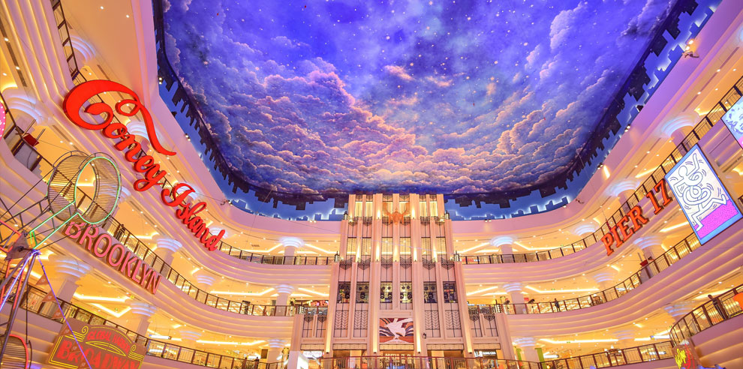
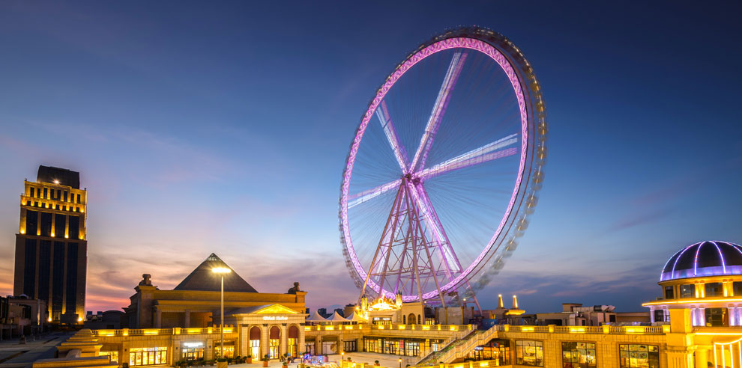
Global Square
cover an area of…
Global fly wheel
Wirewalking
Magic show
Eye of Dragon City
Take a view of modern the city scenery
The autumn river shares a scenic hue with the vast sky
The evening glow parallels with a lonely duck to fly

Slide 3
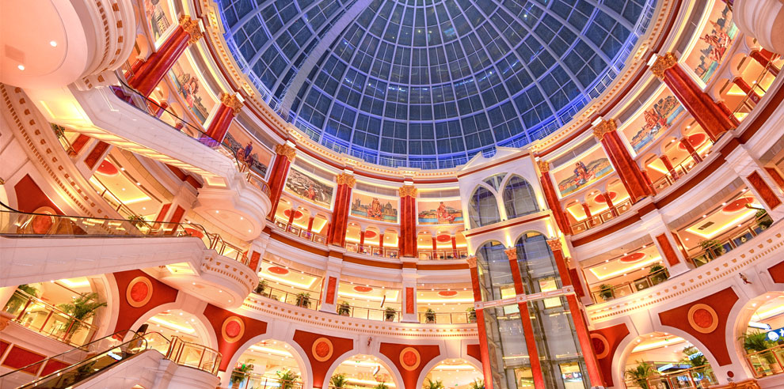
The Sun Hall
enjoy the sight of sun lights
too delighted to leave

Slide 4
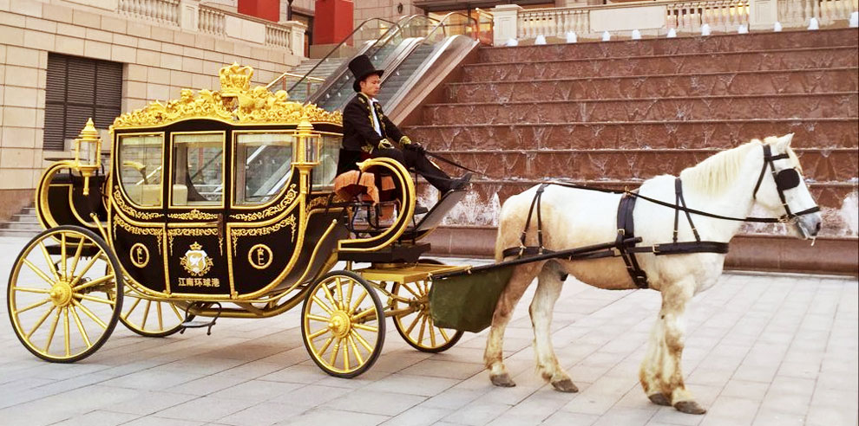
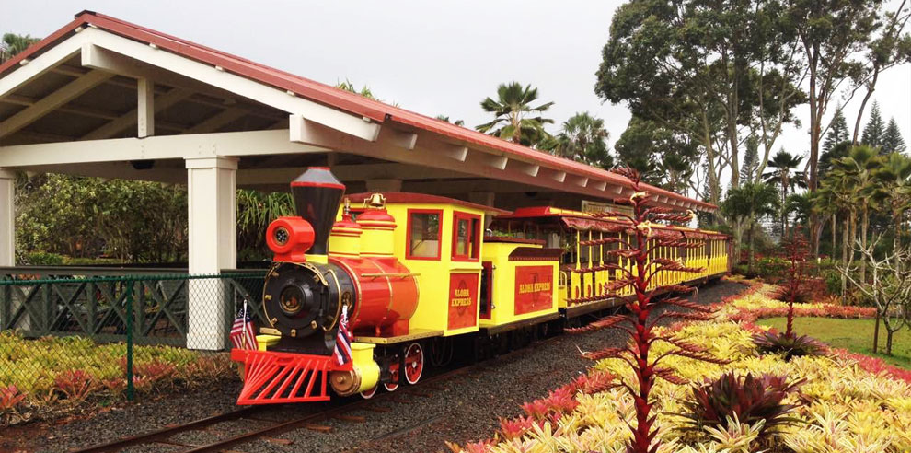
Carriage
enjoy the breeze and have an easy mood
Rail sightseeing vehicle
connect… with…
feel the beauty of the harbor in an old fashioned way

Slide 5
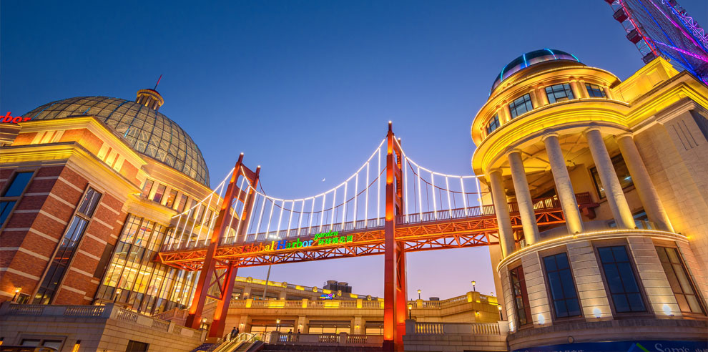
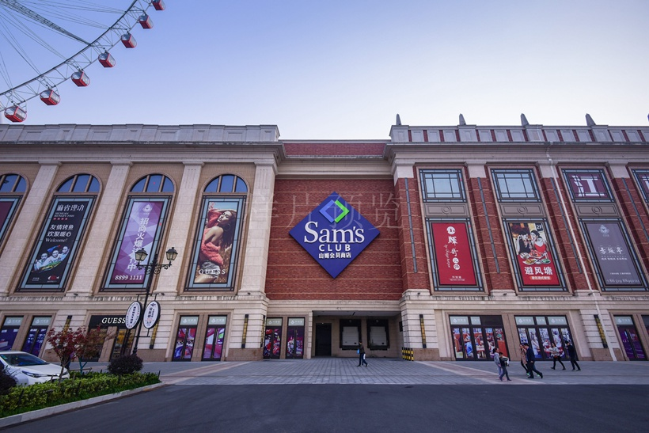
Miniature Golden Gate Bridge
a miniature landscape of the Golden Gate Bridge
Sam’s Club
high-end retail warehouse
membership-only

